Slide 1
An Introduction to Text Mining
文本挖掘介绍
Notes:
http://www.sims.berkeley.edu/~hearst/papers/acl99/acl99-tdm.html
http://www.cs.utah.edu/~riloff/psfiles/aaai99.ps
http://www-2.cs.cmu.edu/~knigam/papers/emcat-mlj99.ps
http://www.acm.org/sigs/sigkdd/explorations/issue2-2/KDD2000TextWkshp.ps

Slide 2
What Is Text (Data) Mining?
“The objective of Text Mining is to exploit information contained in textual documents in various ways, including …discovery of patterns and trends in data, associations among entities, predictive rules, etc.” (Grobelnik et al., 2001)
“Another way to view text data mining is as a process of exploratory data analysis that leads to heretofore unknown information, or to answers for questions for which the answer is not currently known.” (Hearst, 1999)

Slide 3
Text Mining
How does it relate to data mining in general?
How does it relate to computational linguistics?
How does it relate to information retrieval?
 | Finding Patterns | Finding “Nuggets”
 |  | Novel | Non-Novel
Non-textual data | General data-mining | Exploratory Data Analysis | Database queries
Textual data | Computational Linguistics | Text Mining | Information Retrieval

Slide 4
一些文本挖掘子课题
聚类
分类
信息检索、信息抽取、问答系统
关系发现
趋势分析
文本可视化

Slide 5
一些文本挖掘应用
信息检索
  能否把google的搜索结果聚类？
  能否搜索到一部“伤感的，怀旧的，有水或湖或海的爱情片”？
  能否每天把我喜欢了解的信息呈现给我？
  能否找出南华路上适合谈恋爱的不是很贵的小店？

Slide 6
一些文本挖掘应用
  聚类分类
    能否把我的数以万计的电子书或文档自动分类？（类似的题目：照片分类？音乐分类？电影分类？）
    能否以我提出的标准分类？或者，能否帮我提出一个分类的标准？能否支持多重标准？

Slide 7
一些文本挖掘应用
  信息抽取和问答系统
    能否找出一本书的最便宜的网上书店？
    万能问答机器人，知道百科全书、词典、唐诗宋词、甚至某门课程的历年试卷？
    银屑病的历代处方？

Slide 8
一些文本挖掘应用
  关系发现
    谁的谁是那个谁的谁？人立方？老邓的亲戚和社会网络？某个的小三是谁？人肉搜索？
    高血压经常是哪些疾病的症状？

Slide 9
一些文本挖掘应用
  趋势分析
    今天的热点新闻是什么？最近有什么网络新词汇？
    老百姓在谈论什么？房价到底会不会降下来？
    HMM模型在不同学科中是如何应用的？

Slide 10
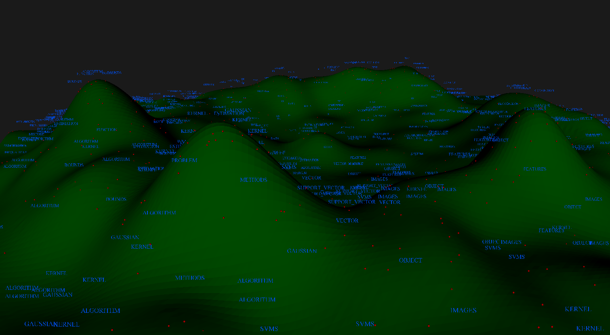
一些文本挖掘应用
  文本可视化
  表示文本集合中的话题分布和关系
  把高维的文本空间表示为二维或三维的图
  非常好玩!
theory
natural language processing
multimedia
processing
kernel methods

Slide 11
Challenges in Text Mining
Data collection is “free text”
  Data is not well-organized
    Semi-structured or unstructured
  Very high “dimensions”
    All possible word and phrases in the language!!
  Natural language text contains ambiguities on many levels
    Lexical, syntactic, semantic, and pragmatic

Slide 12
Challenges in Text Mining
Text Data is semantic
  Complex and subtle relationships between concepts in text
    “AOL merges with Time-Warner”
    “Time-Warner is bought by AOL”
  Many ways to represent similar concepts
    E.g. space ship, flying saucer, UFO
  Abstract concepts are difficult to represent，and concepts are difficult to visualize
  Computational Linguistics is still a young field, esp. weak on semantics

Slide 13
Who is in the text analysis arena?
Knowledge Rep. &
Reasoning / Tagging
Search & DB
Semantic Web
Web2.0
Information
Retrieval
Computational
Linguistics
Text Analysis
Data Analysis
Natural Language
Processing
Machine Learning
Text Mining

Slide 14
文本挖掘基础：文本表示
Character (character n-grams and sequences)
Words (stop-words, stemming, lemmatization)
Phrases (word n-grams)
Part-of-speech tags
Taxonomies / thesauri
Vector-space model
Language models
Full-parsing

Slide 15
Character level
Character level representation of a text consists from sequences of characters…
  …a document is represented by a frequency distribution of sequences
  Usually we deal with contiguous strings…
  …each character sequence of length 1, 2, 3, … represent a feature with its frequency

Slide 16
Good and bad sides
Representation has several important strengths:
  …it is very robust since avoids language morphology
    (useful for e.g. language identification)
  …it captures simple patterns on character level
    (useful for e.g. spam detection, copy detection)
  …because of redundancy in text data it could be used for many analytic tasks
    (learning, clustering, search)
…for deeper semantic tasks, the representation is too weak

Slide 17
Word level
The most common representation of text used for many techniques
  …there are many tokenization software packages which split text into the words
Important to know:
  Word is well defined unit in western languages – Chinese has different notion of what constitutes of a word

Slide 18
Words Properties
Relations among word surface forms and their senses:
  Homonomy: same form, but different meaning (e.g. bank: river bank, financial institution)
  Polysemy: same form, related meaning (e.g. bank: blood bank, financial institution)
  Synonymy: different form, same meaning (e.g. singer, vocalist)
  Hyponymy: one word denotes a subclass of an another (e.g. breakfast, meal)
Word frequencies in texts have power distribution (Zpif Law):
  …small number of very frequent words
  …big number of low frequency words

Slide 19
Stop-words
Stop-words are words that from non-linguistic view do not carry information
  …they have mainly functional role
  …usually we remove them to help the methods to perform better
Stop words are language dependent – examples:
  English: A, ABOUT, ABOVE, ACROSS, AFTER, AGAIN, AGAINST, ALL, ALMOST, ALONE, ALONG, ALREADY, ...
  Dutch: de, en, van, ik, te, dat, die, in, een, hij, het, niet, zijn, is, was, op, aan, met, als, voor, had, er, maar, om, hem, dan, zou, of, wat, mijn, men, dit, zo, ...
  Slovenian: A, AH, AHA, ALI, AMPAK, BAJE, BODISI, BOJDA, BRŽKONE, BRŽČAS, BREZ, CELO, DA, DO, ...
  汉语：的，我，你，她，在，把，为，了，地，过，得, …

Slide 20
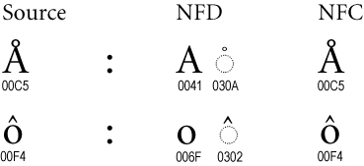
Word character level normalization
Hassle which we usually avoid:
  Since we have plenty of character encodings in use, it is often nontrivial to identify a word and write it in unique form
  …e.g. in Unicode the same word could be written in many ways – canonization of words:
  藏语问题更多：基本集和扩A扩B

Slide 21
Stemming (1/2)
Different forms of the same word are usually problematic for text data analysis, because they have different spelling and similar meaning (e.g. learns, learned, learning,…)
Stemming is a process of transforming a word into its stem (normalized form)
  …stemming provides an inexpensive mechanism to merge

Slide 22
Stemming (2/2)
For English is mostly used Porter stemmer at http://www.tartarus.org/~martin/PorterStemmer/
Example cascade rules used in English Porter stemmer
  ATIONAL -> ATE relational -> relate
  TIONAL -> TION conditional -> condition
  ENCI -> ENCE valenci -> valence
  ANCI -> ANCE hesitanci -> hesitance
  IZER -> IZE digitizer -> digitize
  ABLI -> ABLE conformabli -> conformable
  ALLI -> AL radicalli -> radical
  ENTLI -> ENT differentli -> different
  ELI -> E vileli -> vile
  OUSLI -> OUS analogousli -> analogous

Slide 23
Phrase level
Instead of having just single words we can deal with phrases
We use two types of phrases:
  Phrases as frequent contiguous word sequences
  Phrases as frequent non-contiguous word sequences
The main effect of using phrases is to more precisely identify sense

Slide 24
Google n-gram corpus
In September 2006 Google announced availability of n-gram corpus:
  http://googleresearch.blogspot.com/2006/08/all-our-n-gram-are-belong-to-you.html#links
  Some statistics of the corpus:
    File sizes: approx. 24 GB compressed (gzip'ed) text files
    Number of tokens: 1,024,908,267,229
    Number of sentences: 95,119,665,584
    Number of unigrams: 13,588,391
    Number of bigrams: 314,843,401
    Number of trigrams: 977,069,902
    Number of fourgrams: 1,313,818,354
    Number of fivegrams: 1,176,470,663

Slide 25
Example: Google n-grams
ceramics collectables collectibles 55
ceramics collectables fine 130
ceramics collected by 52
ceramics collectible pottery 50
ceramics collectibles cooking 45
ceramics collection , 144
ceramics collection . 247
ceramics collection </S> 120
ceramics collection and 43
ceramics collection at 52
ceramics collection is 68
ceramics collection of 76
ceramics collection | 59
ceramics collections , 66
ceramics collections . 60
ceramics combined with 46
ceramics come from 69
ceramics comes from 660
ceramics community , 109
ceramics community . 212
ceramics community for 61
ceramics companies . 53
ceramics companies consultants 173
ceramics company ! 4432
ceramics company , 133
ceramics company . 92
ceramics company </S> 41
ceramics company facing 145
ceramics company in 181
ceramics company started 137
ceramics company that 87
ceramics component ( 76
ceramics composed of 85
serve as the incoming 92
serve as the incubator 99
serve as the independent 794
serve as the index 223
serve as the indication 72
serve as the indicator 120
serve as the indicators 45
serve as the indispensable 111
serve as the indispensible 40
serve as the individual 234
serve as the industrial 52
serve as the industry 607
serve as the info 42
serve as the informal 102
serve as the information 838
serve as the informational 41
serve as the infrastructure 500
serve as the initial 5331
serve as the initiating 125
serve as the initiation 63
serve as the initiator 81
serve as the injector 56
serve as the inlet 41
serve as the inner 87
serve as the input 1323
serve as the inputs 189
serve as the insertion 49
serve as the insourced 67
serve as the inspection 43
serve as the inspector 66
serve as the inspiration 1390
serve as the installation 136
serve as the institute 187

Slide 26
Part-of-Speech level
By introducing part-of-speech tags we introduce word-types enabling to differentiate words functions
  For text-analysis part-of-speech information is used mainly for “information extraction” where we are interested in e.g. named entities which are “noun phrases”
  Another possible use is reduction of the vocabulary (features)
    …it is known that nouns carry most of the information in text documents
Part-of-Speech taggers are usually learned by HMM algorithm on manually tagged data

Slide 27
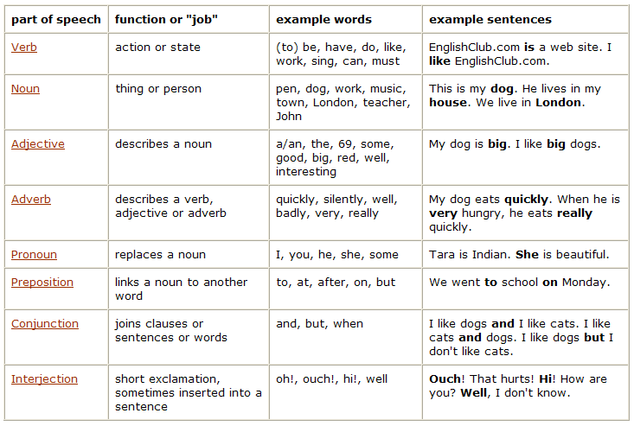
Part-of-Speech Table
http://www.englishclub.com/grammar/parts-of-speech_1.htm

Slide 28
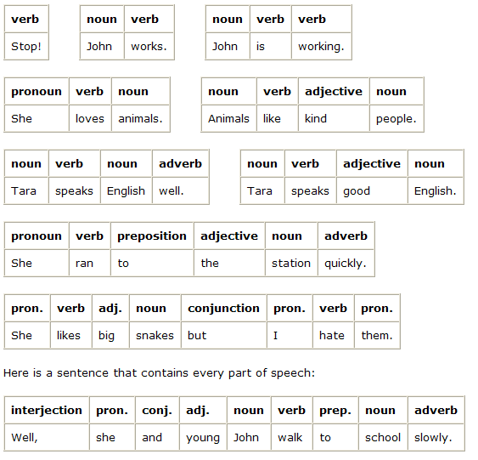
Part-of-Speech examples
http://www.englishclub.com/grammar/parts-of-speech_2.htm

Slide 29
Taxonomies/thesaurus level
Thesaurus has a main function to connect different surface word forms with the same meaning into one sense (synonyms)
  …additionally we often use hypernym relation to relate general-to-specific word senses
  …by using synonyms and hypernym relation we compact the feature vectors
The most commonly used general thesaurus is WordNet which exists in many other languages (e.g. EuroWordNet)
  http://www.illc.uva.nl/EuroWordNet/

Slide 30
WordNet – database of lexical relations
WordNet is the most well developed and widely used lexical database for English
  …it consist from 4 databases (nouns, verbs, adjectives, and adverbs)
Each database consists from sense entries – each sense consists from a set of synonyms, e.g.:
  musician, instrumentalist, player
  person, individual, someone
  life form, organism, being
Category | Unique Forms | Number of Senses
Noun | 94474 | 116317
Verb | 10319 | 22066
Adjective | 20170 | 29881
Adverb | 4546 | 5677

Slide 31
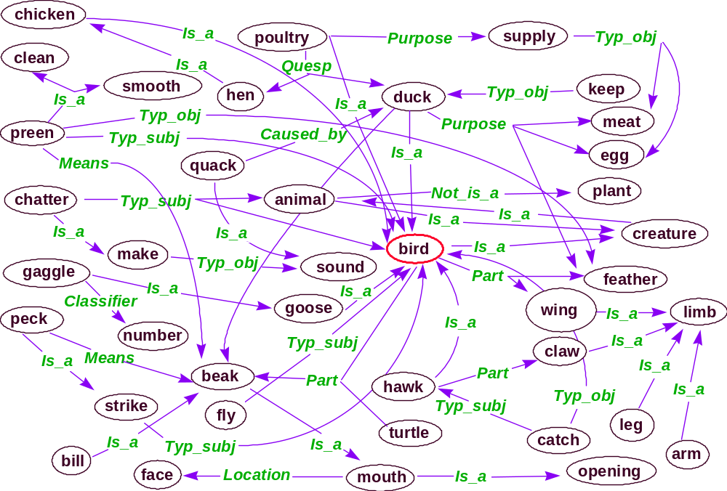
WordNet – excerpt from the graph
sense
relation
sense
26 relations
116k senses

Slide 32
WordNet relations
Each WordNet entry is connected with other entries in the graph through relations
Relations in the database of nouns:
Relation | Definition | Example
Hypernym | From lower to higher concepts | breakfast -> meal
Hyponym | From concepts to subordinates | meal -> lunch
Has-Member | From groups to their members | faculty -> professor
Member-Of | From members to their groups | copilot -> crew
Has-Part | From wholes to parts | table -> leg
Part-Of | From parts to wholes | course -> meal
Antonym | Opposites | leader -> follower

Slide 33
Vector-space model level
The most common way to deal with documents is first to transform them into sparse numeric vectors and then deal with them with linear algebra operations
  …by this, we forget everything about the linguistic structure within the text
  …this is sometimes called “structural curse” because this way of forgetting about the structure doesn’t harm efficiency of solving many relevant problems
  This representation is referred to also as “Bag-Of-Words” or “Vector-Space-Model”
  Typical tasks on vector-space-model are classification, clustering, visualization etc.

Slide 34
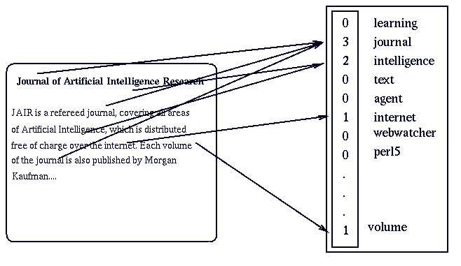
Bag-of-words document representation

Slide 35
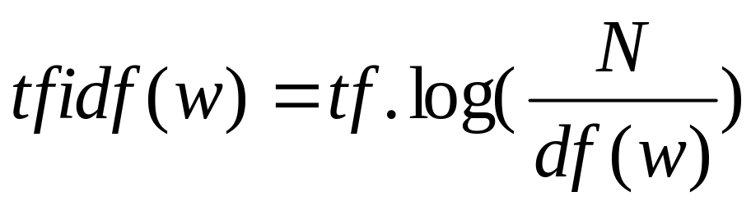
Word weighting
In the bag-of-words representation each word is represented as a separate variable having numeric weight (importance)
The most popular weighting schema is normalized word frequency TFIDF:
Tf(w) – term frequency (number of word occurrences in a document)
Df(w) – document frequency (number of documents containing the word)
N – number of all documents
TfIdf(w) – relative importance of the word in the document
The word is more important if it appears
several times in a target document
The word is more important if it appears in less documents

Slide 36
Example document and its vector representation
TRUMP MAKES BID FOR CONTROL OF RESORTS Casino owner and real estate Donald Trump has offered to acquire all Class B common shares of Resorts International Inc, a spokesman for Trump said. The estate of late Resorts chairman James M. Crosby owns 340,783 of the 752,297 Class B shares. Resorts also has about 6,432,000 Class A common shares outstanding. Each Class B share has 100 times the voting power of a Class A share, giving the Class B stock about 93 pct of Resorts' voting power.
[RESORTS:0.624] [CLASS:0.487] [TRUMP:0.367] [VOTING:0.171] [ESTATE:0.166] [POWER:0.134] [CROSBY:0.134] [CASINO:0.119] [DEVELOPER:0.118] [SHARES:0.117] [OWNER:0.102] [DONALD:0.097] [COMMON:0.093] [GIVING:0.081] [OWNS:0.080] [MAKES:0.078] [TIMES:0.075] [SHARE:0.072] [JAMES:0.070] [REAL:0.068] [CONTROL:0.065] [ACQUIRE:0.064] [OFFERED:0.063] [BID:0.063] [LATE:0.062] [OUTSTANDING:0.056] [SPOKESMAN:0.049] [CHAIRMAN:0.049] [INTERNATIONAL:0.041] [STOCK:0.035] [YORK:0.035] [PCT:0.022] [MARCH:0.011]
Original text
Bag-of-Words
representation
(high dimensional
sparse vector)

Slide 37
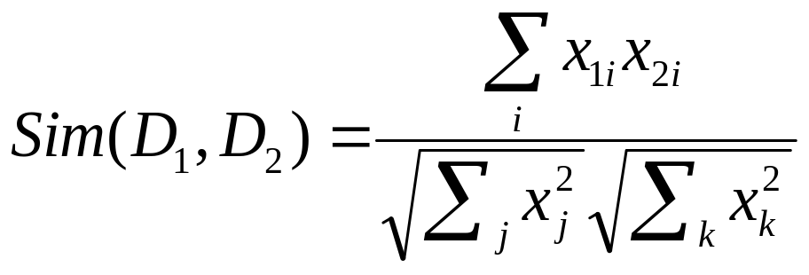
Similarity between document vectors
Each document is represented as a vector of weights D = <x>
Cosine similarity (dot product) is the most widely used similarity measure between two document vectors
  …calculates cosine of the angle between document vectors
  …efficient to calculate (sum of products of intersecting words)
  …similarity value between 0 (different) and 1 (the same)

Slide 38
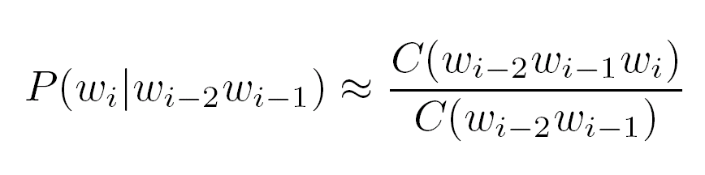
Language model level
Language modeling is about determining probability of a sequence of words
  The task typically gets reduced to the estimating probabilities of a next word given two previous words (trigram model):
  It has many applications including speech recognition, OCR, handwriting recognition, machine translation and spelling correction
Frequencies
of word
sequences

Slide 39
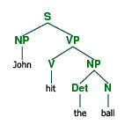
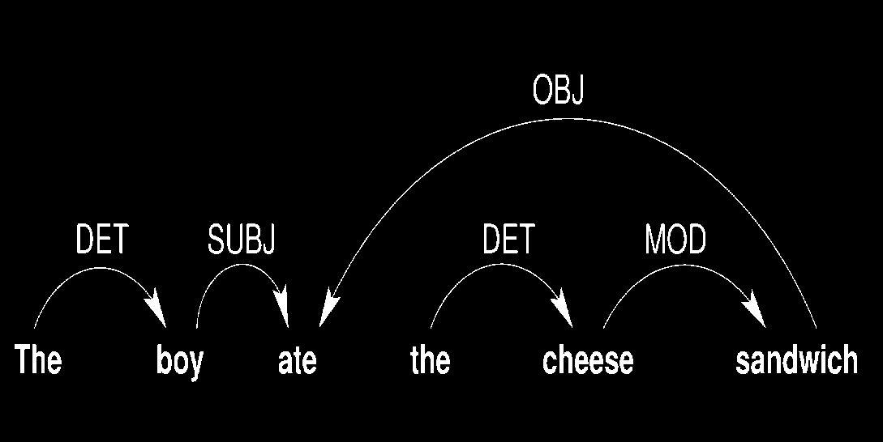
Full-parsing level
Parsing provides maximum structural information per sentence
On the input we get a sentence, on the output we generate a parse tree
For most of the methods dealing with the text data the information in parse trees is too complex

Slide 40
clustering
Document clustering
Word clustering

Slide 41
Document clustering: K-Means
Represent document as real-valued vectors
  Each word is a dimension
    Stop words should be removed
    Stemming ?
    中文需要分词
  Use word Frequency or tfidf as value
    Each document is a Bag of words

Slide 42
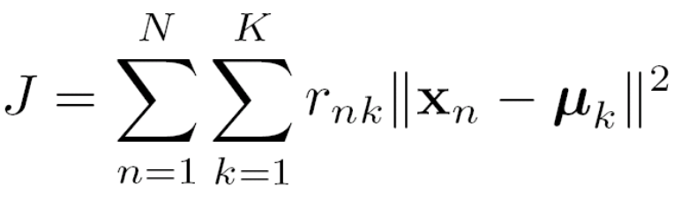
K-means clustering
Suppose x₁,…,x_{N} are real-valued vectors
Goal: Learn K means and assign each training case to a mean
Denote the means by μ₁,…, μ_{K}
Use one-of-K encoding for the assignments:
r_{nk} = 1 if x_{n} is assigned to μ_{k}, and r_{nk} = 0 otherwise
The goal of k-means clustering is to find the r’s and μ’s that minimize the following cost function:
Generally, finding an exact solution takes time that is exponential in N

Slide 43
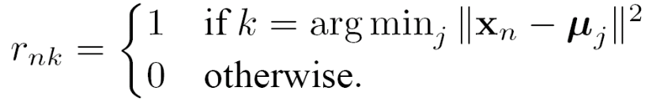
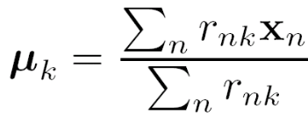
K-means clustering
Note that given the μ’s we can efficiently find the best r’s, and given the r’s, we can efficiently find the best μ’s
Here’s the algorithm:
Pick initial means randomly or cleverly
Loop until convergence (the means don’t change)
  Assign each training case to its nearest mean:
  Set each mean to the average of its training cases:
Each step minimizes J wrt the r’s or the μ’s, but the procedure is not guaranteed to find the minimum of J

Slide 44
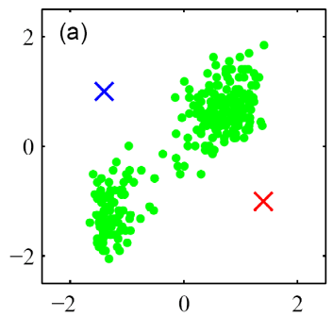
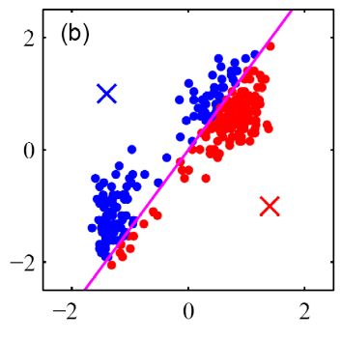
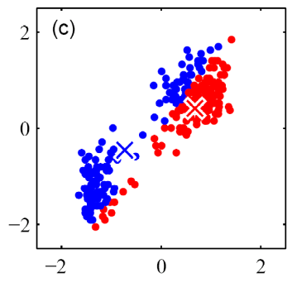
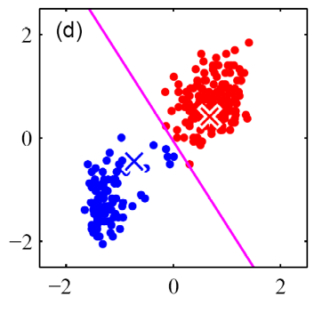
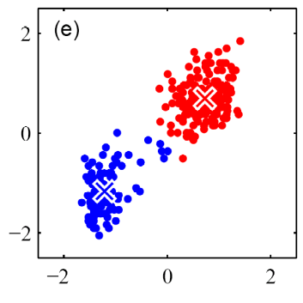
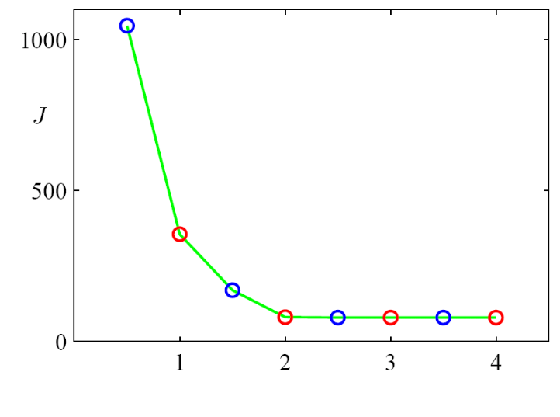
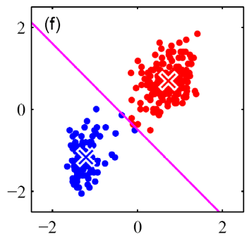
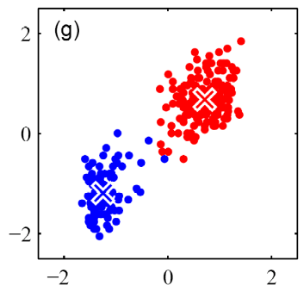


Example
Data and initial (random) means
Assign each point to its nearest mean
Set each mean to the average of its data
Iteration 1
Iteration 2
Iteration 3
Iteration 4 and convergence
Iteration

Slide 45
K-means clustering
Advantage:
    Relatively fast (each iteration is of linear time complexity)
    works relatively well in low dimension space
Drawback:
    distance computation in high dimension space
    centroid vector may not well summarize the cluster documents
    k is a supplied parameter
    initial k clusters affect the quality of clusters

Slide 46
Document Clustering: HAC
Hierarchic agglomerative clustering(HAC):distance-based
hierarchic clustering
0. Input: D::={d₁,d₂,…d_{n} };
1. Calculate similarity matrix SIM[i,j]
2. Repeat
3. Merge the most similar two clusters, K and L,
to form a new cluster KL
4. Compute similarities between KL and each of the remaining
cluster and update SIM[i,j]
5. Until there is a single(or specified number) cluster
6. Output: dendogram of clusters
Advantage:
    producing better quality clusters
    works relatively well in low dimension space
Drawback:
    distance computation in high dimension space
    Each iteration is of quadratic time complexity
Notes:
K-means and HAC are traditional methods and are used widely. Experiments shown that they perform well in low dimensional data space. Many variants to them are studied extensively to improve the performance. But they work poorly in relatively high dimensional data space because in this case the means of clusters differ slightly from one cluster to next.

Slide 47
作业
层次聚类也可以反着来做(Divisive). 请给出算法。
对20110922的2000多篇搜狐博客进行聚类，并给出结果的直观描述。

Slide 48
Text classification (TC)
Tag a document as belonging to one of a set of pre-defined classes
  Many practical uses
    Group documents into different domains (useful for domain specific information extraction)
    Learn reading interests of users
    Automatically sort e-mail
    On-line New Event Detection

Slide 49
Challenges in TC
Need lots of labeled examples as training data
  Expensive
  With limited labeled data, precision is low.
What other sources of information can reduce the need for labeled examples?

Slide 50
TC from Labeled and Unlabeled Documents using EM (Nigam et al., 2000)
Expectation-Maximization
  Iterative algorithm for MLE/MAP in parametric estimation problems with missing data (e.g. the labels for the example)
Nigam et al. combined the EM algorithm with a Naïve Bayes classifier, using both labeled and unlabeled data as input
  Dynamically adjust strength of unlabeled data’s contribution to parameter estimation in EM
  Reduce the bias of naïve Bayes by modeling each class with multiple mixture components

Slide 51
Text Classification from Labeled and Unlabeled Documents using EM
Machine Learning (2000)
Kamal Nigam
Andrew K. McCallum
Sebastian Thrun
Tom Mitchell

Slide 52
Motivation
The task:
- Given a set of news articles, automatically find documents on the same topic.
- We would like to require as few labeled documents as possible, since labeling documents by hand is expensive.

Slide 53
Previous work
The problem:
- Existing statistical text learning algorithms require many training examples.
- (Lang 1995) A classifier with 1000 training documents ranked unlabeled documents. Of the top 10% only about 50% were correct.

Slide 54
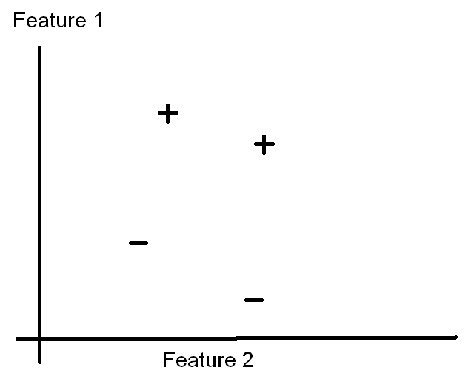
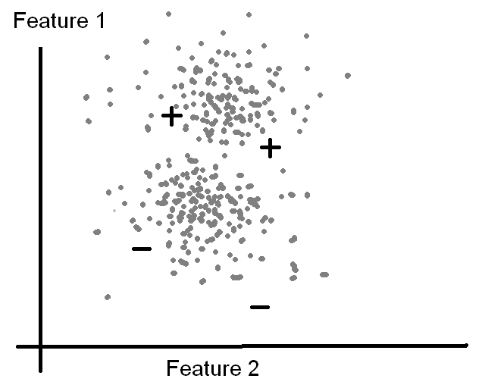
Motivation
Can we somehow use unlabeled documents?
- Yes! Unlabeled data provide information about the joint probability distribution.

Slide 55
Algorithm Outline
Train a classifier with only the labeled documents.
Use it to probabilistically classify the unlabeled documents.
Use ALL the documents to train a new classifier.
Iterate steps 2 and 3 to convergence.
This is just EM.

Slide 56
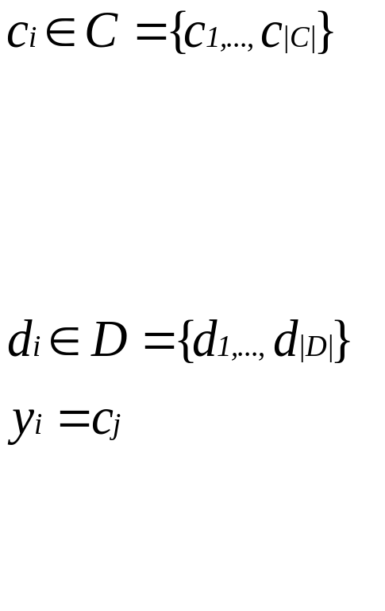
Probabilistic Framework
Assumptions:
- The data are produced by a mixture model.
Mixture components and class
labels
There is a one-to-one correspondence between mixture components and document classes.
Documents
Class variables. This statement means the i ^{th} document belongs to class j.

Slide 57


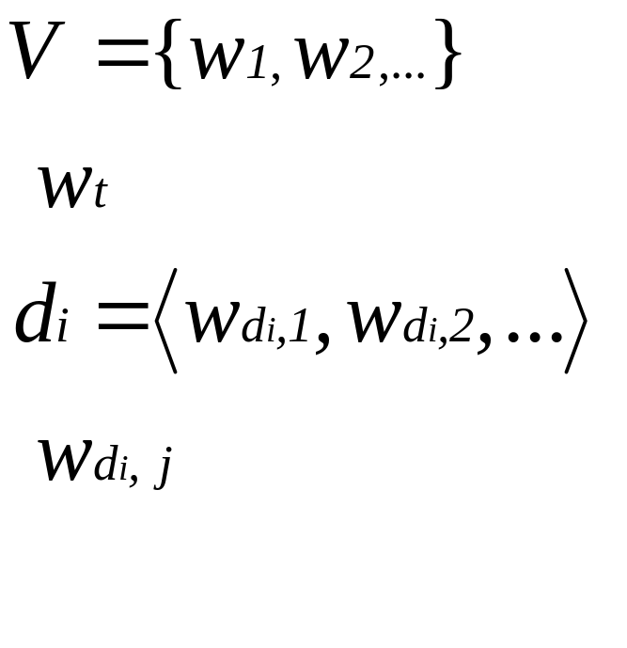
Probabilistic Framework (2)
θ代表模型（参数）
Mixture Weights
Probability of class j generating document i
the vocabulary
indicates a word in the vocabulary.
Documents are ordered word lists.
indicates the word at position j in document i.

Slide 58
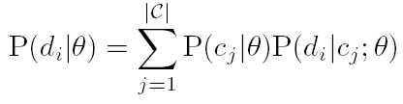
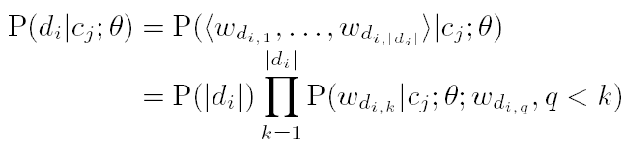
Probabilistic Framework (3)
The probability of document d_{i} is
The probability of mixture component c_{j} generating document d_{i} is:

Slide 59
Probabilistic Framework (4)
The Naive Bayes assumption: The words of a document are generated independently of their order in the document, given the class.

Slide 60
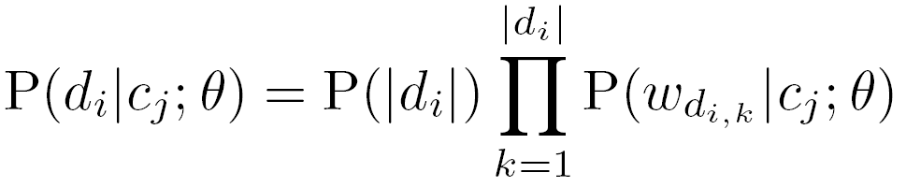
Probabilistic Framework (5)
Now the probability of a document given its class becomes
We can use Bayes Rule to classify documents: find the class with highest probability given a novel document.

Slide 61




Probabilistic Framework (6)
To learn the parameters θ of the classifier, use ML/MAP; find the most likely set of parameters given the data set:
=
The two parameters we need to find are the word probability estimates and the mixture weights, written
  and

Slide 62
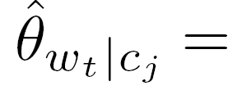
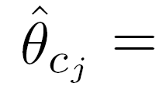
Probabilistic Framework (6)
The maximization yields parameters that are word frequency counts:
1 + No. of occurrences of w_{t} in class j
|V| + No. of words in class j
1 + No. of documents in class j
|C| + |D|
Laplace smoothing gives each word a prior probability.

Slide 63
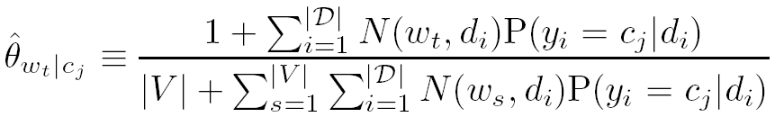
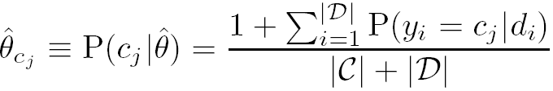
Probabilistic Framework (7)
Number of occurrences of word t in document i
This is 1 if document i is in class j, or 0 otherwise.
Formally

Slide 64
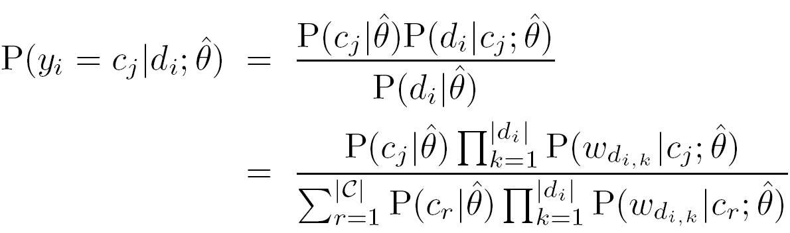
Probabilistic Framework (8)
Using Bayes Rule:

Slide 65


Application of EM to NB
Estimate with only labeled data
Assign probabilistically weighted class-labels to unlabeled data.
Use all class labels (given and estimated) to find new parameters .
Repeat 2 and 3 until does not change.

Slide 66



More Notation
Set of unlabeled documents
Set of labeled documents

Slide 67
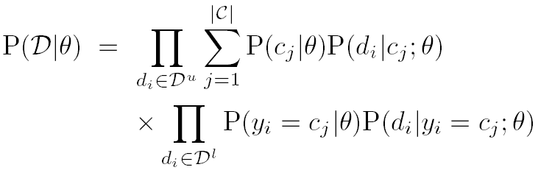
Deriving the basic Algorithm (1)
The probability of all the data is:
For unlabeled data, the component of the probability is a sum across all mixture components.

Slide 68

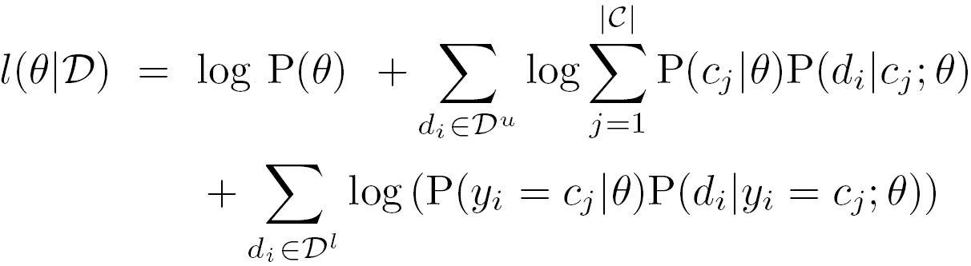
Deriving the basic Algorithm (2)
Easier to maximize the log-likelihood:
This contains a log of sums, which makes maximization intractable.

Slide 69

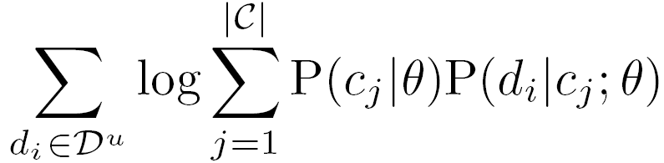
Deriving the basic Algorithm (3)
Suppose we have access to the labels for the unlabeled documents, expressed as a matrix of indicator variables z, where if document i is in class j, and 0 otherwise (so rows are documents and columns are classes). Then the terms of
are nonzero only when z_{ij} = 1; we treat the labeled and unlabeled documents the same.

Slide 70
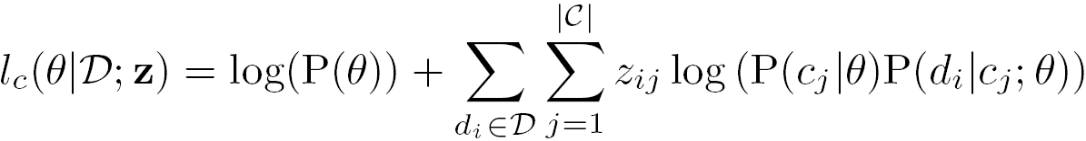
Deriving the basic Algorithm (4)
The complete log-likelihood becomes:
If we replace z with its expected value according to the current classifier, then this equation bounds from below the exact log-likelihood, so iteratively increasing this equation will increase the log-likelihood.

Slide 71
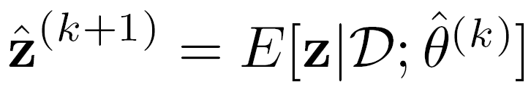
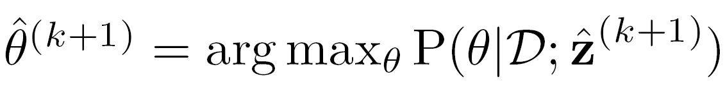
Deriving the basic Algorithm (5)
This leads to the basic algorithm:
E-step:
M-step:

Slide 72
Data sets
20 Newsgroups data set:
20017 articles drawn evenly from
20 newsgroups
Many categories fall into confusable clusters.
Words from a stoplist of common short words are removed.
62258 unique words occurring more than once
Word counts of documents are scaled so each document has the same length.

Slide 73
Data sets
WebKB data set:
4199 web pages from university CS departments
Divided into four categories (student, faculty, course, project) with pages.
No stoplist or stemming used.
Only 300 most informative words used (mutual information with class variable).
Validation with a leave-one-university-out approach to prevent idiosyncrasies of particular universities from inflating success measures.

Slide 74
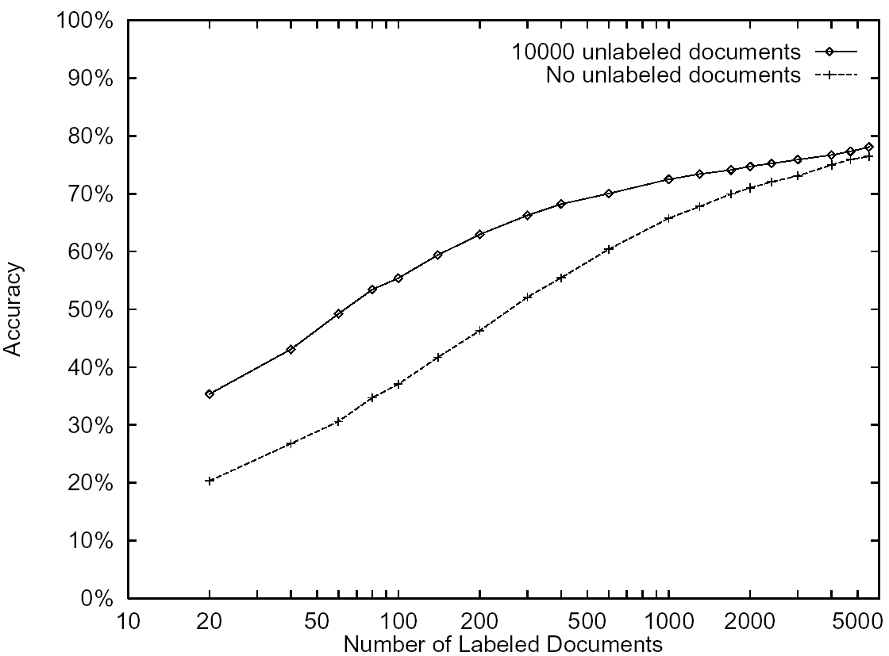
Classification accuracy of 20 NewsGroups

Slide 75
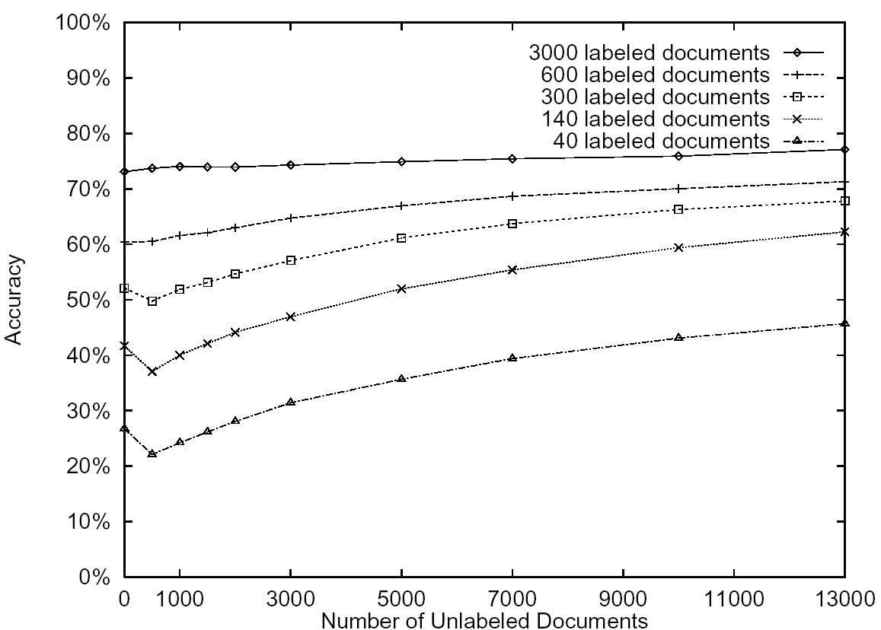
Classification accuracy of 20 NewsGroups

Slide 76
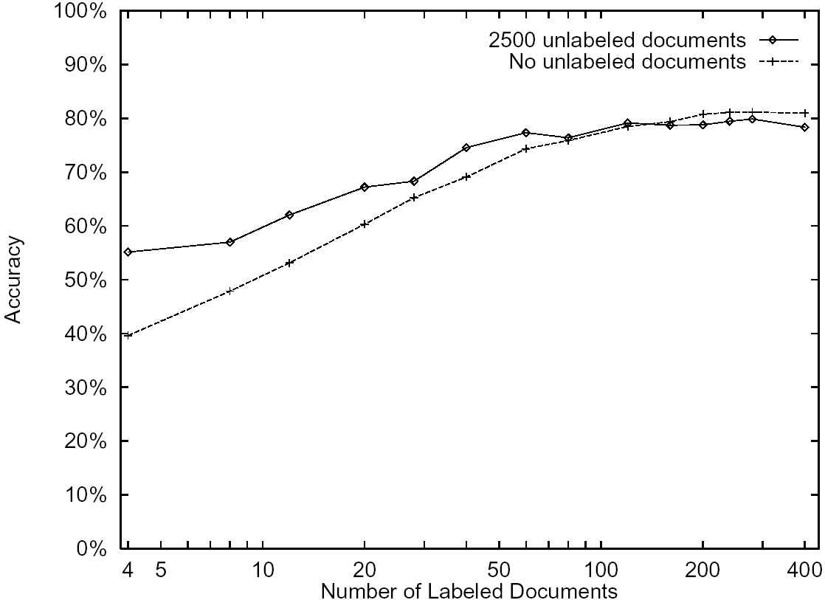
Classification accuracy of WebKB

Slide 77
Predictive words found with EM
Iteration 0 Iteration 1 Iteration 2
Intelligence DD D
DD D DD
artificial lecture lecture
understanding cc cc
DDw D* DD:DD
dist DD:DD due
identical handout D*
rus due homework
arrange problem assignment
games set handout
dartmouth tay set
natural DDam hw
cognitive yurttas exam
logic homework problem
proving kkfoury DDam
prolog sec postscript
knowledge postscript solution
human exam quiz
representation solution chapter
field assaf ascii

Slide 78
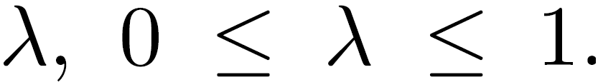
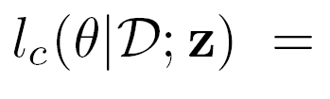
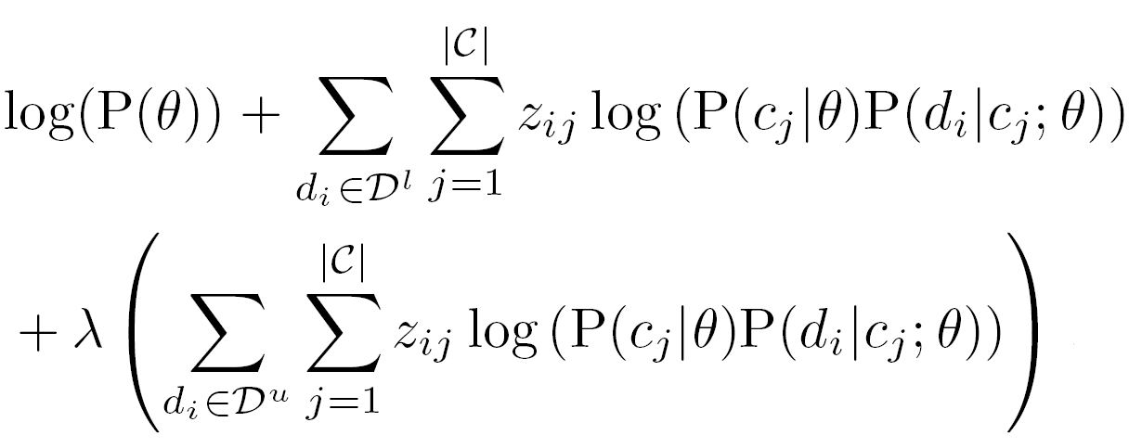
改进1: EM-λ
Modulate the influence of unlabeled data with a parameter And maximize
labeled documents
Unlabeled Documents

Slide 79
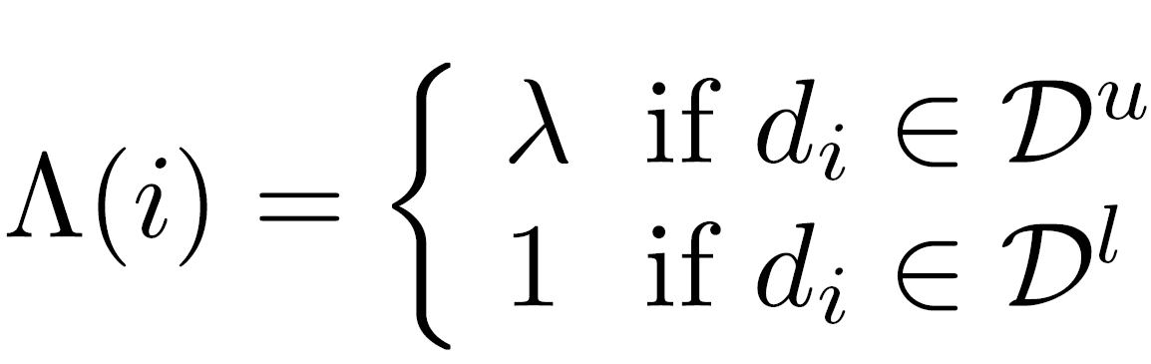
EM-λ
The E-step is exactly as before, assign probabilistic class labels.
The M-step is modified to reflect λ.
Define:
as a weighting factor to modify the frequency counts.

Slide 80
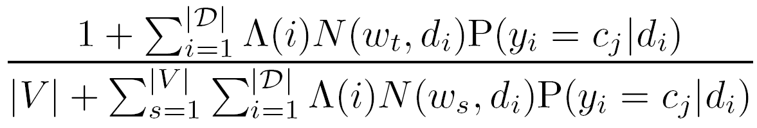
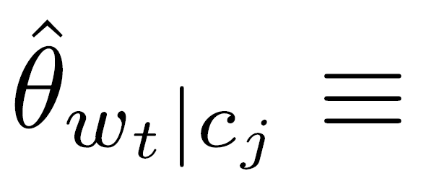
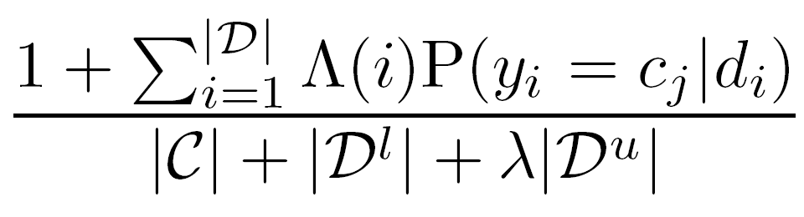

EM-λ
The new NB parameter estimates become
Weight
Word count
Probabilistic class assignment
sum over all words and documents

Slide 81

Classification accuracy of WebKB

Slide 82

Classification accuracy of WebKB

Slide 83
改进2： 不同的概率模型
Relax the one class one mixture component assumption
  Allow labeled data to fall into “topics” within a class
  Modify E-step to allow labeled document to probabilistically belong to sub-topics

Slide 84
信息抽取
（1）信息抽取的定义
（2）信息抽取的技术基础
（3）Web信息抽取系统的设计
（4）Web信息提取实例-uread

Slide 85
What is Information Extraction ?
“extracts pieces of information that are salient to the user's needs”

Slide 86

比如买书前货比三家

Slide 87
比如了解名人的动态
人名 | 时间 | 地点 | 事件
温家宝 | 20100705 | 湖南 | 调查研究
李克强 | 20100625 | 河北 | 调研
温家宝 | 20100624 | 江西 | 视察抗洪救灾工作
温家宝 | 20100625 | 阿里巴巴 | 考察

Slide 88
从Web抽取信息
源信息是结构化的：比如网页中的表格
源信息是半结构化的：比如网页中的文本
后者需要用到自然语言处理

Slide 89
信息抽取的技术基础

Slide 90
半结构化文本处理
Xml parser
  网页是html，可以看作是xml的一种

Slide 91
自然语言处理技术
命名实体识别
  人名
  地名
  机构名
  数字
  时间、日期

Slide 92
自然语言处理技术
实体关系识别
  多个实体间是什么关系？
共指消解
  代词
  指代
事件结构
  与抽取任务相关
  需要用到深层的自然语言处理

Slide 93
自然语言处理基础
分词、词性标注
句法分析
语义分析
上下文分析

Slide 94
Web信息抽取系统的设计

Slide 95
可分为以下4个步骤
抽：从源抽取感兴趣的，舍弃其他
标：标注，从抽取的内容中找出我们感兴趣的实体
挖：找出实体间的关系
合：把各关系合并，并剔除错误。

Slide 96
抽
去除广告等无关信息
  比想象的困难
一般采用正规表达式来抽取感兴趣内容
  正规表达式=有限自动机

Slide 97
标
包括句子划分、分词、标注、命名实体识别等
都可以看作分类问题，采用很多机器学习办法，如HMM、SVM、ME、CRF等模型来解决
  有一定的错误率

Slide 98
挖
挖掘实体间的关系。
  二元关系 R（A,B)
  多元关系可以看作是多个二元关系
    R(A,B,C) => R1(R, A), R2(R,B), R3(R, C)
经常也看作分类问题，采用机器学习方法解决

Slide 99
合
利用共指关系得出新关系
  R(A,B), Coref(A,C) => R(C, B)
剔除伪关系
  R(A, B) : p （p为可信度）
  R’(A, B): p’
  R和R’不能同时成立，则选可信度大者

Slide 100
相关资源
MUC系列国际会议（早期）
ACE系列国际会议
KDD系列国际会议

Slide 101
信息抽取实例-uread

Slide 102
什么是uread
通用Web信息抽取系统
  目前实现的功能：
    抽取网络书籍
    抽取网页图片、视频
    抽取博客、论坛内容
    抽取有些实用信息（如餐饮）
  即将实现的功能
    抽取热点词汇
    抽取用户评价（如对某款产品，某个社会事件）

Slide 103
什么是uread
  打算实现的功能：
    抽取新闻事件
    抽取百科知识
    抽取语言学知识，自动词典编纂
    用户信息代理
    垂直搜索引擎
    问答系统
    其他自然语言处理功能

Slide 104

URead演示

Slide 105
URead中的文本分类
仅利用书名给书籍分类（以后可以用更多的信息，但是需要元信息抽取）
迭代算法，类似EM：
  采用书名中的n元组
对医学书籍的准确率可达98%以上，对小学生和经贸类准确率则要差不少。

Slide 106
课程设计
根据用户的阅读数据或下载数据，挖掘出书之间的关系，据此进行推荐；并且对用户进行聚类，以便建立兴趣小组;对书、兴趣小组以及他们之间的关系进行三维可视化。

