Slide 1
搜索引擎基础
史晓东

Slide 2
提纲
搜索引擎一些概念
倒排索引
Lucene介绍
跨语言检索
知识搜索与语义搜索

Slide 3
搜索引擎举例
文本搜索
论文搜索
多媒体搜索
问答系统
……

Slide 4
What does it take to build a search engine?
Decide what to index
Collect it (crawling)
Index it (efficiently)
Provide user-friendly query facilities
  Rank the documents
  Cluster or classify documents for results
Evaluate performance
Keep the index up to date

Slide 5
What To Index
The size of the indexed world wide web pages (By Sep.4, 2012)
  Indexed by Google: about 40 billion pages
  Indexed by Bing: about 16.5 billion pages
  Indexed by Yahoo: about 4.8 billion pages
http://www.worldwidewebsize.com/

Slide 6
Twitter hits 400 million tweets per day (June, 2012. Dick Costolo, CEO at Twitter)
Over 2.5 billion photos uploaded to Facebook each month (2010. blog.facebook.com)
Google’s clusters process a total of more than 20 petabytes of data per day. (2008. Jeffrey Dean from Google [link])

Slide 7
55 Million WordPress Sites in the World
WordPress.com users produce about 500,000 new posts and 400,000 new comments on an average day
http://en.wordpress.com/stats/

Slide 8
Dynamically generated content
New pages get added all the time
The size of the blogosphere doubles every 6 months
Yahoo deals with 12TB of data per day (according to Ron Brachman)

Slide 9
How to crawl the web
Web crawler, also called spider.
Definition:
  A Web crawler is a computer program that browses the World Wide Web in a methodical, automated manner. (Wikipedia)
Object:
  Text, video, image and so on.
How to write a crawler
  Must analyze the web page to follow the link structure.
  Robustness
    Infinitely deep directory structures: 信息学院的网页有无穷链！
  Politeness: which pages can be crawled, and which cannot
    robots exclusion protocol: robots.txt
  Scalable，efficient, …

Slide 10
Architecture of a crawler
Doc
Fingerprint
Robots
templates
URL
set
URL
RE
www
Fetch
Parse
Content
Seen?
URL
Filter
Dup
URL
Elim
Custom
filter
URL Frontier

Slide 11
Architecture of a crawler (Cont’d)
Other issues:
  Housekeeping tasks:
    Log crawl progress statistics: URLs crawled, frontier, etc. (Every few seconds/minutes/hours)
  Priority of URLs in URL frontier:
    High quality urls vs. low quality urls
  Politeness:
    Avoid repeated fetch requests to a host within a short time span.
    Otherwise: blocked ☹

Slide 12
实践
自己写的程序down
  一开始用来下载书籍(2010)
  现在主要用来下载语料
  也可以用于下载网页
Down演示
网上有很多其他爬虫

Slide 13
indexing
为了快速搜索网页（或其他文档），必须建立索引
必须对文档进行处理

Slide 14
Key Terms Used in IR
QUERY: a representation of what the user is looking for - can be a list of words or a phrase.
DOCUMENT: an information entity that the user wants to retrieve
COLLECTION: a set of documents
INDEX: a representation of information that makes querying easier
TERM: word or concept that appears in a document or a query

Slide 15
Sample query
toley spies grames
tolley spies games
totally spies games
tajmahal restaurant brooklyn ny
taj mahal restaurant brooklyn ny
taj mahal restaurant brooklyn ny 11209
do you love me like you say
do you love me like you say lyrics
do you love me like you say lyrics marvin gaye

Slide 16
Characteristics of user queries
Very short queries: typically 2 words long.
A large number of typos.
A small number of popular queries. A long tail of infrequent ones.
Almost no use of advanced query operators with the exception of double quotes

Slide 17
Documents
Not just web pages
Can be mp3, images, videos
Document encoding (Unicode)
Document representation
Document preprocessing (e.g., removing metadata)
Words, terms, types, tokens
Queries can be seen as documents

Slide 18
Document representations
Term-document matrix (m x n)
Document-document matrix (n x n)
Typical example in a medium-sized collection: 3,000,000 documents (n) with 50,000 terms (m)
Typical example on the Web: n=30,000,000,000, m=1,000,000
Boolean vs. integer-valued matrices

Slide 19
Document preprocessing
Dealing with formatting and encoding issues
Hyphenation, accents, stemming, capitalization
Tokenization:
  USA vs. U.S.A. – equivalence class
  Paul’s, Willow Dr., Dr. Willow, 555-1212, New York, ad hoc, can’t
  Example: “The New York-Los Angeles flight”
  Hewlett-Packard
  numbers, e.g., (888) 555-1313, 1-888-555-1313
  dates, e.g., Jan-13-2012, 20120113, 13 January 2012, 01/13/12
  MIT, mit (in German)?

Slide 20
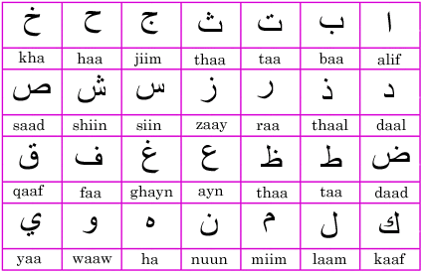
Non-English languages
Arabic:
Japanese:
(kono hon ha omoi)
テレビドラマ
German: Lebensversicherungsgesellschaftsangesteller
Chinese
  简体: 吃饭
  繁体：吃飯
كتاب
この本は重い。

Slide 21
Document preprocessing
Normalization:
  Casing (cat vs. CAT), the Fed
  Stemming (computer, computation)
  Accent removal: French (Côte d'Ivoire ➔ cote)
  Labeled/labelled, extraterrestrial/extra-terrestrial/extra terrestrial, Qaddafi/Kadhafi/Ghadaffi
Index reduction
  Dropping stop words (“and”, “of”, “to”)
    Problematic for “to be or not to be”

Slide 22
Porter’s algorithm
http://www.tartarus.org/~martin/PorterStemmer/def.txt
Computable Comput
Intervention Intervent
Retrieval Retriev
Document Docum
Representing Repres
Representative Repres
caresses caress
Ponies poni
Cats cat

Slide 23
提纲
搜索引擎一些概念
倒排索引
Lucene介绍
跨语言检索

Slide 24
Inverted index
采用倒排表
  CLEVELAND: D1, D2, D6
  OHIO: D1, D5, D6, D7
Use linked lists to be able to insert new document postings in order and to remove existing postings.
Can be used to compute document frequency
Keep everything sorted! This gives you a logarithmic improvement in access.

Slide 25
Inverted index
倒排表的结构
Posting
Brutus
2
4
8
16
32
64
128
Calpurnia
1
2
3
5
8
13
21
34
Caesar
13
16
Dictionary
Postings lists
通常还记录链表的长度
Sorted by docID

Slide 26





Inverted index construction
Documents to
be indexed.
Friends, Romans, countrymen.
Tokenizer
Token stream.
Friends
Romans
Countrymen
NLP（Stemmer, …)
Modified tokens.
friend
roman
countryman
Indexer
friend
2
4
roman
1
2
Inverted index.
countryman
13
16

Slide 27
Query processing: AND
Consider processing the query:
  Brutus AND Caesar
  Locate Brutus in the Dictionary;
    Retrieve its postings.
  Locate Caesar in the Dictionary;
    Retrieve its postings.
  “Merge” the two postings:
2
4
8
16
32
64
128
Brutus
1
2
3
5
8
13
21
34
Caesar

Slide 28
The merge
Walk through the two postings simultaneously, in time linear in the total number of postings entries
2
2
4
4
8
8
16
16
32
64
128
32
64
128
Brutus
2
8
1
Caesar
1
2
2
3
5
5
8
8
13
13
21
21
34
3
34
If the list lengths are x and y, the merge takes O(x+y)
operations.
Crucial: postings sorted by docID.

Slide 29
Query optimization
Query: Brutus AND Calpurnia AND Caesar
➔
(Caesar AND Brutus) AND Calpurnia
Brutus
2
4
8
16
32
64
128
Calpurnia
1
2
3
5
8
16
21
34
Caesar
13
16

Slide 30
More general optimization
e.g., (madding OR crowd) AND (ignoble OR strife)
Get freq’s for all terms.
Estimate the size of each OR by the sum of its freq’s (conservative).
Process in increasing order of OR sizes.

Slide 31
Space Requirements
To reduce space requirements, a technique called block addressing can be used
  Advantages:
    the number of pointers is smaller than positions
    all the occurrences of a word inside a single block are collapsed to one reference
  Disadvantages:
    online (dynamic) search over the qualifying blocks necessary if exact positions are required

Slide 32
实践
2003年写了一个基于倒排索引的搜索程序cesearch
  Block addressing
  英文单词、汉语单字和双字索引
  采用elias gamma encoding进一步压缩链表
cesearch演示

Slide 33
提纲
搜索引擎一些概念
倒排索引
Lucene介绍
跨语言检索

Slide 34
Lucene介绍
a high-performance, full-featured text search engine library written in Java
  Scalable, High-Performance Indexing
  Powerful, Accurate and Efficient Search Algorithms
  Cross-Platform

Slide 35
Lucene
Open source Java library for indexing and searching
  Lets you add search to your application
  Not a complete search system by itself
  Written by Doug Cutting
Used by: Twitter, LinkedIn, Zappos, CiteSeer, Eclipse, …
  … and many more (see http://wiki.apache.org/lucene-java/PoweredBy)
Ports/integrations to other languages
  C/C++, C#, Ruby, Perl, Python, PHP, …

Slide 36
Lucene in a search system
Users
Index document
Analyze document
Search UI
Index
Build document
Build query
Render results
Acquire content
Raw Content
Run query

Slide 37
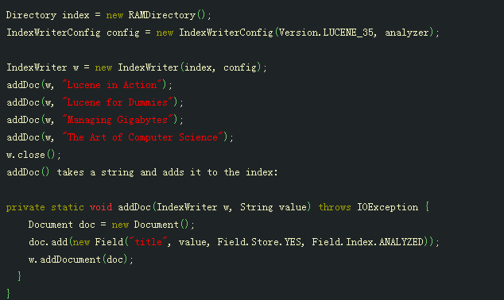
Index

Slide 38
Query

Slide 39
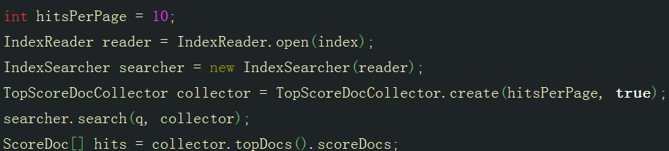
Search

Slide 40
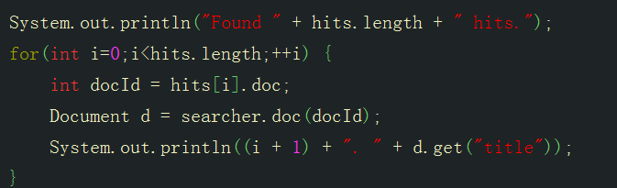
Display

Slide 41
lucene问题
虽然提供了多种tokenizer，但是无法处理藏文！必须自己写tokenizer！
解决办法：
  采用WhitespaceAnalyzer
  这样每种语言需要一个分词程序
    藏文分词
    汉语分词
    英语tokenizer
    ……

Slide 42
搜索引擎
必须自己写一个Web接口，集成lucene的索引和搜索功能，才能变成一个完整的搜索引擎

Slide 43
实践
2014.1.10 决定搭建一个藏文搜索引擎
决定先索引西藏新闻网
后来，增加多种语言，爬取了西藏大学、西北民族大学、厦门大学、wiki的藏文部分、stanford大学等站点的网页

Slide 44
实践
Preindex，从down下载的网页开始，完成抽取url，title，date, 转换html为文本的工作
语言识别程序，乱码检测程序
多语种分词程序

Slide 45
云使搜索引擎
采用Delphi XE5编写的cgi程序，调用java解释器以集成Lucene提供的搜索程序
亮点：集成机器翻译，提供跨语言检索！
  输入中文可以检索藏文，英文！
  其实输入任意语言都可以检索任意语言，前提是，需要有任意语言间的翻译程序！
2016年4月已经索引接近100万网页
演示

Slide 46
提纲
搜索引擎一些概念
倒排索引
Lucene介绍
跨语言检索

Slide 47
跨语言信息检索
Cross Language Information Retrieval (CLIR) ：“A subfield of information retrieval dealing with retrieving information written in a language different from the language of the user's query.”
E.g., Using Chinese queries to retrieve English documents
Also called multi-lingual, cross-lingual, or trans-lingual IR.

Slide 48
Why CLIR?
E.g., On the web, we have:
  Documents in different languages
  Multilingual documents
  Images with captions in different languages
  A single query should retrieve all such resources.

Slide 49
Approaches to CLIR
most
efficient;
commonly
used
 | Knowledge-based | Corpus-based
Query Translation | Dictionary/Thesaurus-based | Pseudo-Relevance Feedback (PRF)
Document Translation | MT (rule-based) | MT (EBMT/StatMT)
Intermediate Representation | UNL (AgroExplorer) | Interlingua (e.g. learned by deep learning)
infeasible
for
large
collections
Most effective approaches are hybrid – a combination of knowledge and corpus-based methods.

Slide 50
CLIR Evaluation – TREC
(Text REtrieval Conference)
TREC CLIR track (2001 and 2002)
    Retrieval of Arabic language newswire documents from topics in English
    383,872 Arabic documents (896 MB) with SGML markup
    50 topics
    Use of provided resources (stemmers, bilingual dictionaries, MT systems, parallel corpora) is encouraged to minimize variability
    http://trec.nist.gov/

Slide 51
CLIR Evaluation – CLEF
(Cross Language Evaluation Forum)
Major CLIR evaluation forum
Tracks include
  Multilingual retrieval on news collections
      topics will be provided in many languages
  Multiple language Question Answering
  ImageCLEF
  Cross Language Speech Retrieval
  WebCLEF
  http://www.clef-campaign.org/

Slide 52
知识搜索
知识图谱(knowledge graph)：本质上是一种语义网络 。其结点代表实体（entity）或者概念（concept），边代表实体/概念之间的各种语义关系。
  Dbpedia
  Freebase
  yago
Sparql
  an RDF query language for knowledge bases

Slide 53
语义搜索
概念搜索，而不是关键词
  如何表示语义非常关键，如采用词向量
    Apache solr + word2vec
推理功能
结合知识库
问答系统可看作是一种语义搜索
  Deep learning based QA

Slide 54
Project
构建一个字符串快速搜索程序，可以从一个文档集合中把该字符串的所有出现全部找出来。能否支持正规表达式的快速搜索？

