Slide 1
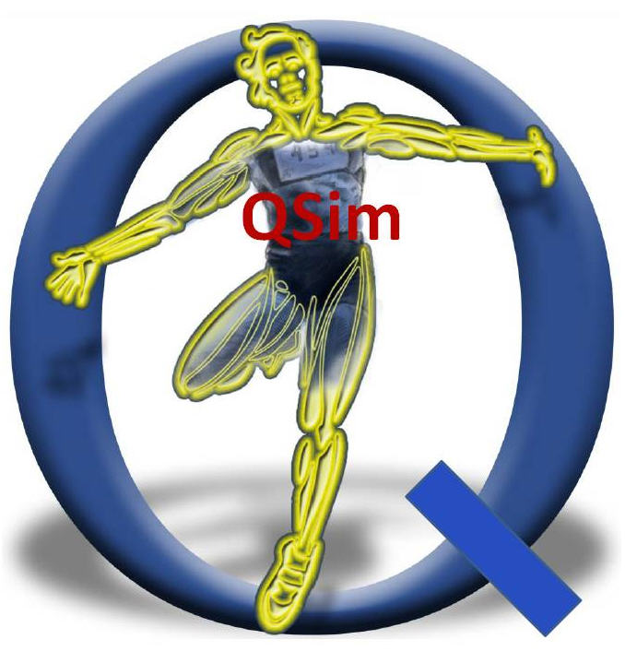
NIH Center for Biomedical Computation at Stanford
Scott Delp Paul Mitiguy
Edith Arnold Michael Sherman
Matt DeMers Ayman Habib
Sam Hamner Ajay Seth
Jennifer Hicks Peter Eastman
Chand John Joy Ku
Melanie Fox Clay Anderson
Visit www.simtk.org or contact mitiguy@stanford.edu

