Slide 1
Predict the House Price Using Gradient Boosting and Xgboosting
Ruiwan Xu

Slide 2
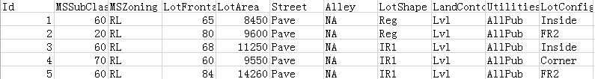
Dataset
Ames Housing dataset
80 original features
1459 training samples
1460 testing samples

Slide 3
Feature Selection
Missing data
Data converting
Feature deletion

Slide 4
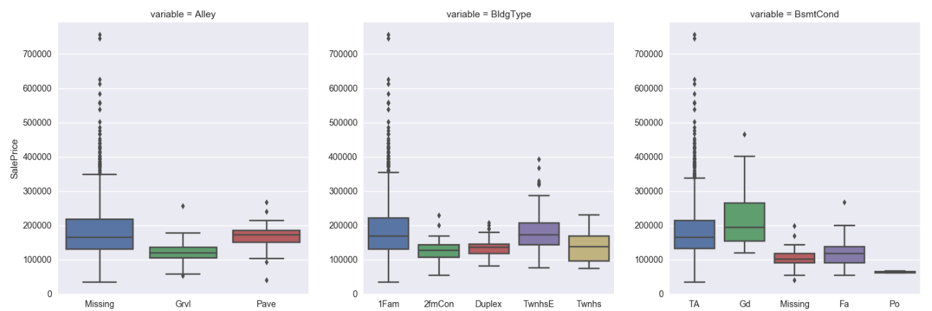
Categorical Features (43)
Boxplot

Slide 5
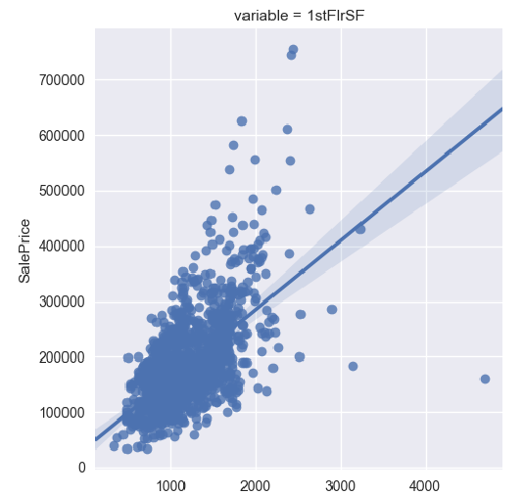
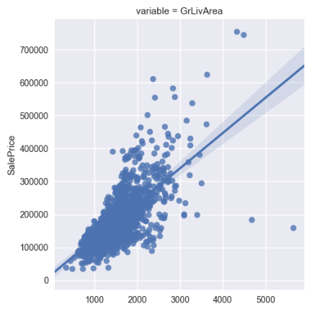
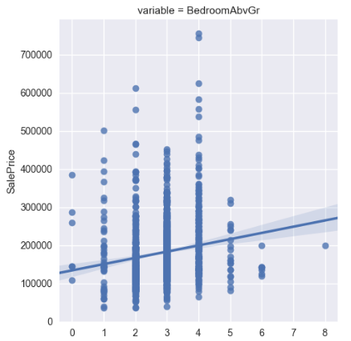
Numerical Features (37)
Scatter diagram

Slide 6
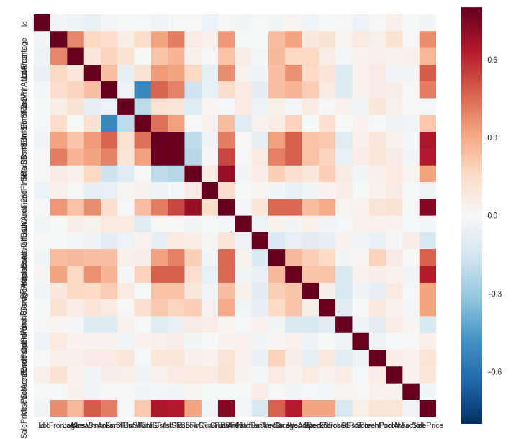
Correlation between features

Slide 7
Missing Data
Missing over 15%, delete the feature
Filling in the missing value ——using NA, average or median

Slide 8
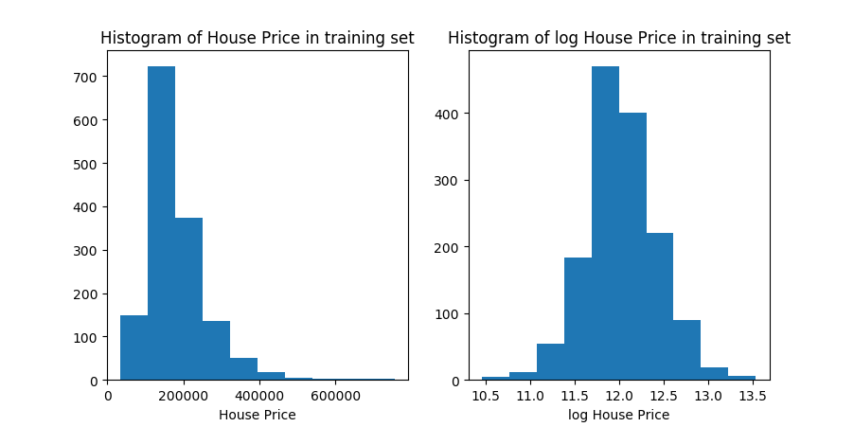
House Price
Taking log value

Slide 9
Training & Predicting
Gradient Boosting
Xgboosting

Slide 10
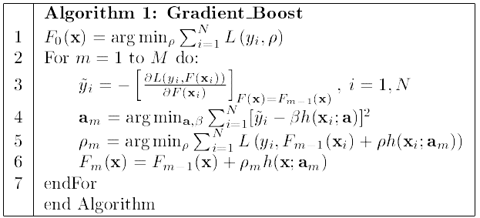
Gradient boosting
Decreasing the loss function on the direction of gradient
Giving higher weight to bad samples
RMSE: 0.1180

Slide 11




Xgboosting
Using first derivative and second derivative to decrease loss function
Loss function in iteration t (Using CART as weak classifier):
Taylor expansion:
Splitting CART tree
RMSE: 0.116

Slide 12
Model improvement
Improve the feature selection part
Find more appropriate parameters for Xgboosting
Give weights to different models to ensemble the prediction

Slide 13
Thank You

