Slide 1
U.S. Flight Delay
Analysis & Prediction
Can we identify flights at high risk of delay early enough for an airline operations team to act?
U.S. domestic flights · 2024–2025

Slide 2
1. Problem Frame
The same model would be designed differently for passengers and airline operations.
Passenger-facing
Airline operations — chosen use case
Earlier warning is more useful
Prioritize flights that may need attention
Predicted risk should match what happens in practice
Use recent operational signals
False alerts can reduce trust
Still leave time to intervene
At T−2h, which operating flights are most likely to arrive ≥15 minutes late?

Slide 3
2. Data & Data Quality
Three data sources
How I handled missing values
• Cancelled / diverted flights: arrival fields are structurally
missing → excluded from this target, not imputed.
BTS
Flight schedule, actual operations, target and delay causes
• Aircraft age / seats: high coverage with small missing share → median imputation in the training pipeline.
FAA
Aircraft model, manufacture year and seating capacity
• Aircraft model: missing values kept as “Unknown.”
IEM ASOS
Recent origin weather available at prediction time
• Weather: numeric fields median-imputed; gust keeps a separate reported/not-reported indicator.
• Delay-cause fields: EDA only — not model features because they are known after the outcome.
2024–2025 · ~14.1M scheduled flights

Slide 4
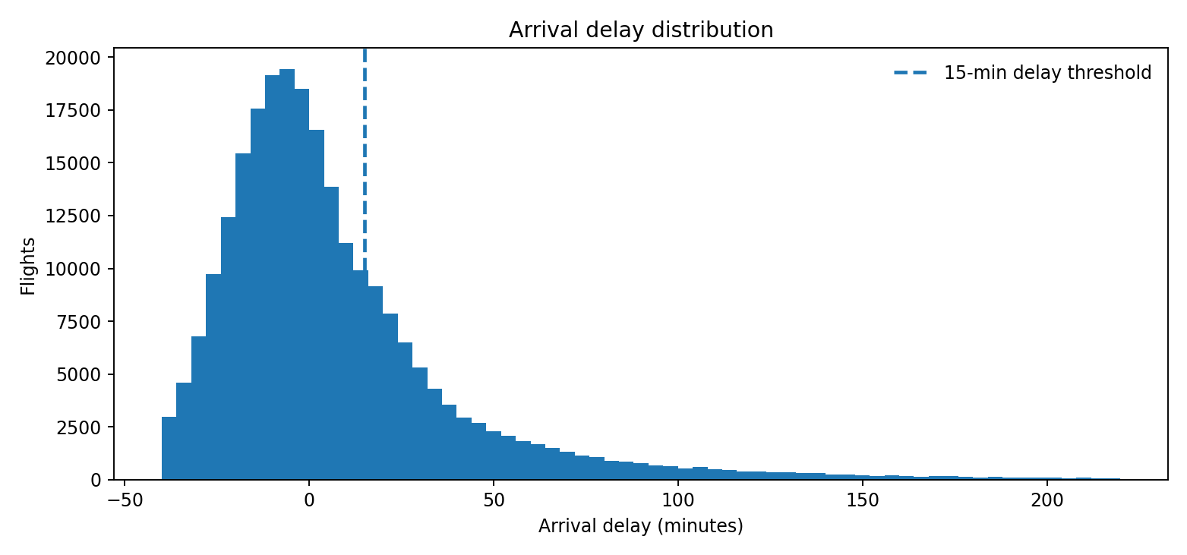
EDA1: Delays Are Strongly Right-skewed
What I see
• Median arrival: 6 min early
• 21.6% arrive ≥15 min late
• 95th percentile: 87 min late
• 99th percentile: 220 min late
Takeaway: most flights are near schedule, but a smaller group has very large delays. The target is also imbalanced: about 22% of completed flights are delayed ≥15 min.
Plot shown over the central range for readability; extreme delays are retained in the model.

Slide 5
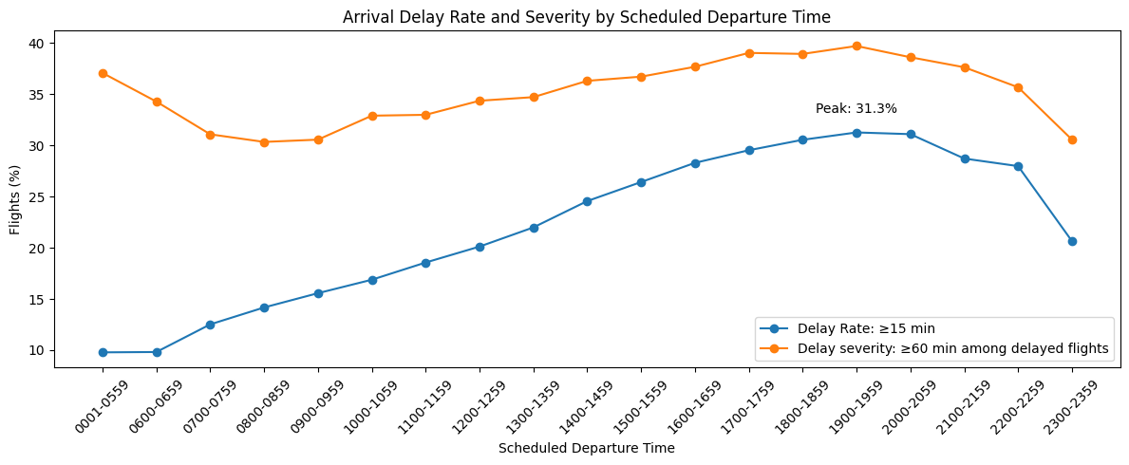
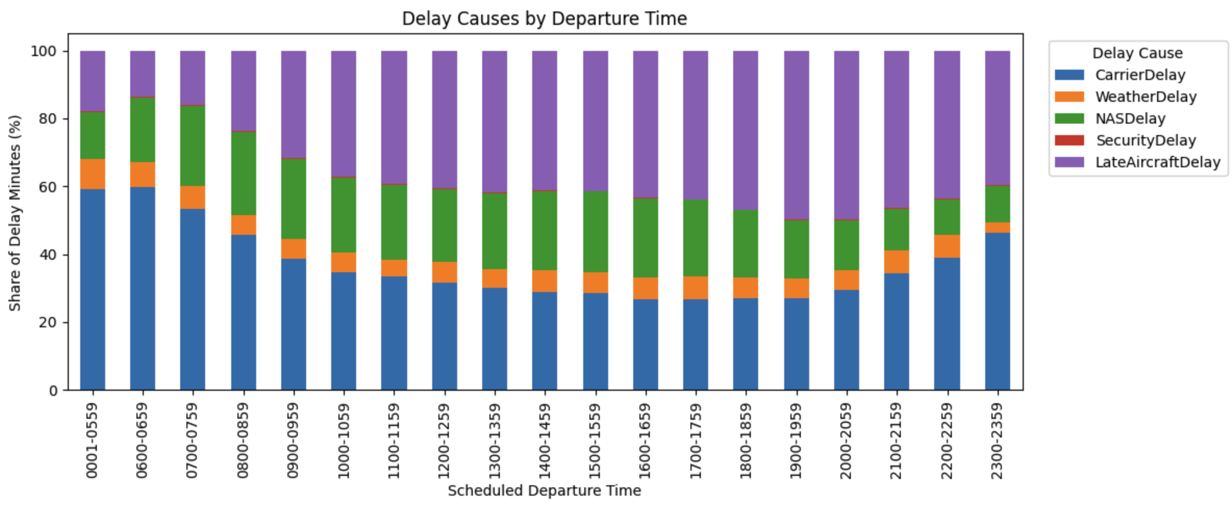
EDA2: Pointed to an operational mechanism
Delays become more frequent and severe later in the day. Late-aircraft delays also increase, suggesting delay carryover may be one factor.
Takeaway: schedule features miss current operating conditions → test inbound-aircraft state.

Slide 6
4. Feature Engineering: Add Information Only if it is Available at T−2h
The main design goal was to capture operational state without leaking future outcomes.
Schedule
Inbound aircraft
Aircraft
Weather
Final model
airline, origin, destination, time
six availability / buffer states
model, age, seats
latest origin observation ≤ T−2h
Risk ranking
Inbound aircraft state
Weather join
Link flights by tail number only when the previous destination matches the current origin.
Example — current flight JFK → MIA, departs 3:00 PM; prediction time = 1:00 PM • Prior flight BOS → JFK arrived 12:25 PM → Already arrived • Prior flight was due 12:10 PM but has not arrived by 1:00 PM → Expected already — not arrived • Prior flight is not due yet → use scheduled turnaround buffer vs. that airline’s typical buffer Six states summarize aircraft availability and buffer risk.
Map weather station → airport, then take the latest origin observation at or before T−2h; maximum age = 2 hours. Coverage ≈99.8–99.9%. Weather features in plain English: • temperature & humidity • wind speed / direction / gust • precipitation • visibility • cloud cover & cloud-base height • weather condition code (fog, rain, thunderstorm, etc.) Example observation: 41°F, 100% humidity, 3 kt wind, 0.25 mi visibility, fog, ~100 ft cloud base.
Leakage rule: if the information was not known by T−2h, it does not enter the feature set.

Slide 7
5. Better Information Mattered More Than a More Complex Algorithm
Validation PR-AUC improved most when inbound-aircraft state and weather were added.
Main finding
Operational state > model complexity
0.4807
0.3972
0.4032
0.3178
0.3218
0.3224
Logistic
schedule
XGBoost
schedule
+ Route
+ Inbound
aircraft
+ Aircraft
metadata
+ Weather

Slide 8
6. Final Held-out Test: High-risk Flights Are Much More Likely To Be Delayed
Jul–Dec 2025 was evaluated once after the feature set was frozen.
0.7417
0.4941
TOP 10% EXAMPLE
ROC-AUC
PR-AUC
60%
of selected flights
were actually delayed
If the team can focus on only a share of flights:
Flights targeted
Precision
Recall
26%
Top 1%
86.96%
3.83%
of all delayed flights
were captured
Top 5%
70.18%
15.45%
Top 10%
60.11%
26.47%
Top 20%
49.11%
43.25%

Slide 9
7. Recommendation: Use The Model as a T−2h Risk Ranking
Deploy as decision support first; expand the feature set around information available at the decision time.
Recommended use
Next steps
Rank flights by delay risk at T−2h
Match the cutoff to operational capacity
Use as decision support, not an automatic passenger alert
In production, prioritize using delay risk + expected severity + business impact
Add a delay severity model to distinguish moderate vs. major delays
Add destination weather forecasts available at T−2h
Test congestion and more live operational signals
Model cancellations / diversions separately
Monitor model performance and data coverage over time

