Slide 1

UMS 2026 University Management System
A Modern Desktop Application for University Administration
Built with C# Windows Forms
SQL Server Database
Entity Framework ORM
.NET Framework 4.7.2

Slide 2
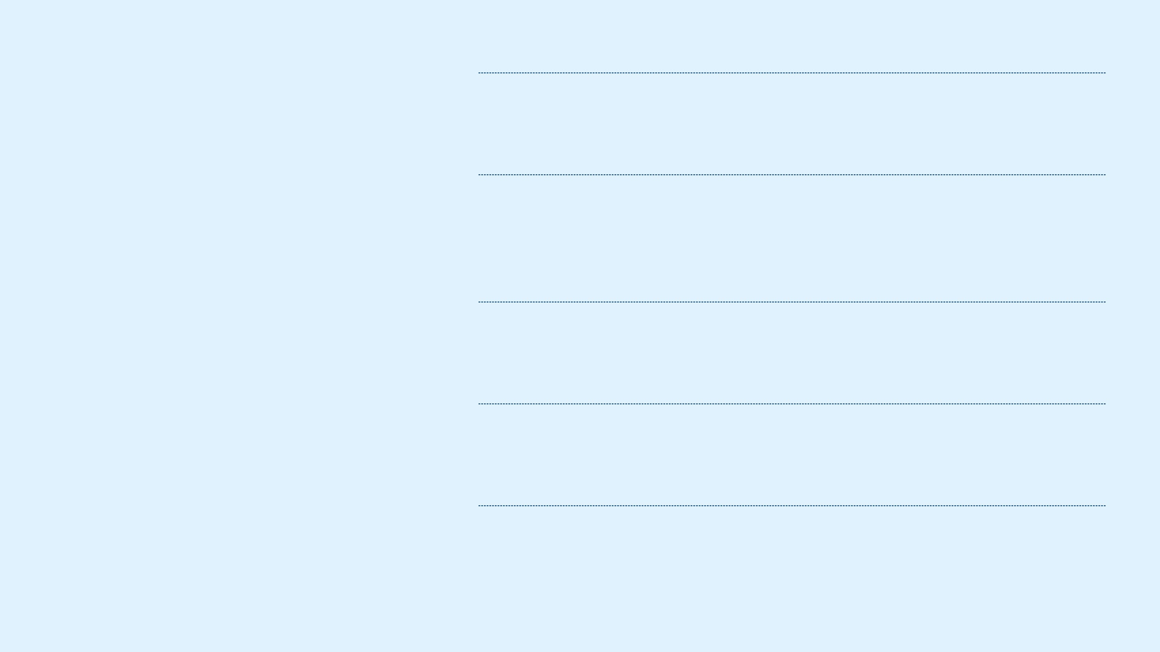
Centralizes University Operations into One Integrated Platform
01
Platform
Windows Desktop Application (.exe)
02
Technology Stack
C# (.NET 4.7.2), Windows Forms, SQL Server (sqlexpress), Entity Framework, MaterialSkin UI
03
Application Name
UMS 2026 is a comprehensive desktop-based University Management System designed to streamline the day-to-day administrative operations of a university — from managing students and instructors to scheduling classes and generating analytical reports.
UMS2026.exe
04
Target Users
University Administrators

Slide 3
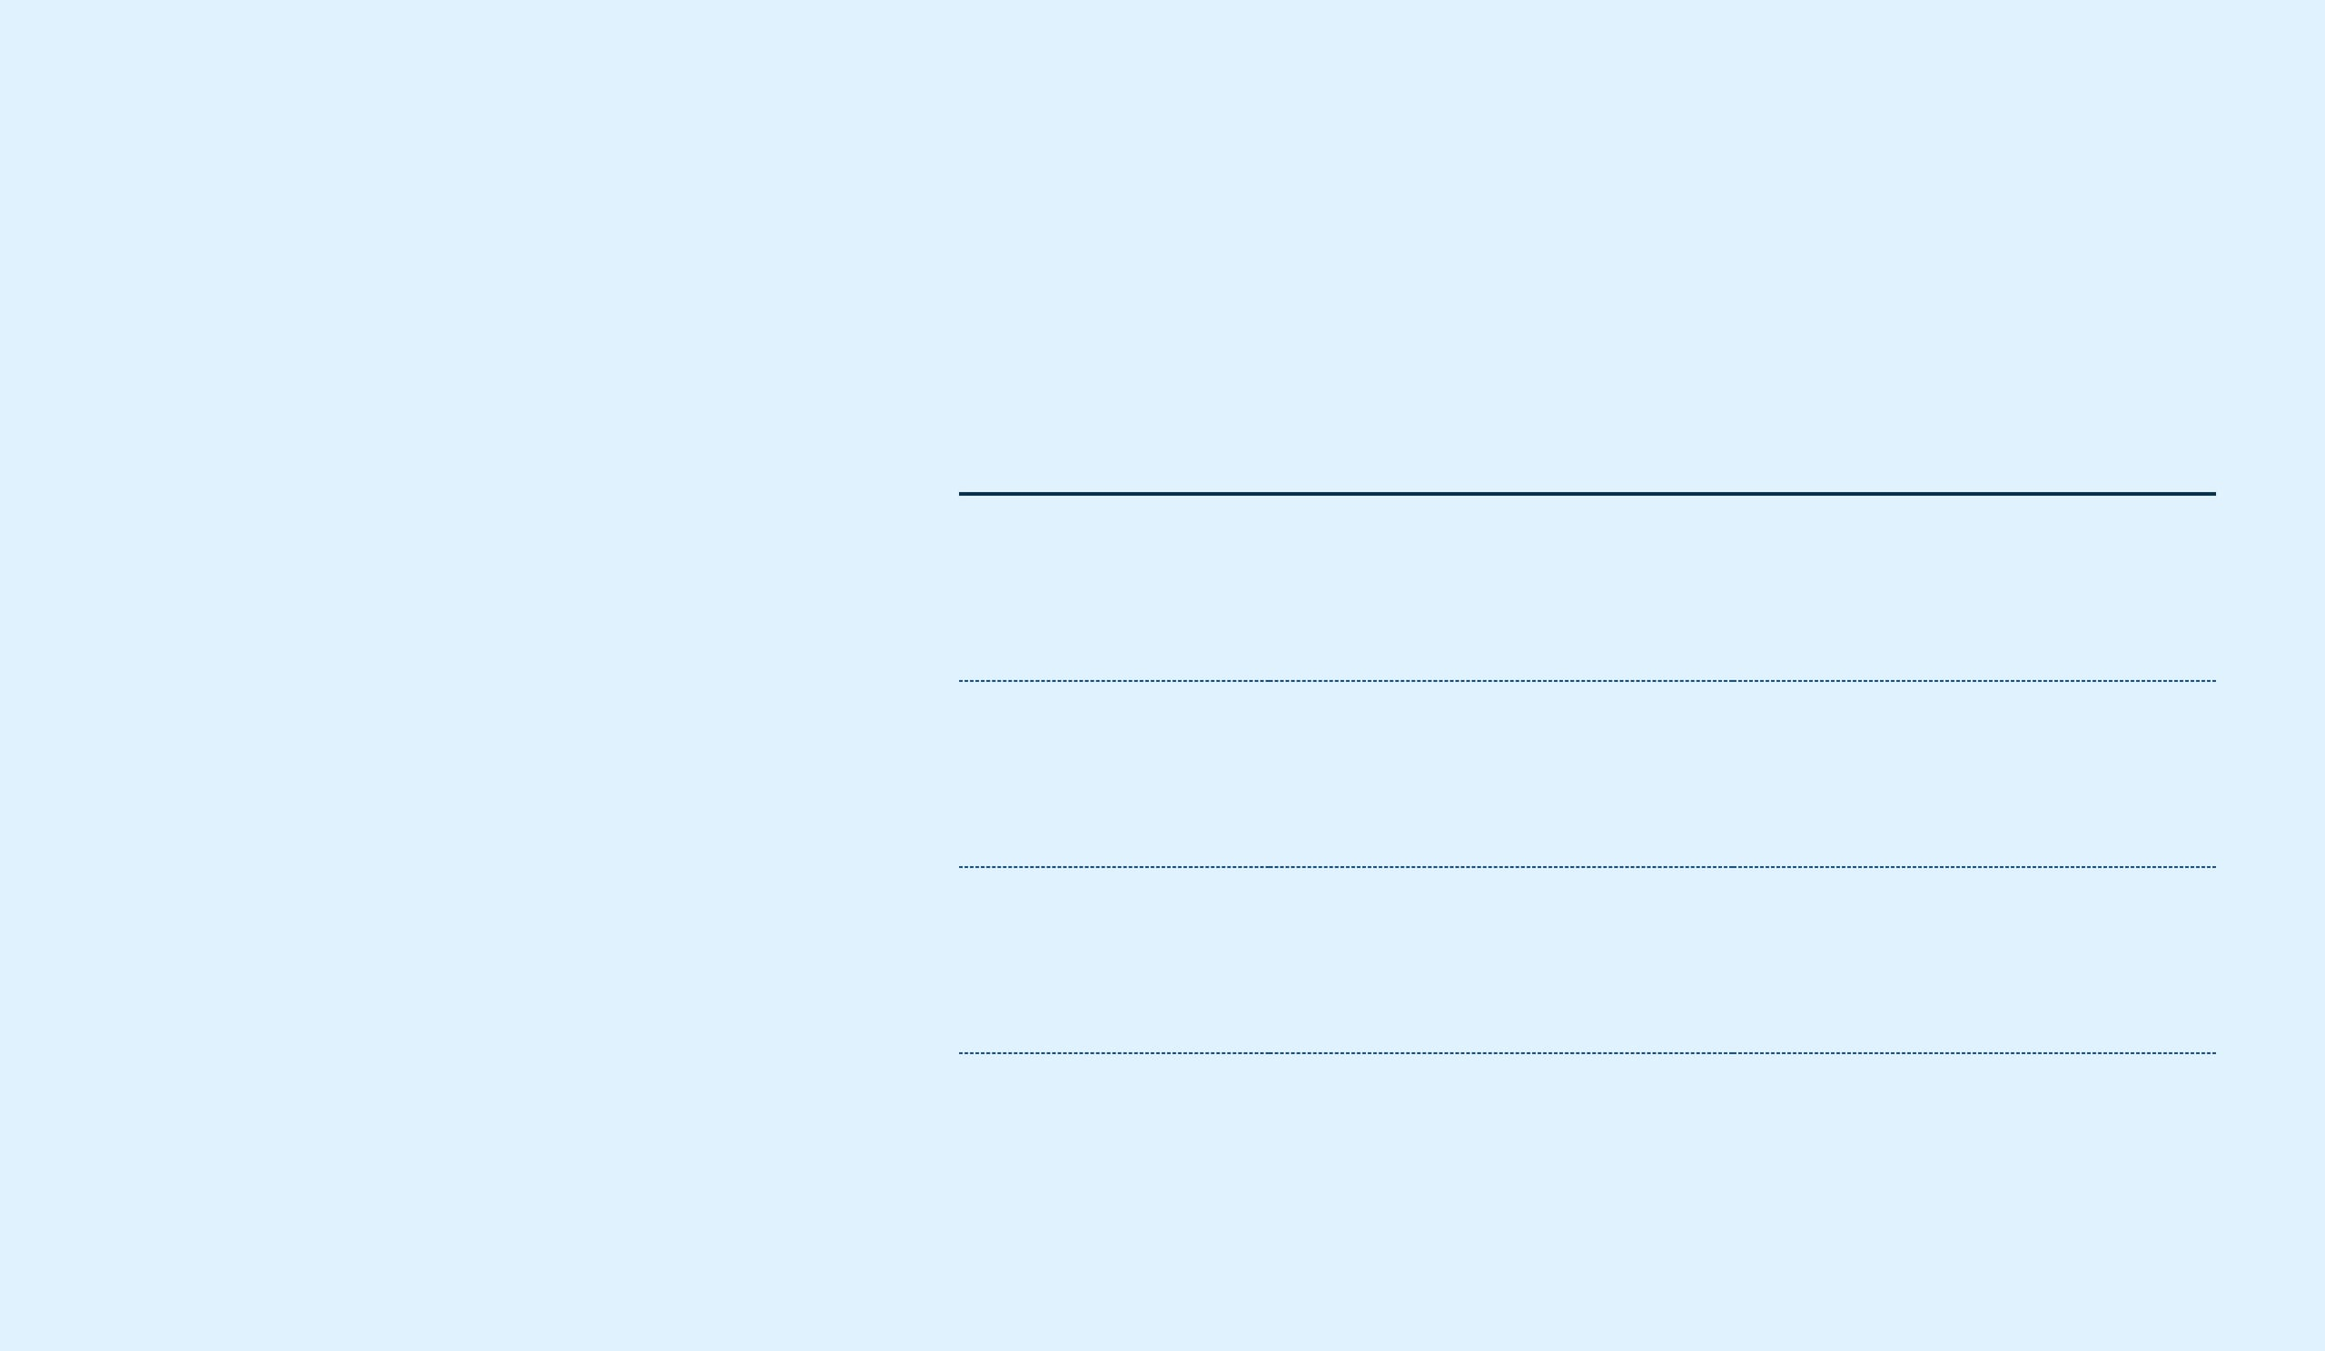
Three-Tier Architecture Ensures Clean Separation of Concerns
Layer
Technology
Responsibility
Presentation
C# Windows Forms + MaterialSkin
UI rendering, user interaction
UMS 2026 follows a classic three-tier architecture that separates the user interface, business logic, and data access layers, ensuring maintainability and scalability.
Business Logic
C# Classes (.cs files)
Data validation, operations
Data Access
Entity Framework + SQL Server
Database queries, ORM mapping
The Entity Data Model (UniversityModel.edmx) maps all database tables to C# classes, enabling strongly-typed data access throughout the application.

Slide 4
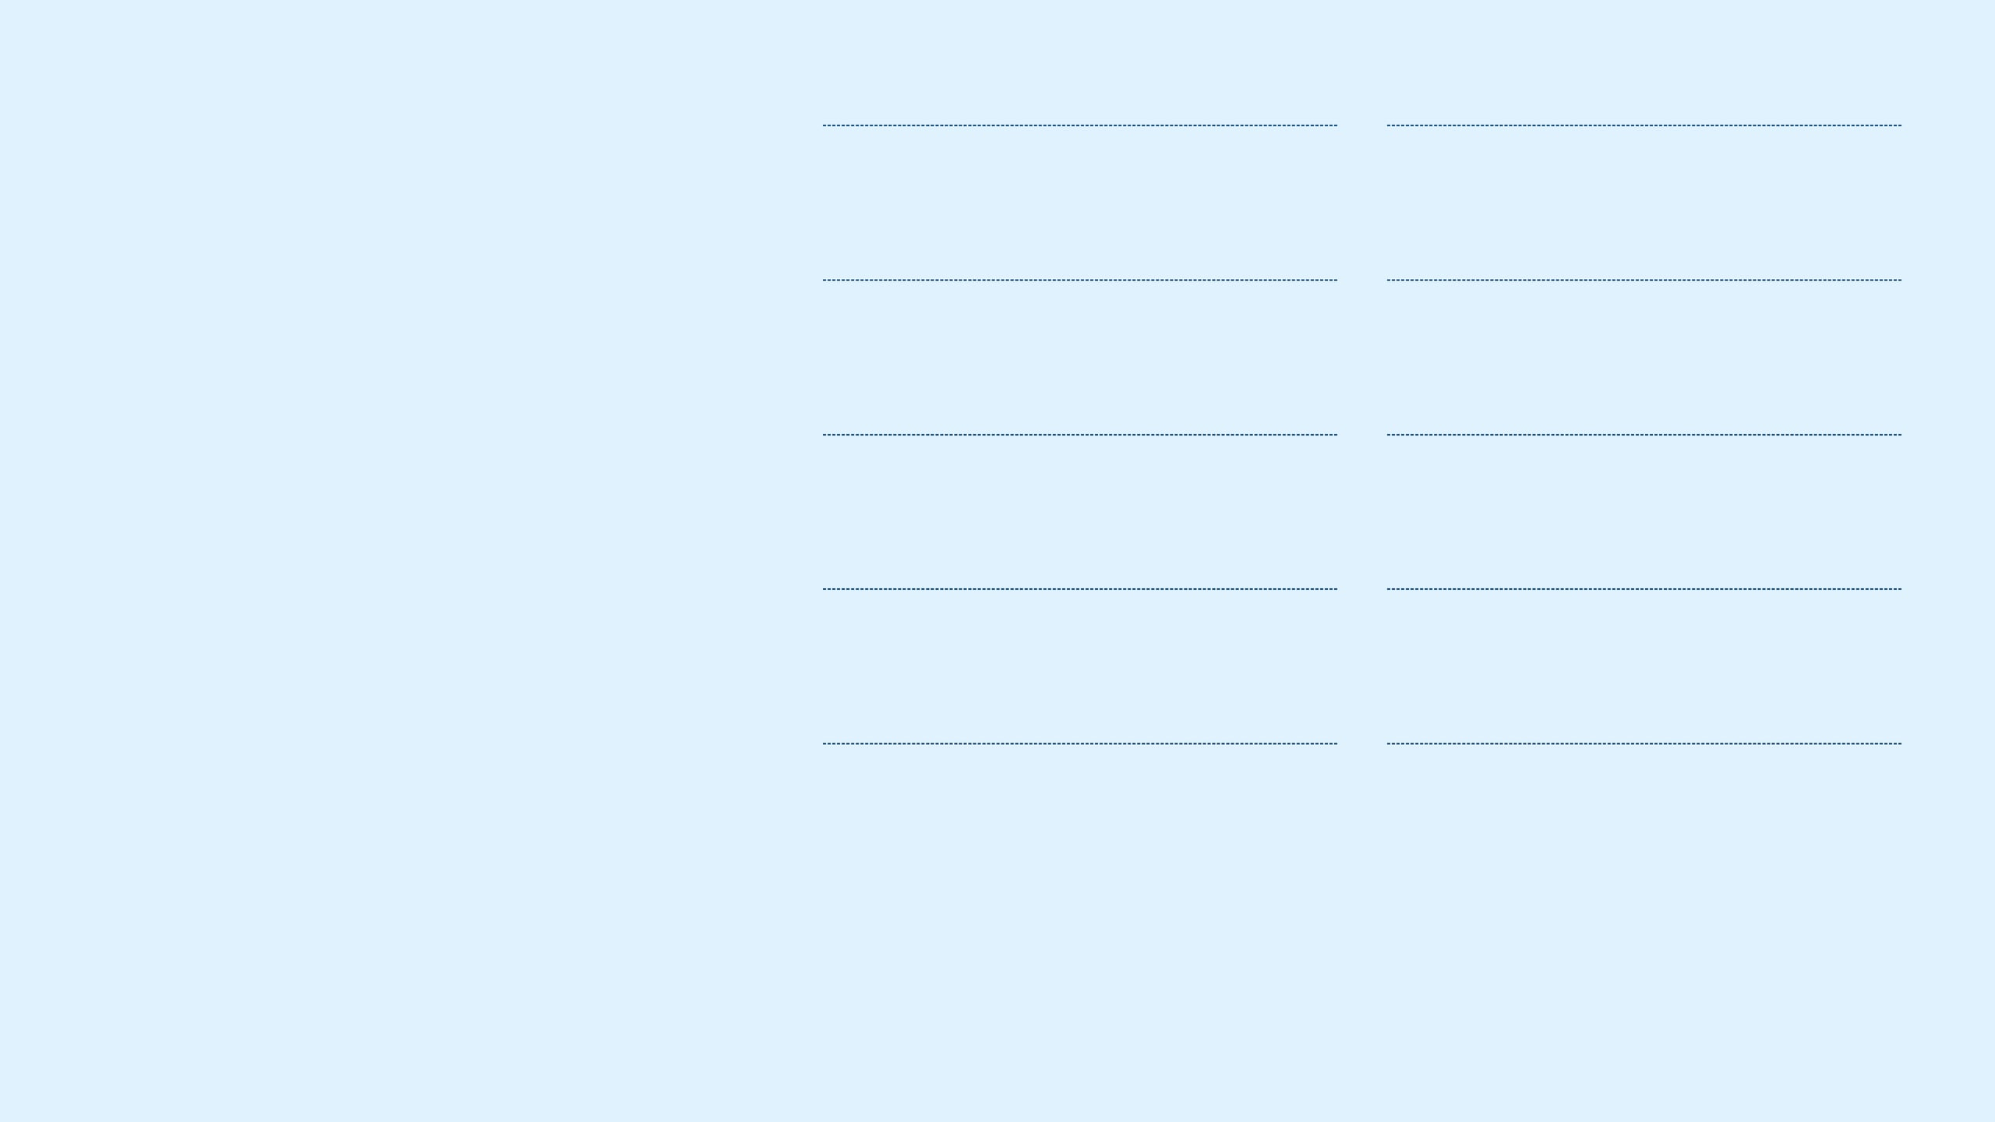
Nine Interconnected Entities Form the Core Data Model
STUDENT
INSTRUCTOR
Fields: ID, name, dept_name, tot_cred Links: Dept, Advisor, Takes courses
Fields: ID, name, dept_name, salary Links: Dept, Advises, Teaches
DEPARTMENT
COURSE
Fields: dept_name, building, budget Links: Courses, Instructors, Students
Fields: course_id, title, credits Links: Dept, Sections, Prerequisites
SECTION
ENROLLMENT (TAKE)
The system's database is built around nine core entities that reflect a real-world university structure. These entities are mapped via Entity Framework and connected through well-defined relationships.
Fields: sec_id, semester, year, room Links: Course, Classroom, Time Slot
Fields: student ID, course/sec, grade Links: Student to Section
CLASSROOM
TIME SLOT
Fields: building, room_number, capacity Links: Hosts Sections
Fields: time_slot_id, day, start/end Links: Assigned to Sections
USER
Fields: ID, Username, Password, role Links: Authentication & Access

Slide 5

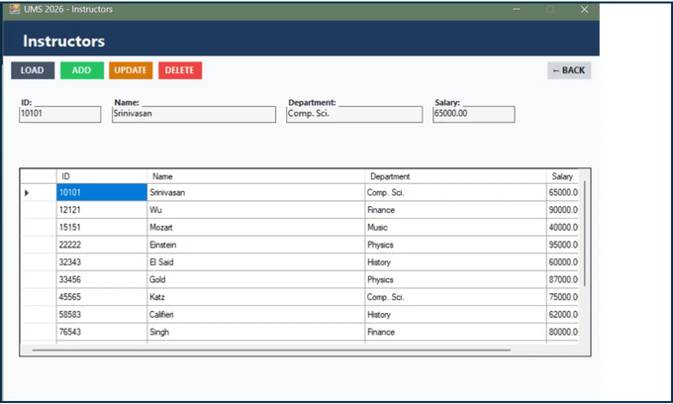
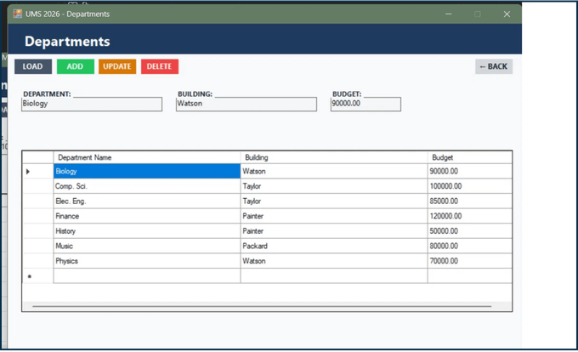
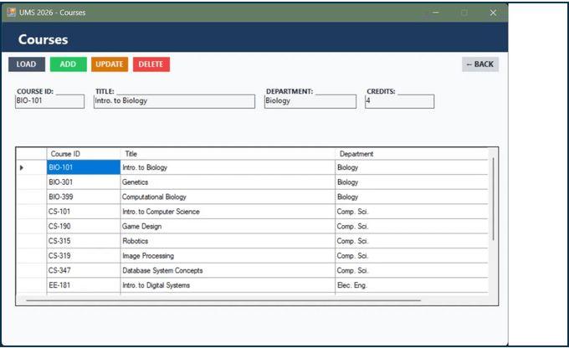
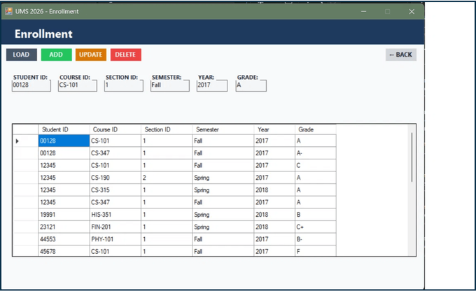
Eight Functional Modules Cover Every Aspect of University Administration
Student & Instructor — Full profile management
Departments — Budget & building tracking
Course Catalog — Credits & dept assignment
Enrollment — Course registration & grading
INSTRUCTORS
DEPARTMENTS
Scheduling — Time slot & room allocation
Analytics — Visual reporting & charts
COURSES
ENROLLMENT

Slide 6

Secure Role-Based Login Guards All System Access
01
Database Validation
Credentials (username and password) are validated against the user table in SQL Server.
02
Password Masking
Password field uses bullet-character masking for security (PasswordChar = '●').
The application launches with a modern login screen that authenticates users against the database before granting access to the Admin Dashboard.
03
Role-Based Access
Role field in the user entity supports future expansion for multi-role access (e.g., admin, faculty, registrar).
04
UI Design
Login form features a centered card design on a deep navy background (800×500 px).
05
Error Handling
Failed logins display appropriate error messages via MessageBox dialogs.

Slide 7
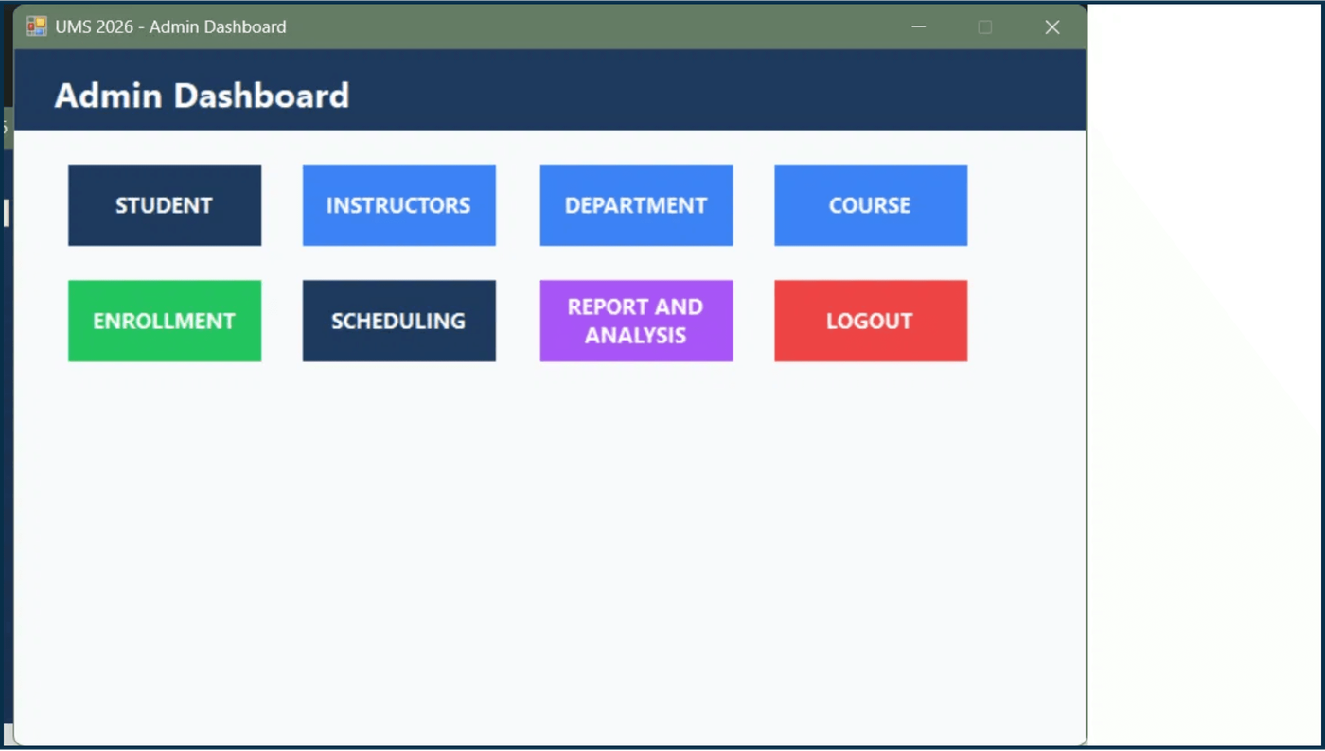
The Dashboard Organizes All Modules in a Clean 2×4 Grid Layout
The Admin Dashboard (AdminForm) serves as the central navigation hub of the application. It presents all eight management modules as large, color-coded buttons arranged in a 2×4 grid.
Each button features hover effects and a hand cursor for intuitive interaction, with semantic colors guiding the user's workflow.
FIGURE 1: UMS 2026 ADMIN DASHBOARD UI

Slide 8
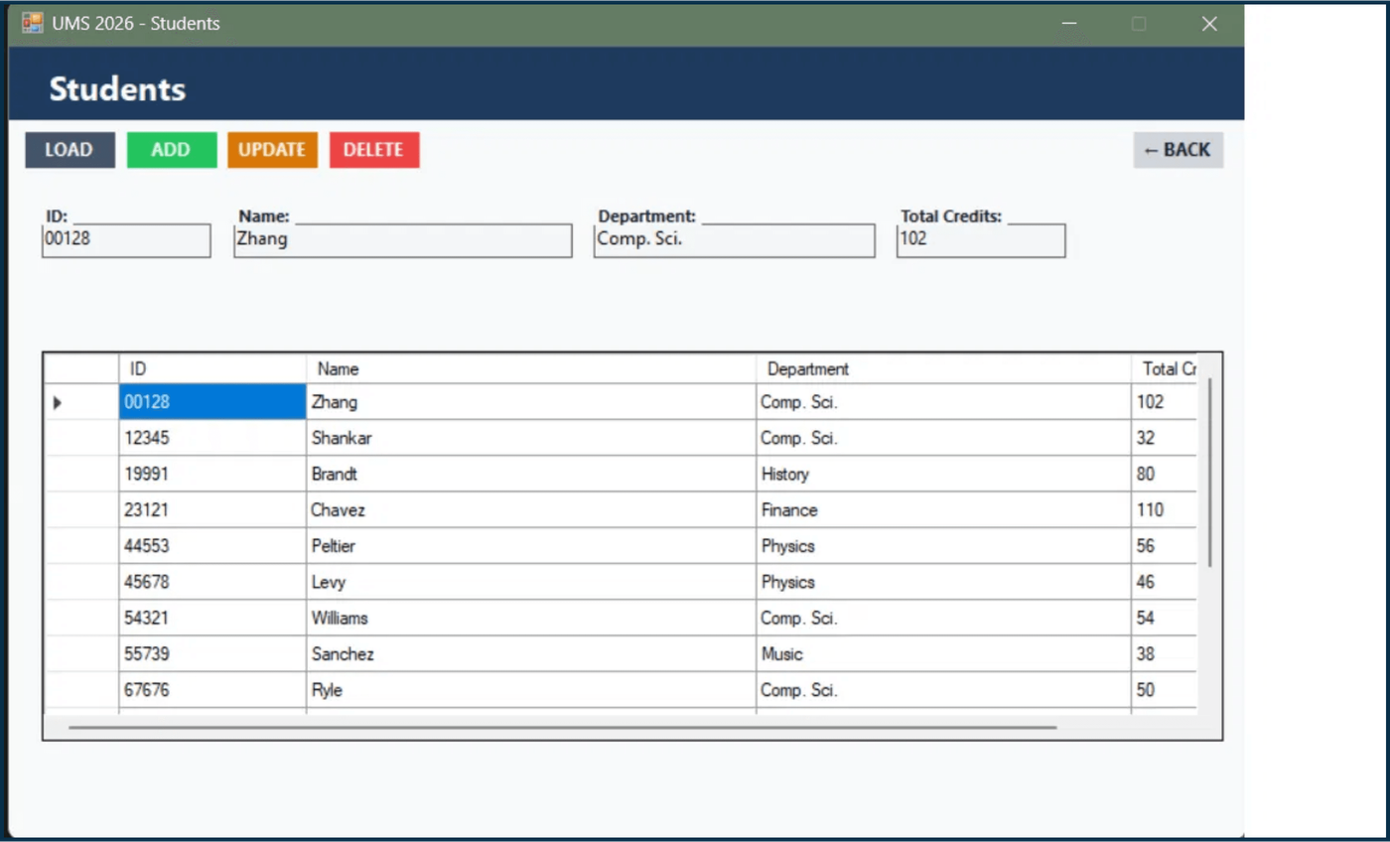
All Data Forms Follow a Consistent, Intuitive CRUD Layout
Header Panel — Dark navy bar with form title
Action Bar — LOAD, ADD, UPDATE, DELETE, BACK
Input Fields — Horizontal row for quick entry
DataGridView — Tabular display of records
FIGURE 2: STANDARDIZED DATA MANAGEMENT FORM (STUDENT MODULE)

Slide 9
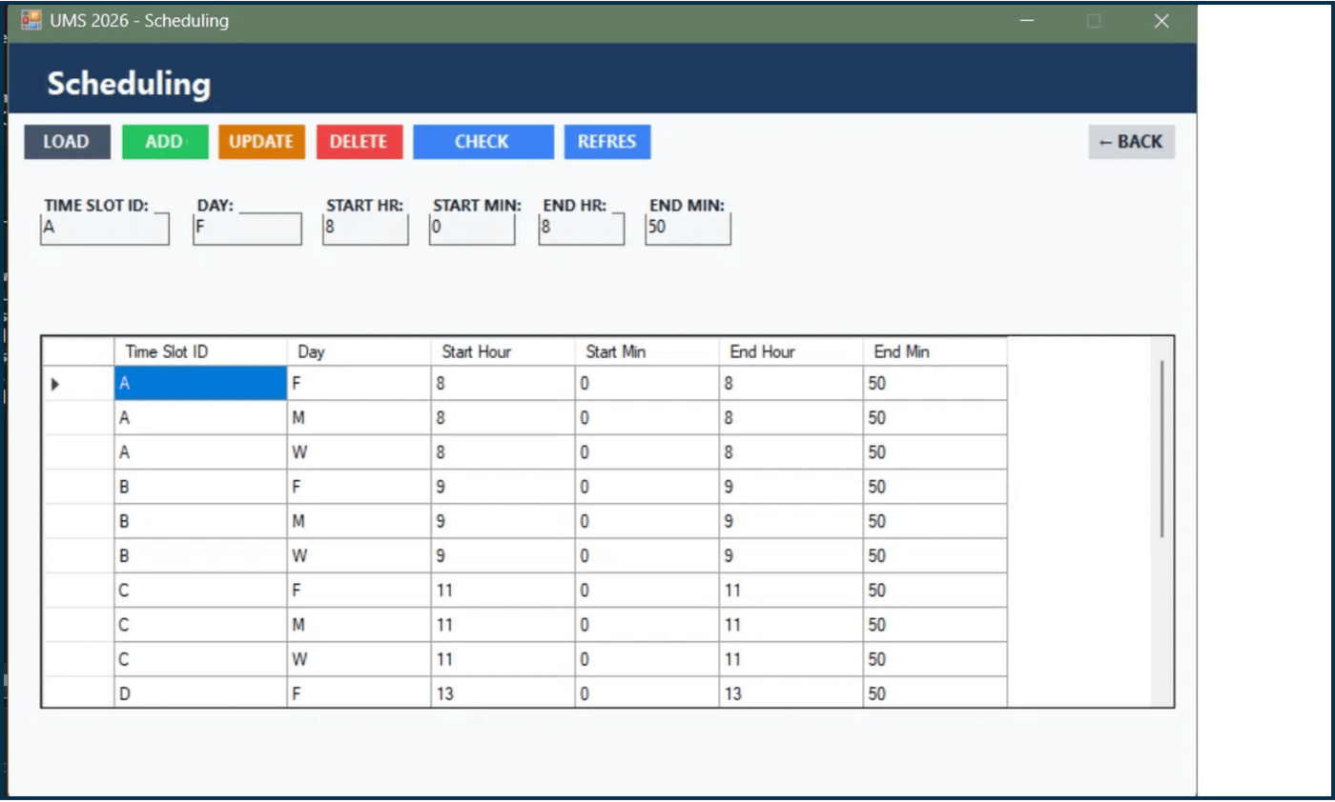
The Scheduling Module Proactively Detects Time Slot Conflicts
Conflict Check Button — Triggers overlap validation
Interval Logic — SQL-based time range comparison
Real-time Feedback — Immediate MessageBox alerts
Grid Integration — Direct editing from tabular view
FIGURE 3: SCHEDULING & CONFLICT DETECTION INTERFACE

Slide 10
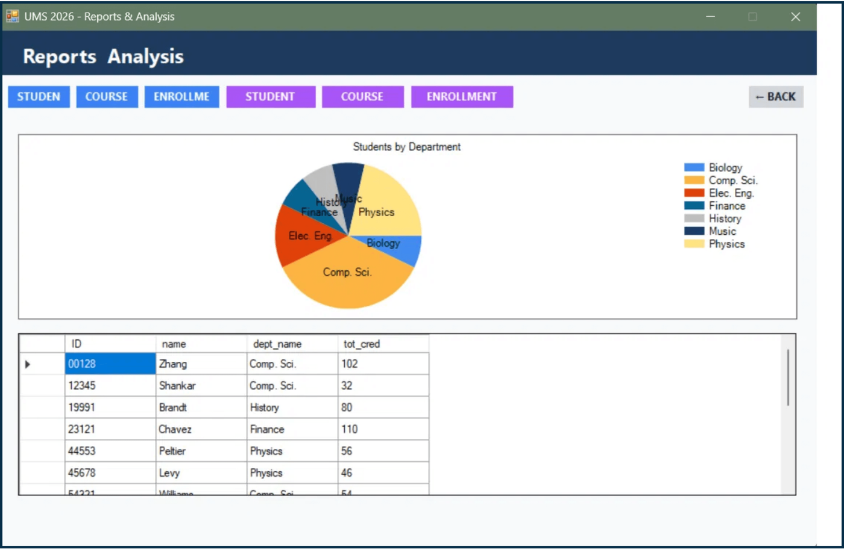
Built-In Analytics Deliver Visual Insights on University Data
Dynamic Charts — Real-time visual data breakdown
Department Analytics — Student distribution via Pie charts
Tabular Integration — Combined chart and grid views
Multiple Views — Support for Students, Courses, and Enrollment
FIGURE 4: DYNAMIC REPORTING & VISUAL ANALYTICS MODULE

Slide 11
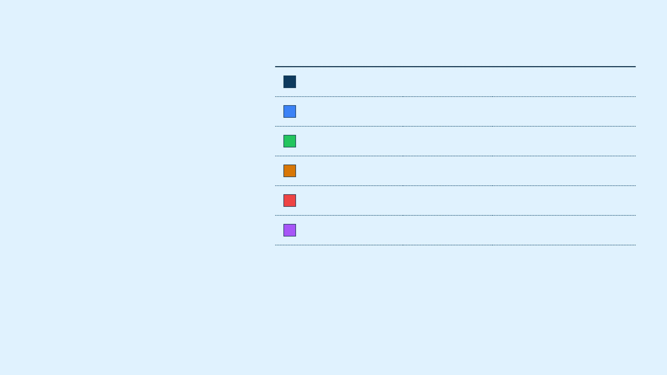
A Modern Enterprise Design System Ensures Visual Consistency
Color
RGB Value
Usage
(30, 58, 95)
Headers, primary actions
Primary Blue
(59, 130, 246)
Secondary buttons
Secondary Blue
(34, 197, 94)
ADD, Enrollment actions
Success Green
(217, 119, 6)
UPDATE actions
Warning Orange
(239, 68, 68)
DELETE, Logout
The application follows a carefully defined design system documented in DESIGN_NOTES.md, ensuring a professional and consistent appearance across all forms.
Danger Red
(168, 85, 247)
Report & Analysis
Purple
Typography
Segoe UI font family — 16–20px Bold for headers, 9px Regular for body text, 9–11px Bold for buttons.

Slide 12

UMS 2026 Delivers a Complete, Production-Ready University Management Solution
Technical Strengths
Design Strengths
Clean three-tier architecture with Entity Framework ORM
Semantic color coding for intuitive navigation
Consistent CRUD operations across all eight management modules
Standardized form layout reduces learning curve
Real-time conflict detection in the scheduling module
Professional enterprise-grade visual design system
Dynamic chart generation for data analytics
Responsive hover effects and hand cursors for usability
Secure authentication with role-based user model
UMS 2026 is a fully functional, well-structured university management system that demonstrates strong software engineering principles and a polished user experience.
Built With
C# · .NET 4.7.2 · Windows Forms · SQL Server · Entity Framework · MaterialSkin

