Slide 1
Probabilistic Inference
Matthew Guzdial

Slide 2
Random Variables
Did you cover these?
Any variable that may be different every time we check it.
Not all random variables are uniform random
Distribution determines likelihood of each value
Example: Chance that I am about to combust

Slide 3
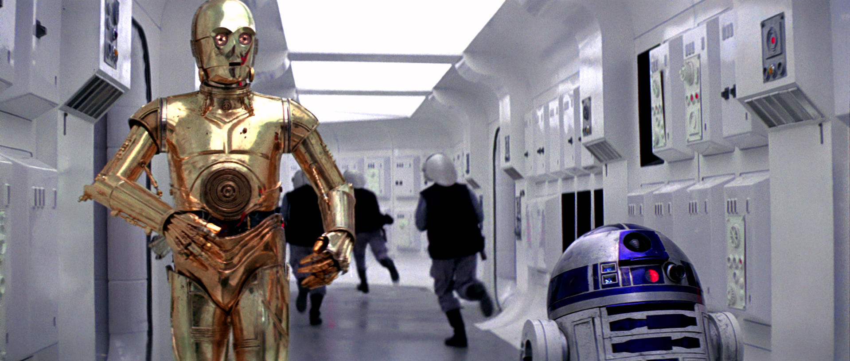

Slide 4
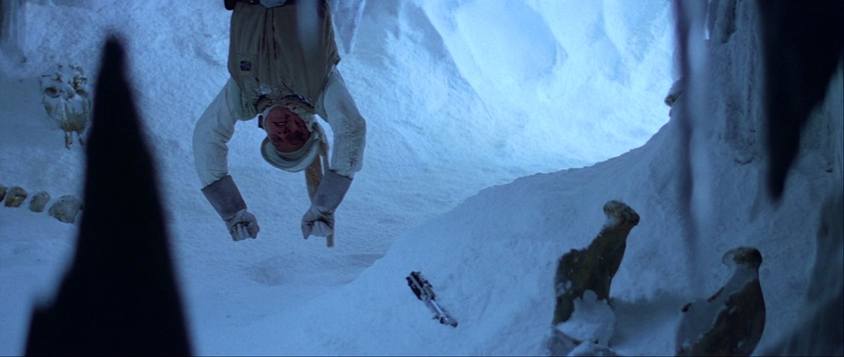
C-3PO: R2 says the chances of survival are 725... to one

Slide 5

C-3PO: Sir, the possibility of successfully navigating an asteroid field is approximately three thousand, seven hundred twenty to one!

Slide 6
That’s Probability!
In the 1980’s Bayesian probability was a pretty big deal in AI circles
And it’s the basis for a lot of state-of-the-art approaches today (machine learning!)

Slide 7
Why is Probability Helpful?
Let’s imagine we want to build a fire detector for a fire alarm system. How could we go about building a fire alarm system with the AI approaches you know about? Assume all and any random variables.
e.g. if (HIGH_TEMPERATUR) then FIRE

Slide 8
Random Variables
We can ignore any information we don’t have when worrying about probabilities, because at the end of the day P(FIRE) + P(¬FIRE) = 1.
P(x) = Probability that x is true
P(¬x) = Probability that x is false

Slide 9
Hidden Variables
All possible worlds must sum to 1, which means we can make decisions even without perfect information
e.g. P(FIRE) = 0.01 and P(¬FIRE) = 0.99
…or P(FIRE ∧ HIGH_TEMPERATURE) = 0.009, P(FIRE ∧ ¬HIGH_TEMPERATURE) = 0.001 P(¬FIRE ∧ HIGH_TEMPERATURE) = 0.33 P(¬FIRE ∧ ¬HIGH_TEMPERATURE) = 0.66

Slide 10
Logic/Probability Notation
∧ = AND
∨ = OR
Do I need to go over the tables?

Slide 11
Again: Why is Probability Helpful?
Hint: You’ve already covered logical agent behaviors in terms of search/planning, which makes sense when the world is logical and observable.

Slide 12
Exercise 1: Computing Probabilities
 | HIGH_TEMP | ¬HIGH_TEMP
FIRE | 0.009 | 0.001
¬FIRE | 0.33 | 0.66
<- This is a probability table
Each cell is called a “world” as in a particular world we could be in.
The sum of all worlds must equal 1.0
What is P(HIGH_TEMP)?
What is P(¬HIGH_TEMP)?
What is P(HIGH_TEMP ∧ FIRE)?
What is P(HIGH_TEMP ∨ FIRE)?
What is P(HIGH_TEMP ∨ ¬FIRE)?

Slide 13
Answers
 | HIGH_TEMP | ¬HIGH_TEMP
FIRE | 0.009 | 0.001
¬FIRE | 0.33 | 0.66
What is P(HIGH_TEMP)? 0.339
What is P(¬HIGH_TEMP)? 0.661
What is P(HIGH_TEMP ∧ FIRE)? 0.009
What is P(HIGH_TEMP ∨ FIRE)? 0.34
What is P(HIGH_TEMP ∨ ¬FIRE)? 0.999

Slide 14
Full Joint Probability
We call it “Full Joint Probability” when we have all the values of the full probability table.
This doesn’t happen all the time, as every new variable brings exponentially more complexity

Slide 15
Example Full Joint Probability
 | toothache |  | ¬toothache
 | abscess | ¬abscess | abscess | ¬abscess
cavity | 0.108 | 0.012 | 0.072 | 0.008
¬cavity | 0.016 | 0.064 | 0.144 | 0.576
Can compute probability of any event by identifying which random variables are true + adding probabilities
Called marginalization or summing out

Slide 16
Are Random Variables always Boolean?
 | Tails | Heads
Dice shows 1 | 1/12 | 1/12
Dice shows 2 | 1/12 | 1/12
Dice shows 3 | 1/12 | 1/12
Dice shows 4 | 1/12 | 1/12
Dice shows 5 | 1/12 | 1/12
Dice shows 6 | 1/12 | 1/12
Nope!
Dice shows 1 | 1/6
Dice shows 2 | 1/6
Dice shows 3 | 1/6
Dice shows 4 | 1/6
Dice shows 5 | 1/6
Dice shows 6 | 1/6

Slide 17
Hold on…
Rolling a dice and flipping a coin are independent events.
Does it make sense to treat abscesses, toothaches, and cavities as independent events?

Slide 18
Conditional Probability
We express dependence from one variable to another with the notation P(x|y), which is read as “the probability of x given y”.
In this way we can denote for example P(cavity|¬toothache)

Slide 19
Calculating Conditional Probability
P(a|b) = P(a ∧ b) / P(b)
In English: “The probability of a given b is the probability of the co-occurrence of the events divided by the probability of seeing P(b)”
We call the probability of seeing P(b) a prior

Slide 20
Exercise 2: Conditional Probabilities
 | toothache |  | ¬toothache
 | abscess | ¬abscess | abscess | ¬abscess
cavity | 0.108 | 0.012 | 0.072 | 0.008
¬cavity | 0.016 | 0.064 | 0.144 | 0.576
Reminder
P(a|b) = P(a ∧ b) / P(b)
What is P(cavity | toothache)?
What is P(cavity | ¬ toothache)?

Slide 21
Exercise 2: Answers
 | toothache |  | ¬toothache
 | abscess | ¬abscess | abscess | ¬abscess
cavity | 0.108 | 0.012 | 0.072 | 0.008
¬cavity | 0.016 | 0.064 | 0.144 | 0.576
Reminder
P(a|b) = P(a ∧ b) / P(b)
What is P(cavity | toothache)? 0.6
What is P(cavity | ¬ toothache)? 0.1
(abscess was a hidden variable)

Slide 22
Independence
If two variables are independent then
P(a|b) = P(a)
Why?

Slide 23
Some cool implications (Chain rule)
Definition of conditional probability:
P(a|b) = P(a ∧ b) / P(b)
P(a ∧ b) = P(a|b)P(b)
P(b ∧ a) = P(b|a)P(a)
P(b ∧ a) = P(a ∧ b)
∴ P(a ∧ b) = P(a|b)P(b) = P(b|a)P(a)
Notes:
Chain rule let’s us convert between conditional and indepedence

Slide 24
Bayes Theorem
From the Chain Rule: P(a|b)P(b) = P(b|a)P(a)
P(a|b) = P(b|a)P(a)/P(b)
Now we don’t need the full joint probability table at all!
Why is that important?

Slide 25
Exercise 3: Smoke Alarm
My alarm went off, is there a fire?
P(fire) = 0.008
P(-fire) = 0.992
P(alarm|fire) = 0.98
P(-alarm|fire) = 0.02
P(alarm|-fire) = 0.03
P(-alarm|-fire) = 0.97
P(a|b) = ( P(b|a)P(a) ) P(b)

Slide 26
Answer: Probably not
P(alarm|fire)P(fire) = 0.0078
P(alarm|-fire)P(-fire) = 0.0298
Trick is we don’t need P(alarm)
Priors really matter!

