Slide 1
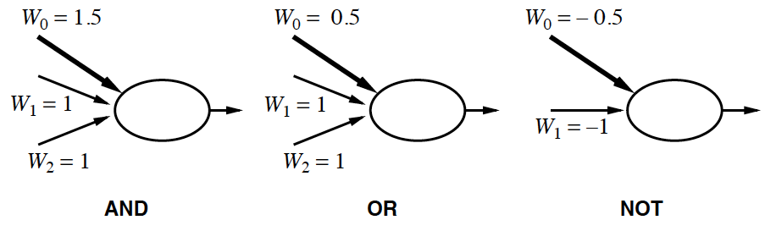
Comparison to logic
Can replicate logic gates with nodes
Can compute any boolean logic statement with neural network
a₀ = -1
a₀ = -1
a₀ = -1

Slide 2
Back propagation
Search for a set of weights that reduces the error of the output nodes
Hidden nodes:
Each hidden node j is responsible for some of the error in each of the output nodes
The greater the weight, the more of the error the hidden node is responsible for
The more it should change
Gradient Descent

Slide 3
Back propagation
Initialize weights in network to small random numbers
Given an example (x, y), run the network
Propagate backwards
For each node j in output layer do: Δ_{j} = g’(in_{j}) × (y_{j} – a_{j})
For each layer l from L-1 to 1 do:
For each node i in layer l do: Δ_{i} = g’(in_{i})∑_{j} w_{i,j}∆_{j}
For each weight w_{i,j} in network do: w_{i,j} = w_{i,j} + (α × a_{i} × ∆_{j}) x -1
Repeat until some stopping criteria

Slide 4
Back propagation
Initialize weights in network to small random numbers
Given an example (x, y), run the network
Propagate backwards
For each node j in output layer do: Δ_{j} = g’(in_{j}) × (y_{j} – a_{j})
For each layer l from L-1 to 1 do:
For each node i in layer l do: Δ_{i} = g’(in_{i})∑_{j} w_{i,j}∆_{j}
For each weight w_{i,j} in network do: w_{i,j} = w_{i,j} + (α × a_{i} × ∆_{j}) x -1
Repeat until some stopping criteria
input
output
Derivative of activation
Difference between output node
activation and the answer
Weight update

Slide 5
Setting up a neural network learning problem
Decide structure
Perceptron network
Multilayer network
Multilayer usually has one hidden layer
How many hidden nodes?
Each layer fully connected to the next layer
Decide learning algorithm
Back propagation
Other forms of gradient descent or hill-climbing

Slide 6
How to train
Epoch: feed each <x_{i}, y_{i}> data point through the neural network and backpropagate error
Each data point will result in a change in weights
Data point 2 may cause weight changes to undo the changes for data point 1
Solution: run multiple epochs

Slide 7
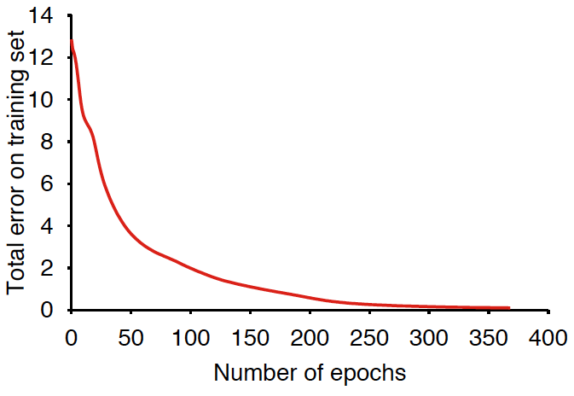
Error decreases to zero – converges to a perfect fit on training data
Continue to run epochs until total error on training set converges

Slide 8
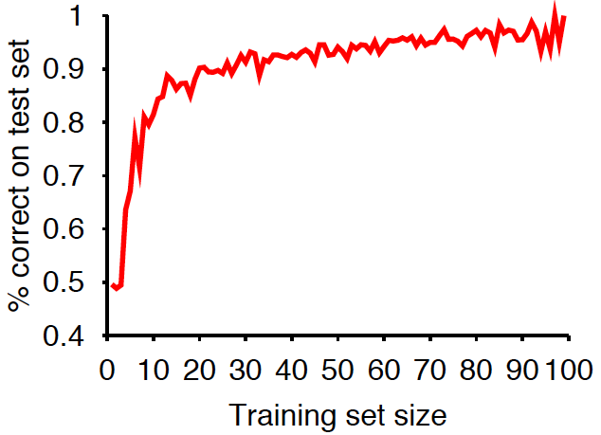
How to train
Good practice is to test network periodically
Training set: used to train the network
Testing set: held out and only used to test

Slide 9
How do we assess?
How do we know h ≈ f?
A learning algorithm is good if it produces hypotheses that do a good job of predicting decisions/classifications from unseen examples
Collect a large set of examples (with answers)
Divide into training set and test set
Use training set to produce hypothesis h
Apply h to test set (w/o answers)
Measure % examples that are correctly classified
Repeat 2-4 for different sizes of training sets, randomly selecting examples for training and test
Vary size of training set m
Vary which m examples are training

