Slide 1
Multisettings Training Lab

Slide 2
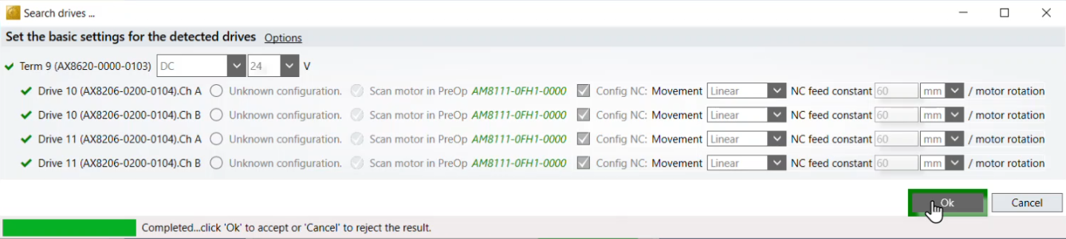
Multisettings Training Lab
Base Project Preparation
Create a new XAE solution
Connect to your CX
Scan in your test hardware
Configure both AX8000s with Drive Manager 2
Scan in Motors and scale to 60mm

Slide 3
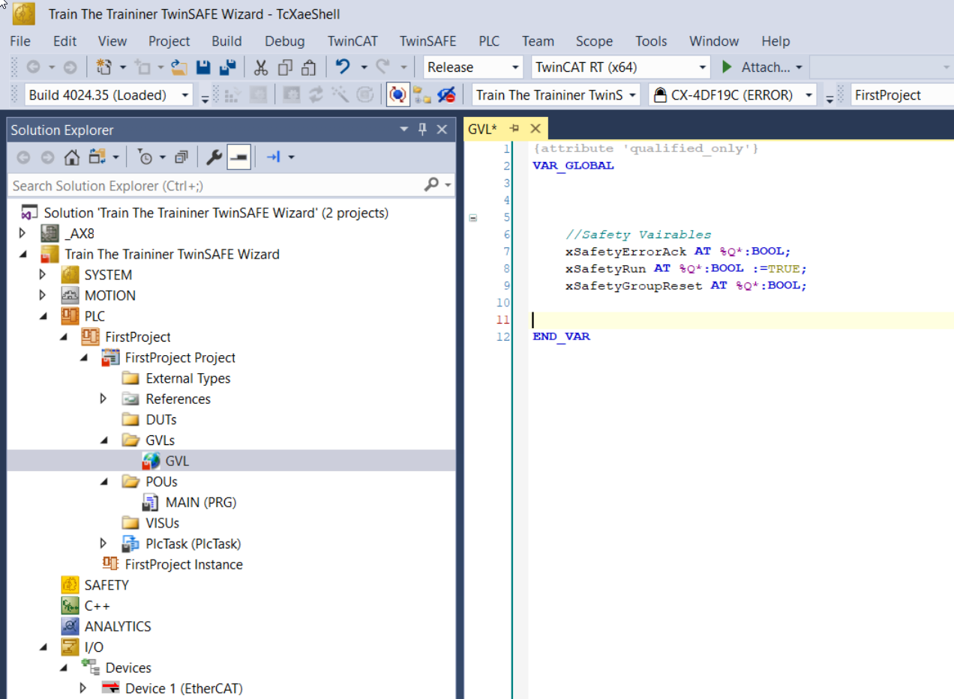
Multisettings Training Lab
Add a new PLC project.
Create a GVL with these three outputs variables:
xSafetyErrorAck AT %Q*:BOOL;
xSafetyRun AT %Q*:BOOL :=TRUE;
xSafetySLS AT %Q*:BOOL;
Re-build

Slide 4
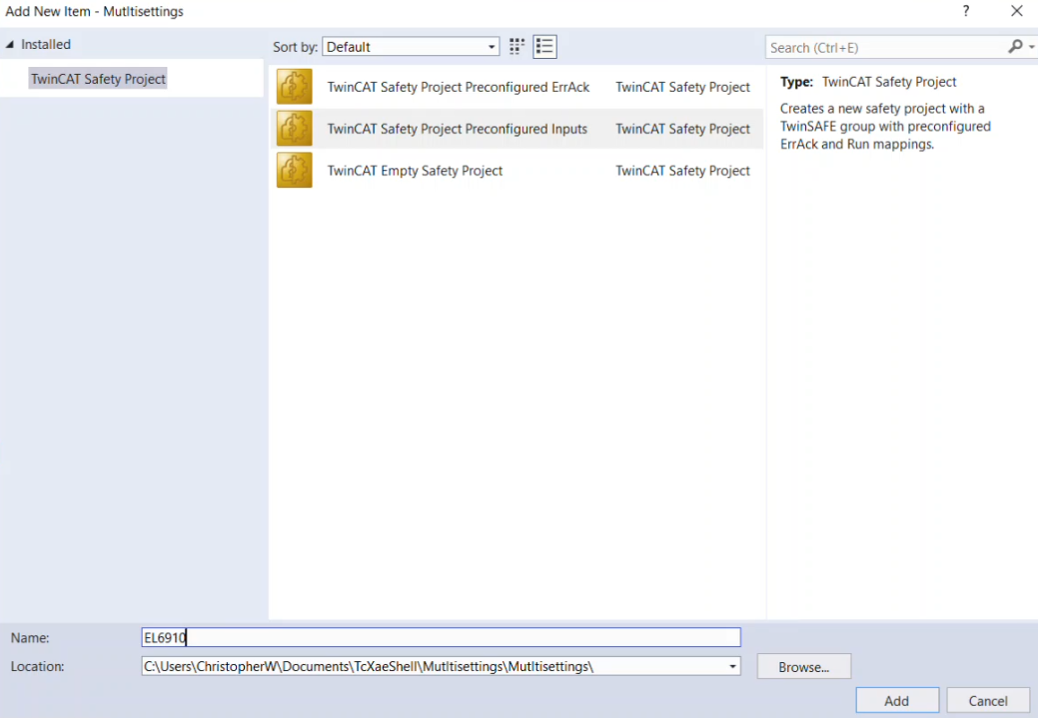
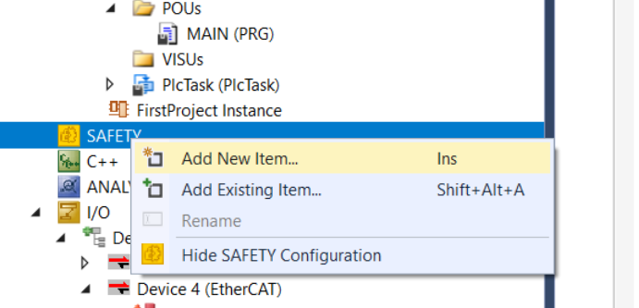
Multisettings Training Lab
Add a new safety project with the following name
“EL6910”

Slide 5
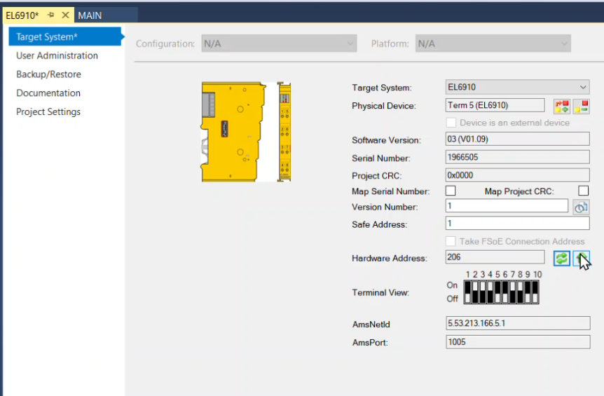


Multisettings Training Lab
Configure the Target System.
Make sure the Safe Address matches Hardware address

Slide 6
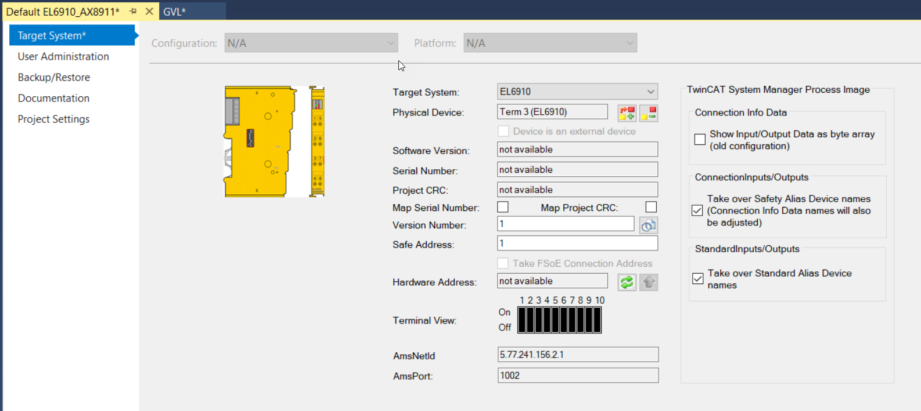
Multisettings Training Lab
Set the two checkmarks in the target system area
Without the checkmarks there is no visible traceability
With these checkmarks, an exact interpretation of the links are possible!!!
Save-All
NOTE: Top checkmark is for TwinCAT 2 imported projects

Slide 7
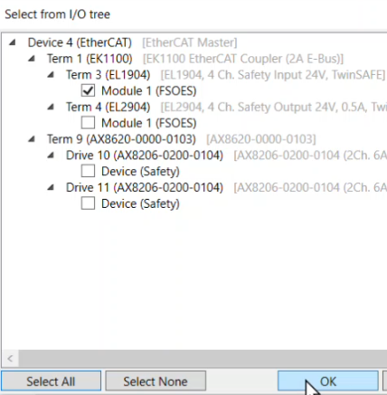
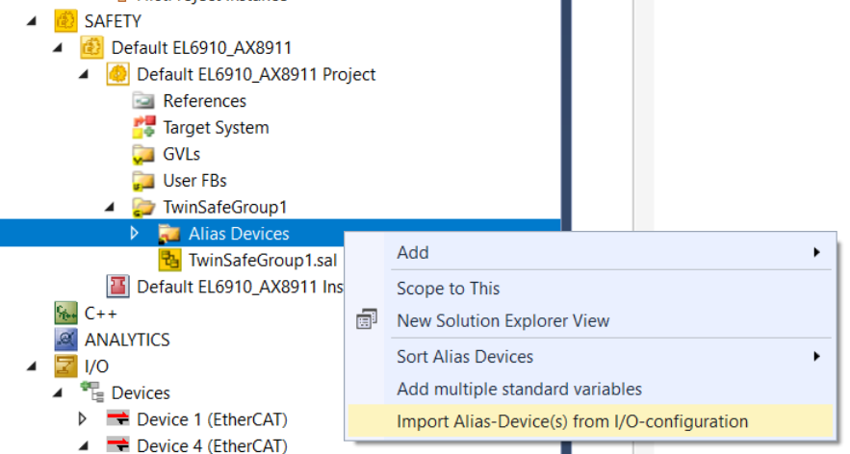
Multisettings Training Lab
Import EL1904 alias device.

Slide 8
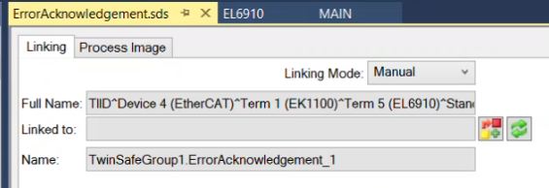
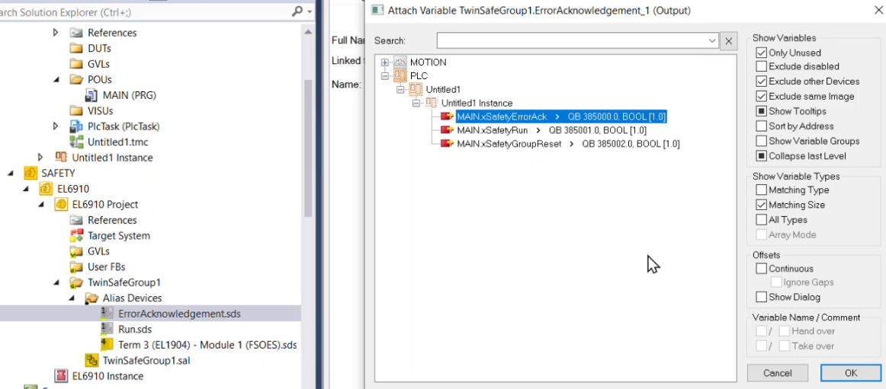
Multisettings Training Lab
Link Error Acknowledgement and Run to PLC variables.

Slide 9
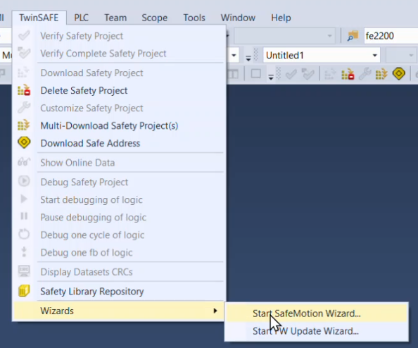
Multisettings Training Lab
Save-All
Start the SafeMotion Wizard

Slide 10
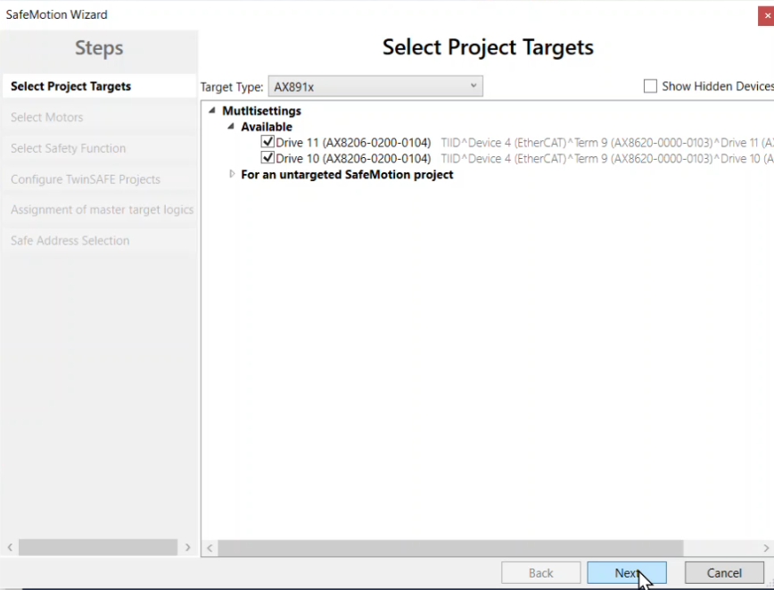
Multisettings Training Lab
Select the drives we want to use for Multisettings.

Slide 11
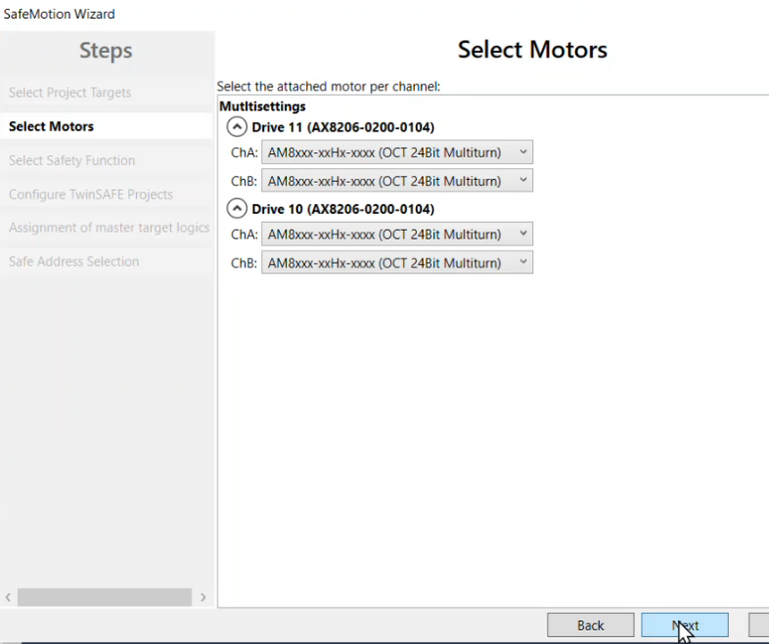
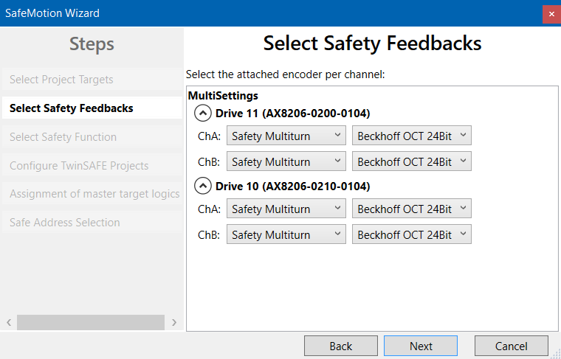
Multisettings Training Lab
Select the encoder types for ChA and ChB
If you see the old TE9000 window, we have a newer version available on our Beckhoff website.
Old TE9000
New TE9000

Slide 12
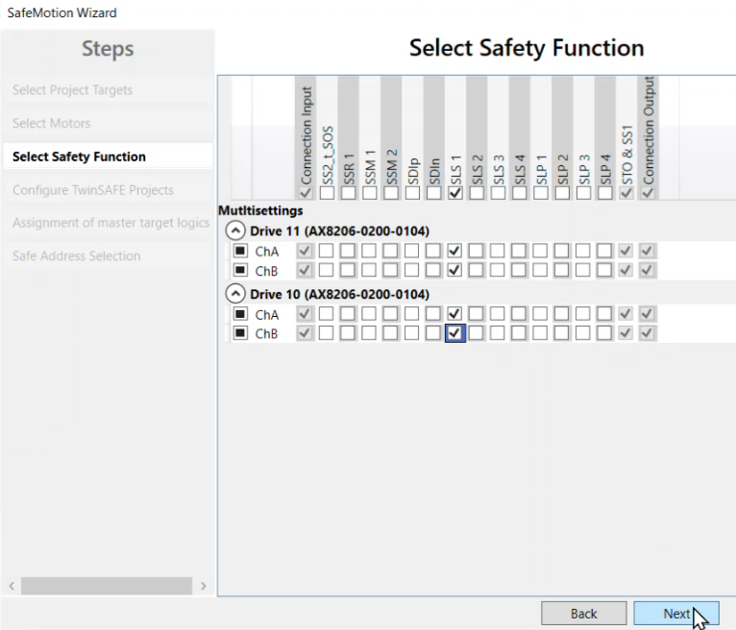
Multisettings Training Lab
Select SLS1 for each motor.

Slide 13
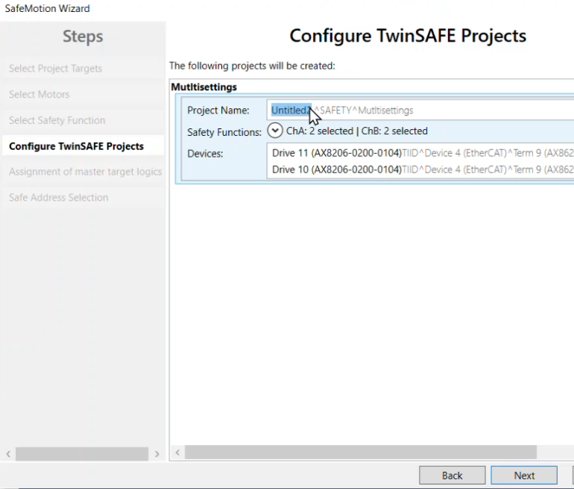
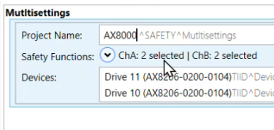
Multisettings Training Lab
Change the project name to AX8000.

Slide 14
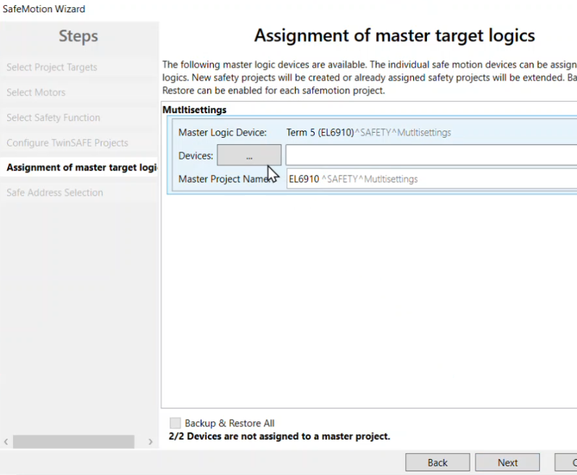
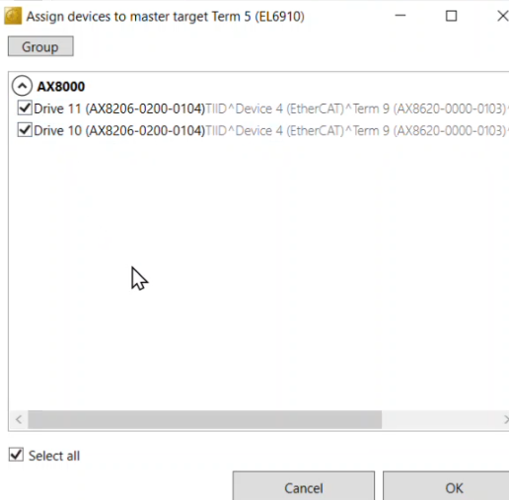
Multisettings Training Lab
Assign additional logic devices to our master EL6910

Slide 15
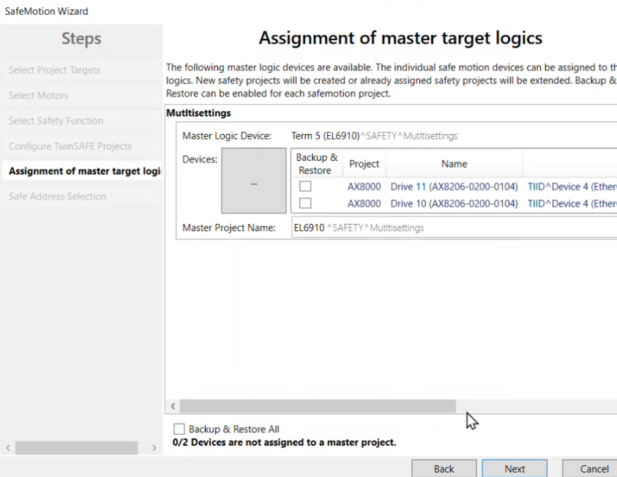
Multisettings Training Lab
We can see the result of our selections.
Our master logic device is EL6910
Our master project is the EL6910 project.
Wizard will build additional projects with our selected Devices.
Additional projects will communicate back to a Master project/logic device. EL6910 in this case.

Slide 16
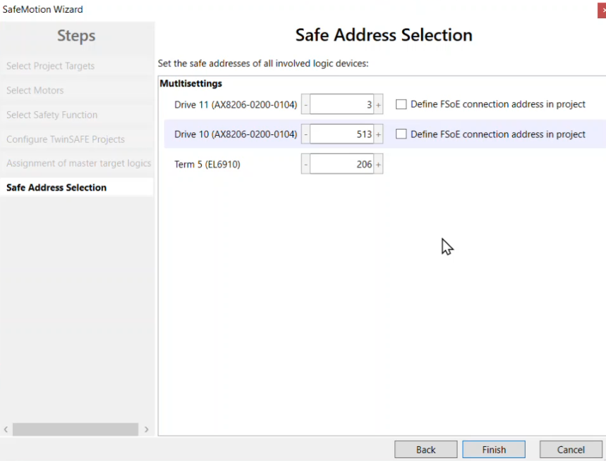
Multisettings Training Lab
Finally, we have the option to set the Safe Addresses for the logic devices.
Keep defaults and click finish.
Note:
If the system is offline the safe addresses must be setup manually.

Slide 17
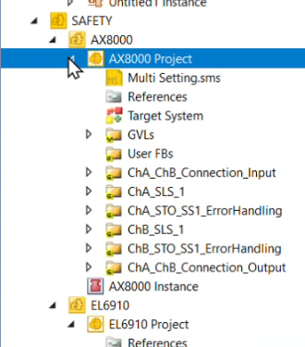
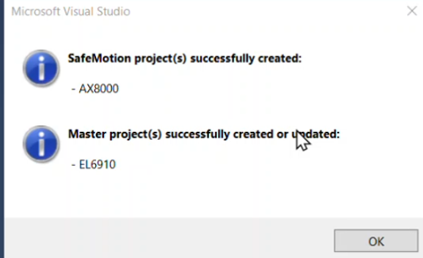
Multisettings Training Lab
A pop up lets you know the projects were created successfully.
Our AX8000 project has now been created.

Slide 18
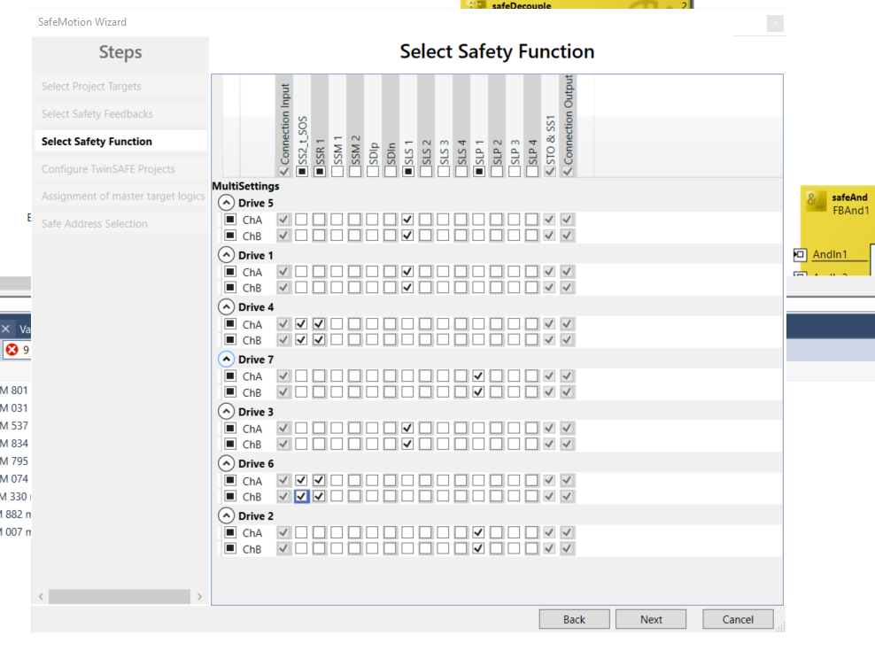
Multisettings Training Lab
Example…
Drives with the same selected functions will be grouped together in the coming steps

Slide 19
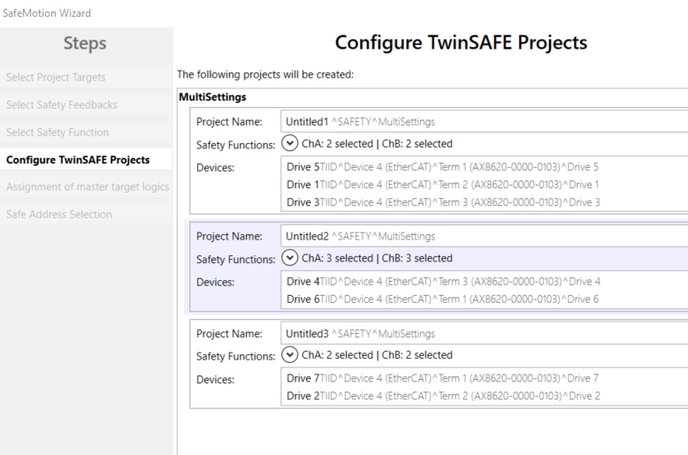
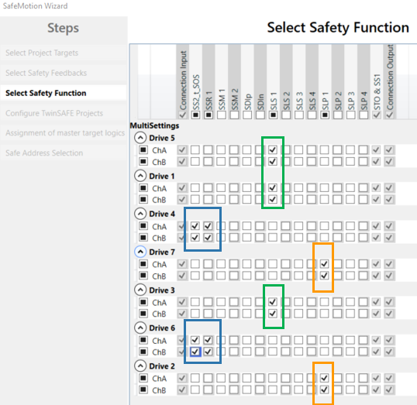
Multisettings Training Lab
Example continued…
Notice the grouping of the drives from the previous example.

Slide 20
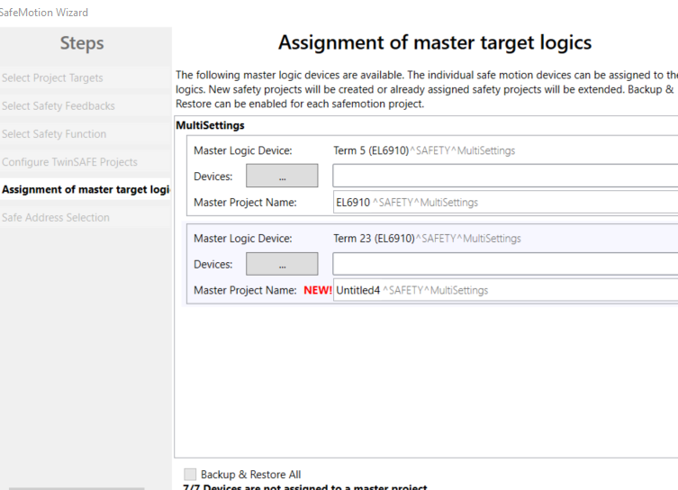
Multisettings Training Lab
Example continued…
In this scenario, we have two EL6910s in the IO. One of them already has a safety project configured. The other does not.
The EL6910 that does not have a safety project configured yet stands out with NEW!

Slide 21
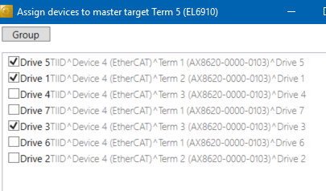
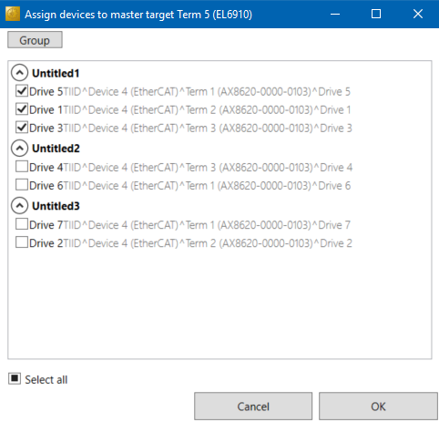
Multisettings Training Lab
Example continued…
Group setting is something we still need clarification on.
In this I show a picture of no groups, once I selected Drive 5, the wizard will automatically check the boxes for Drive 1 and Drive 3.
This is because of our Functions that we previously selected.

Slide 22
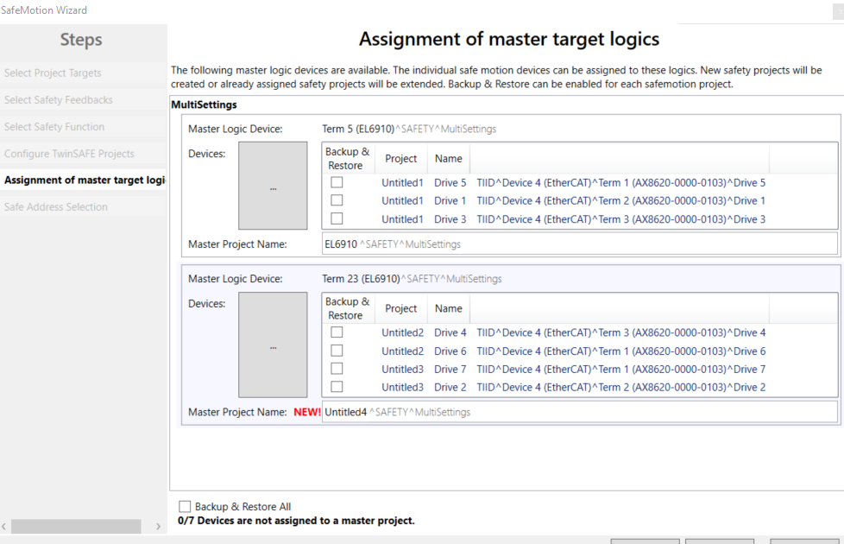
Multisettings Training Lab
Example continued…
Project groups are being retained and shown here with their applicable EL6910 masters assigned.
Determines the Custom FSOE Connection alias linking.

Slide 23
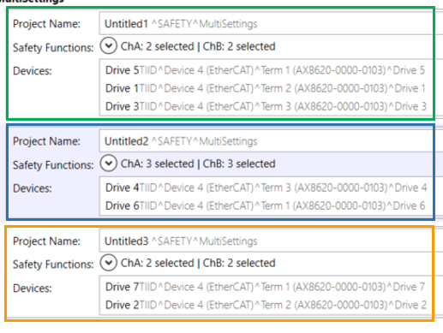
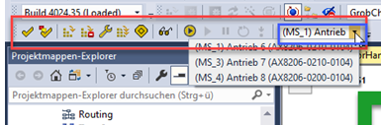
Multisettings Training Lab
Example conclusion…
3 projects would be created.
Each project will have drives associated with the project function blocks.
When navigating in online view, you can select from a dropdown to navigate between the various drives and their online function block data.
This dropdown should NOT be used for development and should be treated as READ-ONLY. Any changes made in a .SAL will only change the Target System drive.
After this wizard is complete, changes made to subsequent drives FBs shall be made in the Multi-Settings.sms file.
Further explanation in later slides.

Slide 24
Multisettings Training Lab
PAUSE
How are we doing?
Any questions so far?
Notes:
This is when the XAE crashed on us.

Slide 25
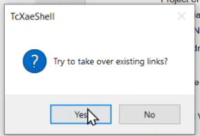
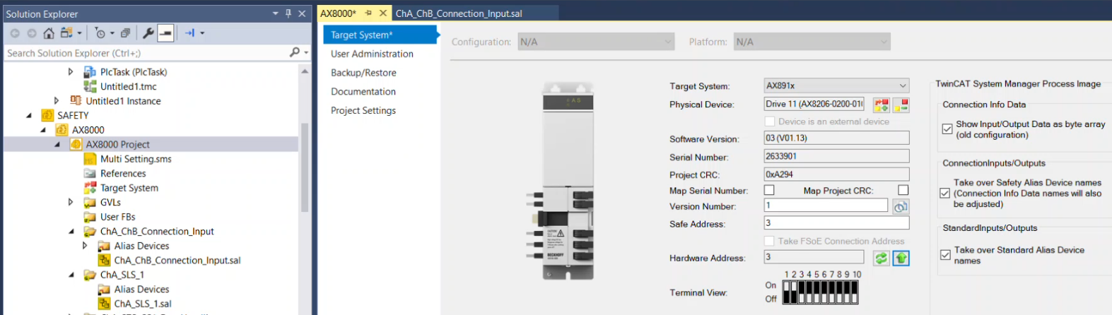
Multisettings Training Lab
Configure AX8000 project’s Target System.
Make Safe Address match Hardware Address.
Check boxes for Connection/Standard Inputs Outputs
Save-All
Click yes for taking over existing links

Slide 26
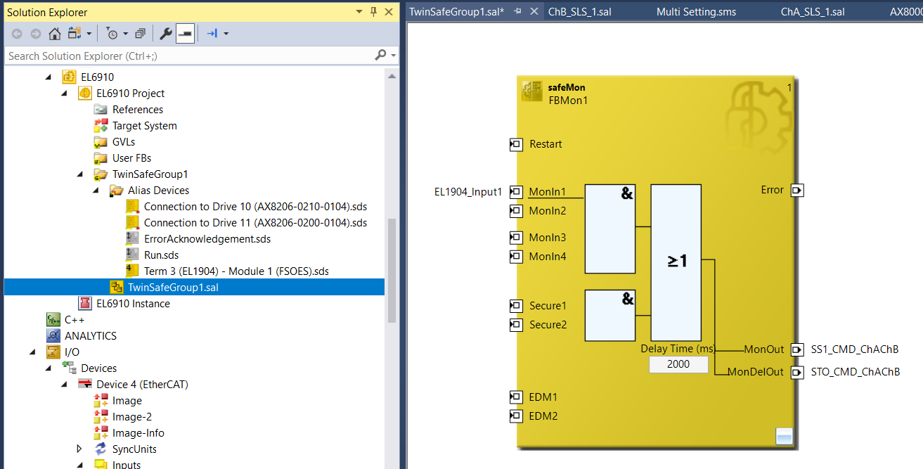
Multisettings Training Lab
Navigate back to the EL6910 .sal
Add safeMon block and variables, as shown below.
Notes:
This is when the XAE crashed on us.

Slide 27
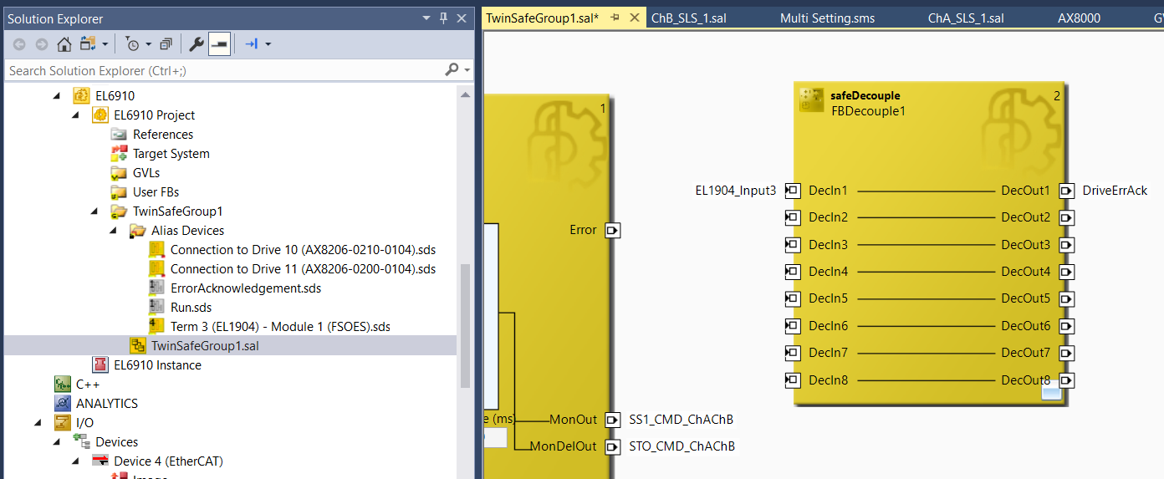
Multisettings Training Lab
Add a safeDecouple block
Add variables as shown below.
Notes:
This is when the XAE crashed on us.

Slide 28
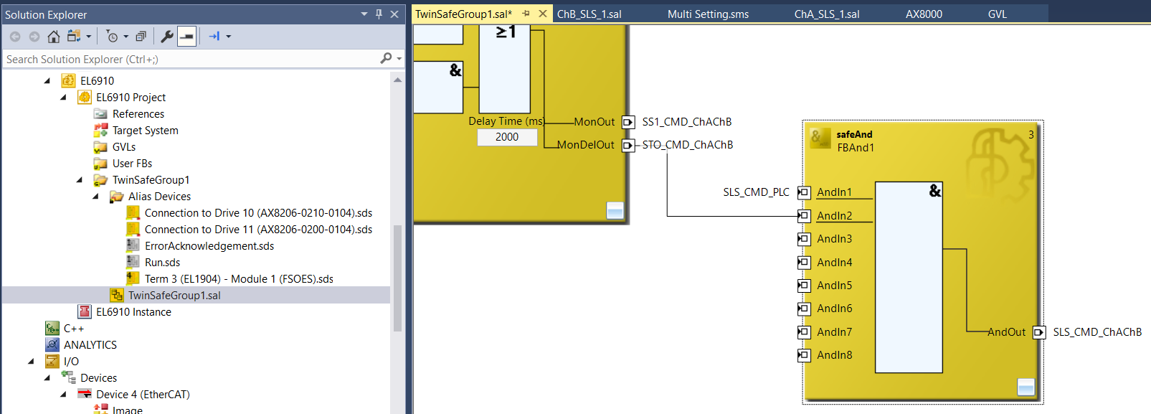
Multisettings Training Lab
Add a SafeAnd block
Add variables as shown below
Drag a link from SafeMon MonDelOut to the AndIn2 input on the SafeAnd block
Notes:
This is when the XAE crashed on us.

Slide 29
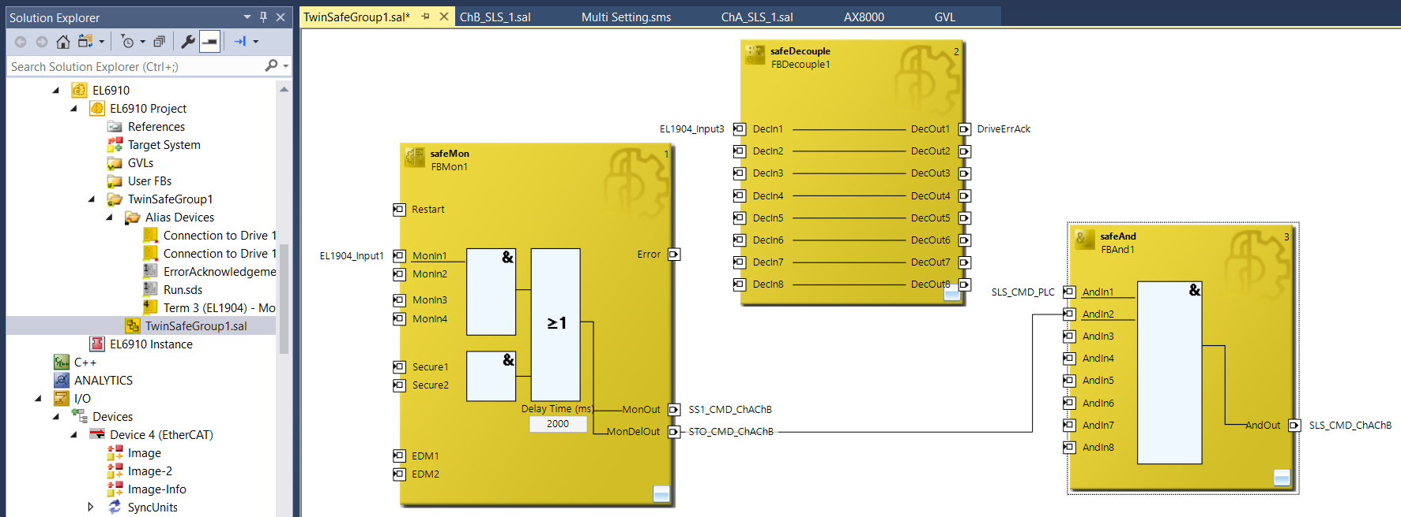
Multisettings Training Lab
EL6910 .sal result for reference.
Notes:
This is when the XAE crashed on us.

Slide 30
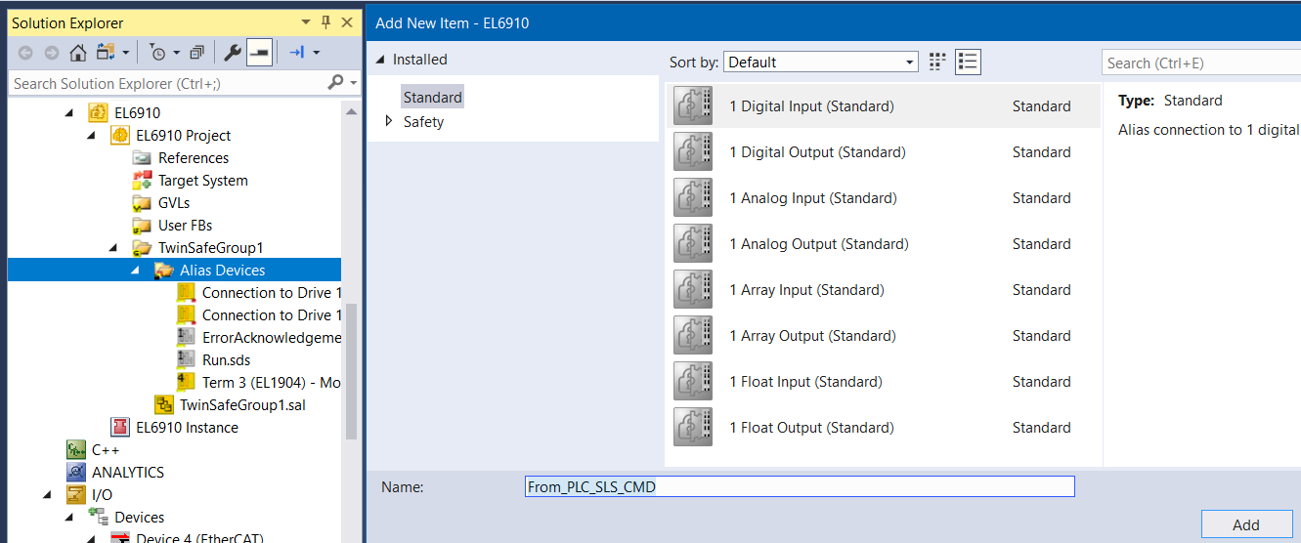
Multisettings Training Lab
Add a new digital input Alias named From_PLC_SLS_CMD
Notes:
This is when the XAE crashed on us.

Slide 31
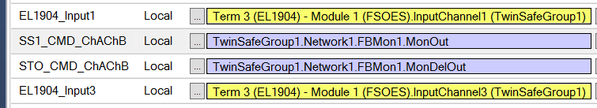
Multisettings Training Lab
Open the Variable Mapping tab for the EL6910 .sal
Map the EL1904 inputs
Notes:
This is when the XAE crashed on us.

Slide 32
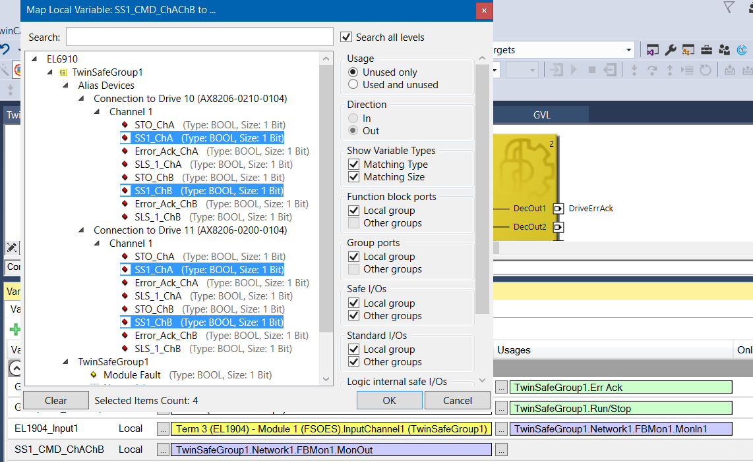
Multisettings Training Lab
Map the SS1_CMD_ChAChB
Notes:
This is when the XAE crashed on us.

Slide 33
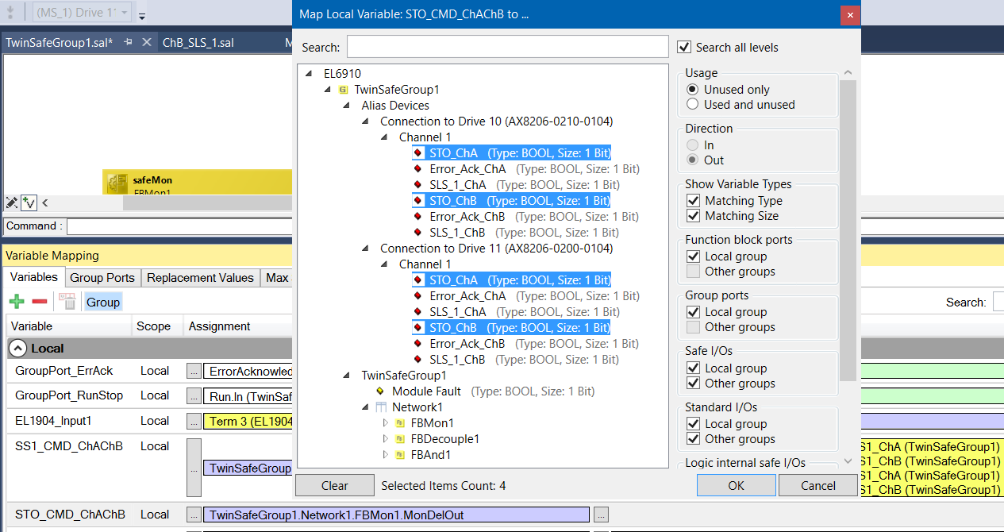
Multisettings Training Lab
Map the STO_CMD_ChAChB
Notes:
This is when the XAE crashed on us.

Slide 34
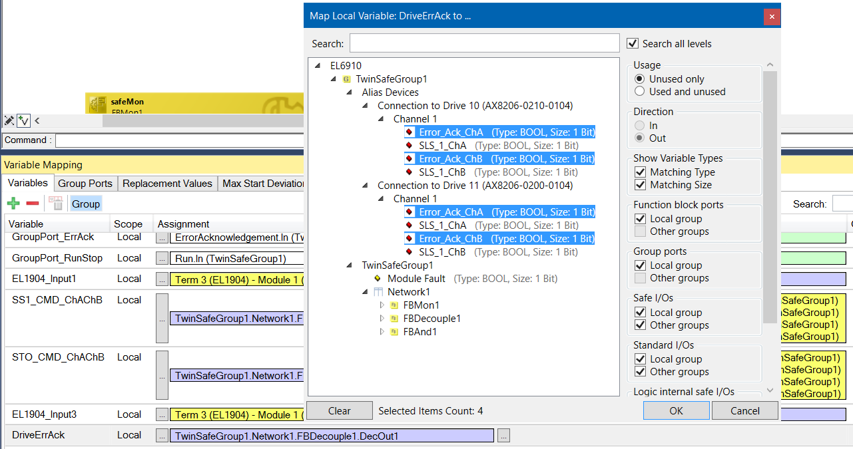
Multisettings Training Lab
Map the STO_CMD_ChAChB
Notes:
This is when the XAE crashed on us.

Slide 35
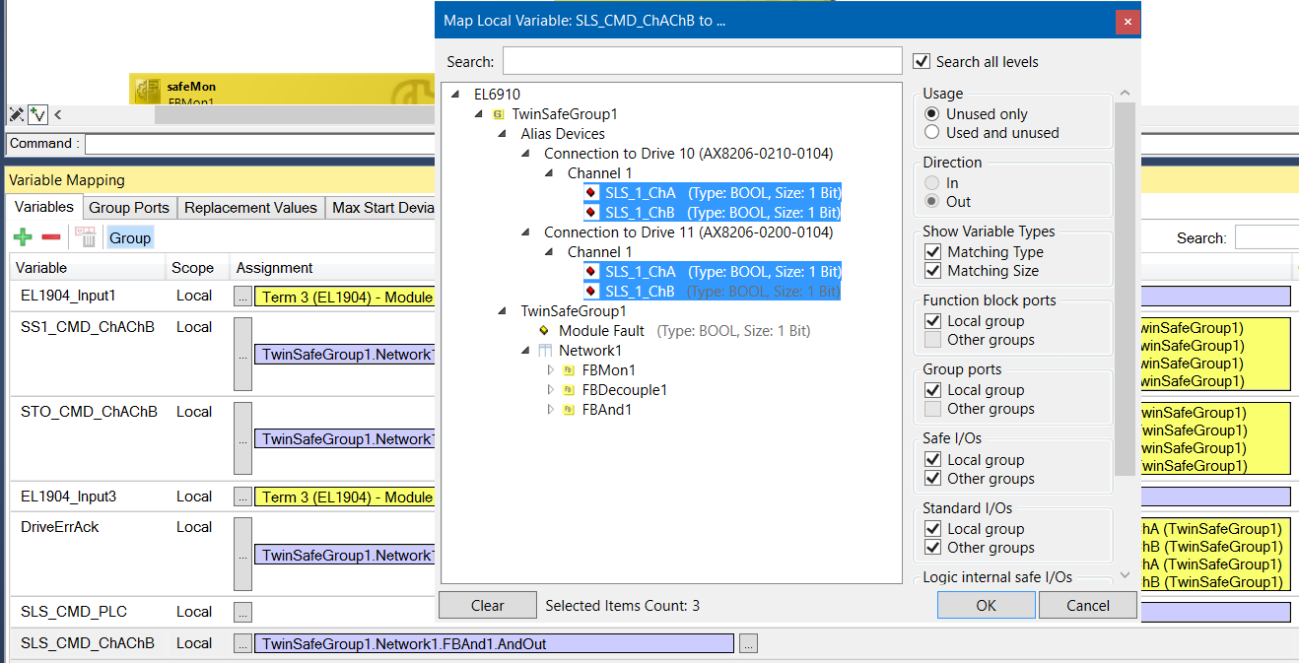
Multisettings Training Lab
Map the SLS_CMD_ChAChB
Notes:
This is when the XAE crashed on us.

Slide 36
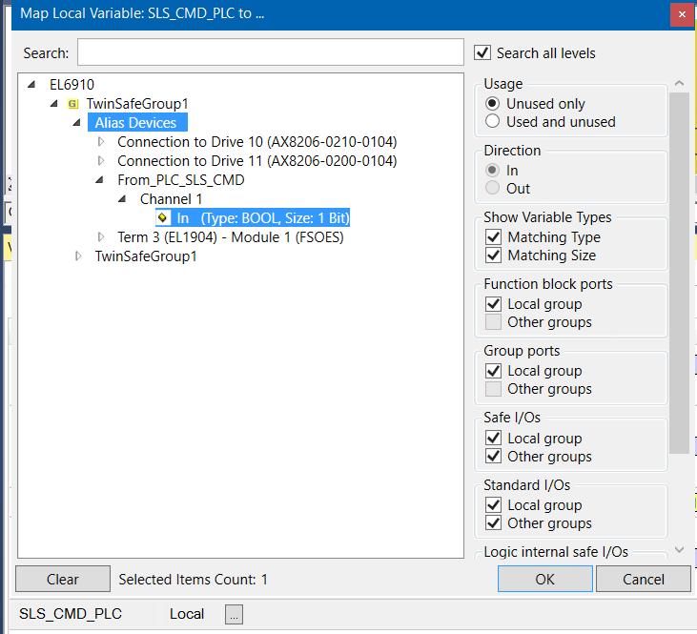
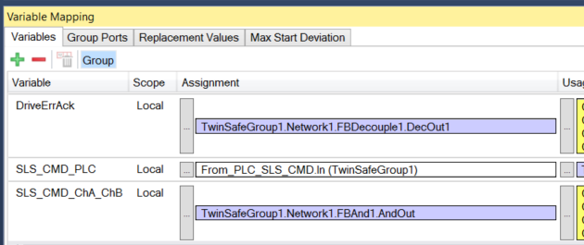
Multisettings Training Lab
Map the SLS_CMD_PLC to our PLC_SLS_CMD digital input alias
Notes:
This is when the XAE crashed on us.

Slide 37
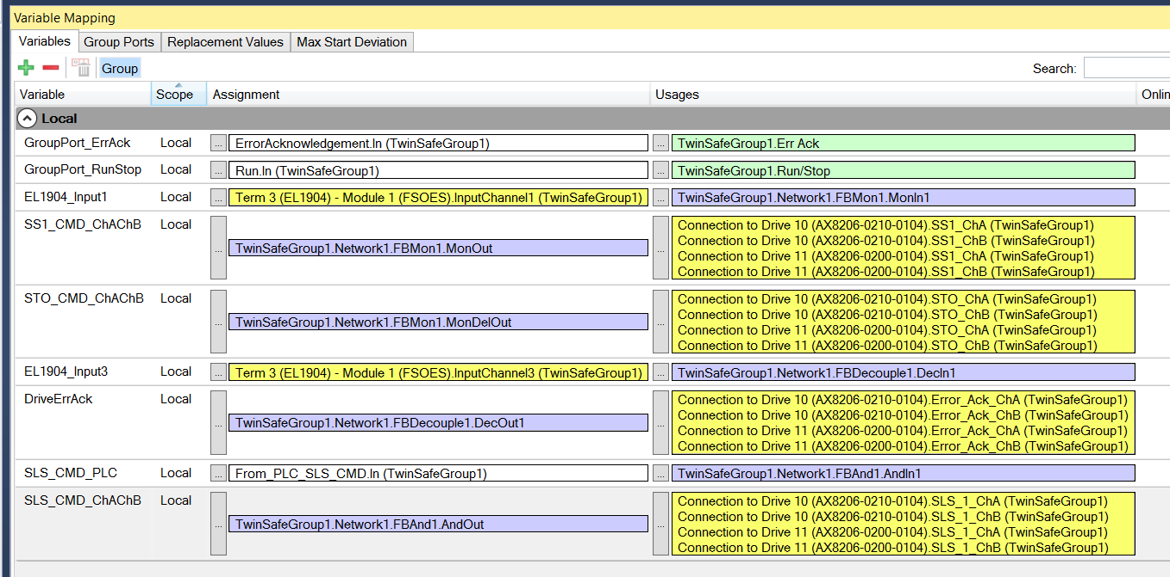
Multisettings Training Lab
Final look at the variable mappings for EL6910 project
Notes:
This is when the XAE crashed on us.

Slide 38
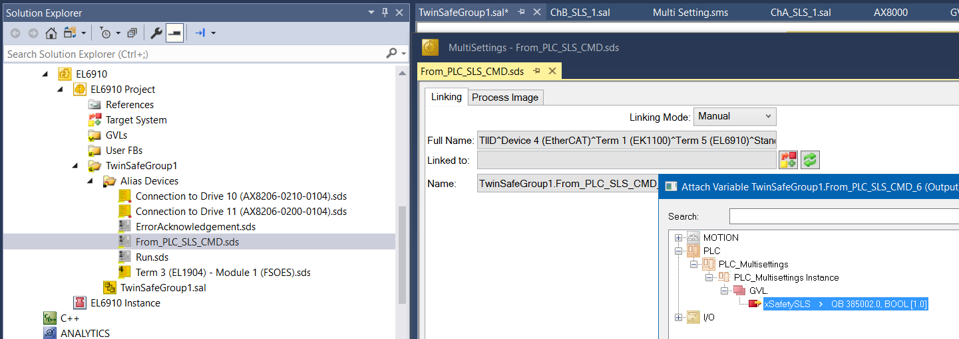
Multisettings Training Lab
Link the From_PLC_SLS_CMD.sds digital input to our PLC variable
Notes:
This is when the XAE crashed on us.

Slide 39
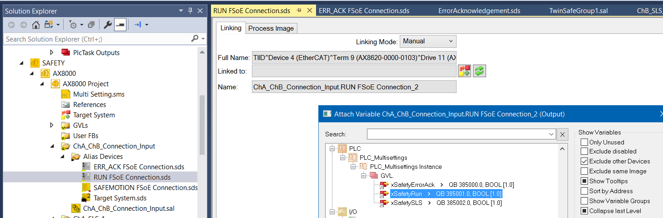
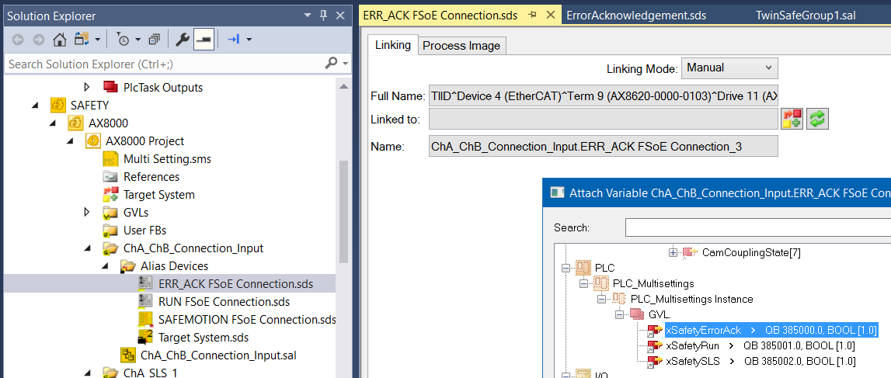
Multisettings Training Lab
Navigate to ChA_ChB_Connection_Input in the AX8000 project
Link the Run bit to PLC
Link the ErrAck bit to PLC
Notes:
This is when the XAE crashed on us.

Slide 40
Multisettings Training Lab
Now would be a good time to Save-All before continuing.
Notes:
This is when the XAE crashed on us.

Slide 41

Multisettings Training Lab
Navigate to ChA_SLS_1.sal
Input Min/Max values for the safeLimit
Save-All
Next two slides will help you determine the values needed.
Note: Pay attention to the min/max value placement. As the min is on top and the max is on bottom.
Some FBs this is reversed with max on top and min on bottom.

Slide 42



Multisettings Training Lab
Detailed view of SLS handling ChA
Function Block: SLS_1_Limit:
This function block is used to declare and monitor the speed limits for SLS-SafeMotion-Function if the Speed(ChA.PRIFB_VELOCITYMAX is in the limit range the output InLimit is TRUE
If it is outside the limit range the InLimit is FALSE
Scaling for the speed limits: 50RPM = = +/-3579140 inc/ms
2^32/inc/ms
1000
Function Block: SLS_1_Enabled:
This function block is responsible for handling the error response when the limits are exceeded or not reached.
ChA.SLS_1_CMD = FALSE→SLS-Function is active→Is controlled via the SAFEMOTION FSoE Connection object[SLS_1_CHA].
ChA.SLS_1_CMD = TRUE→SLS-Function is active→Is controlled via the SAFEMOTION FSoE Connection object[SLS_1_CHA].
Function:
If the SLS function is active by the ChA.SLS_1_CMD, the output of the function block [SLS_1_Enable] FALSE and SS1/STO is triggered in case of a limit override because the Input in the STO_SS1_ErrorHandling-Project [CHA_STO_SS1_ErrorHandling.STO_SS1_1.SAFEMOTION_ChA_1.AndIn1 (monIn4?) becomes False.
Function Block: INVERT_SLS_1_STATE_ChA:
This function blok is for the status generation of the SLS function.
ChA.SLS_1_STATE = TRUE→SLS-Function is active and speed is in the limit→Is forwarded to
SAFEMOTION FSoE Connection object[SLS_1_active_CHA].
ChA.SLS_1_STATE = FALSE→SLS-Function is not active and speed is in the limit→Is forwarded to
SAFEMOTION FSoE Connection object[SLS_1_active_CHA].

Slide 43

Multisettings Training Lab
Introduction to the SLS Calculator.

Slide 44

Multisettings Training Lab
Navigate to ChB_SLS_1.sal
Input Min/Max values for the safeLimit
Save-All
See next slide for explanation of min/max calculation
Note: Pay attention to the min/max value placement. As the min is on top and the max is on bottom.
Some FBs this is reversed with max on top and min on bottom.

Slide 45

Multisettings Training Lab
Introduction to the SLS Calculator.

Slide 46

Multisettings Training Lab
Introduction to Multi Settings.
Navigate to the Multi Setting.sms file in the AX8000 safety project

Slide 47

Multisettings Training Lab
Manually link FSOE data for our second drive.
See next slide

Slide 48

Multisettings Training Lab
Before we can link, we need to update the Process Image for the target system.
We do this with a simple button click below.

Slide 49

Multisettings Training Lab
Click the Refresh view button next
This will update the Multi Setting.sms values for our SLS function blocks and RUN/ERR_ACK links

Slide 50

Multisettings Training Lab
Now, we can link the ChA_ChB_Connection_Input for the second drive.
SAFEMOTION FSoE Connection Input
Uncheck the box for Excluding Same Image (if no links show up in dialog).

Slide 51

Multisettings Training Lab
Result should look like the image below.

Slide 52

Multisettings Training Lab
Now, we can link the ChA_ChB_Connection_Input for the second drive.
SAFEMOTION FSoE Connection Output

Slide 53

Multisettings Training Lab
Result should look like the image below.

Slide 54

Multisettings Training Lab
Scroll to the right and you should see the RUN/ERR_ACK links.
Should resemble the image below. If you do not see a link already for the first drive, hit the Refresh view button.
If they still do not show up for the first drive, double check your Alias linking for the RUN/ERR_ACK in the AX8000 project and try hitting the Refresh button again.

Slide 55



Multisettings Training Lab
Link the RUN and ERR_ACK to our PLC variables.

Slide 56



Multisettings Training Lab
Scroll to the right.
Input the SLS limit values for the second drive.

Slide 57


Multisettings Training Lab
Placing a different value for Drive 10’s ChA_SLS_1 Min/Max.

Slide 58
Multisettings Training Lab
Save-All
Multi-Download safety projects
Activate Configuration.
We are ready to test.

Slide 59

Multisettings Training Lab
Login to the PLC
Toggle PLC xSafetyErrorAck to True and back to False
Toggle PLC xSafetySLS to True
When xSafetySLS is true, we are bypassing the SLS functionality. So, it is NOT active. As you can see in the ChA_SLS and ChB_SLS files. Notice the SafeOr block needs either the PLC command or the inLimit bit.

Slide 60



Multisettings Training Lab
Navigate to ChA_SLS_1.sal
Login to see online values.
Notice we have Drive 11 selected.

Slide 61

Multisettings Training Lab
Logout of online view for Safety.
You will notice a new safety toolbar dropdown is available.
Select Drive 10

Slide 62

Multisettings Training Lab
While still in the ChA_SLS_1.sal file
Login to see online values again.
Notice we now have Drive 10 selected and can see its specific online values.

Slide 63

Multisettings Training Lab
Logout of online view.
Drive 10 is still selected in the dropdown.
But the values that are shown have switched back to Drive 11.

Slide 64


Multisettings Training Lab
Notice we only have 1 Safety project for 2 drives.
Our Target System is Drive 11.
The project is for Drive 11.
Drive 10 becomes an instance of Drive 11.

Slide 65

Multisettings Training Lab
Any changes in the project’s various .SAL files will only change Drive 11’s configuration.
Any changes for Drive 10’s SLS function blocks shall be done in the Multi settings.sms file.
The dropdown is for changing views of online data between drives.
It is the only way to view Drive 10’s online data.

Slide 66

Multisettings Training Lab
Moving on with the testing of SLS.
Navigate to Axis 1 in the NC and set the Enable

Slide 67


Multisettings Training Lab
Navigate to the Functions tab for Axis 1
Set the Start mode to Endless +
Set the Target Velocity to 11
Press start
Should run smoothly when the xSafetySLS PLC bit is turned to TRUE
Press the Stop button in the Functions tab

Slide 68

Multisettings Training Lab
Toggle the xSafetySLS PLC variable to FALSE.
Go back into the Functions tab for Axis 1
With the same settings (Endless + and Target velocity = 11)
Press Start
Axis should immediately STO
This is due to the velocity being higher than our configured SLS of 10mm/s

Slide 69

Multisettings Training Lab
Summary:
SafeMotionWizard’s Multi Settings allows the user the ability to configure multiple drives/motors at the same time.
Simplifies, expedites and points the users in the right direction to help setup their safety application
Simplifies development with less safety projects being needed. Instead utilizing one single file for duplicating projects with the ability to alter parameters.

