Slide 1
Carbon-Use Efficiency Predicts the
outcomes of Microbial Community
Coalescence
Jiayi Chen
02/07/2025

Slide 2
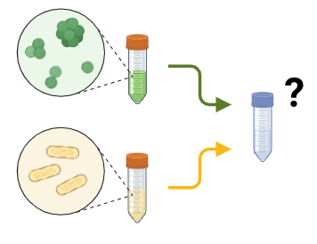
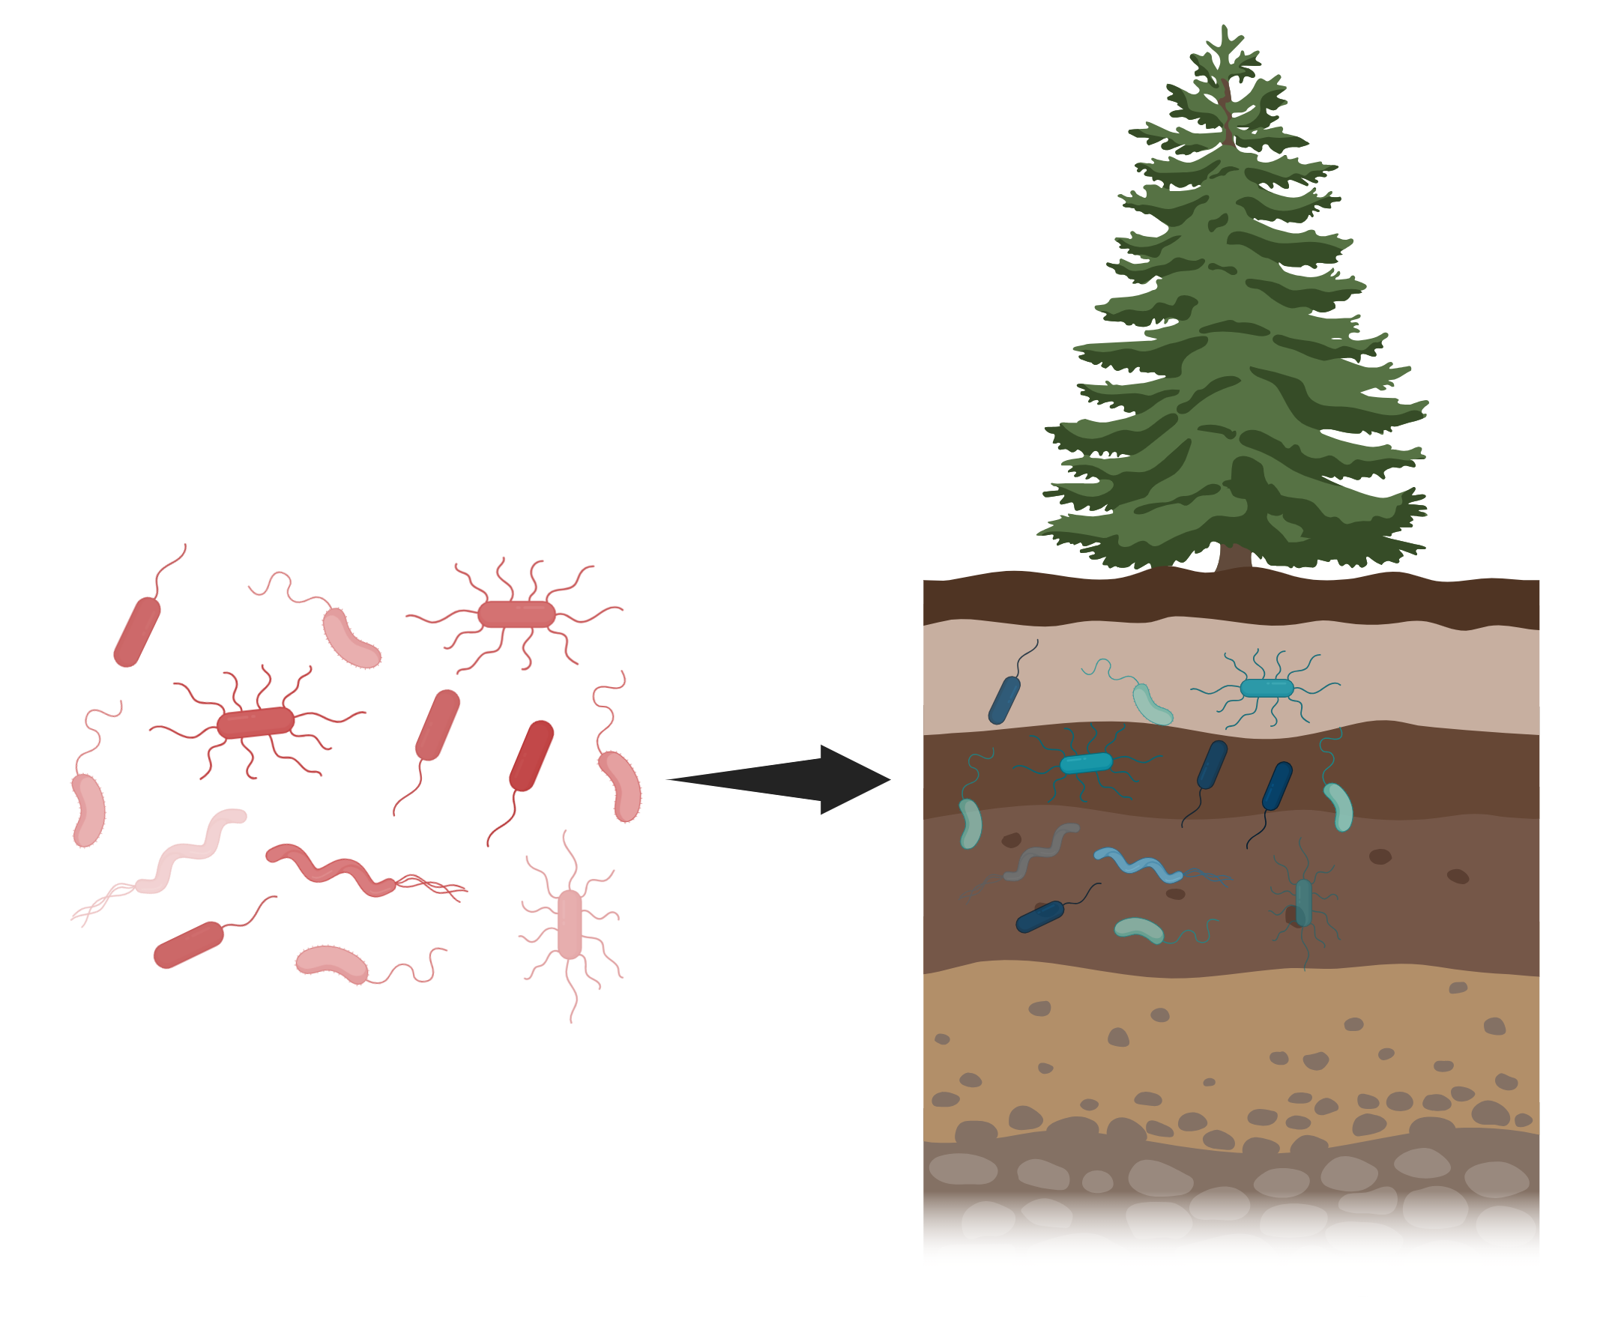

Introduction
Question
Can CUE be used to predict community "fitness" for coalescence?
Coalescence:
Hypothesis
After coalescence, Communities with higher overall CUE will be more dominant in descendent community.
This pattern arises from a positive correlation between species-level CUE and abundance.
The underlying mechanism is linked to community niche overlap or competitive interactions.
Carbon usage efficiency:
Notes:
Coalescence can result in approximately equal contributions from the founding communities or dominance of one community over another(Castledine et al., 2020). However, expectation of a particular result remains unknown. CUE is the intrinsic property of a given species and reflects a major component of its life history strategy to maximise fitness (Duan et al., 2024). It is verified that compositional differences are proportional to differences in function, as profiles of resource use are strongly correlated with composition. Therefore,

Slide 3
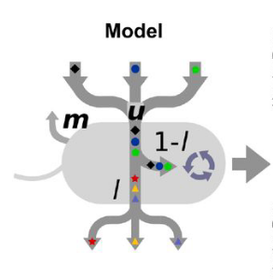
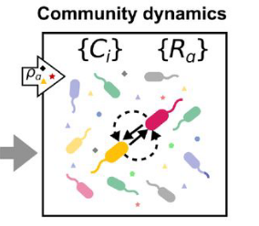
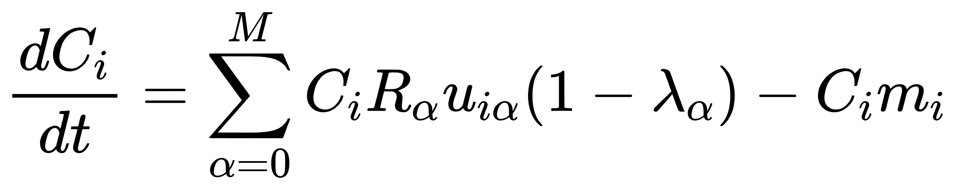
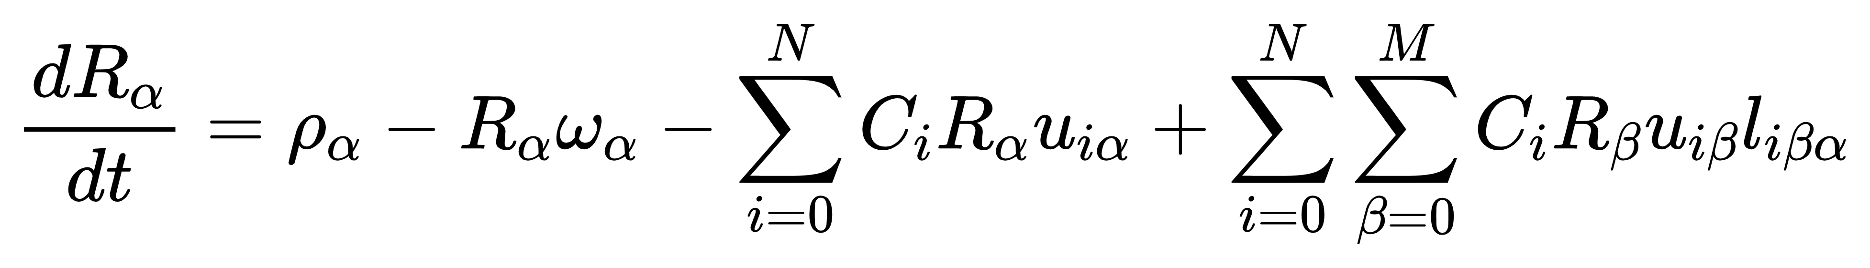
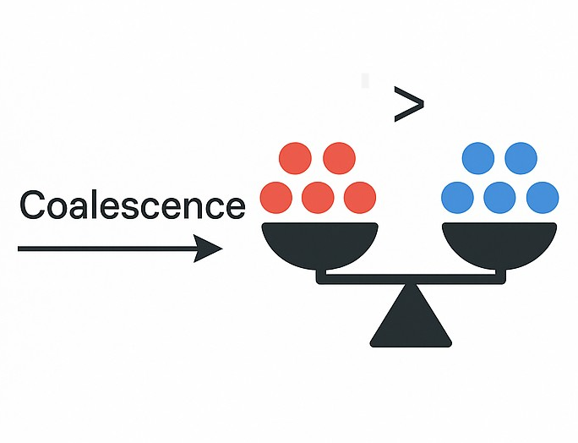
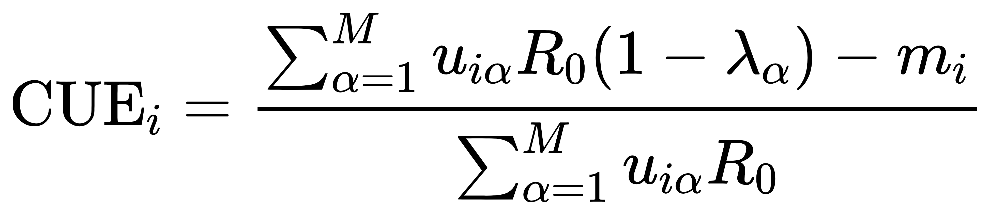
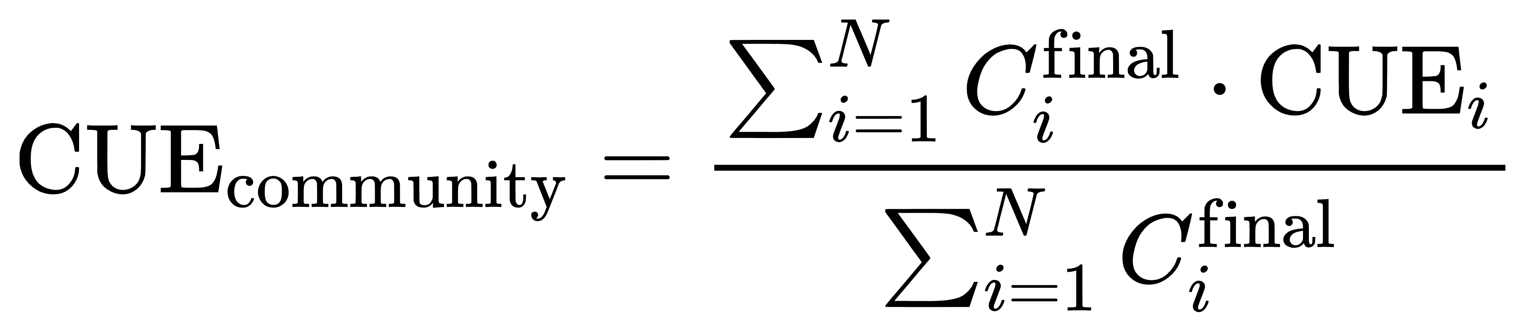
Methods
Microbial consumer resource model
ω
Community after coalescence
Calculate CUE
Species level:
Species level:
compare abundance
Community level :
Community level :

Slide 4
Assemble communities
Set a big pool and select from it according to indices
species pool contains N kinds of species
leakage matrices
......
row sum = λ
M types of resources
row sum = 1
N

Slide 5
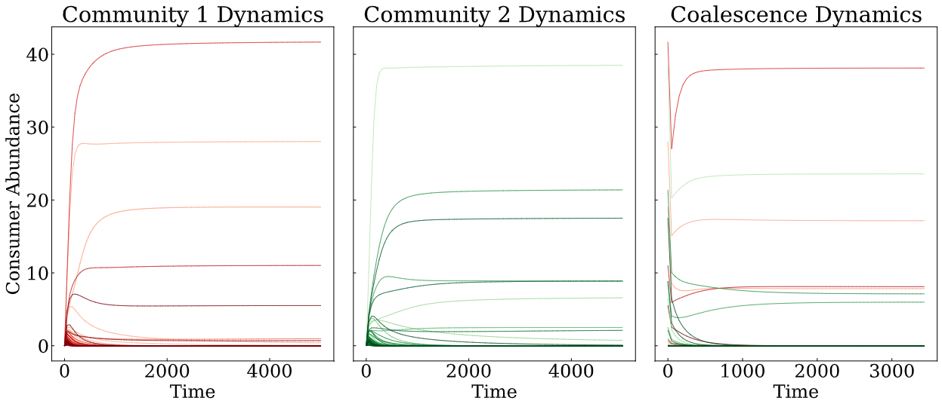
Results
Start from the equilibrium state of two parental communities
↑
Figure 1. Consumer abundance dynamics during community assembly and coalescence. Panels for Community 1 and Community 2 show the assembly processes, while Community 3 illustrates the dynamics during coalescence.

Slide 6
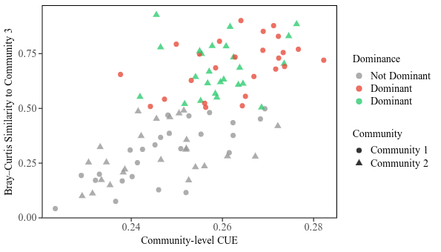
Community CUE and dominance
Figure 2. (a) Dominance as a function of community CUE. Community with higher CUE will be more dominant in the descendent community. (b) Similarity between parent and offspring communities. Community with higher CUE influence more on descendant community structure

Slide 7
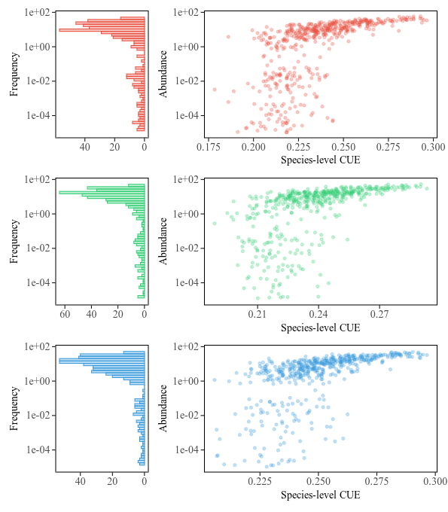
Species-level explanation
Coalescence was repeated 50 times
Figure 3. CUE-abundance relationship and Species abundance distribution. In species level, higher CUE species achieve higher abundance, with a certain ceilling. Community 3 exhibits a longer left shape, indicating a greater presence of rare species after coalescence.

Slide 8
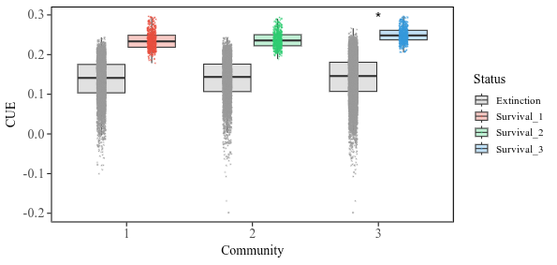
Species CUE distribution after assembly/coalescence
Figure 4. CUE of survival and extinct species in each communities. The increase of CUE in community 3 (blue) is because of the survival boundary levels up.

Slide 9
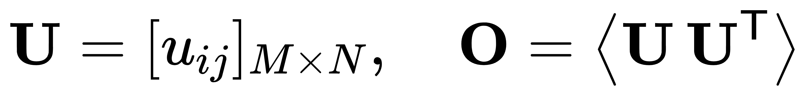
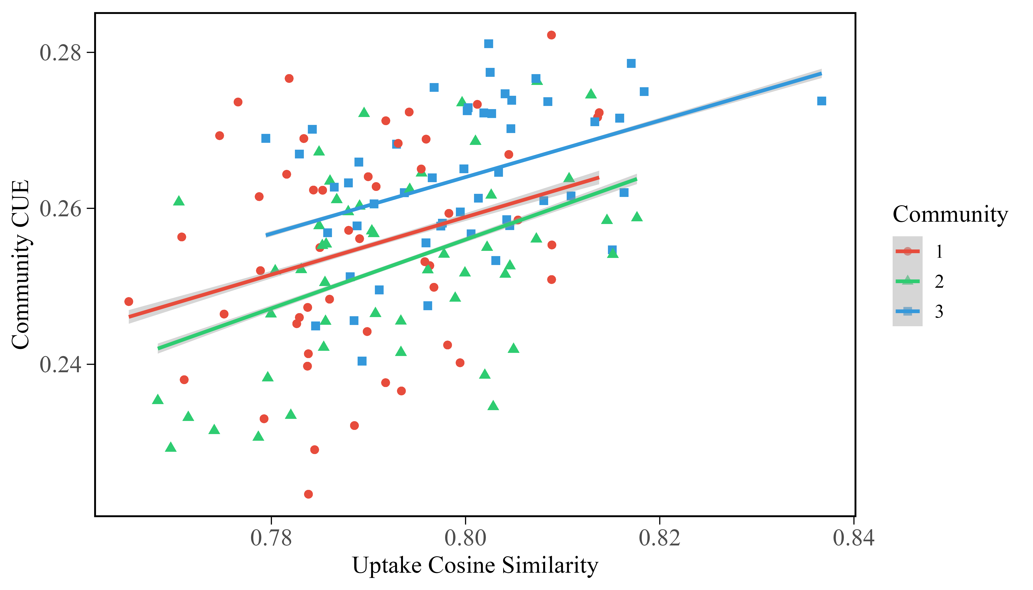
Machenism
Niche overlap
Figure 5. Community CUE as a function of niche overlap. There is a significant positive relationship across all three communities, suggesting high overlap in resource usage promotes higher Carbon usage efficiency.

Slide 10
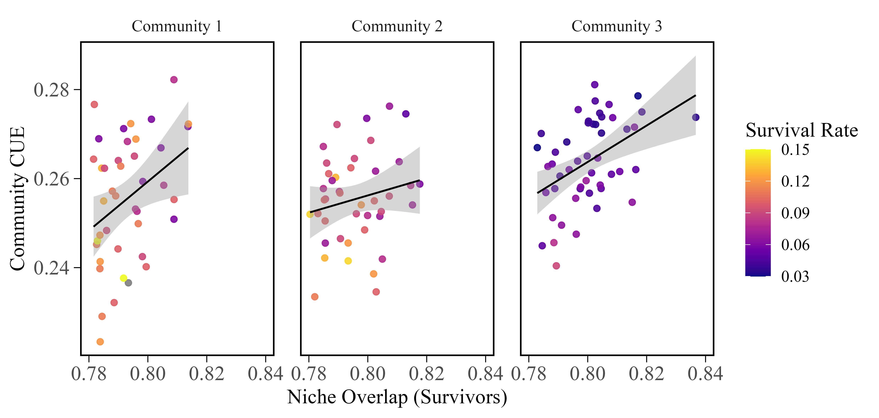

Slide 11
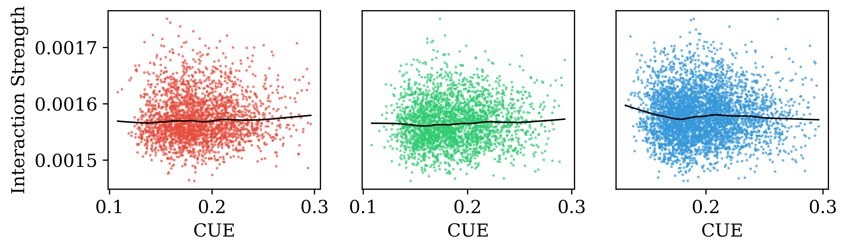
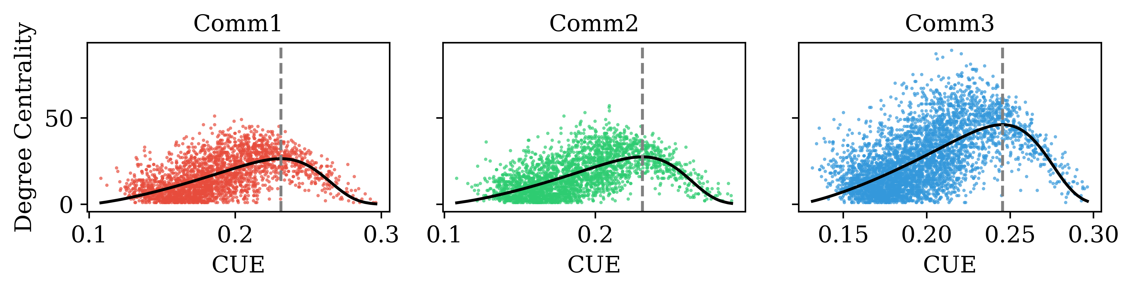
Species level Interaction and Centrality
Figure 6. (a) LOWESS fit of interaction strength as a function of species-level CUE for each community. No clear pattern found in this relationship. (b) Relationship between species–level CUE and degree centrality across 50 coalescence replicates. Guassian fit capture the unimodal relationship, with a similar peak for community 1 and 2.

Slide 12
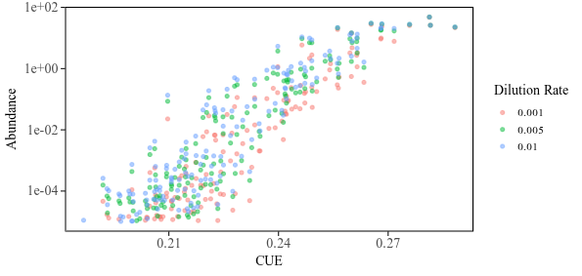
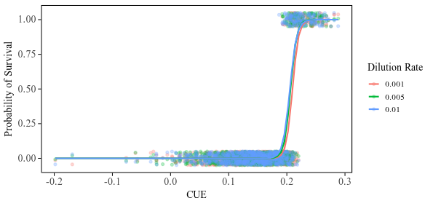

Slide 13
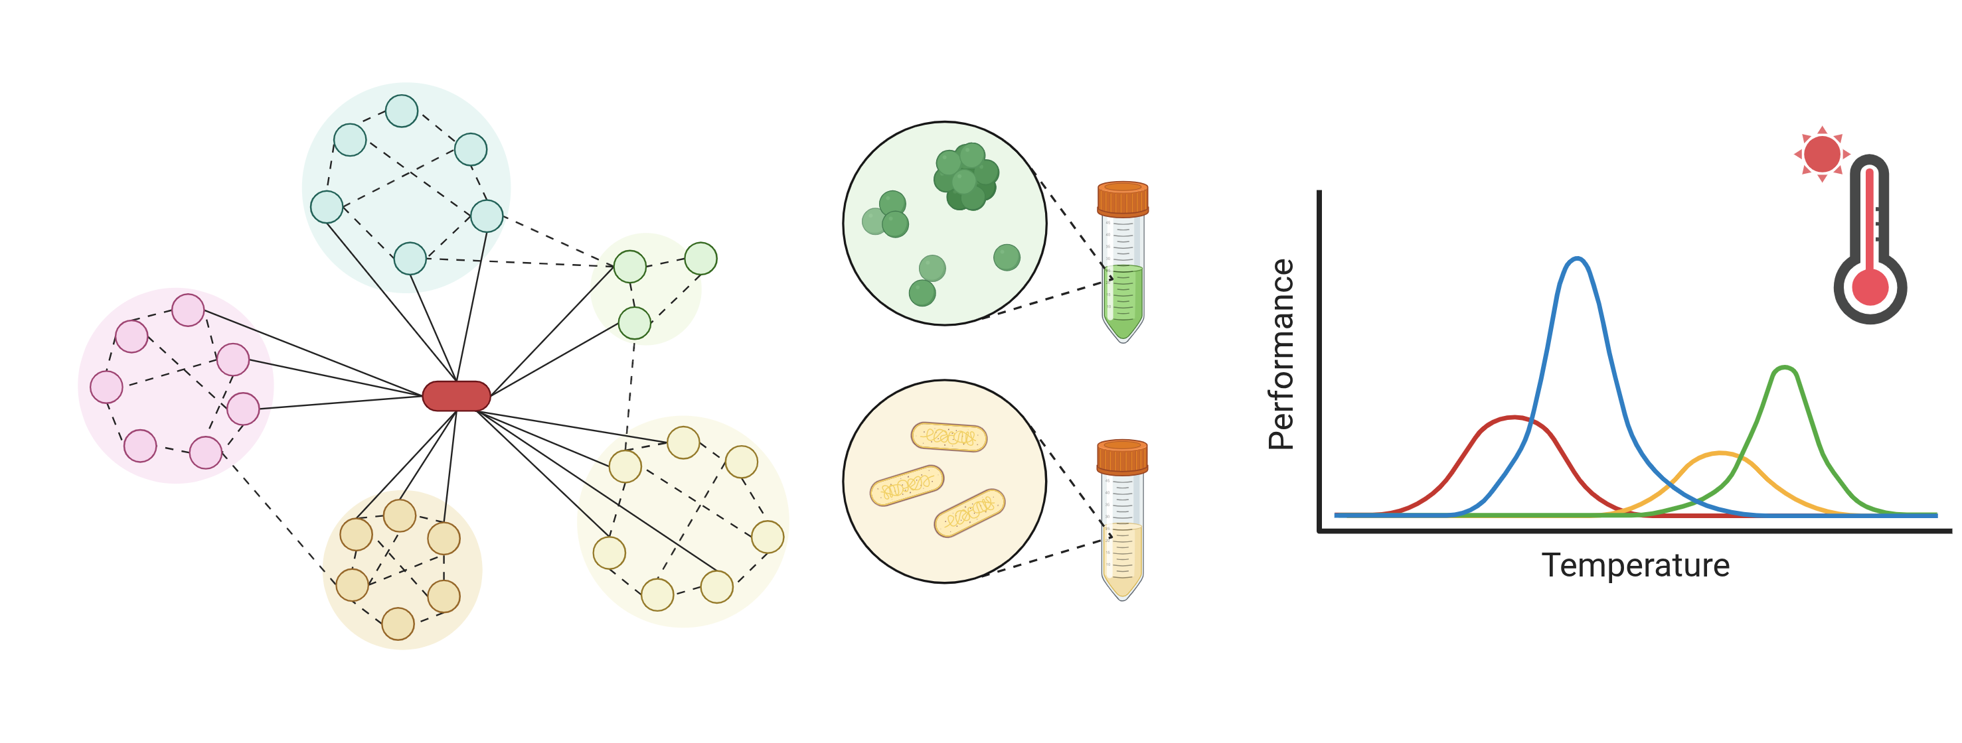
Conclusions
After coalescence, Communities with higher overall CUE are more dominant in descendent community.
Because in species level, there is a positive correlation between CUE and abundance.
The underlying mechanism of this is not that clear, since we didn't find the relationship between CUE with net competition and community level CUE as expected.
There exists unimodal connection between CUE and degree, indicating potential competitive exclusion pattern in our system.
Next step:
Try to explain the positive correlation between community CUE and niche overlap.
Find more support for the linkage between degree and CUE.

Slide 14
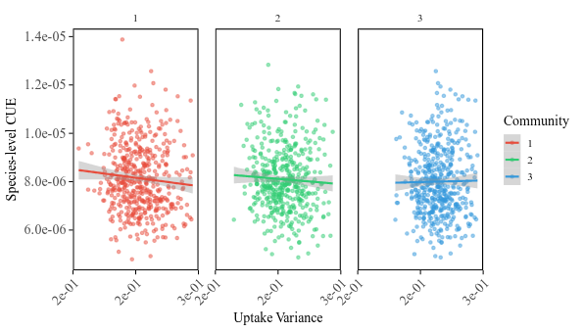
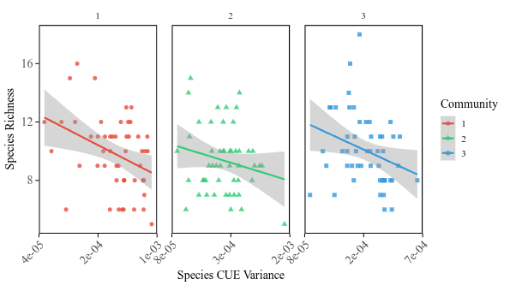

Slide 15
