Slide 1
Tree Microbiome:
16S Data Analysis with QIIME2 Pipeline

Slide 2
DADA2 Denoising Stats Summary
Default trunc-len-f and –r @ 240 and 160 produced bad results, so readjusted based on sequence length from data (301 bp) to 250 and 250. I tried 290 and 290 to keep longer sequence lengths, however, this produced lower merge rates and smaller sizes of feature tables. So, went with the truncation parameters of 250 and 250.
Also, the pre-trained SILVA classifier file had download issues. QIIME forum recommendation was to build your own classifier using RESCRIPt. So, I built my own classifier based on the primer sequences (515F and 806R: figured this out from the sequences in the data) that target the V4 region of the 16S rRNA gene.

Slide 3
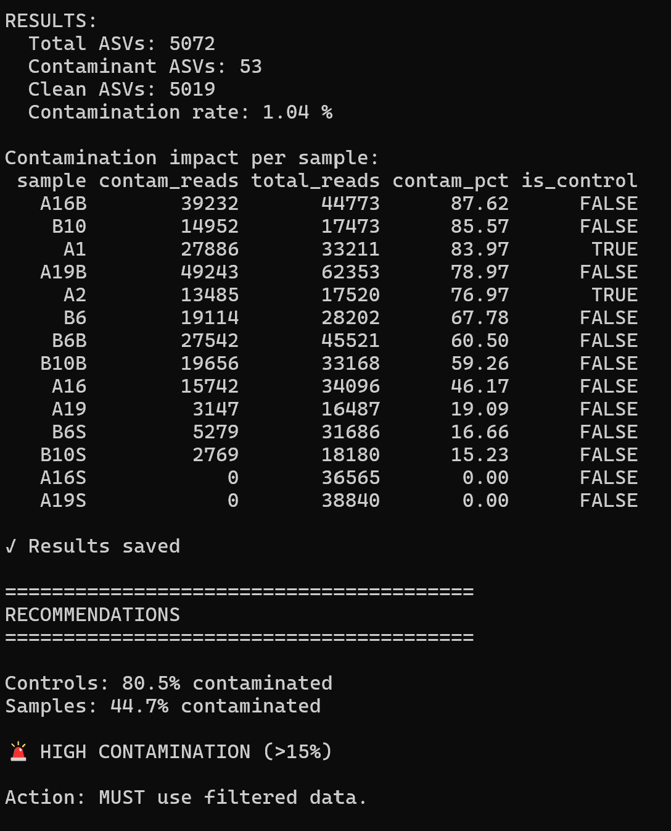
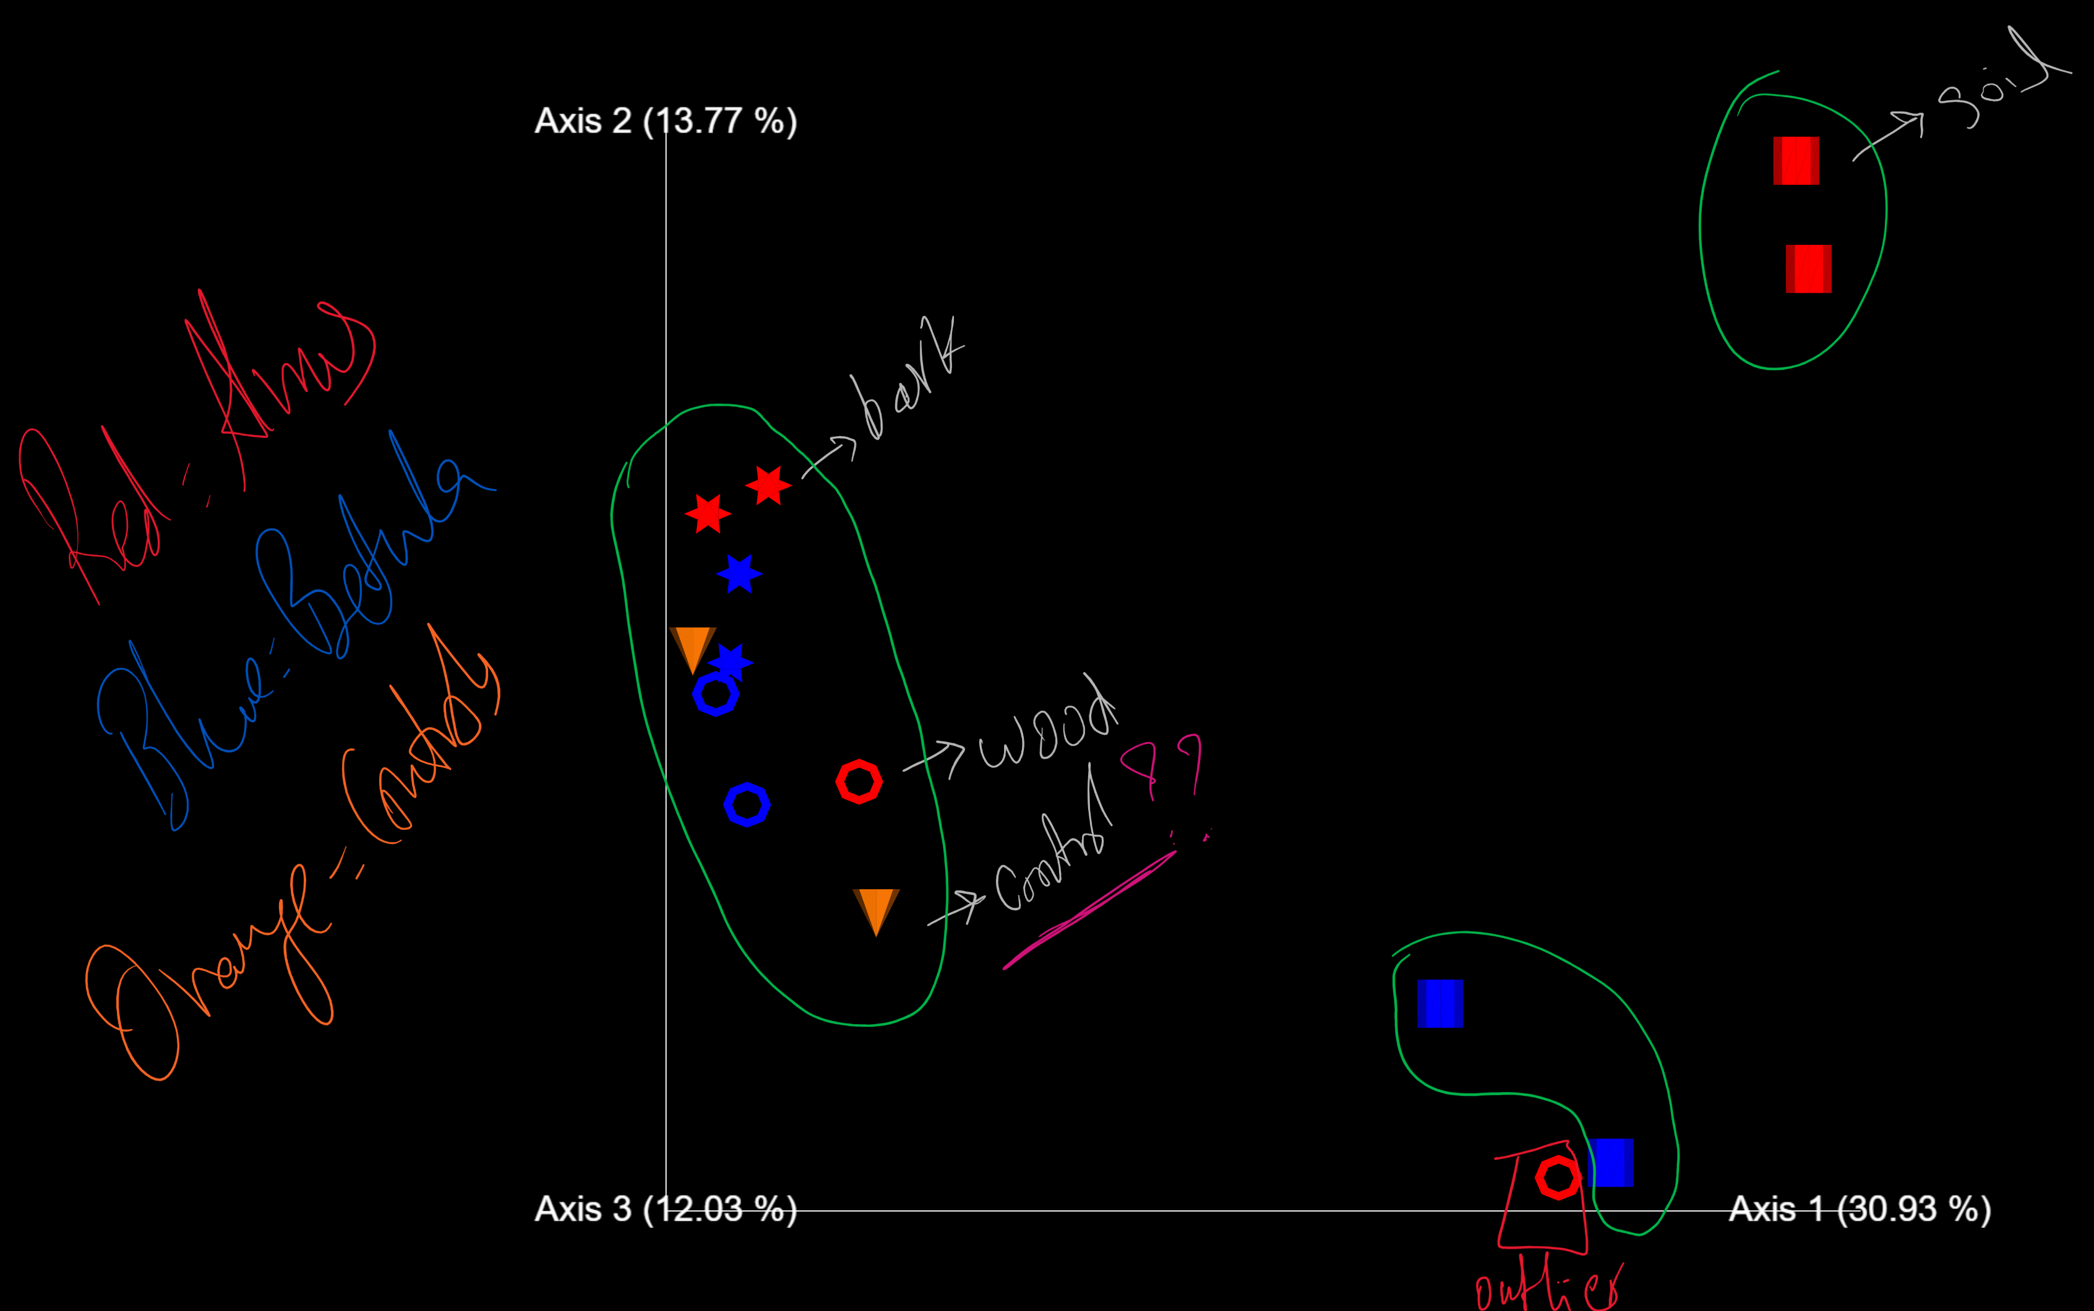






PCoA: Principal Coordinate Analysis: with controls (shapes indicate tissue/source type)
Controls cluster with samples, data need decontamination.
Controls cluster with samples, so data need to be decontaminated.

Slide 4
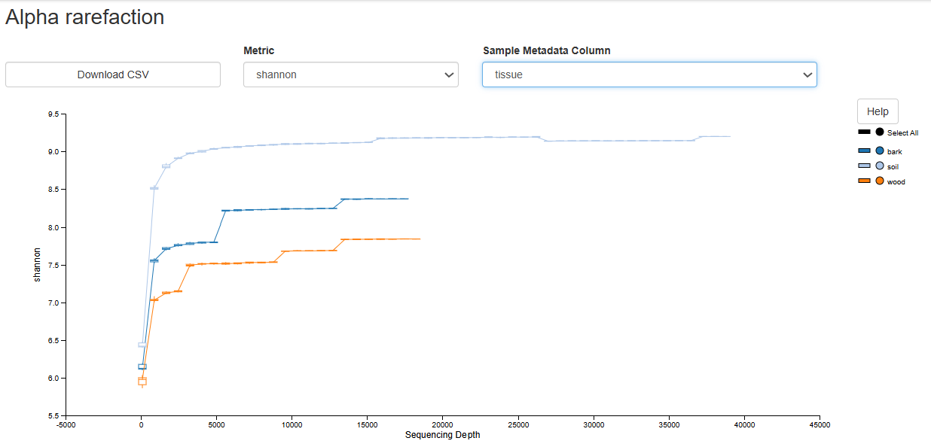
QC: Removal of PCR control contaminant reads and rarefaction curves.
For 16S sequencing, total reads of >2000 per sample after decontamination are somewhat acceptable although the minimum threshold is 5,000-10,000. There is enough sequencing depth to gain some insights from the data.
Additionally, rarefaction curves (by source/tissue) show plateauing with cleaned reads, which means the sequencing was deep enough. The intention here is to randomly sample equal number of reads from all samples and see if more depth is required, clearly not as they all plateau.

Slide 5
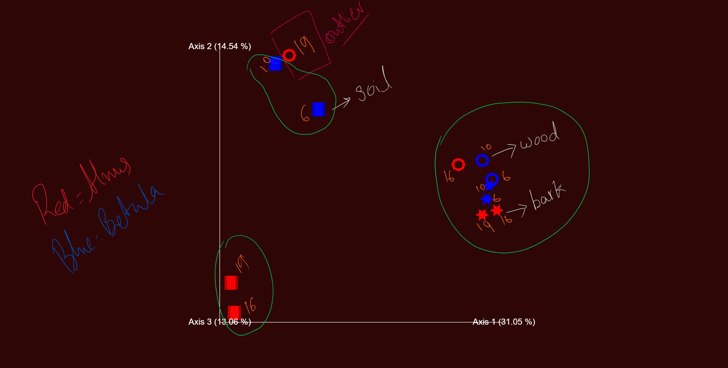
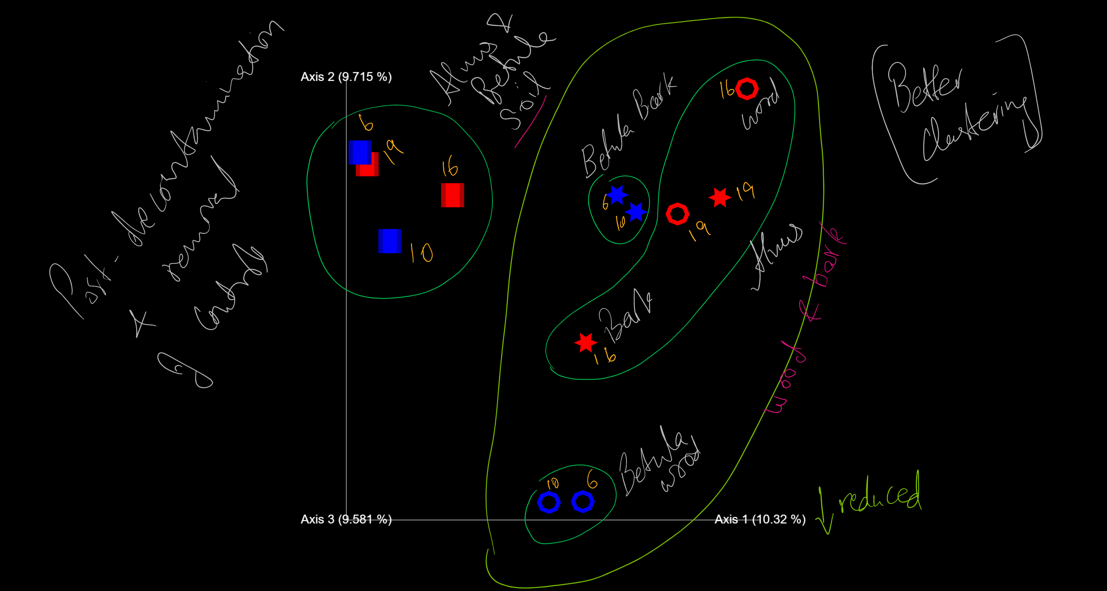
PCoA following decontamination/removal of features/ASVs from control and test samples.
Without controls, with contaminant ASVs.
Decontamination shows true clusters but reduces PCoA % along Axis 1. About ~30% of differences between samples are explained by the 3 axes or PCoAs.
No outliers and soil samples cluster closer.
Numbers are tree numbers.
Without controls, decontaminated.

Slide 6
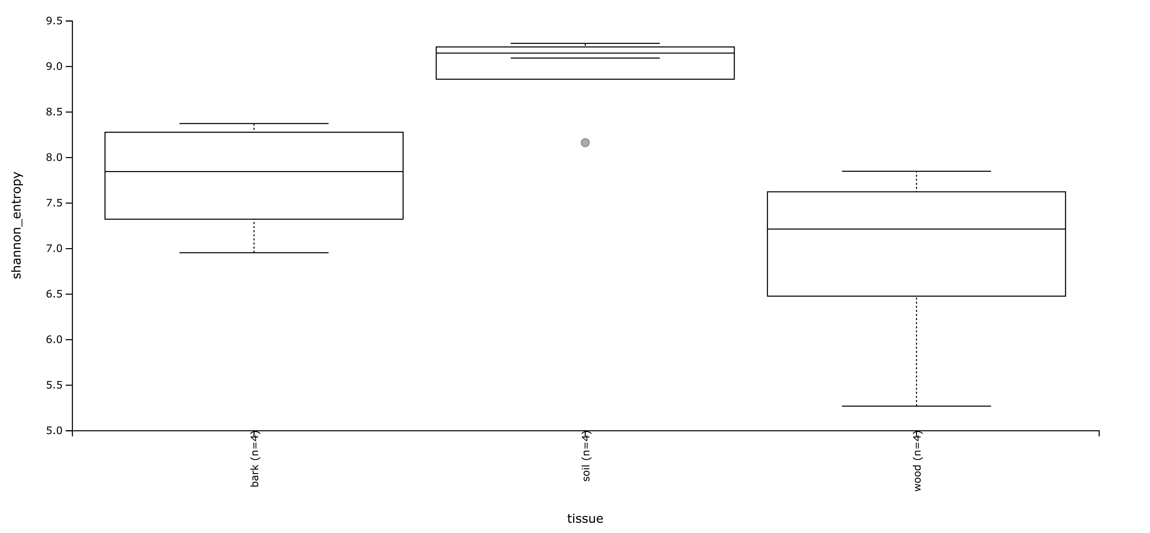


Shannon Index (alpha diversity): tissue/source seems most relevant niche for differences, not tree type.
Higher Shannon indexes mean more diverse/rich and more balanced/even.

Slide 7
PERMANOVA test: Permutational Multivariate Analysis of Variance
PERMANOVA is used to determine if the overall composition of complex ecological or microbiome communities is statistically distinct between groups, using robust, non-parametric permutation testing of a chosen distance metric.
Tissue = source of sample, i.e. soil, wood, or bark.
Tree species = Alnus or Betula

