Slide 1
CareMessage Demo
Optimizing the platform for Rural FQHCs in Wisconsin

Slide 2
Agenda
Introduction
Main Features
Challenges faced by Rural Clinics
Interactive Demo

Slide 3
Introduction to CareMessage
Our mission is to leverage technology to help safety net organizations fulfill the essential needs of underserved populations.
Our Patient Activation platform seeks to:
Improve patient access and communication
Drive efficiency
Maximize clinical quality

Slide 4
Main Features
Manage your patients
Create appointments
Conduct outreach

Slide 5
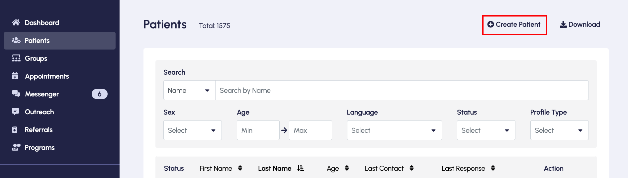
Manage your Patients
Easily add new patients

Slide 6
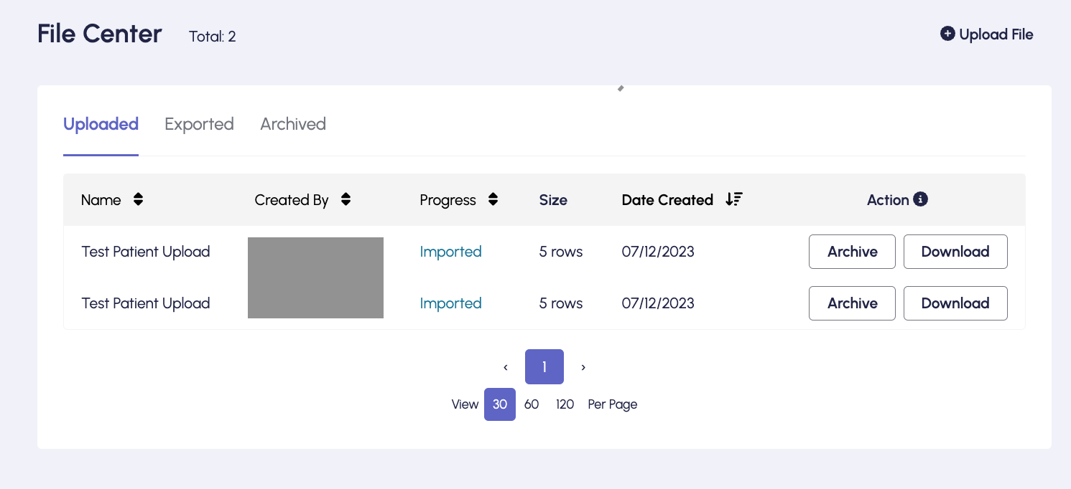
Manage your Patients
Extract data from existing files and upload onto platform

Slide 7
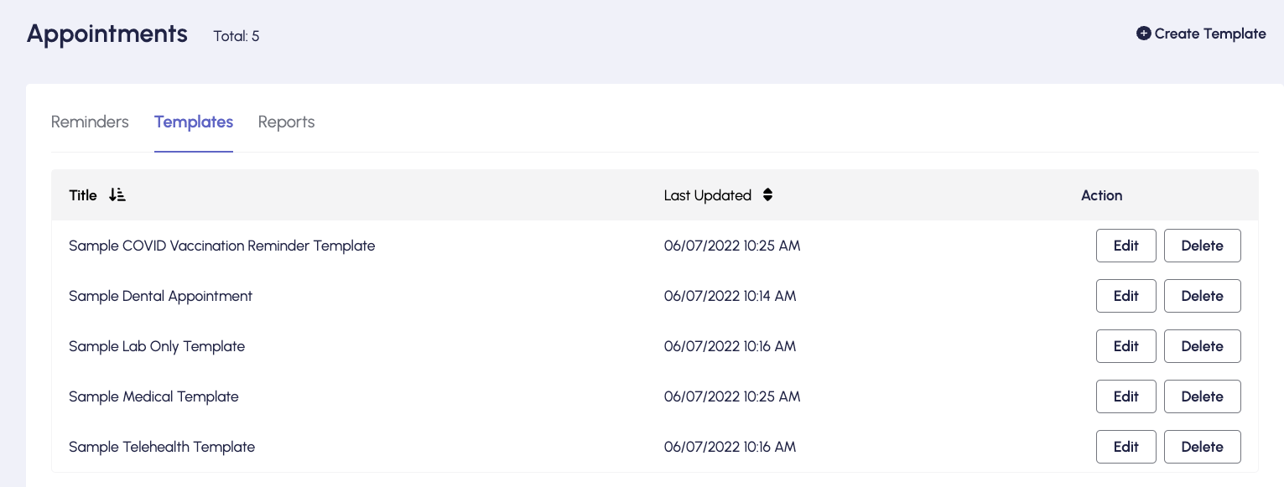
Create Appointments
Book appointments for patients
Utilize built-in templates

Slide 8
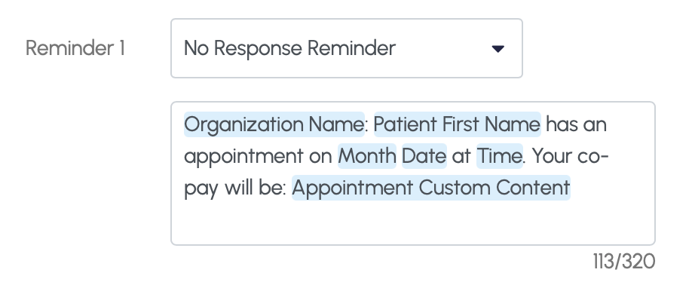
Create Appointments
Custom smart tags for personalizing patient reminders

Slide 9
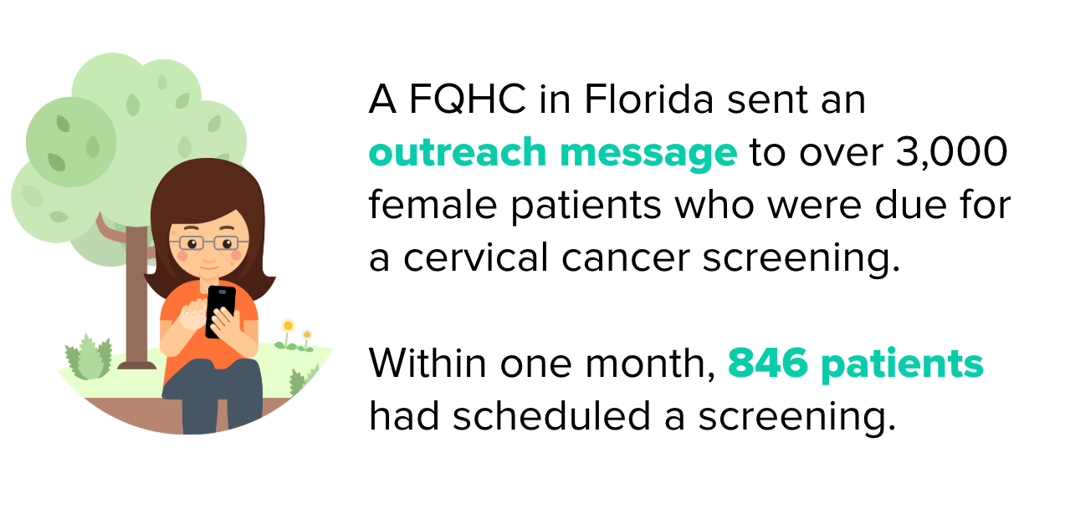
Conduct Outreach
Craft generic messages to all of your patients, or targeted messages to a subset of your patient population.

Slide 10
Challenges faced by Rural Clinics
Limited Specialist Availability
Impact of Snow Days and Last-Minute Cancellations
Diverse Populations

Slide 11
Demo

Slide 12
Summary -
Challenges faced by Rural Clinics
Limited Specialist Availability
Segment your Patient Populations using Groups
Directly communicate/update patients about scheduling
Impact of Snow Days and Last-Minute Cancellations
Promptly cancel or reschedule patients individually or in mass
Diverse Population
Text-based health education programs

Slide 13
Questions?

