Slide 1
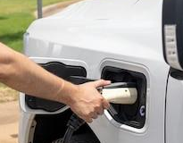
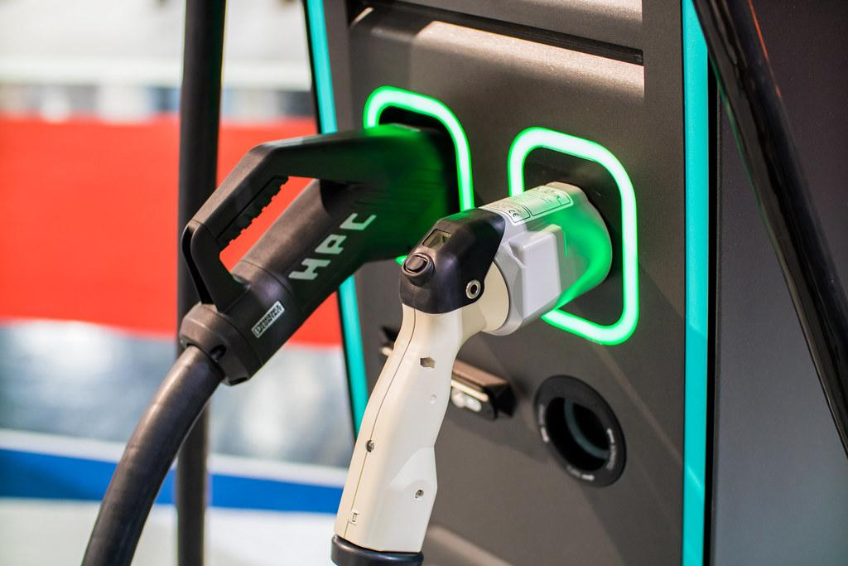
MSU Data Analytics Boot Camp
Project 3 / Group 4
Data Set:
Global Analysis of EV Charging Stations
Thaissa Champagne - Luisa Murillo - Jason Johnson -
Ugur Cetin - Willian Ruiz

Slide 2
Introduction Purpose of Project
This project explored a comprehensive global dataset of EV
charging stations, aiming to extract meaningful insights into the
current state and trends of EV charging infrastructure. The dataset
encompassed key attributes such as station location (latitude and
longitude), charger types (AC Level 1, AC Level 2, DC Fast
Charger), charging capacity (kW), station operator, connector
types, installation year, and renewable energy usage.

Slide 3
Data and Data Cleaning/ High level research questions
Project Focus: The project analyzed a global dataset of EV charging stations to uncover insights about the current state and trends in EV charging infrastructure.
Key Dataset Features: The dataset included information on station location, charger types (AC Level 1, AC Level 2, DC Fast Charger), charging capacity, station operators, connector types, installation year, and renewable energy usage.
Motivations for the Study:
Optimizing station deployment to meet growing demand.
Improving route planning for EV users, ensuring accessibility to charging stations
Evaluating renewable energy integration within the charging infrastructure.
Forecasting future energy needs and grid requirements through energy consumption studies.

Slide 4
Data & Limitations and Bias
Data cleaning revealed fictitious addresses (e.g., "Random Rd").
500 rows contained incorrect location data.
This could mislead consumers searching for EV chargers.
Issues like these highlight the importance of data cleaning & validation.
Address discrepancies remain inconclusive—some may exist, but not definitively.

Slide 5


Slide 6
Conclusion
Developed a user-friendly app to visualize global EV charging stations
Dashboard provides clear insights on installation trends & charger types
Map helps users explore charging station locations worldwide
Faced challenges with incomplete map data (only 500 out of 5000 locations)
Future Work
Fix data issues to ensure all 5000 stations are mapped correctly
Clean and update data, possibly adding new sources
Improve app performance for better speed and user experience
Expand visualizations with insights on charging speed & regional trends

