Slide 1
Husham Sattar (Software Engineer)
My job on the team is a backend Software Engineer, my responsibilities are working on the code, and ensuring that it's compatible with the hardware.

Slide 2
Husham Sattar (Software Engineer)
Working on implementing a portion of the backend specifically the sensor logic and algorithms.
Working on interface of sensors like using I²C communication protocol between the ICs on the PCB.
Implementing several conversion factors acquired by the sensors to SI Units for readability.
Using Kalman’s filter and other noise reduction filters to provide estimates of the data stream from the sensors and implement an averaging filter to help us reduce noise.
Creating a custom data type structure so that we can deliver all that data in a concise data packet that gets written to a csv file inside the SD card.

Slide 3
Cameron De La Fuente (Software Engineer)
In my role as a software engineer, I was involved in shaping its control and integration aspects. I contributed to the development of control algorithms for sensor's data stream. Additionally, I played a role in implementing PI/D controllers that regulated the aircraft's orientation and overall stability, aligning control outputs with desired and real-time states. Created various flight modes for the users, from beginners to seasoned experts, enhancing the overall control experience.

Slide 4
Cameron De La Fuente (Software Engineer)
My contributions extended to the integration of radio control protocols, namely PPM (Pulse Position Modulation) and SBUS. I formulated the use PPM to transmit multiple control channels within a single signal, and potentially set up SBUS for high-resolution, bidirectional communications, which should provide more precise controls.

Slide 5
Henry Vo (Financial Officer/Hardware Engineer)
As the financial officer of the project, some of my responsibilities include keeping track of the budget and keeping track of prices of components that may be used.
As the hardware engineer of the project, my responsibilities include, reading component datasheets, choosing optimal components, working around unavailable parts and choosing other components with similar specifications.

Slide 6
Henry Vo (Financial Officer/Hardware Engineer)
My main responsibility is in designing power portion of the PCB.
Choosing linear and/or switching regulators.
Reading datasheets to see if minimum or maximum current/voltage thresholds are not interfering.
Researching optimal ways to get efficiency without too much noise.
Reading datasheets for typical application and design on Altium Designer.
Doing theoretical calculations on thermal junction based on the datasheet to choose certain components.
Working with other members of the project on checking if parts/components, methods and routing are optimal to them also.
Designing Power Management/SD card schematic.
Creating routes on PCB for components.
Researching optimal layer format for 4-layer PCB design.

Slide 7
Brent Parker (Program Manager/Hardware Engineer)
As the program manager, my responsibility is keeping track of meetings, making sure that everyone is working together effectively, communicating tasks and assignments to members.
My responsibility as a hardware engineer, is reading datasheets, researching methods to create PCBs, methods used and typical applications.

Slide 8
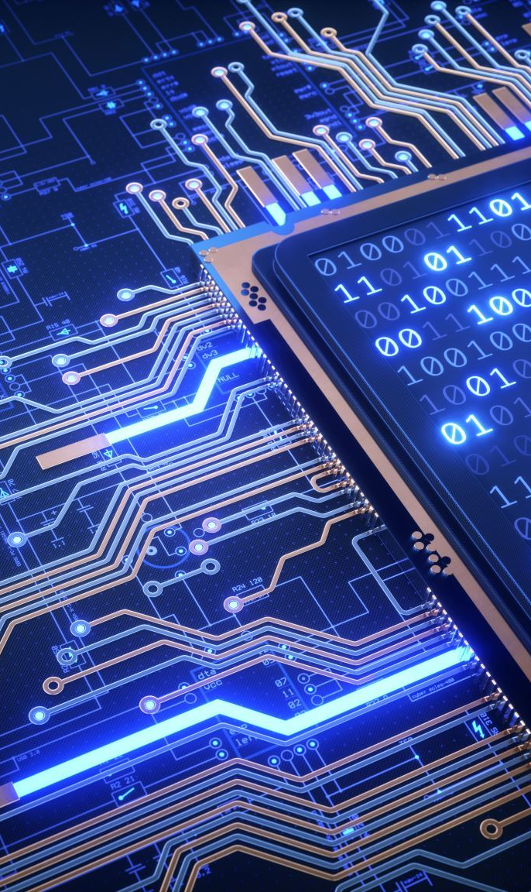
Some responsibilities.
Choosing and weighing which sensor would best fit.
Reading datasheets to see if the sensors are the right type and are needed.
Researching which sensors would be optimal.
Reading datasheets for typical application and design on Altium software.
Working with other members of the project on checking if parts/components, methods and routing are optimal to them also.
Designing some aspects of the PCB schematic when it came to the IMU and Barometer.

Slide 9
Michael Ruiz (Secretary/Hardware & Software Engineer)
As the secretary, my responsibility is effectively the same as the Program Manager, these include, sending documents to all members regarding assignments, setting time for meetings, updating required tasks to all team members.
My responsibility as the hardware engineer, is reading and using datasheets to construct typical application circuits that will be used for the design, finding optimal components to be used.
My other responsibility as the software engineer, includes planning and overseeing deployment of software and ensuring that the program works free of issues.

Slide 10
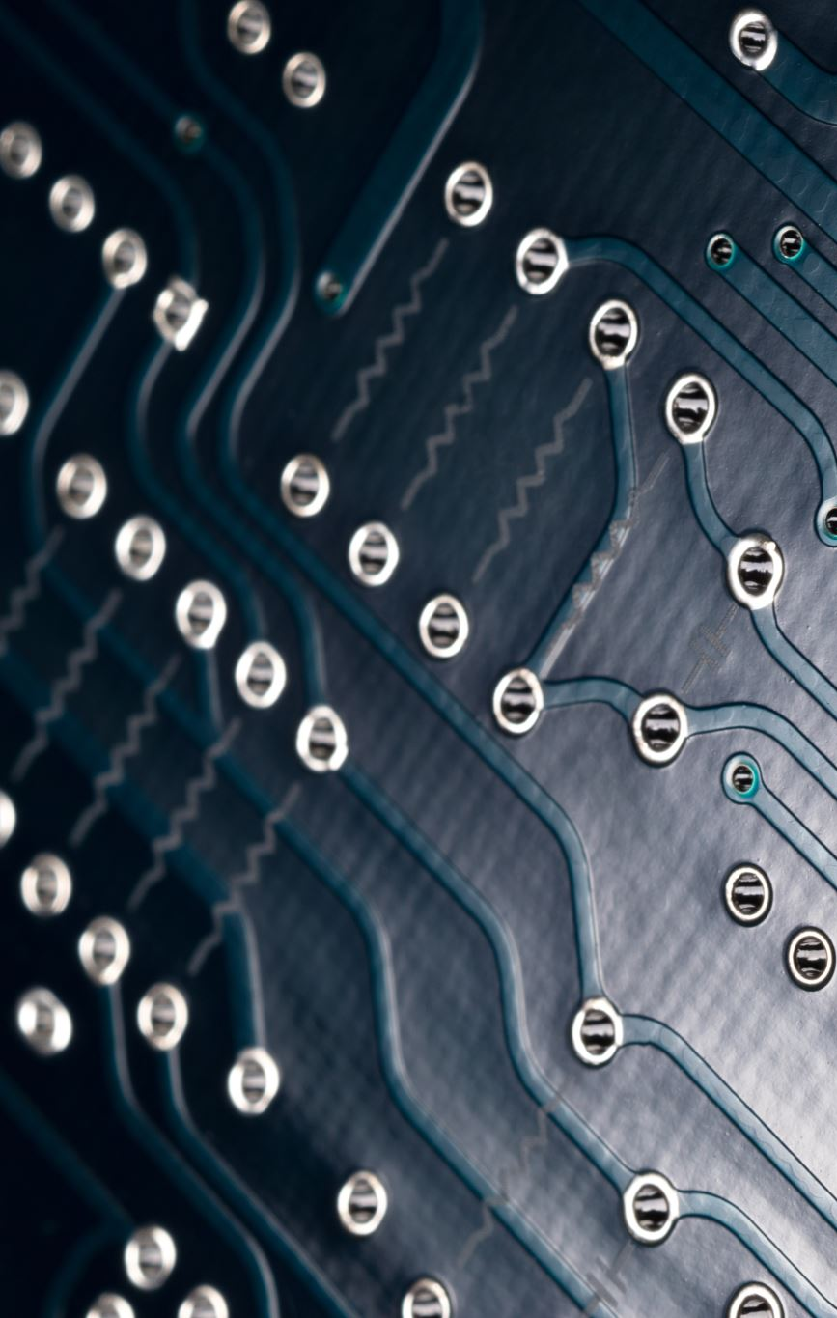
Some responsibilities.
Finding the most optimal components.
Reading datasheets for typical application and design on Altium software.
Working with other members of the project on checking if parts/components, methods and routing are optimal.
Designing MCU and sensor portion of the schematic.
Working around unavailability of parts.
Routing and placing parts on the PCB on Altium Designer.
Creating Vias and through-holes and multiple layer planes on the PCB.
Provided technical guidance and direction to the software and hardware teams.
Collaborated with team members to ensure tasks are being done.
Doing calculations for trace-widths on PCB routing, wherever necessary.

