Slide 1
CPG 221 · CAPSTONE PROJECT · MID-SEMESTER PANEL EVALUATION
DeepErase
Measuring the Depth and Breadth of Knowledge Removal
in Large Language Model Unlearning
Team Members
Project Mentor
Rishabh Garg · 102317044
Karanvir Singh · 102317045
Kalpesh Paliwal · 102317087
Rujul Ganjoo · 102317200
Pranav Goyal · 102303829
Dr. Suresh Kumar Chaudhary
Assistant Professor, CSE
Thapar Institute of Engineering and Technology, Patiala
BE , CoE/CoSE · August 2026
Notes:
[Sources]
Primary content: DeepErase_Panel_PPT.pdf (user supplied).
Visuals: user-supplied DeepErase technical diagrams.

Slide 2
PROBLEM DEFINITION & SCOPE
02 / 15
Removal must be measured beyond surface refusal
An answer can disappear while the underlying fact remains internally available.
REMOVED
SUPPRESSED
The fact is genuinely absent from the model’s internal representation.
The model may still hold the fact, but has learned not to state it.
Research problem
For an unlearned model, determine how deeply target knowledge is removed, how broadly that removal generalises beyond exact wording, and how both vary with unlearning strength.
In scope
Out of scope
Depth: two-stage activation patching (UDS)
Breadth: tiered forced-choice probes calibrated to reference models
GA, GradDiff, NPO with a utility floor · TOFU · Llama-3.2 1B / 3B
New unlearning methods or competitive claims
Closed-weight models or scales beyond 3B
Adversarial attack development and formal privacy guarantees
Problem Definition & Scope
DeepErase · CPG 221 · August 2026
Notes:
[Sources]
Primary content: DeepErase_Panel_PPT.pdf (user supplied).
Visuals: user-supplied DeepErase technical diagrams.

Slide 3
PROBLEM DEFINITION & SCOPE
03 / 15
Approved objectives and current status
Objective
Status
O1
Reproducible environment and TOFU data pipeline
Complete
O2
Mechanistic depth measurement, validated
Complete
O3
Breadth measurement calibrated to references
Partial — B0, B1, R done
O4
Unlearning methods with collapse stopping rule
Complete
O5
Traverse the depth-breadth plane by extrapolation
First trajectory obtained
O6
Report relationships across methods, seeds and scales
In progress
O3 note
The six-tier ladder is designed (B0–B4 + R). Only B0 exact, B1 paraphrase and R retain control are populated; B2–B4 remain future work (T3).
Problem Definition & Scope
DeepErase · CPG 221 · August 2026
Notes:
[Sources]
Primary content: DeepErase_Panel_PPT.pdf (user supplied).
Visuals: user-supplied DeepErase technical diagrams.

Slide 4
PROJECT ANALYSIS & DESIGN
04 / 15
Literature establishes the measurement gap
Six of the 26 reviewed papers directly shaped this phase.
Paper
Contribution
Role in DeepErase
Maini et al., 2024 (TOFU)
Fictitious-author benchmark; matched Full / Retain pairs
Models, B0 questions and retain control
Lee, Kim & Jo, 2026
Two-stage activation-patching depth score (UDS)
Depth axis; re-implemented and validated
Wang et al., 2025 (UIPE)
Extrapolates the unlearning update vector
Measurement dial, not a training step
Deeb & Roger, 2024
Unlearned knowledge can remain in weights
Motivates depth vs breadth hypothesis
Hong et al., 2025
Internal fact traces can persist after suppression
Further evidence for the hypothesis
Thaker et al., 2025
Benchmarks are weak measures of removal
Field-level gap addressed here
Project Analysis & Design
DeepErase · CPG 221 · August 2026
Notes:
[Sources]
Primary content: DeepErase_Panel_PPT.pdf (user supplied).
Visuals: user-supplied DeepErase technical diagrams.

Slide 5
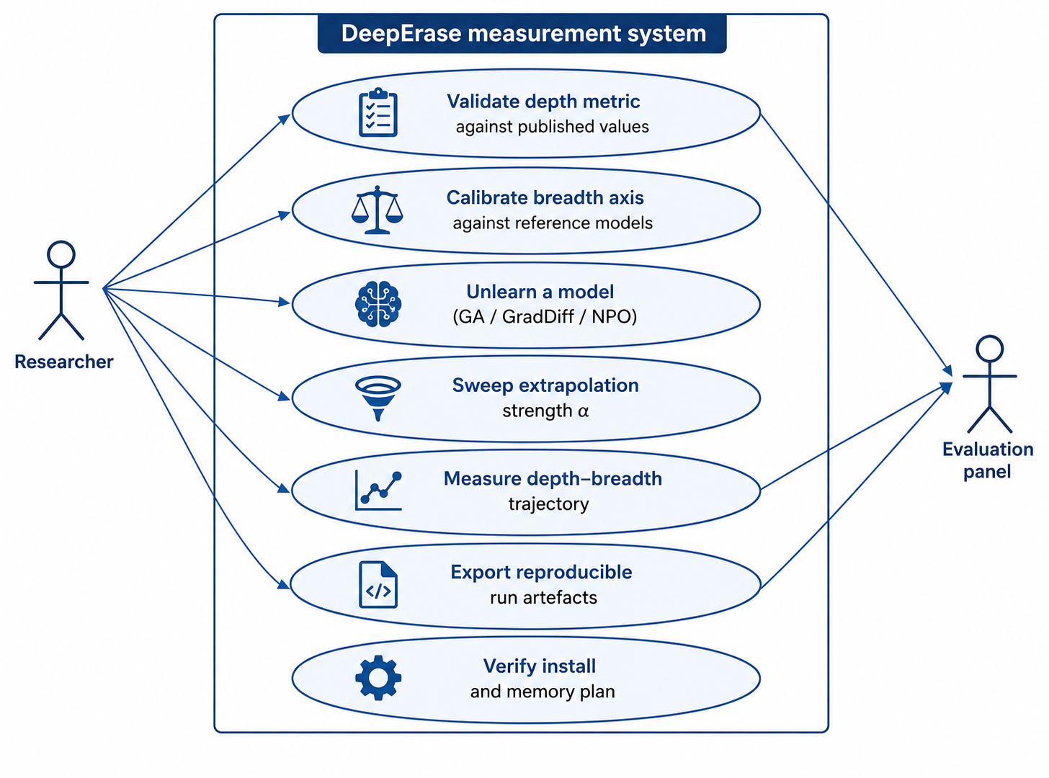
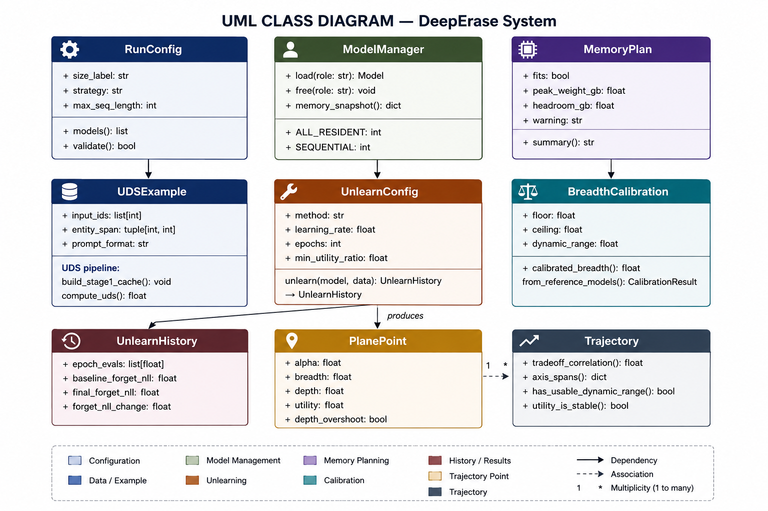
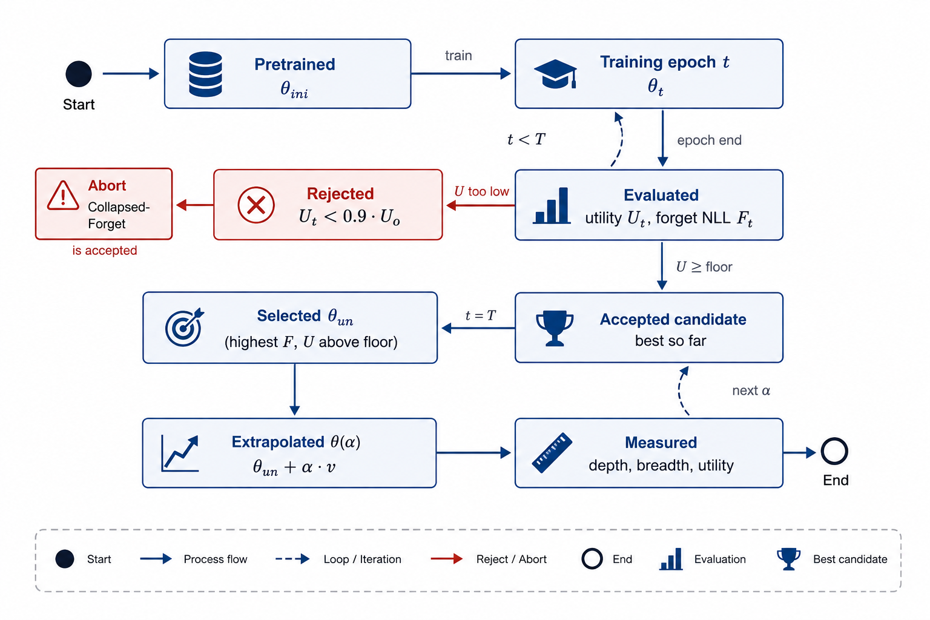
SYSTEM DESIGN
05 / 15
Three views make the measurement system inspectable
The use case, class model and checkpoint lifecycle together describe the prototype’s operation, structure and control flow.
Use case: researcher to evaluation panel
Class diagram: core data and measurement objects
State chart: utility-gated checkpoint selection
System Design
DeepErase · CPG 221 · August 2026
Notes:
[Sources]
Primary content: DeepErase_Panel_PPT.pdf (user supplied).
Visuals: user-supplied DeepErase technical diagrams.

Slide 6
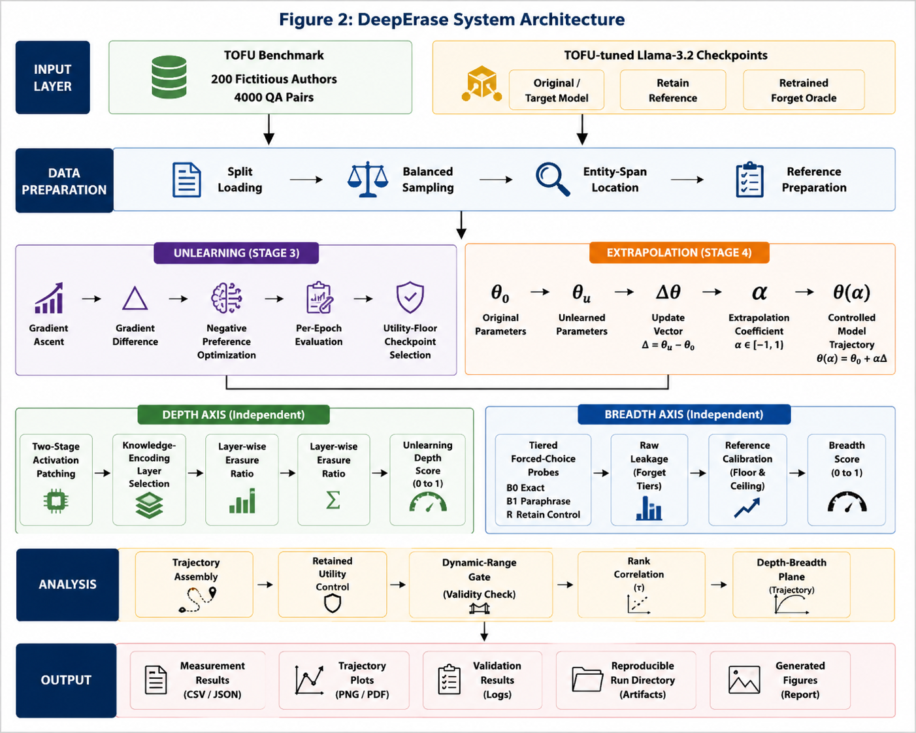
DETAILED DESIGN
06 / 15
DeepErase is a layered measurement pipeline
Data flows from TOFU and tuned checkpoints through unlearning, independent depth/breadth axes, and trajectory analysis.
Detailed Design
DeepErase · CPG 221 · August 2026
Notes:
[Sources]
Primary content: DeepErase_Panel_PPT.pdf (user supplied).
Visuals: user-supplied DeepErase technical diagrams.

Slide 7
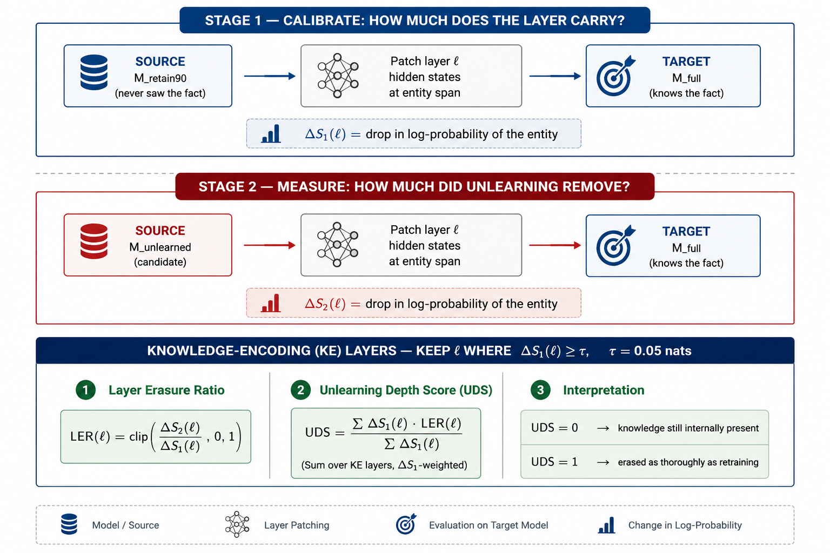
DETAILED DESIGN
07 / 15
Depth is measured causally inside the model
1. Calibrate
Stage 1 measures how much each layer carries the fact using retain90 → full patching.
2. Measure
Stage 2 compares the unlearned candidate against full at the same entity span.
3. Aggregate
Keep KE layers where ΔS₁(ℓ) ≥ τ = 0.05; aggregate LER(ℓ) into UDS.
UDS = 0: knowledge still internally present · UDS = 1: erased as thoroughly as retraining
Detailed Design
DeepErase · CPG 221 · August 2026
Notes:
[Sources]
Primary content: DeepErase_Panel_PPT.pdf (user supplied).
Visuals: user-supplied DeepErase technical diagrams.

Slide 8
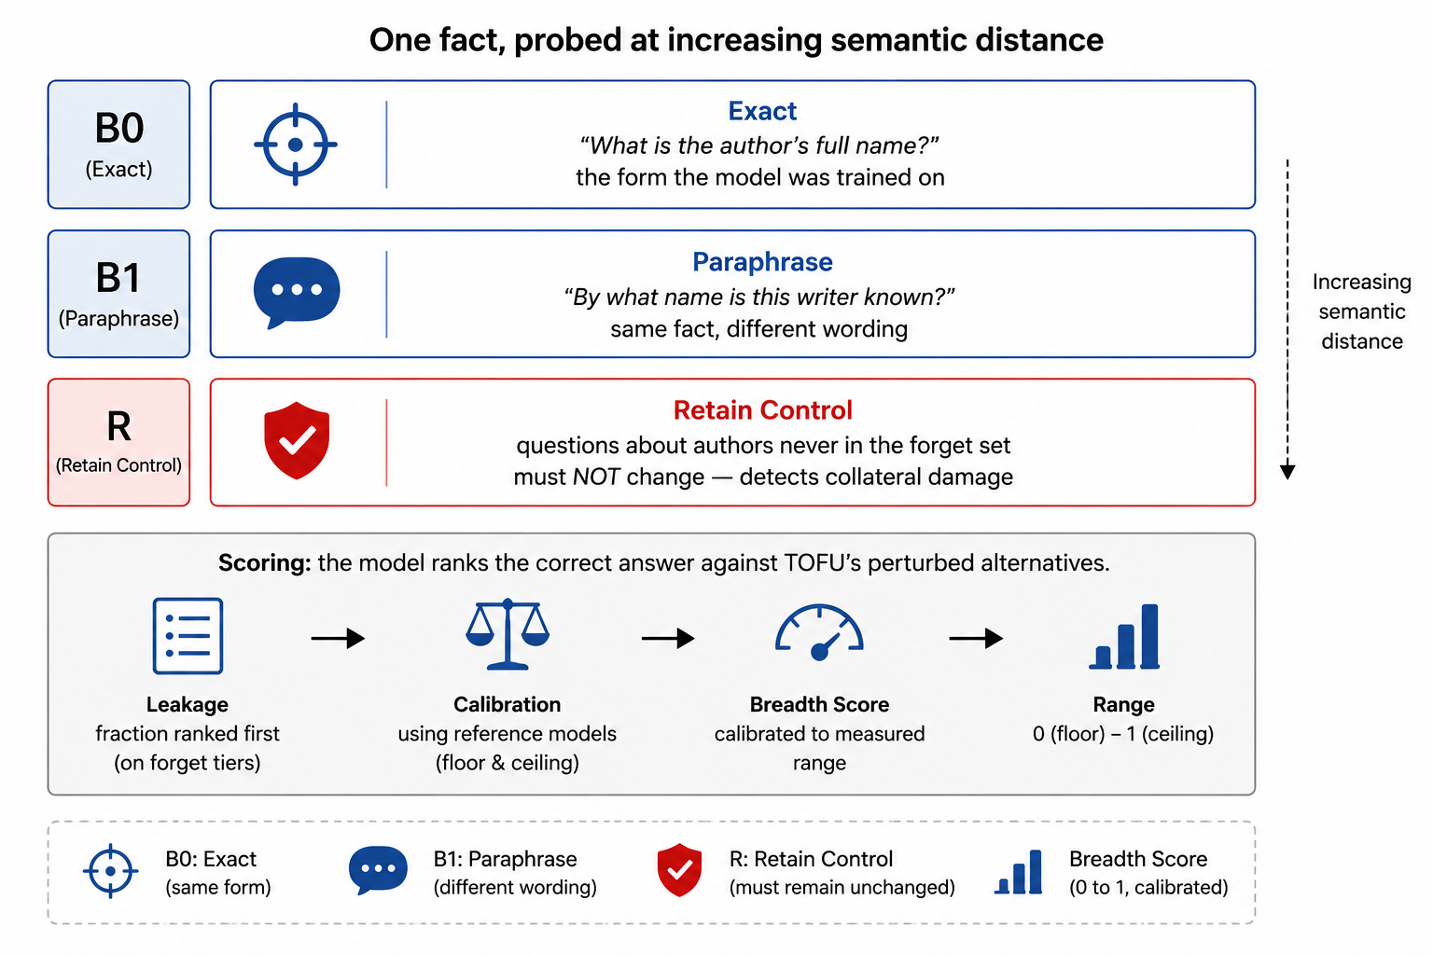
DETAILED DESIGN
08 / 15
Breadth tests whether removal generalises
Probe ladder
B0 exact: the training form
B1 paraphrase: same fact, new wording
R retain control: must remain unchanged
B2–B4: designed; future work (T3)
Calibrated breadth
(ceiling − leakage) / (ceiling − floor)
floor = retain90 0.510 · ceiling = full 0.775
Detailed Design
DeepErase · CPG 221 · August 2026
Notes:
[Sources]
Primary content: DeepErase_Panel_PPT.pdf (user supplied).
Visuals: user-supplied DeepErase technical diagrams.

Slide 9
DETAILED DESIGN
09 / 15
Checkpoint selection protects retained utility
Only utility-preserving candidates continue to extrapolation and measurement.
1 Evaluate Uₜ and Fₜ at every epoch
2 Reject candidates below U ≥ 0.9 · U₀
3 Select best accepted θun; then sweep α
Detailed Design
DeepErase · CPG 221 · August 2026
Notes:
[Sources]
Primary content: DeepErase_Panel_PPT.pdf (user supplied).
Visuals: user-supplied DeepErase technical diagrams.

Slide 10
DETAILED DESIGN
10 / 15
Reproducible tooling and transparent data design
The prototype is command-line operated; each run writes a self-describing artefact directory.
Language / DL
Python 3.10+ · PyTorch 2.x
Forward hooks for activation capture and patching
Breadth-probe item (JSON)
Models / data
HF Transformers · HF Datasets
Llama-3.2 / TOFU-tuned checkpoints and splits
{
"item_id": "B0_0",
"tier": "B0",
"question": "What is the full name of the
author born in Taipei, Taiwan ...?",
"correct_answer": "Hsiao Yun-Hwa is the
complete name of the writer.",
"correct_source": "paraphrased_answer",
"wrong_answers": ["...", "...", "..."]
}
Numerics
NumPy · SciPy
Array operations and Spearman rank correlation
Testing
Pytest + mutation testing
489 automated tests
Environment / VCS
Conda · Git
Reproducible isolation and result traceability
1,200 breadth items are exported as plain JSON: 400 per populated tier, independent of project code, enabling direct benchmark checks.
Detailed Design
DeepErase · CPG 221 · August 2026
Notes:
[Sources]
Primary content: DeepErase_Panel_PPT.pdf (user supplied).
Visuals: user-supplied DeepErase technical diagrams.

Slide 11
COST ANALYSIS
11 / 15
Compute is the only material cost
No licensed software and no paid data are used. Capacity is planned in GPU-hours.
Item
Basis
Cost
Benchmark data (TOFU)
Public research release
Nil
25 GPU-h
spent to date
Model checkpoints
Llama 3.2 community licence
Nil
Software stack
PyTorch, Transformers, SciPy, Matplotlib, Pytest
Nil
120 GPU-h
remaining
Compute completed
Depth validation + breadth calibration + one 1B study
≈ 25 GPU-h
Compute remaining
Replication across methods / seeds + 3B scale
≈ 120 GPU-h
₹0 / $0
licence or data cost
Storage
Model cache, run artefacts, checkpoints
≈ 250 GB
Cost Analysis
DeepErase · CPG 221 · August 2026
Notes:
[Sources]
Primary content: DeepErase_Panel_PPT.pdf (user supplied).
Visuals: user-supplied DeepErase technical diagrams.

Slide 12
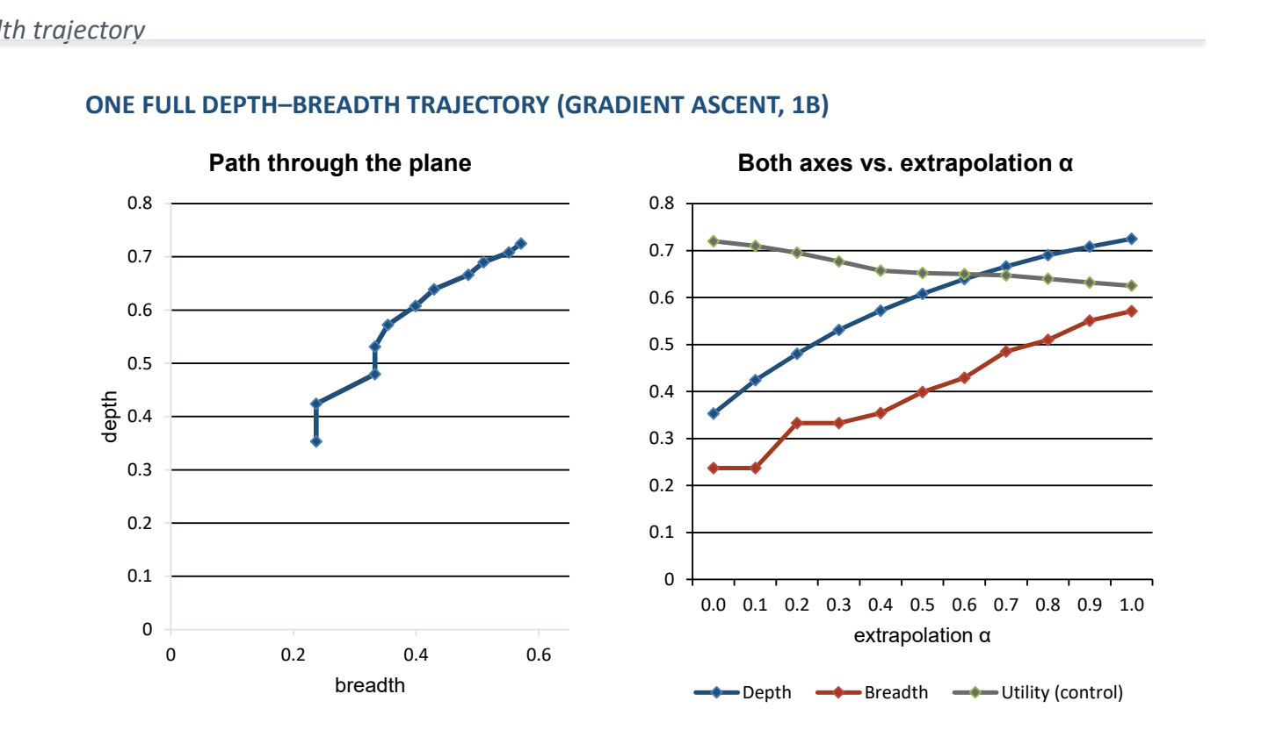
PROJECT OUTCOMES
12 / 15
The instruments work end to end; claims remain bounded
Depth validation is within the pre-set tolerance; one gradient-ascent trajectory is available at 1B.
Depth axis: published vs measured
Model
Published
Measured
Deviation
full
0.002
0.000
0.002
retain99
0.153
0.126
0.027
retain95
0.496
0.486
0.010
retain90
1.000
1.000
0.000
Mean absolute deviation: 0.010 vs. 0.08 tolerance
Interpretation boundary
Retained-knowledge utility falls from 0.720 to 0.625 across the sweep. Part of the joint rise may be general damage rather than targeted forgetting. One method, one model, one seed — not yet a research conclusion.
Project Outcomes
DeepErase · CPG 221 · August 2026
Notes:
[Sources]
Primary content: DeepErase_Panel_PPT.pdf (user supplied).
Visuals: user-supplied DeepErase technical diagrams.

Slide 13
TEAM CONTRIBUTIONS
13 / 15
Each member owns a distinct part of the prototype
1
2
3
4
5
Rishabh Garg
Karanvir Singh
Kalpesh Paliwal
Rujul Ganjoo
Pranav Goyal
102317044
102317045
102317087
102317200
102303829
Unlearning engine: GA / GradDiff / NPO; checkpoint selection; parameter-extrapolation traversal; depth-probe contribution.
Environment and dependency management; debugging model loading and benchmark intake.
Breadth probe tiers B0/B1; data pipeline; result interpretation.
Depth-probe measurement and evaluation harness; cross-checks across runs and model scales.
Documentation, figures, and preparation of the report and presentation.
All members contributed jointly to code review, testing and preparation of this presentation.
Team Contributions
DeepErase · CPG 221 · August 2026
Notes:
[Sources]
Primary content: DeepErase_Panel_PPT.pdf (user supplied).
Visuals: user-supplied DeepErase technical diagrams.

Slide 14
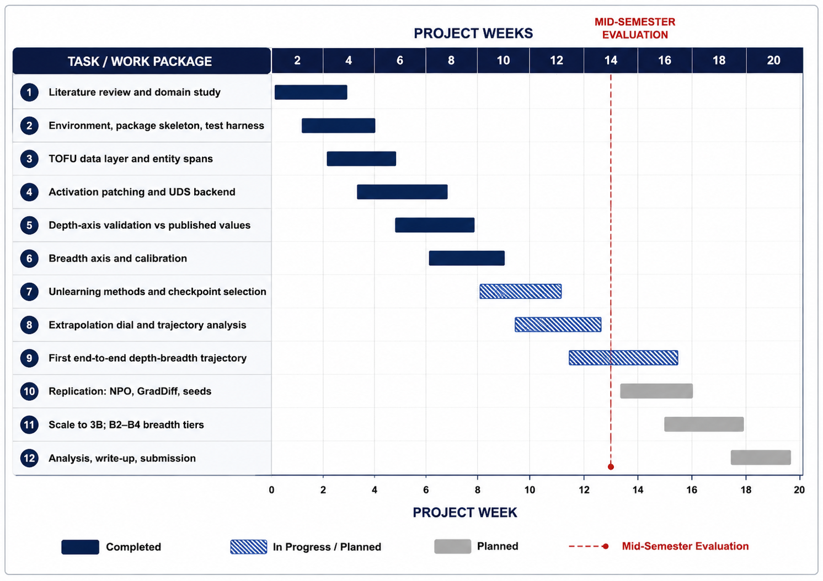
CURRENT PROGRESS
14 / 15
Nine work packages are complete at mid-semester
Current Progress
DeepErase · CPG 221 · August 2026
Notes:
[Sources]
Primary content: DeepErase_Panel_PPT.pdf (user supplied).
Visuals: user-supplied DeepErase technical diagrams.

Slide 15
FUTURE WORK & CONCLUSION
15 / 15
From first trajectory to reliable evidence
Five priorities complete the measurement programme.
T0
Cross-validate depth axis
Run both implementations on identical inputs.
T1
Separate general damage
Add an equal-sized unrelated update control.
T2
Replicate methods and seeds
NPO and GradDiff, three seeds each.
T3
Extend breadth ladder
Validate B2–B4: alias, entailed fact, two-hop.
T4
Scale and consolidate
Repeat at 3B; add LoRA; finalise report.
Conclusion
DeepErase gives a reproducible way to measure internal removal depth, removal breadth beyond exact wording, and the controlled depth-breadth trajectory. The current prototype validates the depth instrument and demonstrates one complete 1B trajectory; the remaining work strengthens controls, replication and scale.
Thank you · Questions and discussion
Future Work & Conclusion
DeepErase · CPG 221 · August 2026
Notes:
[Sources]
Primary content: DeepErase_Panel_PPT.pdf (user supplied).
Visuals: user-supplied DeepErase technical diagrams.

