Slide 1
Fetal Health Multiclassification
Classifying CTG records with only 5 features
Rujul Jain — PES1UG24CS388
Sanjana S Aithal — PES1UG24CS421
UE24CS352A — Machine Learning

Slide 2
Problem Statement
• Cardiotocography (CTG) records fetal heart rate and uterine contractions.
• Task: classify each CTG record as Normal, Suspect or Pathological.
• Reference: Stanford CS229 report, SelectKBest with 10 features, 95.58% accuracy.
• Our goal: rebuild the same pipeline using only 5 features, half the measurements.

Slide 3
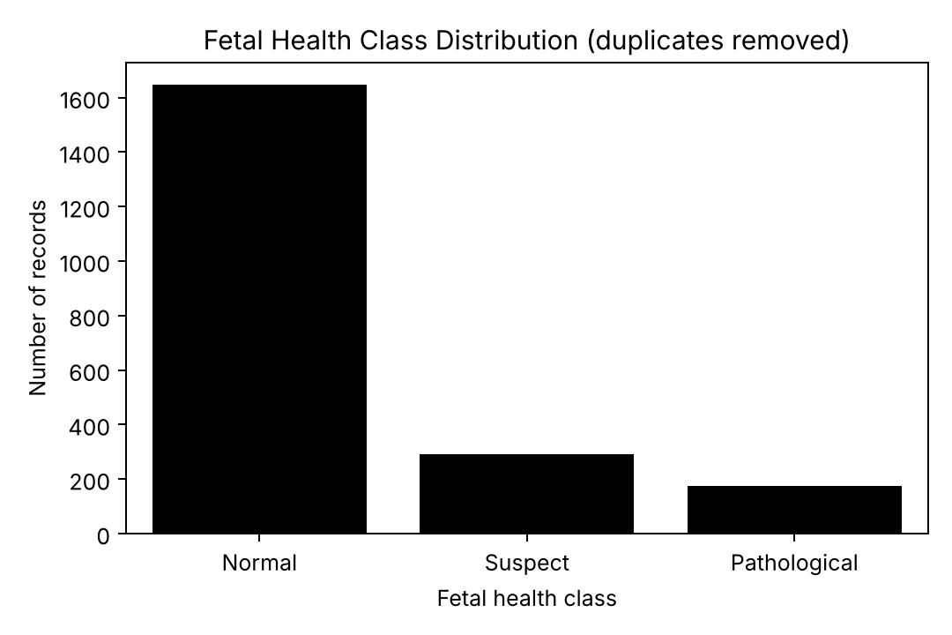
Dataset
• UCI Cardiotocography (ID 193): 2,126 records, 21 numeric features.
• Label NSP: consensus of three expert obstetricians.
• 13 exact duplicate records removed, leaving 2,113 records.
• 1,646 Normal, 292 Suspect, 175 Pathological (78% Normal).
• Imbalance means we report macro and per-class F1, not only accuracy.

Slide 4
Methodology
• 1. Remove the 13 duplicate records.
• 2. Stratified 70/30 train-test split (seed 42): 1,479 train, 634 test.
• 3. StandardScaler fitted on the training split only.
• 4. SelectKBest (ANOVA F-test), k = 5, fitted on the training split only.
• 5. Ten classifiers, each tuned with a small grid search (5-fold CV on train).
• 6. One final evaluation on the held-out test set.

Slide 5
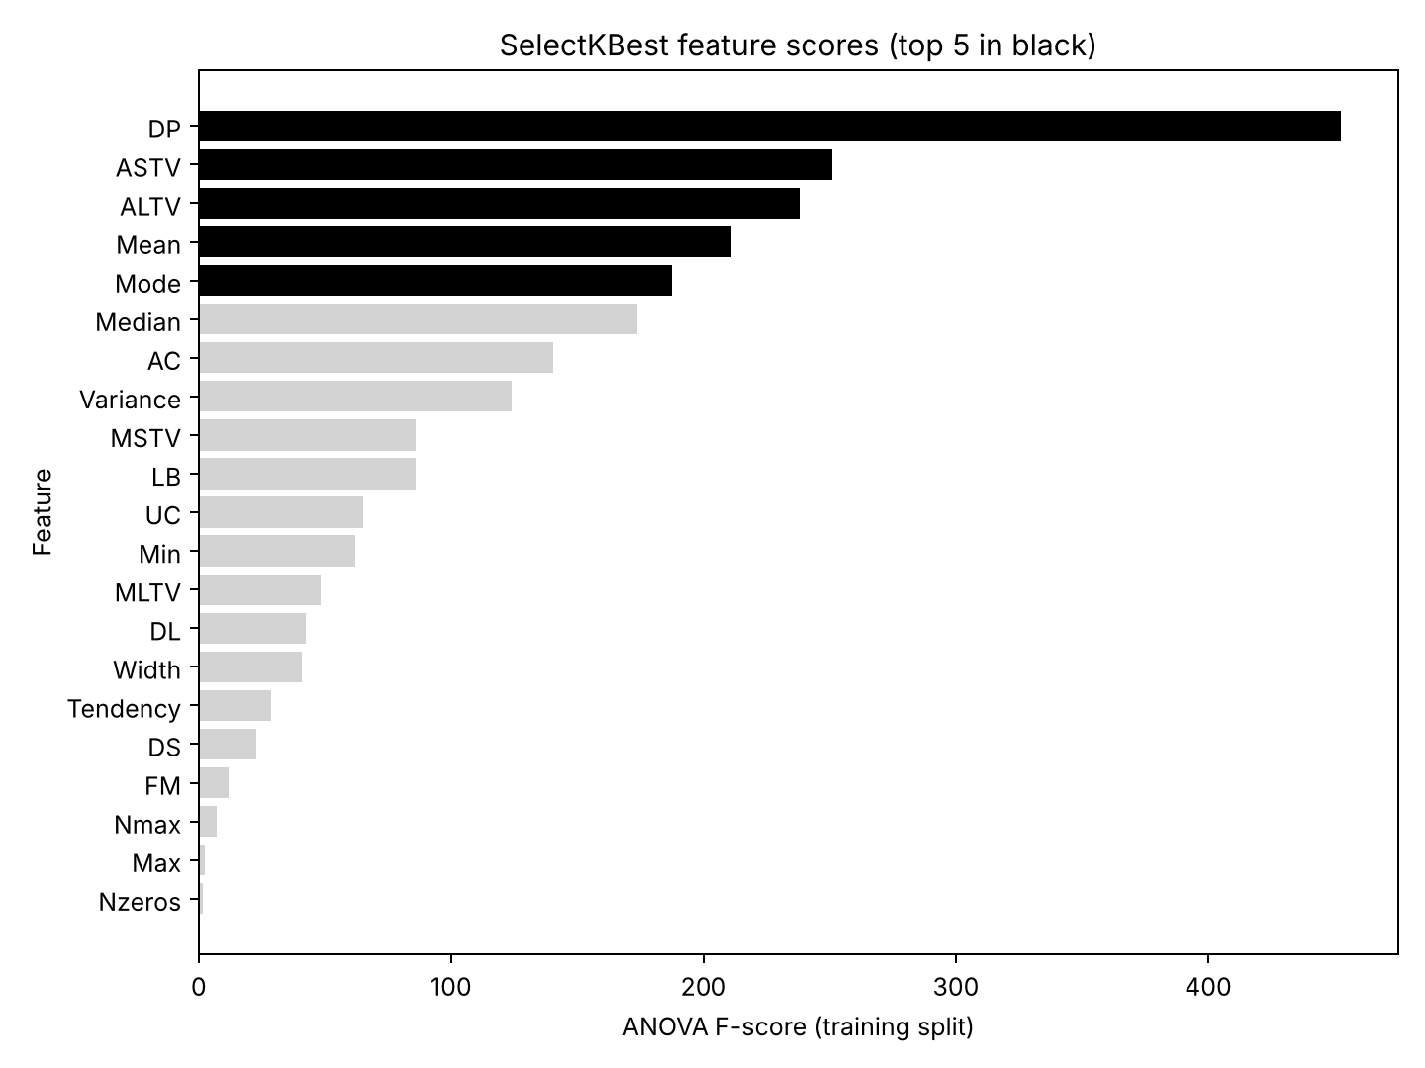
Feature Selection: the 5 Features
• DP: prolonged decelerations
• ASTV: % time with abnormal short-term variability
• ALTV: % time with abnormal long-term variability
• Mean: histogram mean of heart rate
• Mode: histogram mode of heart rate
• Selected: DP, ASTV, ALTV, Mean, Mode

Slide 6
Why SelectKBest and not PCA?
• Same split, same untuned Random Forest (300 trees), 5 inputs each:
• SelectKBest: 93.53% accuracy. PCA: 89.75% accuracy.
• PCA keeps the directions of most variance, not the most class information.
• PCA mixes all features together, so trees lose simple thresholds like ASTV > x.
• SelectKBest keeps real, interpretable clinical measurements.

Slide 7
Models
• Linear: Logistic Regression, Linear SVM
• Instance-based: K-Nearest Neighbors
• Kernel: Support Vector Machine (RBF)
• Neural network: Multi-layer Perceptron
• Trees: Decision Tree, Random Forest
• Boosting: Gradient Boosting, XGBoost, LightGBM

Slide 8
Results (Test Set, 634 Records)
Model | Accuracy | Macro F1 | Normal F1 | Suspect F1 | Pathological F1
Random Forest | 93.38% | 0.882 | 0.962 | 0.783 | 0.902
Gradient Boosting | 93.22% | 0.887 | 0.959 | 0.788 | 0.913
LightGBM | 93.22% | 0.886 | 0.960 | 0.766 | 0.932
XGBoost | 92.43% | 0.876 | 0.954 | 0.763 | 0.913
Multi-layer Perceptron | 91.80% | 0.846 | 0.955 | 0.736 | 0.846
K-Nearest Neighbors | 91.64% | 0.841 | 0.956 | 0.729 | 0.837
Decision Tree | 91.17% | 0.847 | 0.947 | 0.722 | 0.872
Support Vector Machine | 91.17% | 0.830 | 0.952 | 0.688 | 0.851
Logistic Regression | 86.44% | 0.722 | 0.930 | 0.519 | 0.716
Linear SVM | 84.86% | 0.671 | 0.924 | 0.467 | 0.622

Slide 9
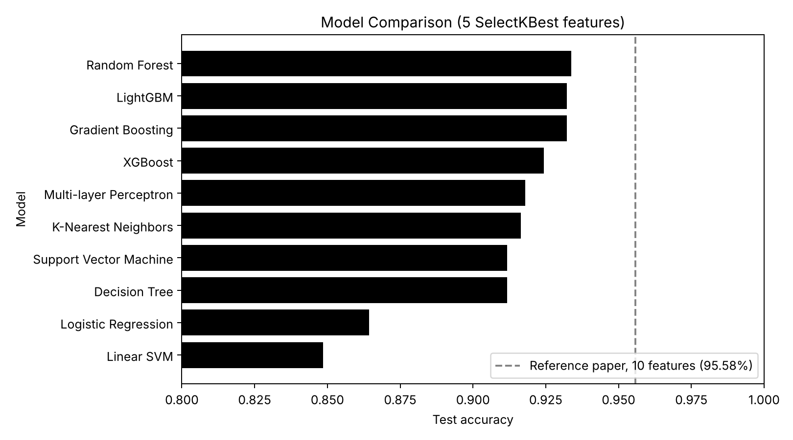
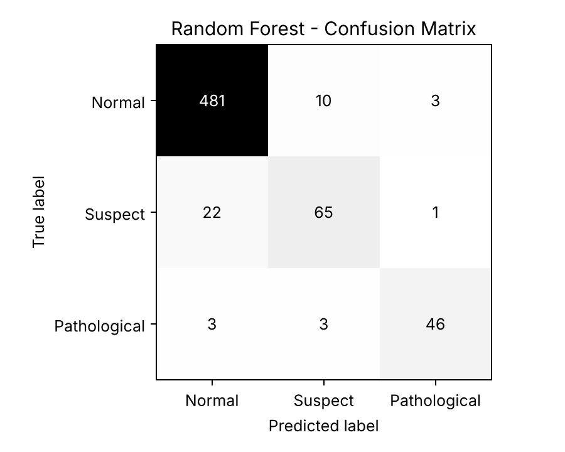
Comparison with the Reference Paper
Best: Random Forest, 93.38% with 5 features
Paper: 95.58% with 10 features (2.2 points higher)

Slide 10
Live Demonstration
• python src/run_experiments.py
• Load data and remove duplicates
• Split, scale and select the 5 features
• Tune and evaluate all ten models
• Show the results table, feature scores and confusion matrix
• Notebook: notebooks/Fetal_Health_Multiclassification.ipynb

Slide 11
Conclusions and Limitations
• 5 features reach 93.38% (Random Forest), with half the paper's inputs.
• This does not beat the paper's 95.58%, which uses 10 features.
• Normal and Pathological stay strong; Suspect is hardest (F1 0.78).
• Removing duplicates and fitting on train only keep the evaluation honest.
• Single split: a 1–2 record difference (0.16% each) is noise.
• Academic prototype, not a clinically validated diagnostic system.

