Slide 1
DEEP LEARNING APPROACHES TO PARTIAL DIFFERENTIAL EQUATIONS WITH
Applications in Finance: Pricing European Style Options
by
Rujul Dwivedi & Pranavi Bannela
under the guidance of
Dr. Lok Pati Tripathi

Slide 2
CONTENTS :
1 Introduction
2 Basic Neural Network for Standard Linear PDEs
3 PINNs for Black-Scholes PDE
4 LSTM-enhanced PINNs for Multi-Asset PDEs
5 Conclusion and Future Work

Slide 3
INTRODUCTION:
What is European style option pricing??
Process of determining the fair price of a european option
Option:
An option is a contract that grants the right, but not an obligation, to buy or sell an underlying asset within a given time frame and subject to certain conditions.
A european option is a type of financial derivative which is exercised at expiration date

Slide 4
Background and Motivation
Types of Options:
Call Option: Right to buy an asset at a predetermined price.
Put Option: Right to sell an asset at a predetermined price.
Key Terms:
Strike (Exercise) Price: Predetermined Price at which the asset can be bought or sold.
Expiration (Maturity) Date: Last date by which the option can be exercised.
Current Price: It is the price of the asset when an option is exercised.

Slide 5
Background and Motivation
Black-Scholes Model: Widely used closed-form solution for pricing options.
Traditional Numerical Methods for Option Pricing:
Finite Difference Method (FDM): Solves partial differential equations. Breaks down time and price into small steps, then estimates option prices at each step
Monte Carlo Simulation: Simulates numerous possible future paths for asset prices to estimate an option’s price. Runs thousands or millions of simulations, each representing a different potential future price movement.

Slide 6
Limitations of Traditional methods:
Scalability: Struggles with high dimensions
Grid Dependency: Requires setting up a grid for each variable
Boundary Conditions: Handling complex boundary conditions can be challenging
Computationally Intensive: Needs thousands or millions of simulations for reliable results.
Slow Convergence: Convergence to an accurate result can be slow, requiring more time and computational resources.

Slide 7
This is where Physics-Informed Neural Networks (PINNs) come in as a powerful solution to address these limitations."

Slide 8
What are PINNs ?
Neural network-based solutions for PDEs governed by physical laws.
They combine the power of neural networks with mathematical equations
Key Feature: Incorporates physical laws directly into the model's training.
How does PINNs work?
Instead of just learning from the data, PINNs learn by minimizing errors in satisfying physical equations.

Slide 9
Why PINNs?
They can solve high dimensional problems efficiently
Less data is needed because they rely on equations to guide the solution.
Work well with complex boundaries.

Slide 10
Introduction to Neural Networks for PDEs :
Network Structure:
Uses a feed-forward architecture with spatial (x) and temporal (t) inputs, outputting the solution to the PDE.
Layers: Input layer, multiple hidden layers with Tanh activation, and an output layer for the PDE solution.
Purpose: Approximates the solution across the domain by learning from data.

Slide 11

Loss Function:
The neural network is trained to minimize a loss function that incorporates both the PDE and the boundary conditions:
Training:
Uses backpropagation with Adam optimization to minimize loss, adjusting network parameters to satisfy PDE and boundary conditions.

Slide 12

Let’s Take an example and solve a PDE using PINNs :
PDE Solved: Heat Equation
Ut​=Uxx​
Boundary Conditions:
U(0,t)=0 , U(1,t)=0 and initial condition U(x,0)=sin⁡(πx).
Exact Solution:

Slide 13
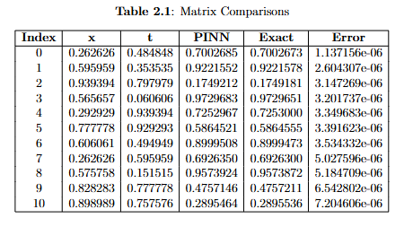
Results and Conclusion:
Comparison Table

Slide 14
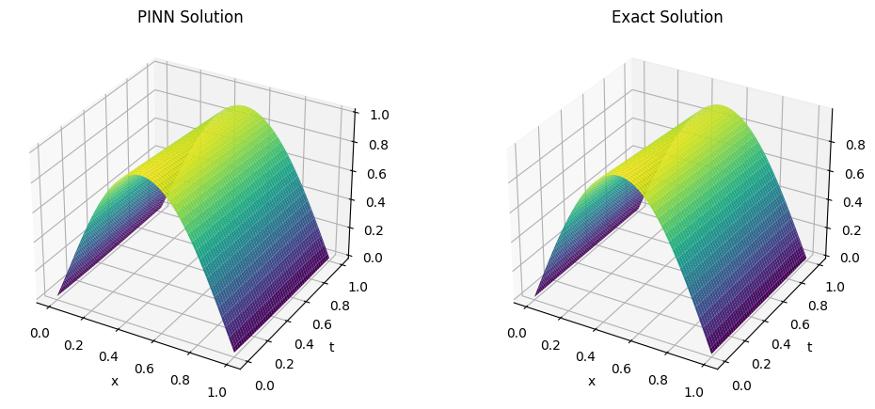
Results and Conclusion:
Surface Graph Comparision

Slide 15

Black-Scholes PDE:
It is a mathematical model that describes the evolution of the price of financial derivatives, specifically European-style options.
It is used to estimate the theoretical price of options based on several key factors, such as the price of the underlying asset, volatility, time to maturity, and the risk-free interest rate.
It is a parabolic partial differential equation given by:

Slide 16
Black-Scholes PDE:
Parameters of Black-Scholes PDE:
S(t) : Price of the underlying asset at time t
C(t, S) is the price of the option as a function of the underlying asset S at time t
r is the annualized risk-free interest rate, continuously compounded
σ is the standard deviation of the stock’s returns, also known as volatility
Boundary and initial conditions for European call options are:
C(t, 0) = 0 for all t ≥ 0,
C(t, S) → S − K for all t ≥ 0 as S → ∞,
C(T, S) = max{S − K, 0}.

Slide 17
Key assumptions of Black-scholes PDE :
• The rate of return on the riskless asset is constant and thus called the risk-free interest rate.
• The stock price follows a geometric Brownian motion, and it is assumed that the drift and volatility of the motion are constant.
• The stock does not pay a dividend.
• There is no way to make a riskless profit.
• The market has the ability to borrow and lend any amount, even fractional, of cash
at the riskless rate.
• The market has the ability to buy and sell any amount, even fractional, of the stock.
• The above transactions do not incur any fees or costs.

Slide 18


Loss Function for Training :
We construct the loss functions to be used for training the neural networks.
Define the residual function as follows:
The loss functions are defined as follows:
Collocation Loss: This loss enforces the solution of the PDE at randomly sampled collocation points:

Slide 19

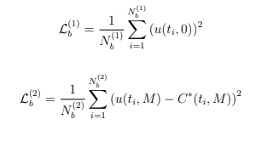
Loss Function for Training :
Expiration Loss: This loss ensures accuracy at expiration:
Boundary Loss: This loss enforces the boundary conditions:

Slide 20
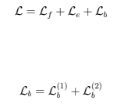
Loss Function for Training :
The total loss function is then defined as:
where:
By minimizing this total loss function, the neural network learns to predict accurate numerical solutions to the Black-Scholes equation.

Slide 21
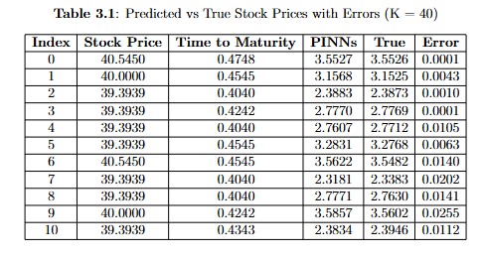
Results and Conclusion:
Comparison table

Slide 22
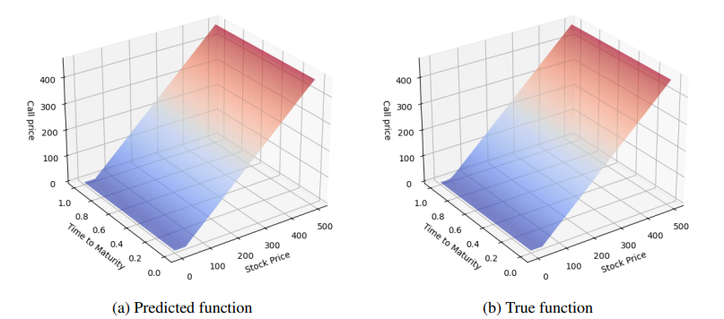
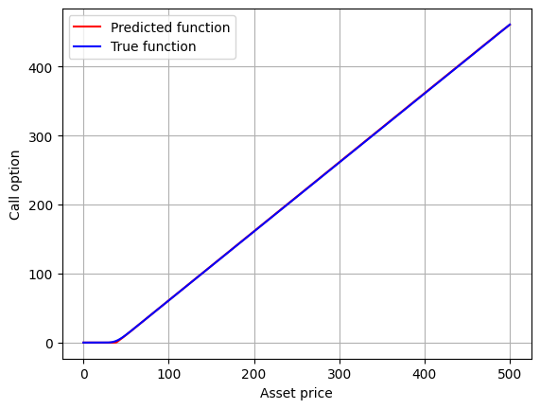
Results and Conclusion:
Surface Graph Comparison
2D Graph Comparison

Slide 23
PINNs Formulation for Black-Scholes PDE:
Key Features:
High Fidelity: PINNs can find optimal solutions even with sparse or partial training data.
Flexibility: PINNs are highly extensible, allowing for the extension to problems such as American options by adjusting loss functions.
Advantages over Traditional Methods: PINNs need not be rerun for each iteration as after the training process, optimised weights are found on which the test data is run.

Slide 24
LSTM-enhanced PINNs for Multi-Asset PDEs

Slide 25
LSTM-enhanced PINNs for Multi-Asset PDEs
Goal :
Extend PINNs to multi-asset option pricing by integrating LSTM layers to capture temporal dependencies.
Why LSTMs?:
The key idea behind integrating LSTM layers into PINNs is to capture the latent dynamics and relationships between the correlated assets’ prices. but just for simplicity, we’ll work with uncorrelated assets.

Slide 26
Network Architecture of LSTM-enhanced PINNs Framework
Input Layer: Receives both the prices of multiple assets S1, S2, . . . , Sn and the time variable t.
LSTM Layers: Process the latent relationships among asset prices by capturing dynamic patterns that evolve based on the combined inputs of asset prices and time.
Fully Connected Layers: Map the outputs of the LSTM to a high-dimensional
space, aiding in predicting the solution of the PDE.
Output Layer: Predicts the option price C(S1, S2, . . . , Sn, t) based on the processed features.

Slide 27

Loss Function in LSTM-enhanced PINNs:
The total loss function is defined as:
Enforces the multi-asset PDE, extending the Black-Scholes model for uncorrelated assets.
Satisfies boundary conditions when asset prices approach zero or infinity.
Ensures the initial condition, based on the option’s payoff at t = 0.
Minimizes the difference between predicted and actual asset prices, helping to maintain consistency in its price predictions across different assets

Slide 28
Training Process
Objective:
Minimize the loss function using backpropagation and gradient descent (Adam/RMSProp).
Advantage of LSTM Layers:
Captures complex relationships between temporal data and for more accurate pricing at different time points. Works best for correlated data.

Slide 29


Multi-Asset Black-Scholes Equation
For n uncorrelated assets, the multi-asset Black-Scholes PDE is given by:
For correlated assets, the PDE includes additional mixed derivative terms. The multi-asset Black-Scholes PDE for correlated assets is given as::
where ρij is the correlation between asset i and j.

Slide 30


Boundary and Initial Conditions
Boundary Condition: At the extremes of asset prices (Si → 0 or Si → ∞), the option price C should satisfy:
Initial Condition: At t = 0, the option price is determined by its payoff. For a
multi-asset European call option:
where K is the strike price.

Slide 31

Closed Form Solution for Multi-Asset European Options
For a European call option on n uncorrelated underlying assets S1, S2, . . . , Sn, the closed form solution can be expressed as:
where
: Expectation under the risk-neutral measure.
wi : Weight of the i-th asset in the basket.

Slide 32
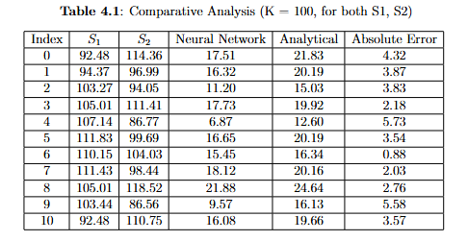
Results and Validation:
Comparison table

Slide 33
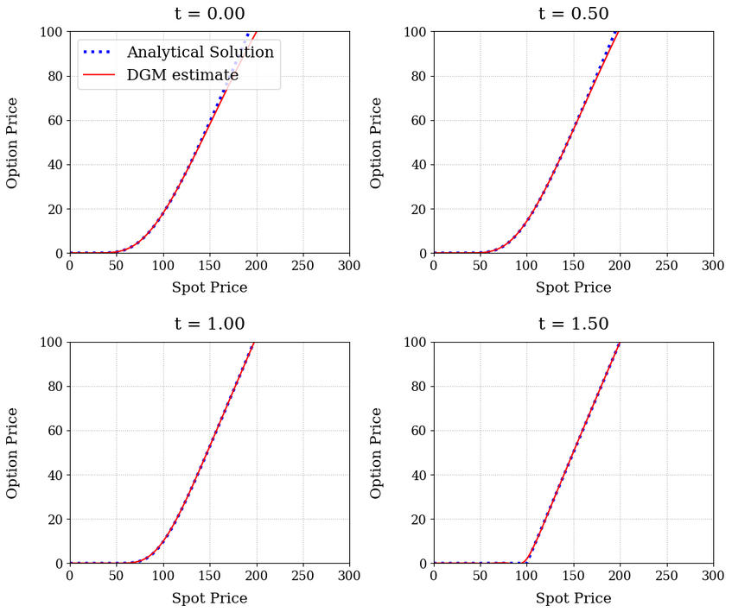
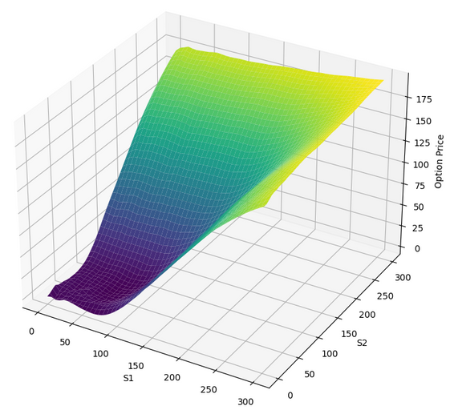
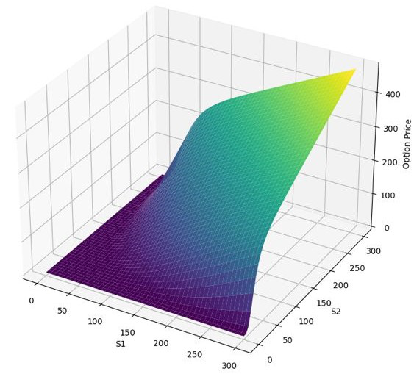
Results and Validation:
Graph without boundary conditions
Graph with boundary conditions
Graph Comparison

Slide 34
Conclusion :
Deep Learning for Financial PDEs:
Demonstrated the effectiveness of PINNs for solving complex financial PDEs, especially in high-dimensional spaces.
LSTM-Enhanced PINNs with DGM:
Integrated LSTM networks with the Deep Galerkin Method (DGM) for a novel solution in multi-asset option pricing, effectively capturing temporal dependencies.
Comparison with Traditional Methods:
Pointed out the main advantages over FDMs and FEMs, like computational efficiency and no need for boundary condition.

Slide 35
Future Work:
Enhancing Training Efficiency:
Explore techniques like transfer learning and advanced optimization algorithms to reduce training time, especially on larger datasets.
Handling Complex Derivatives:
Extend the framework to model exotic options and multi-factor financial models for more sophisticated derivatives
Real-time Pricing Implementation:
Integrate real-time market data to enable dynamic, live pricing for real-world financial applications.

Slide 36
Thank You!
By:
Rujul Dwivedi
Pranavi Bannela

