Slide 1

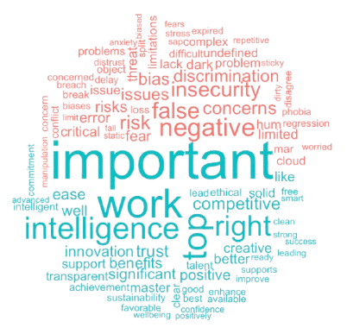
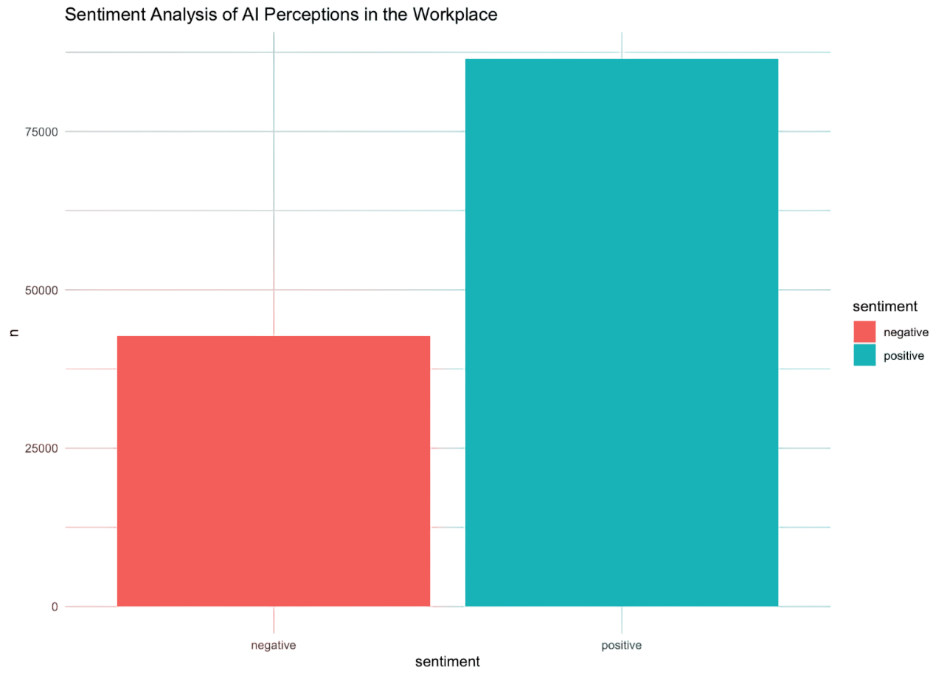
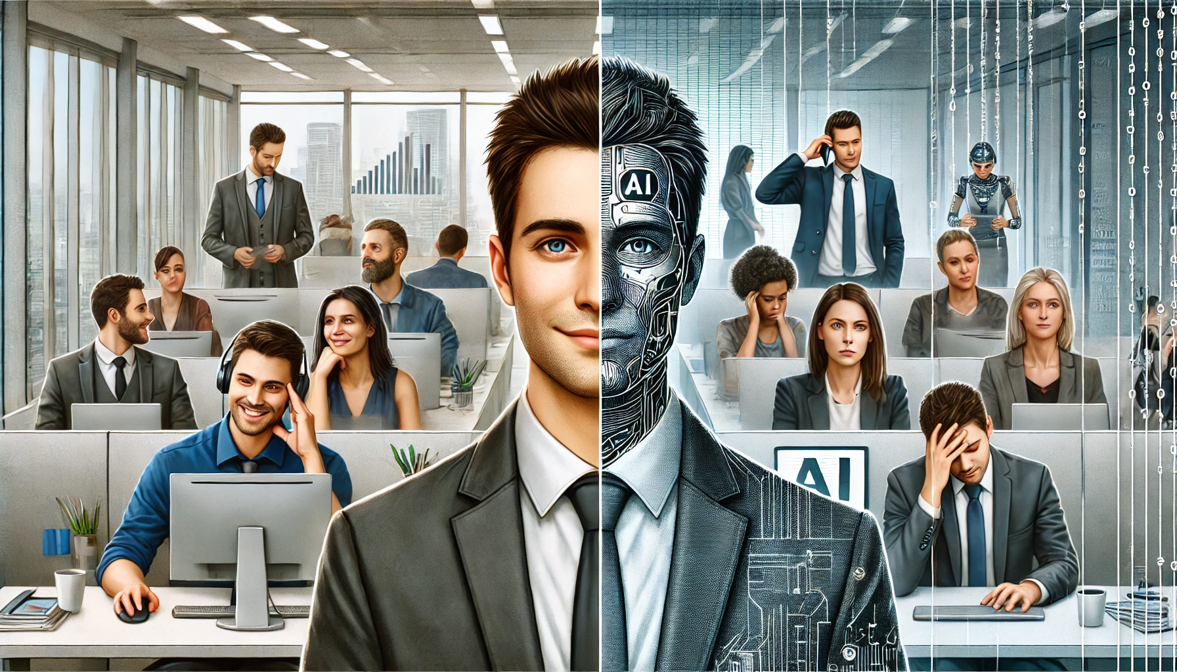
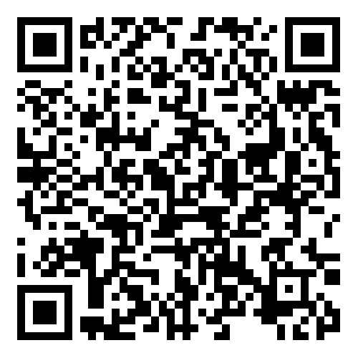
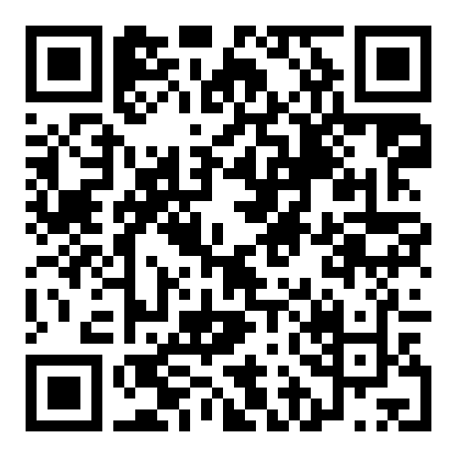
Al in the Workplace: Perceptions and Challenges in the Age of Automation
Rujuta Parekar
University of Central Florida, Orlando, FL
Abstract
Methods
Implications
As AI-driven automation reshapes industries, public perception plays a critical role in its adoption and impact. This study examines public sentiment on AI in the workplace through an analysis of news articles from major media outlets. Using web scraping techniques, articles discussing AI-driven automation and workforce adaptation are collected and categorized. By identifying key themes and trends, this research provides insight into how AI is being portrayed in mainstream media and what it means for the future of work. The findings highlight the evolving narrative around Al adoption, shedding light on both its benefits and challenges in the modern workplace.
To gauge current public perceptions of AI, I decided to compile a list of articles from popular sources by manually selecting articles that appeared through the Google search “News” section for the search terms “perceptions of AI in the workplace” and “employee perceptions of AI.” This led to the acquisition of 110 articles. Of these, 81 articles were successfully web-scraped. The web scraping was conducted using the rvest package in RStudio. Upon extraction of the website content, sentiment analysis was performed on the data using the tidytext package in R.
Overall, the articles conveyed a positive sentiment related to AI.
Even though most people view AI as beneficial to their work, most concerns regarding the technology lie around cybersecurity and trusting it (Castagno & Khalifa, 2020; Brauner et al., 2023). Hence, organizations should aim to mitigate these concerns to ease AI adoption in the workplace.
Results
Introduction
Implementing AI technologies in the workplace brings with it considerable opportunities as well as challenges. AI is usually implemented with the intention of improving productivity. A recent study by the Upwork Research Institute found that AI is increasing employee workload despite the perceptions of organizational leaders that AI will enhance work and improve productivity (Monahan & Burlacu, 2024). The common sentiment regarding AI may not always be reflected in academic research due to the fast-paced evolution of AI and how it may affect work. Thus, I wanted to explore the public sentiment regarding AI since it has been integrated into the workplace via media sources.
Figure 2: Commonly used ”positive” and “negative” words used to describe AI.
References
Brauner, P., Hick, A., Philipsen, R., & Ziefle, M. (2023, February 28). What does the public think about Artificial intelligence?-a criticality map to understand bias in the public perception of ai. Frontiers. https://www.frontiersin.org/journals/computer-science/articles/10.3389/fcomp.2023.1113903/full
Castagno, S., & Khalifa, M. (2020, September 22). Perceptions of artificial intelligence among Healthcare staff: A qualitative survey study. Frontiers. https://www.frontiersin.org/journals/artificial-intelligence/articles/10.3389/frai.2020.578983/full
Monahan, K., & Burlacu, G. (2024, July 23). From burnout to balance: AI-enhanced work models for the future. From Burnout to Balance: AI-Enhanced Work Models. https://www.upwork.com/research/ai-enhanced-work-models
Figure 1: Graph depicting the sentiment analysis of AI perceptions in the workplace. The number of positive and negative words used to describe AI are plotted against the respective sentiment.
“An overwhelming majority of respondents (92%) say AI is having a positive impact on their work and more than one-quarter (26%) call AI a ‘miracle.’ ”
– MIT Technology Review, 2023
QR Codes
“AI is expected to create new job opportunities, with 61% of employees believing AI will lead to new career pathways.”
– Business Reporter, 2025
Poster
GitHub
Repository
Image created using ChatGPT

