Slide 1

Seasonal Agriculture Performance Analysis
RUKESH S G
Vel Tech High Tech Dr.Rangarajan Dr.Sakunthala Engineering College (An Autonomous Institution)
AICTE STU ID : STU6a69822e048c31785299502

Slide 2

PROBLEM STATEMENT
Agricultural performance changes across Kharif, Rabi, and Zaid seasons due to differences in rainfall, temperature, humidity, irrigation, farming inputs, costs, and market prices.
The raw farm data does not clearly show how these factors affect:
Crop yield and production
Resource and irrigation efficiency
Farm profitability
Pest and disease risk
Suitable crop–season combinations
Problem: Analyze the agricultural data to identify seasonal patterns and understand how environmental conditions, farming practices, and farm size influence productivity and profitability.

Slide 3
Project Description
Seasonal Agriculture Performance Analysis is a data analytics project that studies how agricultural performance changes across the Kharif, Rabi, and Zaid seasons.
The project uses 4,000 farm records with 28 variables covering:
Crop and seasonal information
Weather and soil conditions
Irrigation and farming inputs
Production and yield
Cost, revenue, and profit
Using Python-based data analysis and visualizations, the project identifies seasonal performance patterns, productivity factors, resource efficiency, and profitability differences to support better agricultural planning

Slide 4

WHO ARE THE END USERS?
Farmers – To compare crop performance, seasonal yield, irrigation efficiency, and profitability.
Agricultural Planners – To understand seasonal trends and support crop planning decisions.
Agriculture Departments – To identify seasonal risks and improve resource allocation.
Agribusiness & Farm Managers – To evaluate production costs, returns, and suitable crop-season combinations.
Researchers & Analysts – To study relationships between environmental factors and agricultural performance.
The analysis helps different agricultural stakeholders make better decisions using farm-level data.

Slide 5

Technology Used
Programming Language
Python
Libraries
Pandas – Data handling and analysis
NumPy – Numerical calculations
Matplotlib – Data visualization
Seaborn – Statistical visualizations
Development Environment
Jupyter Notebook
Techniques Used
Data Cleaning
Exploratory Data Analysis (EDA)
Statistical Analysis
Correlation Analysis
Data Visualization
Seasonal Comparison
AgriScore Crop Suitability Analysis

Slide 6
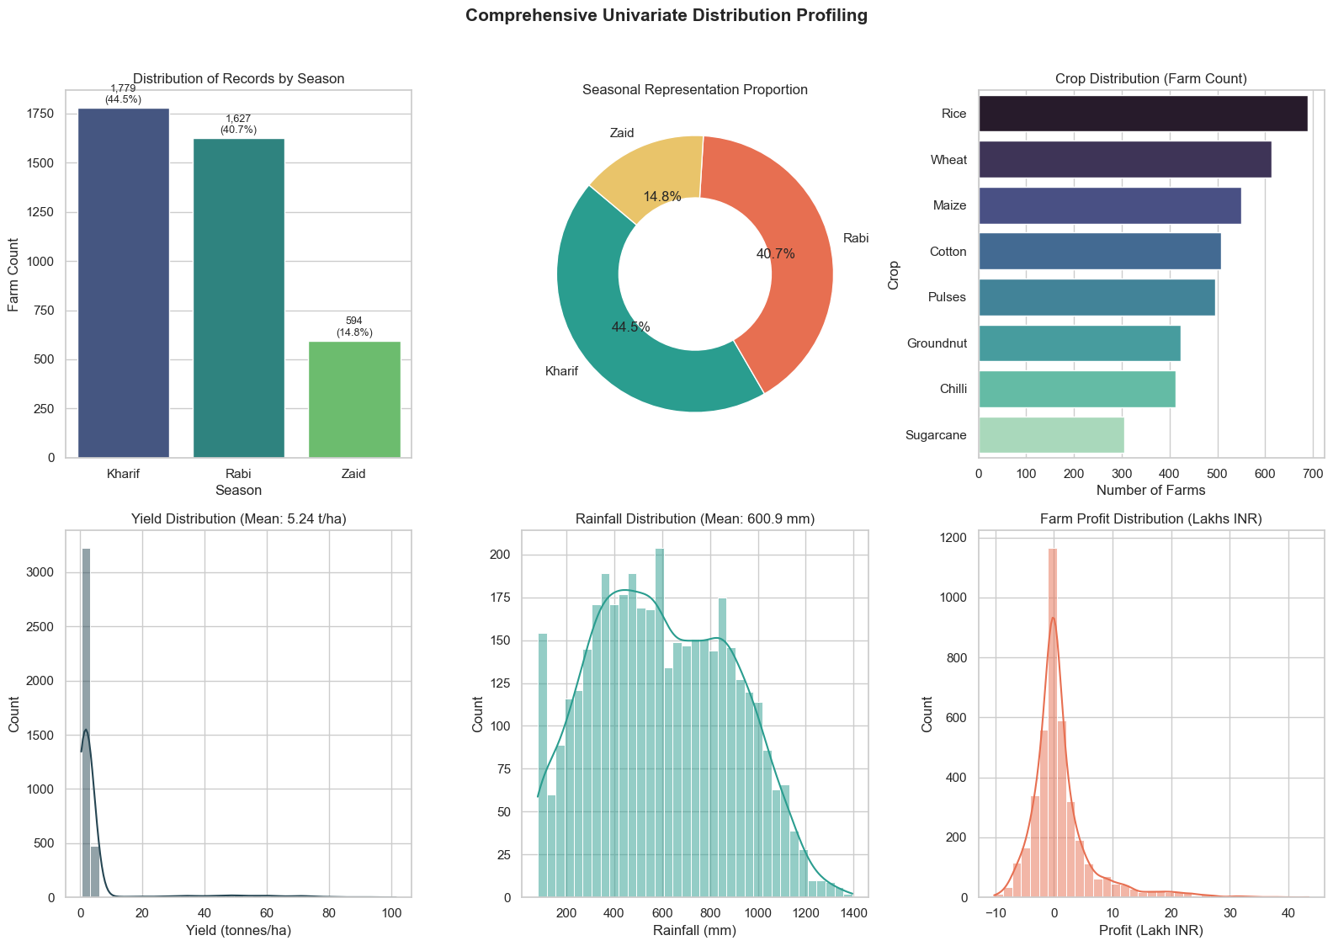
RESULTS
Dataset Distribution: Analyzed 4,000 farm records — Kharif represents 44.5% (1,779 farms), Rabi 40.7% (1,627 farms), and Zaid 14.8% (594 farms).
Crop Diversity: Rice (690) and Wheat (614) represent the largest staple holdings, while Sugarcane and Chilli represent high-value cash crops.
Baseline Metrics: Overall mean agricultural yield is 5.22 t/ha, mean rainfall is 600.9 mm, and mean farm profit is ₹1.03 Lakhs.

Slide 7
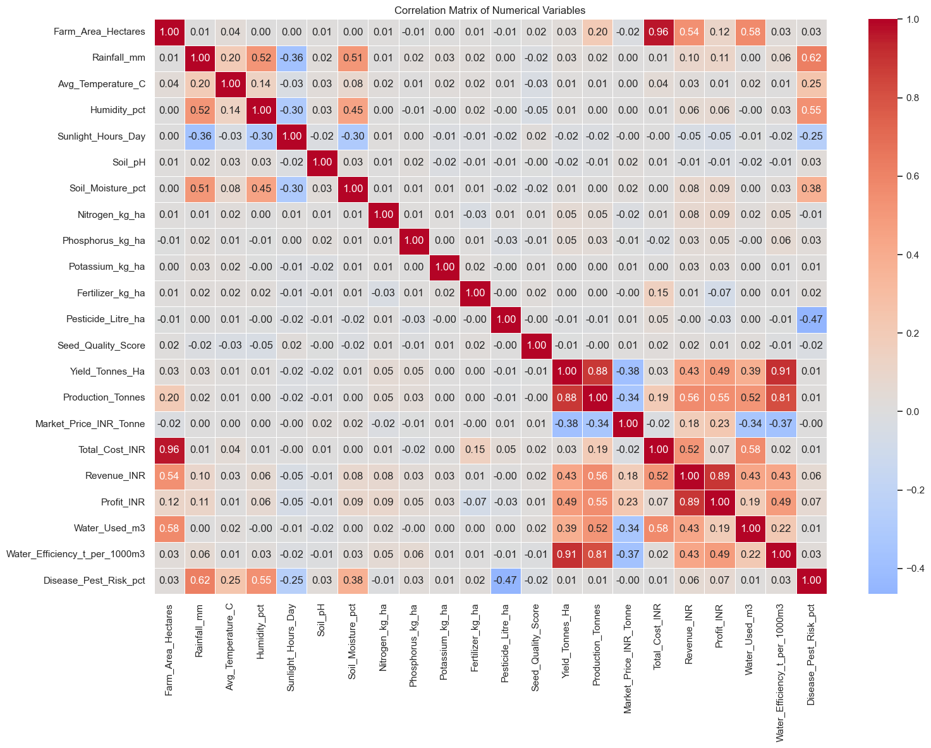
RESULTS
Correlation Matrix of Numerical Variables
Yield and Production: Strong positive correlation (r = 0.88).
Revenue and Profit: Strong positive correlation (r = 0.89).
Farm Area and Total Cost: Very strong positive correlation (r = 0.96).
Rainfall and Disease/Pest Risk: Moderate positive correlation (r = 0.62).
Humidity and Disease/Pest Risk: Positive correlation (r = 0.55).
Pesticide use and Disease/Pest Risk: Negative correlation (r = -0.47).
Key Finding
Production and profitability are strongly related to farm-scale and yield factors, while rainfall and humidity show positive relationships with disease and pest risk.

Slide 8
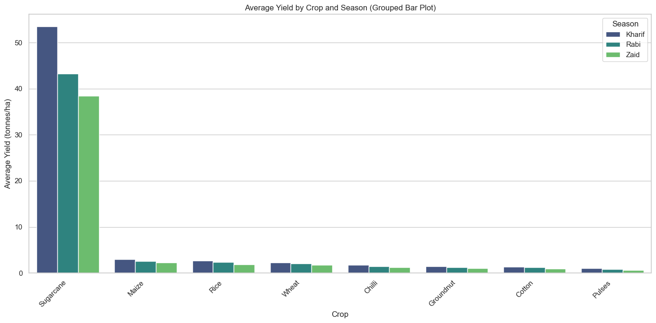
RESULTS
Average Yield by Crop and Season
Kharif generally shows the highest yield across the major crops.
Sugarcane has the highest average yield among all crops.
Rabi shows moderate and relatively stable performance across crops.
Zaid records comparatively lower yields for most crops.
Seasonal differences show that crop performance is closely linked to seasonal conditions.
Key Finding
Kharif performs better in terms of average yield, while Sugarcane is the strongest-performing crop across seasons.

Slide 9
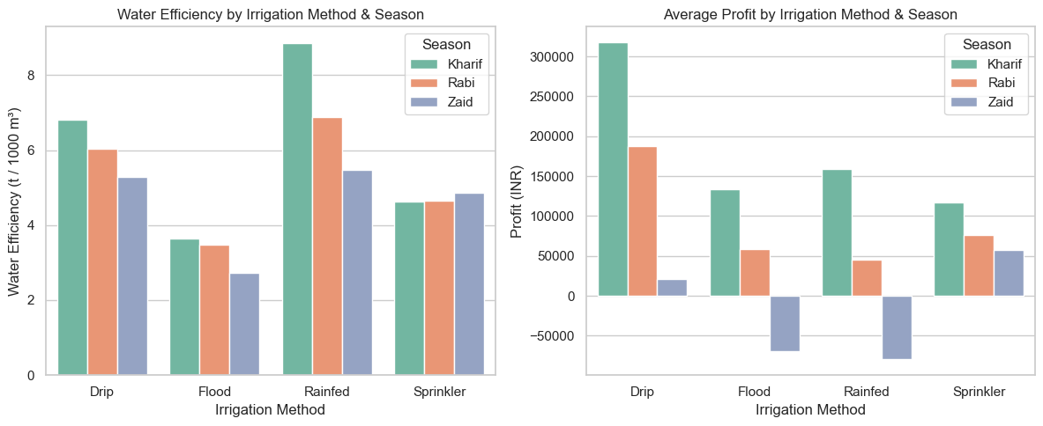
RESULTS
Micro-Irrigation Superiority: Drip irrigation delivers the highest water productivity (6.27 tonnes per $1,000,\text{m}^3$) and highest net profit (₹2.20 Lakhs).
Water Wastage in Flood Irrigation: Flood irrigation yields only 3.44 $t/1000,\text{m}^3$, consuming ~42% more water with lower profit margins.
Seasonal Criticality: In summer (Zaid), micro-irrigation is essential to prevent complete crop failure.

Slide 10
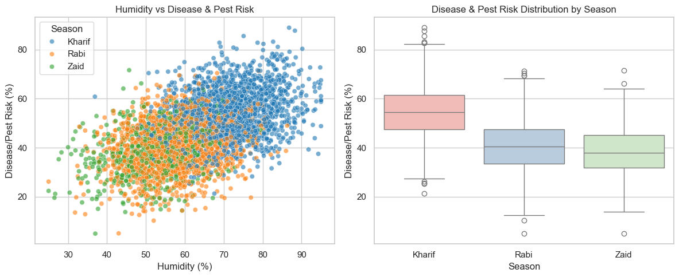
RESULTS
Kharif has the highest disease/pest risk compared with Rabi and Zaid.
Higher humidity is associated with higher disease/pest risk.
This suggests that humid seasonal conditions require better pest and disease management.

Slide 11
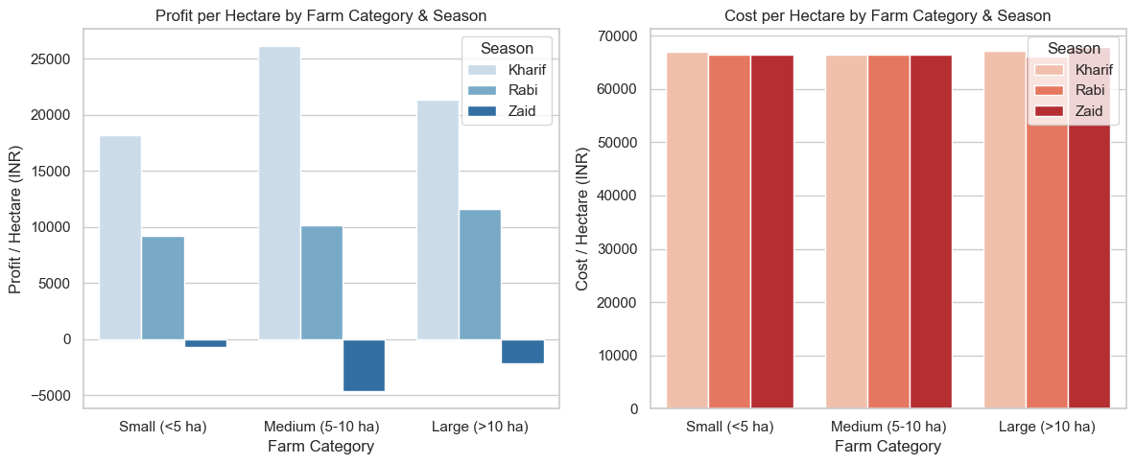
RESULTS
Medium and large farms show higher profit per hectare than small farms.
Cost per hectare remains relatively similar across the three farm categories.
Larger farms show better returns, indicating a possible economy of scale.

Slide 12
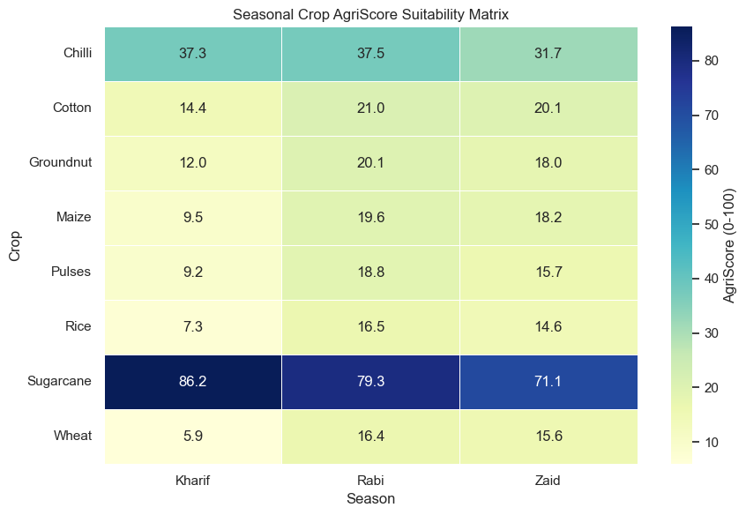
RESULTS
AgriScore Crop Suitability
AgriScore combines Yield, Profitability, Water Productivity, and Pest Resilience into one overall score.
Sugarcane is the strongest performer across all seasons, with the highest score in Kharif (86.22), Rabi (79.34), and Zaid (71.09).
Chilli is the second-best performer, especially in Kharif and Rabi.
Key Finding: Sugarcane shows the highest overall suitability across the three seasons.

Slide 13
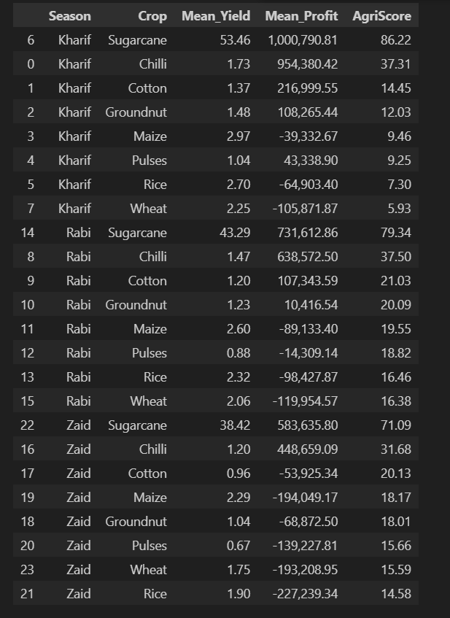
RESULTS
Suitability Summary Table
Season | Best Crop | AgriScore | Mean Profit
Kharif | Sugarcane | 86.22 | ₹10.01 Lakh
Rabi | Sugarcane | 79.34 | ₹7.32 Lakh
Zaid | Sugarcane | 71.09 | ₹5.84 Lakh
Other Strong Performer
Chilli: AgriScore 37.31 (Kharif) and 37.50 (Rabi)
Key Finding: The suitability matrix shows that Sugarcane consistently ranks first, while Chilli provides the next strongest combination of score and profitability.

Slide 14
Future scope
Multi-year Data Analysis: Use data from multiple years to study long-term agricultural and seasonal trends.
Climate Trend Analysis: Analyze the impact of changing rainfall and temperature patterns on crop performance.
GIS Integration: Add district-level maps to study regional differences in agriculture.
Soil & Water Analysis: Include groundwater availability and detailed soil information for better crop planning.
Improved Crop Recommendations: Develop a more advanced system to recommend suitable crops based on seasonal conditions.

Slide 15

GitHub Link
https://github.com/rukeshsg/seasonal-agriculture-performance-analysis

Slide 16

VOIS Course completion certificate - Course name- Data Visualization

Slide 17
Thank you
.
.

