Slide 1


Telecommunication Domain (Churn Prediction)

Slide 2

Objective of the Project
The objective is to predict to a high accuracy, in advance the customers who may attrite from the existing service provider in near future.
Highlighting the Main Variables/Factors influencing the Churn.
Having DSL internet Service also reduce the probability of Churn.
To Predict Customers Churn.

Slide 3
Summary of the Data
Data consists of 7043 fictional customers who belong to various demographics (single; with dependents; senior citizen) and subscribe to different products offerings (internet service; phone line; streaming TV; streaming movies; online security) from a telecom company located in one of the US states.
Almost 27% of the Customers of telecom Company ‘Churns’
Rarely use Online backup, Online Security , Tech Service or device Protection but watch more of streaming Movies and Online Tv on their Connections.

Slide 4
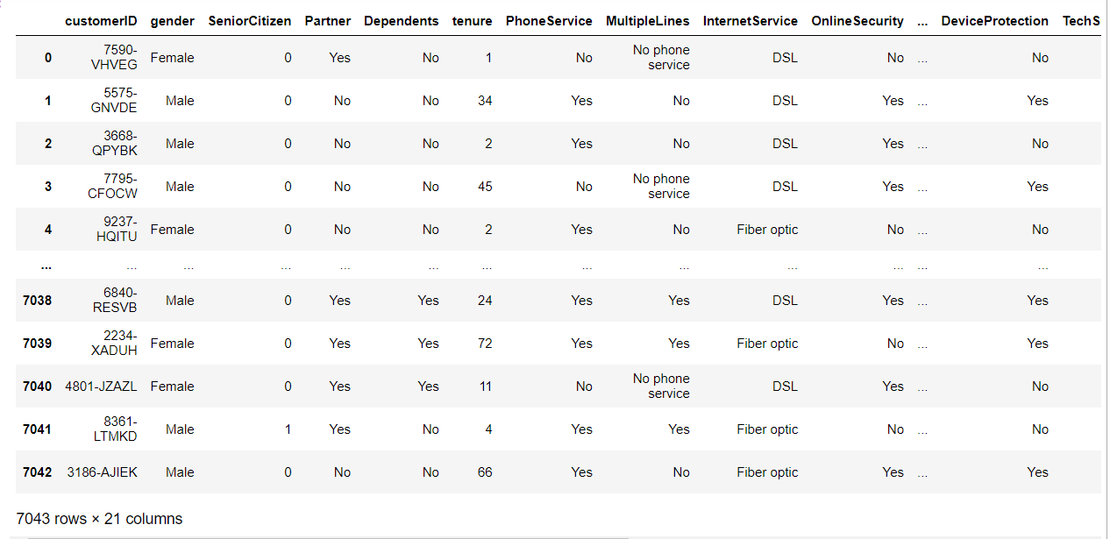
Raw Data
Insights:- From this Data we have 7043 rows and 21 Columns

Slide 5

Data Cleaning and Data Manipulation Steps
Handling the missing values.
Filling the missing values with the Mean Values for the Numerical Data.
Replace missing values.
Converting the Data Types of “String” to “Float”.

Slide 6
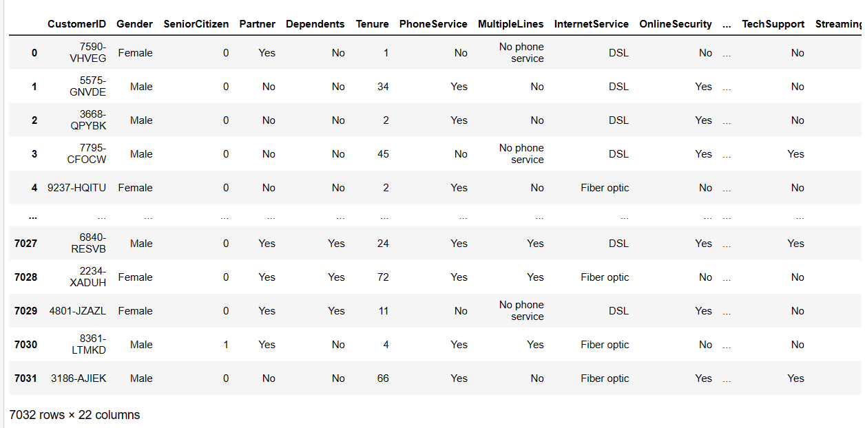
Cleaned Data
Insights:- Cleaned Data Contains 7032 rows and 22 Columns

Slide 7
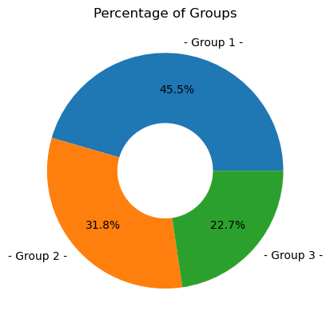
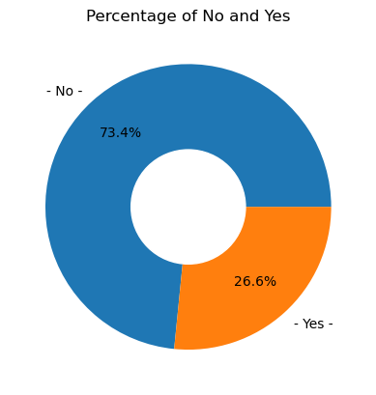
Analysis on Tenure and Churn
INSIGHTS:-
Tenure groups of 1-12 and 13–24 are churning more which can be intuitively understood from the fact that teens and early 20s customers are changing their telecom services more frequently and thus are not so loyal customers in comparison to their parents or grandparents.
INSIGHTS:-
from the data we observed that there are less people who are churned while there are more people who does not churn.

Slide 8
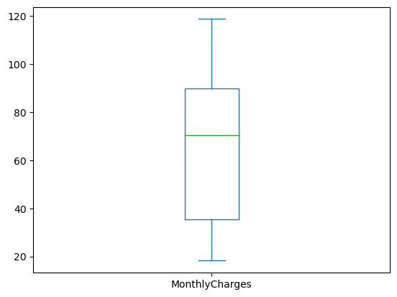
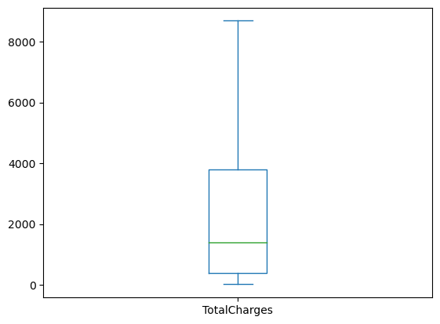
Analysis on Monthly Charges and Total Charges
Insights:-
From the above Box Plot we observed that there are more data in Monthly Charges so, mean lies in the range of 60-80.
Insights:-
From the above plot there are less data so, mean lies in the range of 0-2000.

Slide 9
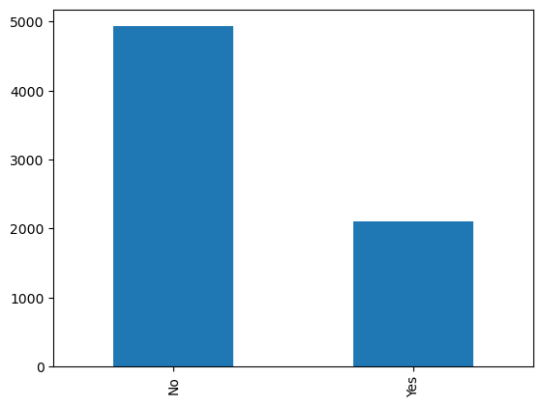
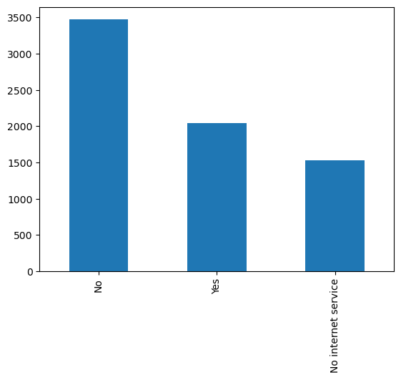
Analysis on Dependents and Tech Support
Insights:-
From the Above Bar Plot we Observed that there are less Dependents while Compared with More Non Dependents
Insights:-
there are more people who are not using tech support while compared with people who are using tech support and there are some people who does not having any internet service

Slide 10
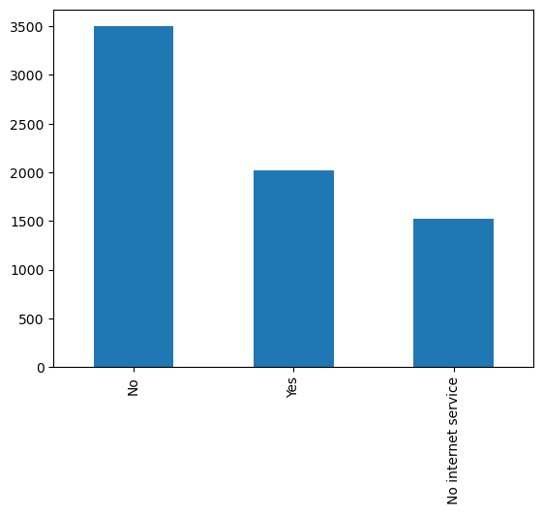
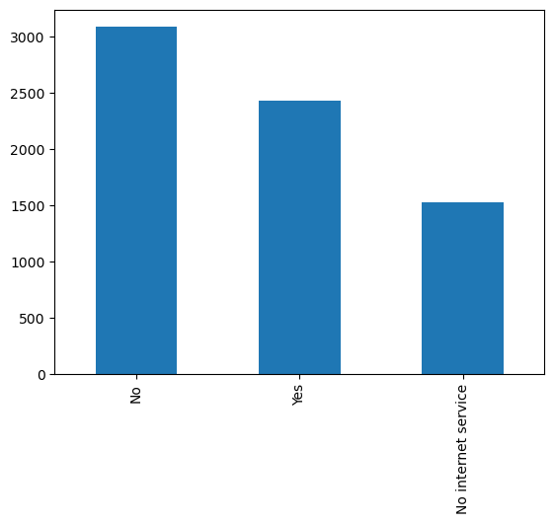
Analysis on Online Security and Online Backup
Insights:-
from the graph there are more people who does not have Online Security while some of them have minimum Online Security, there are some customers with no internet service
Insights:-
from the graph there are more people who does not have Online Backup while some of them have minimum Online Backup, there are some customers with no internet service

Slide 11
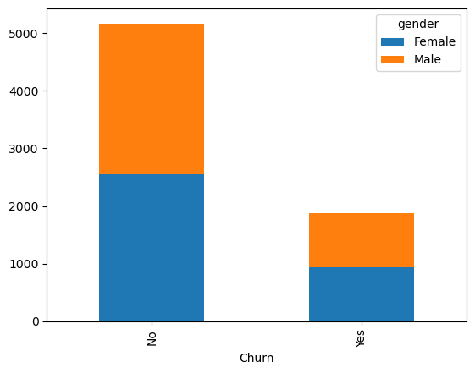
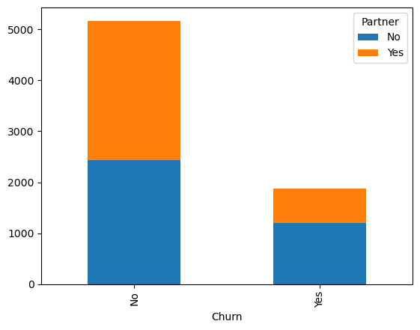
Analysis between Churn with Gender and Partner
Insights:-
From the Stacked Bar Plot there are More People who are willing to churn while There are Less People who doesn’t Churn.
Insights:-
From the distribution above, it can be seen that Customers without partners are churning more in comparison to customers with partners.

Slide 12
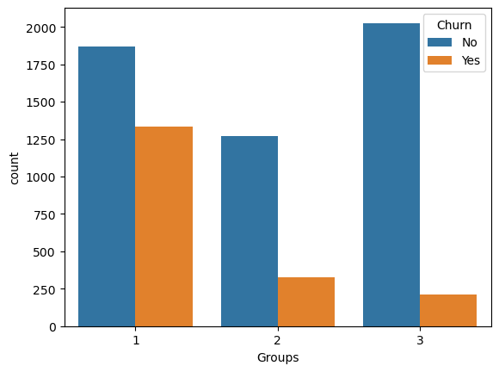
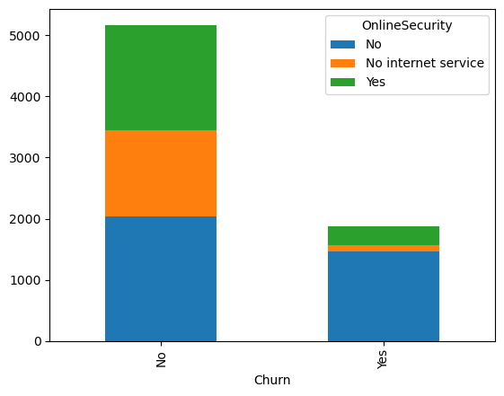
Analysis Between Churn with Tenure and Online Security
Insights:-
Tenure groups of 1-12 and 13–24 are churning more which can be intuitively understood from the fact that teens and early 20s customers are changing their telecom services more frequently and thus are not so loyal customers in comparison to their parents or grandparents.
Insights:-
From the distribution above, it can be seen that Customers without Online Security are churning more in comparison to customers with Online Security.

Slide 13
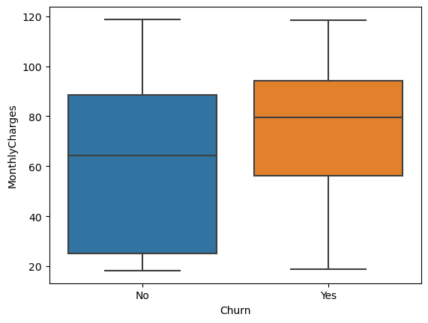
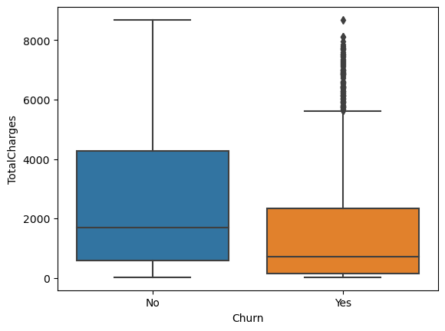
Analysis Between Churn with Monthly Charges and Total Charges
Insights:-
from the above Box Plot we observed that there are more People who does not Churn with monthly Charges whereas very few people are going to churn.
Insights:-
from the above Box Plot we observed that there are more People who does not Churn with Total Charges whereas very few people are going to churn.

Slide 14
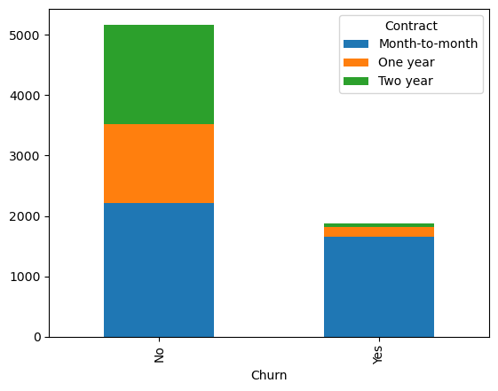
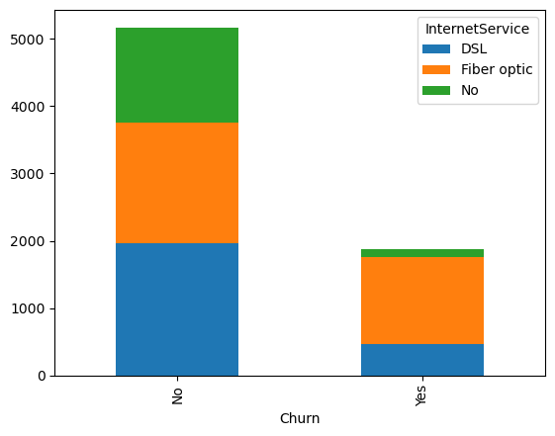
Analysis between Churn with Contract and Internet Service
Insights:-
From the distribution above, it can be seen that Customers without Contract are churning more in comparison to customers with Contract
Insights:-
From the distribution above, it can be seen that Customers without Internet Service are churning more in comparison to customers with Internet Service

Slide 15
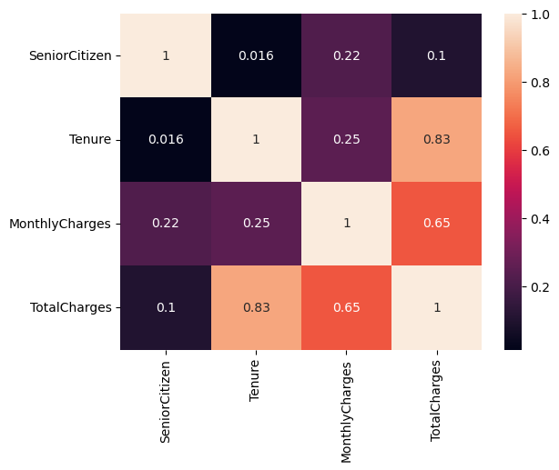
Correlation between all Numerical Columns
Insights:-
As we observed in the above heat map As we can see the highly positive correlation is seen in the (Total charges and Tenure) features so that the total charges are directly proportional to Tenure
ie, Total Charges are increased by increasing in the tenure period. We can also observed that the less positive correlation seen in (Total Charges and Senior Citizen) features .

Slide 16
Key Business Question
A high churn rate means you aren't able to retain customers; therefore, loyalty to your service is low.(Columns such as :- Total Charges, Monthly Charges, Tenure)
What is the impact of churn in telecom industry?
Which activity reduces the risk of churn?
Having DSL internet Service also reduce the probability of Churn.
What is the effect for customer churn in tenure ?
As the Tenure period Increases with decrease in the Churn rate

Slide 17
Conclusion(Key finding overall)
Significant variables impacting “Churn”: Type & Tenure of Contract
Churn is observed to be high for customers:
Without dependents
With high cost Phone Services
Having single line service (no combo services)

Slide 18
Recommendations
Recommendation to Business Team for retaining Customer
Targeted Customer Promotion
Promote Long Term contract
Market more products as Combo (multi) service offerings

Slide 19
Your Experience/Challenges working on the Project:-
Customer Analytics: Telecom companies use Data Science to analyze customer behavior and preferences to personalize offerings, optimize pricing, reduce churn, and enhance customer satisfaction.
Network Optimization: With the help of Data Science, telecom companies can optimize network performance by predicting network failures, optimizing bandwidth allocation, and reducing latency.
Fraud Detection: Data Science is used to detect and prevent fraud in telecom billing and other areas, resulting in significant cost savings for the industry.
Marketing and Sales: Telecom companies use Data Science to develop targeted marketing campaigns, analyze sales trends, and identify new revenue opportunities.
Predictive Maintenance: Telecom companies are using Data Science to perform predictive maintenance on network infrastructure, reducing downtime and improving network availability.

Slide 20


Slide 21

THANK YOU

