Slide 1

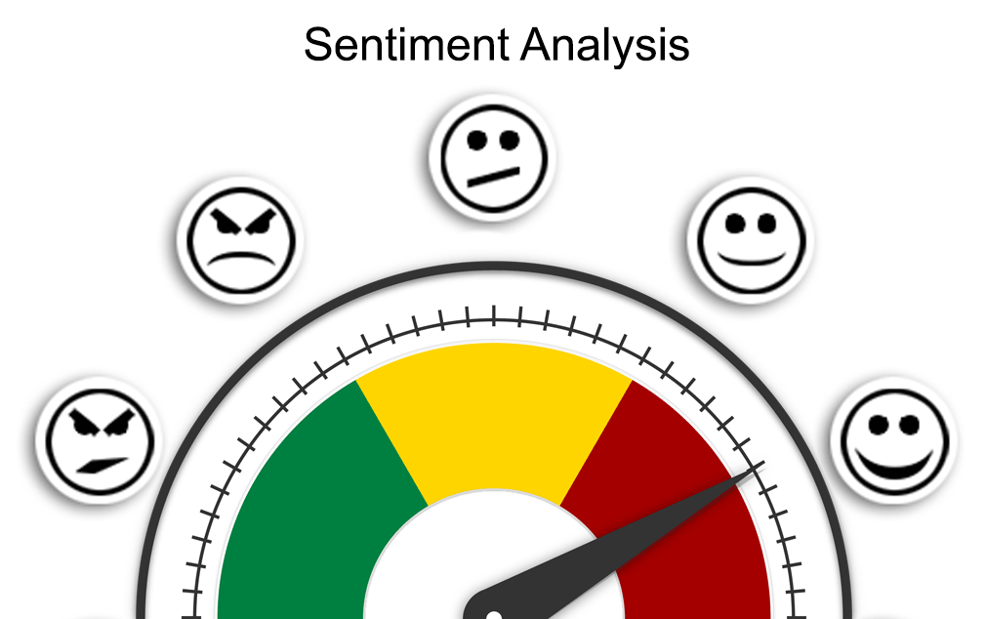
Text Data - Sentiment Analysis

Slide 2
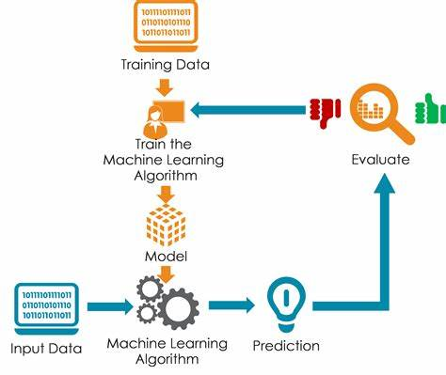
Agenda
Data Analysis
Data Preprocessing
Model Training & Evaluation
Comparison of Models based on Accuracy, size and latency
Model Deployment using Stream lit

Slide 3
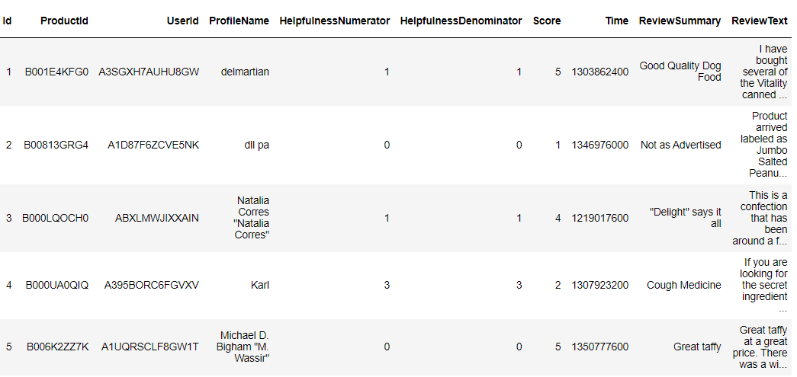
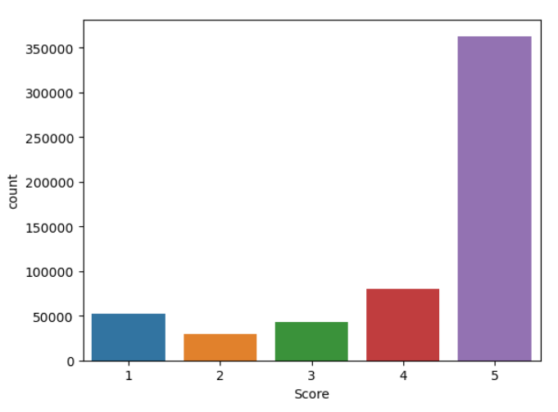
Analysis on the dataset
Data Dimensions: The shape of the Data Frame is (568454, 9), which means it has 568,454 rows and 9 columns. Each row contains a detailed information about each review, including user and product identifiers, review ratings, helpfulness information, timestamps, and review summaries.
Score Distribution Insights: This analysis indicates the distribution of review scores in your dataset. The majority of reviews received a score of 5, followed by scores of 4, 1, 3, and 2.

Slide 4
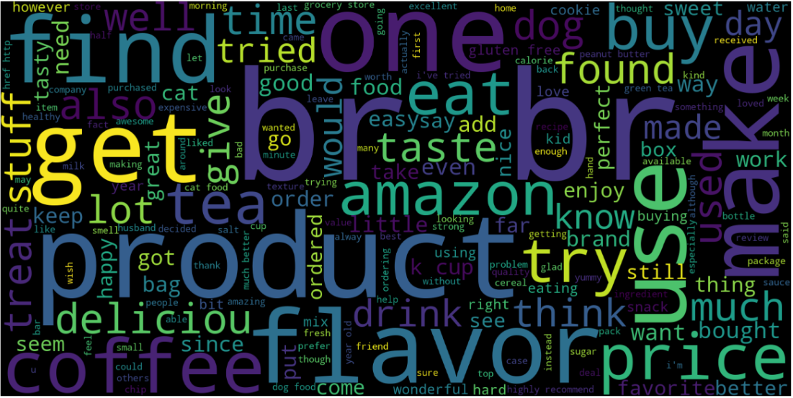
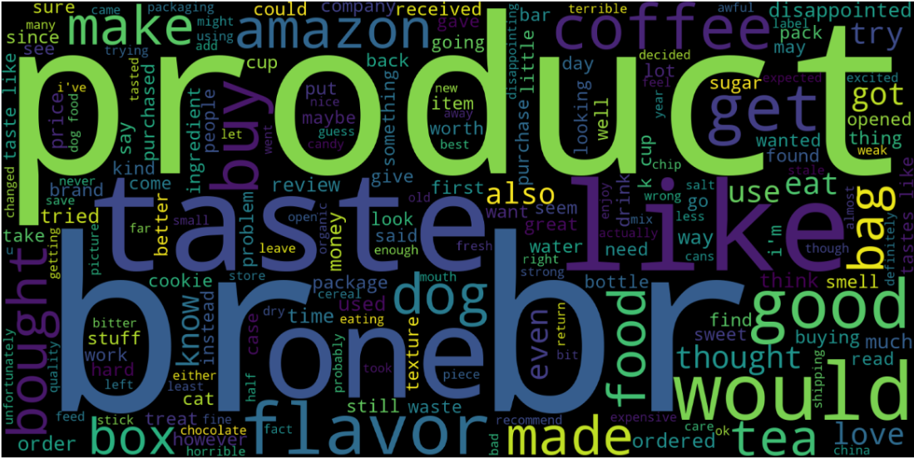
Word Cloud for Positive Sentiment:
Word Cloud for Negative Sentiment:

Slide 5
Machine Learning Framework
Identify Input and Output Variables
Input Variables(X): review_text.
Output Variable(y): Sentiment
Identify the type of ML Task
As the output variable y is discrete categorical hence the ML Task is Classification.
Identify the Evaluation Metric
The evaluation metric used for Classification Task is Accuracy.
Split the data into train and test
1. Split the data into train and test data on both input and output variables in 75:25 ratio such that 75 percent of the data would be
used for training the model and 25 percent of the data which is the unseen data would be used for prediction of the model.
2. After splitting, there are 4 sets of data which are X_train,X_test,y_train and y_test.

Slide 6
Data Preprocessing
The Data preprocessing involves the process of text cleaning and converting the text into numerical representation using Bag of Words and TF-IDF techniques.
Bag of Words (BoW):
Word Count Representation: Bag of Words is a text representation technique that converts a piece of text into a "bag" of its individual words, disregarding grammar and word order.
Tokenization: The text is split into words, called tokens. Punctuation and capitalization are usually removed.
Frequency Count: For each word in the vocabulary, the number of times it appears in the text is counted. The result is a vector where each dimension represents a word and its count in the text.
TF-IDF (Term Frequency-Inverse Document Frequency):
Term Importance: TF-IDF is a technique that assigns a weight to each word in a document based on its frequency in the document (TF) and its rarity across multiple documents (IDF).
Term Frequency (TF): Measures how often a word appears in a document. Words that appear frequently get higher scores.
Inverse Document Frequency (IDF): Measures how unique a word is across all documents. Common words like "the" have low IDF, while specific words have high IDF.
Weight Calculation: The TF-IDF weight of a word in a document is the product of its TF and IDF scores. Words with higher TF-IDF scores are more important for that document.

Slide 7





Model Development & Evaluation
Model Development using train data:
X_train
y_train
Algorithm
Model
Model Prediction using test data:
X_test
Model
y_test_pred
Model Evaluation:
y_test
y_test_pred
evaluation metric
score

Slide 8

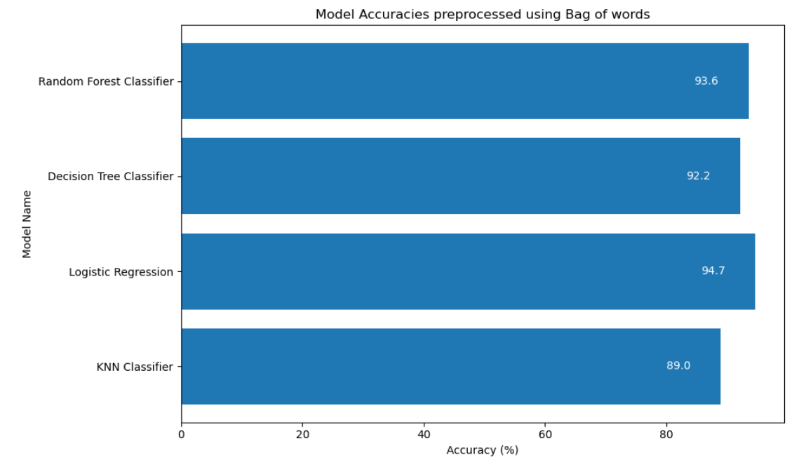
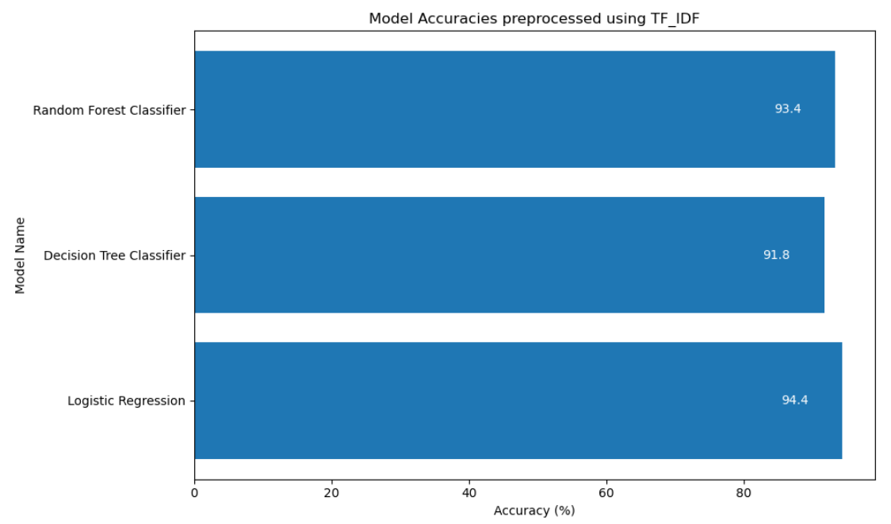
Comparison of different Models
Here are the different models using Bag of Words and TF-IDF, that were used for the prediction of sentiment for a given text along with their accuracies:

Slide 9

Latency of models
Preprocessed using Bag of Words:
Model Name | Prediction Time
Logistic Regression | 0.054189 seconds
Decision Tree Classifier | 0.200557 seconds
Random Forest Classifier | 34.322906 seconds
Preprocessed using TF-IDF:
Model Name | Prediction Time
Logistic Regression | 0.022937 seconds
Decision Tree Classifier | 0.521668 seconds
Random Forest Classifier | 23.467889 seconds

Slide 10

Conclusion
The analysis reveals that the accuracies achieved using both preprocessing techniques are quite comparable.
Among the models evaluated, Logistic Regression stands out with the highest accuracy of 94.7%, outperforming the other models.
In addition, the Logistic Regression model showcases distinct advantages.
It boasts the quickest prediction times and a smaller model size of 648 KB in contrast to the other models under consideration.
Consequently, based on these findings, it can be concluded that the Logistic Regression model is the most fitting choice for the task of text sentiment analysis.

Slide 11
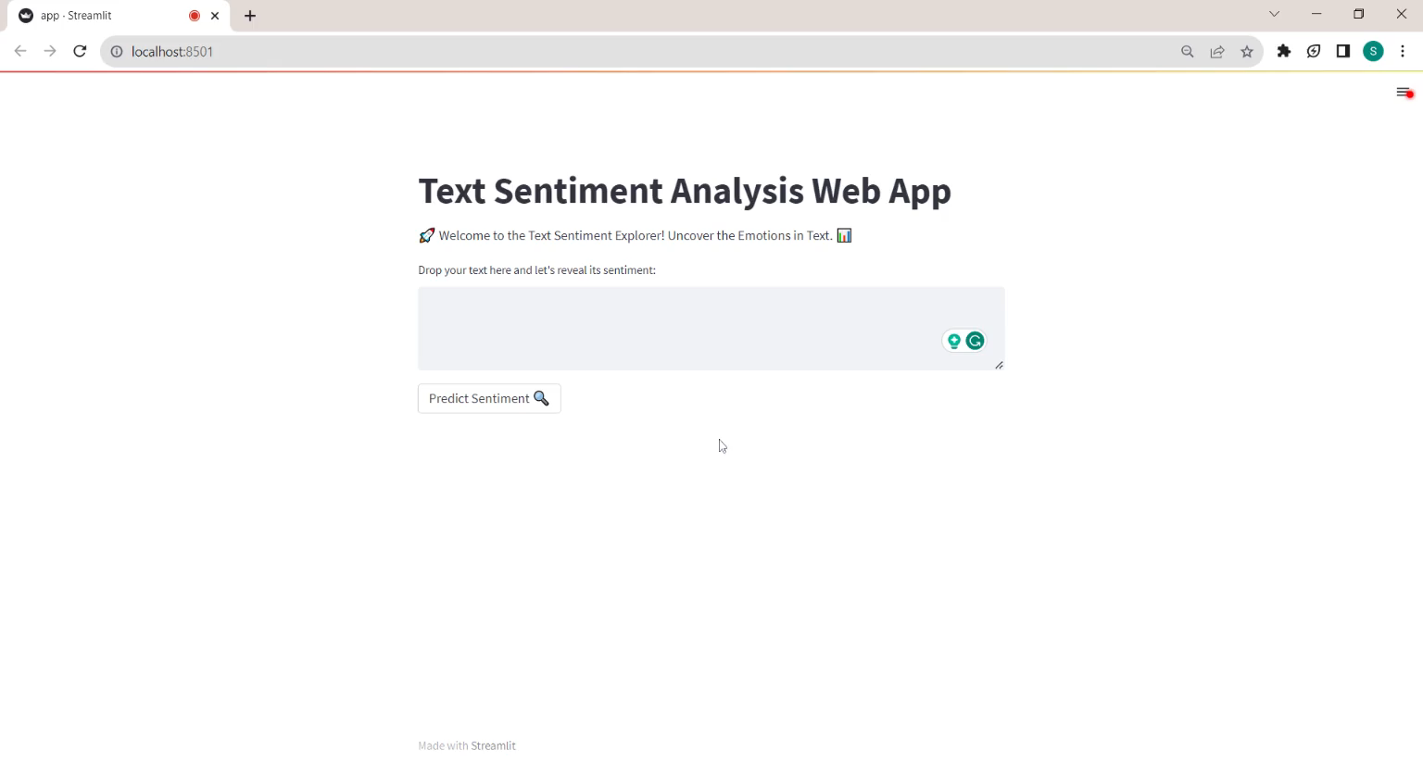
Below is the video showcasing a Streamlit web application that takes an input text and displays the sentiment predicted by the model for the given text.

Slide 12

THANK YOU

