Slide 1

Image Data - Recognizing Handwritten Alphabets
By
Daliparthy Sumukha Kavya
&
Rukesh Varanasi

Slide 2
About us
About Us
Team Member -1 : Myself Daliparthy Sumukha Kavya, I have recently graduated B.Tech. in Computer Science and Engineering at Sastra University, Thanjavur. I am aspiring to be a Data Scientist. During my third year, I started exploring machine learning and the applications of using it in real-time which ignited the interest in me and motivated me in choosing Data Science as my career.
Team Member -2: I am Rukesh Varanasi, a master's graduate in Microbiology specialization from Osmania University. My goal is to become a data scientist and apply my skills and knowledge to solve real-world problems.

Slide 3
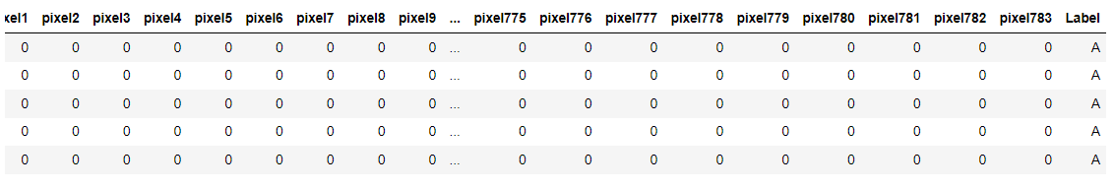
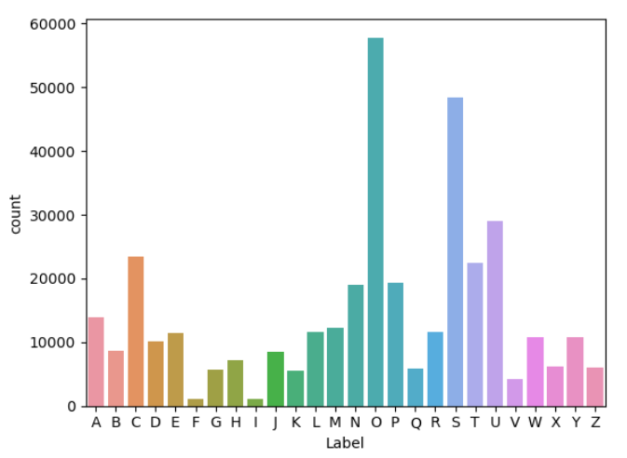
Analysis on the dataset
Data Dimensions: The data frame contains a total of 372,451 samples, each represented by 785 columns. The first 784 columns correspond to the pixel values (28x28 images), and the last column represents the target class labels.
Class Distribution Insights: The dataset consists of 26 classes, representing characters from 'A' to 'Z'. The counts for each class vary, indicating a class imbalance in the dataset. The character 'O' has the highest frequency with 57,825 samples, while 'F' has the lowest frequency with only 1,163 samples.

Slide 4
Agenda
Data Preprocessing: Preprocess the MNIST image data and convert it into a pandas data frame. This step involves reading the image files, handling any missing or corrupted data, and transforming the images into numerical vectors suitable for machine learning.
Model Building: Develop a character recognition model using machine learning or deep learning techniques. Choose an appropriate algorithm or architecture for the task and train the model on the preprocessed data.
Model Evaluation: Evaluate the performance of the built model using accuracy. Measure how well the model can recognize characters from the test data.

Slide 5
Machine Learning Framework
Identify Input and Output Variables
Input Variables(X): the pixel values pixel1,pixel2,……,pixel783.
Output Variable(y): Label (A-Z)
Identify the type of ML Task
As the output variable y is discrete categorical hence the ML Task is Classification.
Identify the Evaluation Metric
The evaluation metric used for Classification Task is Accuracy.
Split the data into train and test
1. Split the data into train and test data on both input and output variables in 75:25 ratio such that 75 percent of the data would be
used for training the model and 25 percent of the data which is the unseen data would be used for prediction of the model.
2. After splitting, there are 4 sets of data which are X_train,X_test,y_train and y_test.

Slide 6
Image Preprocessing
For loading all the images into the dataset, all the images are preprocessed using the following techniques.
Convert the Image to Grayscale:
The input image is in original format (e.g., RGB or RGBA).
The image is converted to grayscale. Grayscale images have only one channel, representing the intensity of the pixels, and are suitable for various computer vision tasks.
Convert Grayscale Image to NumPy Array:
The grayscale image is converted into a NumPy array.
The array contains the pixel intensities are represented by values ranging from 0 to 255.
Flatten the NumPy Array:
The array is now flattened into a one-dimensional array.
The array is appended to the dataframe.
The dataframe now contains the 783 pixel values (since the image size is 28x28) of each image, along with the label column.

Slide 7





Model Development & Evaluation
Model Development using train data:
X_train
y_train
Algorithm
Model
Model Prediction using test data:
X_test
Model
y_test_pred
Model Evaluation:
y_test
y_test_pred
evaluation metric
score

Slide 8

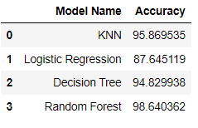
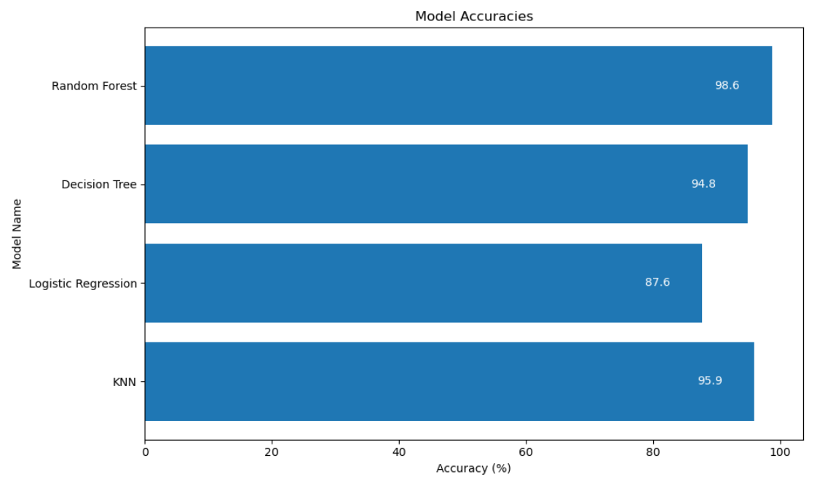
Comparison of different Models
Here are the different models, that were used for the recognition of handwritten alphabet from the image along with their accuracies:
The accuracies of all the models is greater than 85%.
The Random forest classifier model has the highest accuracy compared to the remaining models.

Slide 9

Latency of models
Model Name | Prediction Time
Logistic Regression | 0.671244 seconds
Decision Tree Classifier | 0.233204 seconds
Random Forest Classifier | 8.903592 seconds
The time taken by the Decision Tree classifier model to predict the handwritten alphabet from the image is less compared to the remaining models.
The Random forest classifier model has the highest prediction time.
The KNN classifier model prediction time is quite higher than all the models.
Hence, The Decision Tree classifier model is the model with less latency.

Slide 10

Comparison of sizes of the models
Model Name | Size of the model
KNN Classifier Model | 2,14,969 KB
Logistic Regression Model | 169 KB
Decision Tree Classifier Model | 8678 KB
Random Forest Classifier Model | 11,16,669 KB
K-Nearest Neighbors (KNN) Classifier :
Medium-sized model with moderate complexity.
Memory-based algorithm contributes to the size.
Logistic Regression :
Small-sized model with low complexity.
Fewer parameters compared to other models.
Decision Tree Classifier :
Medium-sized model with moderate complexity.
Size varies based on tree depth and nodes.
Random Forest Classifier:
Large-sized model with high complexity.
Ensemble model with multiple decision trees.

Slide 11

Conclusion
Decision tree classifier model is the best suitable model with less latency and good accuracy and is light for deployment.
Even though the accuracy of Random Forest classifier model and the KNN classifier model is higher compared to the Decision Tree classifier model, their prediction time is quite higher than the Decision Tree classifier model.
Even though, the Logistic Regression model is small in size compared to other models, the latency of the model is high and the accuracy is low.
Hence the Decision Tree Classifier is the most suitable model for the classification of the handwritten alphabets.

Slide 12
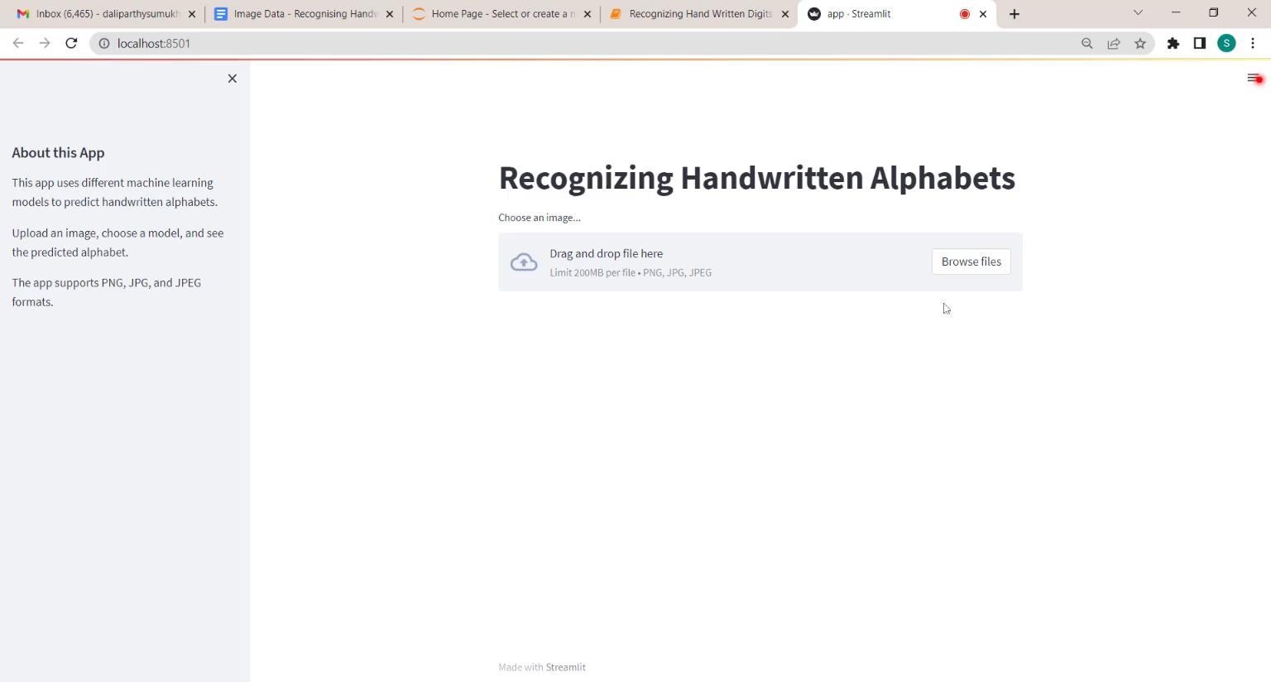
Below is the video showcasing a Streamlit web application that takes an input image and displays the predicted handwritten alphabet using various models:

Slide 13

THANK YOU

