Slide 1


Employing machine learning algorithms to anticipate Insurance Charges

Slide 2
Agenda
Overview of EDA Insights
Machine Learning Model :-
ML Framework
1. Identifying the inputs (X) and output (y).
2. Split the data into train and test.
3. Preprocess the Training data.
4. Build a ML model.
5. Preprocess the Test Data.
6. Prediction on Test Data.
7. Evaluation
Conclusion

Slide 3
Insights
The values of Age feature are uniformly distributed mostly they are from same age group.
Charges column have outliers as we know it is an target variable so we can’t remove data.
Compare to Non smokers, smokers are less.
South – East People are more in number compare to other regions.
The female charges are less compare to males.
Average charges of both male and female are almost equal.
Age and charges features having highly positive correlation in the data.
The smokers are more in males when compared to females.
The Non-smokers charges are less to compare with smokers charges.
As Per EDA we can conclude that " Age " and " Smoker " are the columns which will have adverse Effects on "Charges" column.

Slide 4
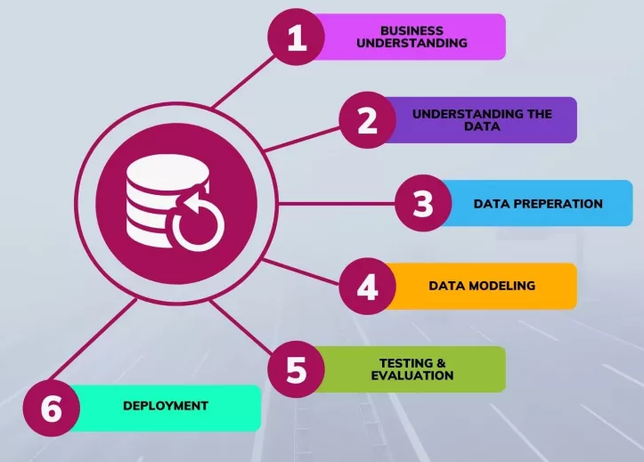
CRISP ML FRAMEWORK

Slide 5
STEPS INVOLVED IN MACHINE LEARNING FRAMEWORK
Identify the input variables and the target or output variable.
Split the data into train and test.
Data preparation on X Train (Fit and Transform)
Building the model.
Data preparation on X Test (Transformation)
Prediction on test data.
Evaluation of model.

Slide 6
IDENTIFYING THE INPUT AND OUTPUT VARIABLES
Input Variables : Age, Bmi, Children, Smoke, Sex, Region.
Target Variable: Charges.
Type of Algorithm: Supervised Learning Algorithms.
Task: Regression since Charges feature contains real-values.
Evaluation Metric: Mean Absolute Error, r2 Score.
SPLITTING THE DATA INTO TRAIN TEST
We are taking 75% of the data points as our training data and 25% as test data .
Out of 1338 data points 996 are training data points and 333 are test data points.

Slide 7
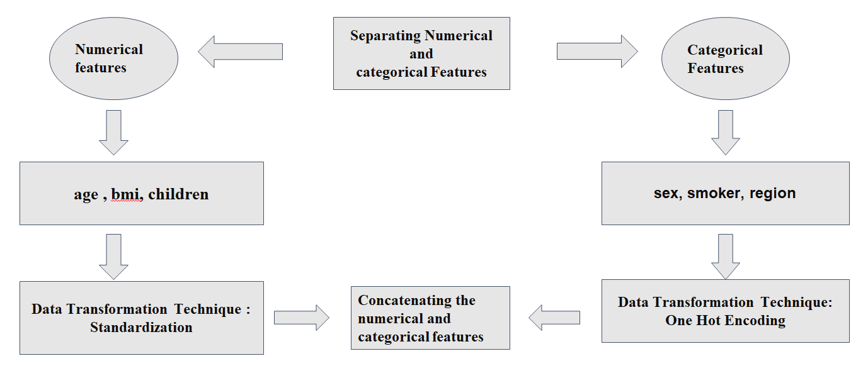
Data Preparation on train Input features

Slide 8
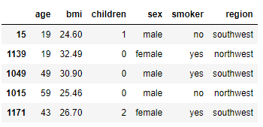
Data before transformation
Standardization : The standardization is the techinique to rescaled the numeric data to single scale
The mean becomes approximately 0 and standard deviation 1. The standardization also
known as Z-score transformation. Standardization is not bounded by range.
Onehotencoding : One hot encoding is a transformation techinique to convert categorical data to
numeric representation because categorical columns are nominal values

Slide 9
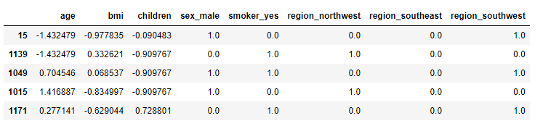
Data after transformation
Evalution metric
Mean absolute error :-
It measures the average absolute difference between the predicted values and the
actual values.
R2-Score :-
It represents the proportion of the variance in the target variable. R2 ranges from 0 to 1.

Slide 10
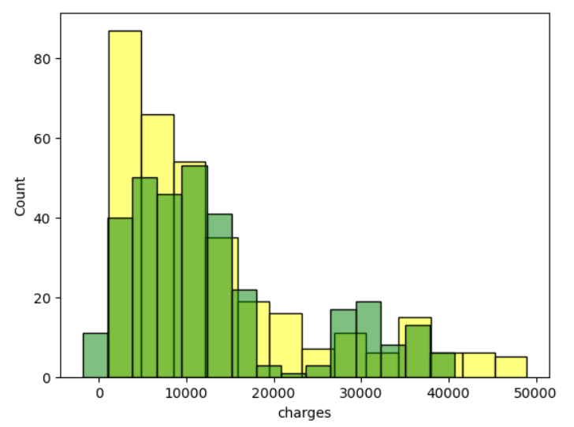
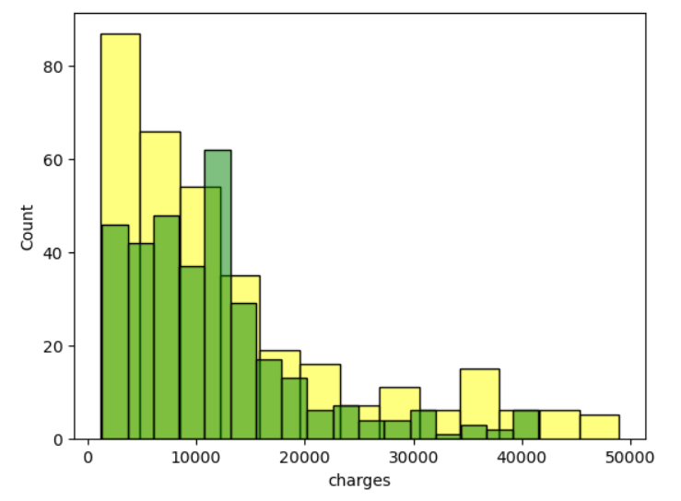
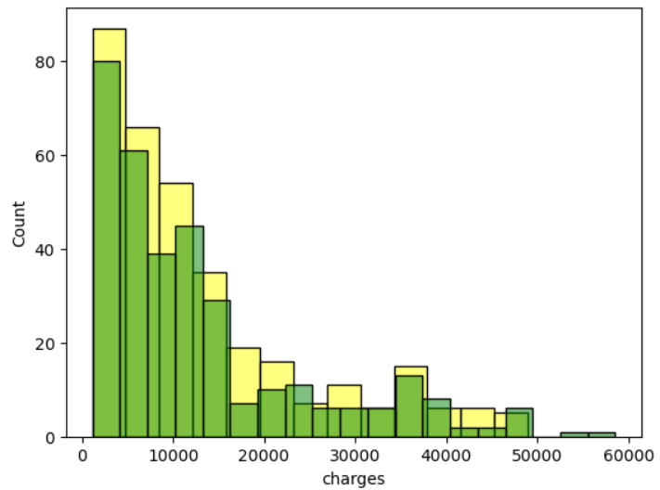
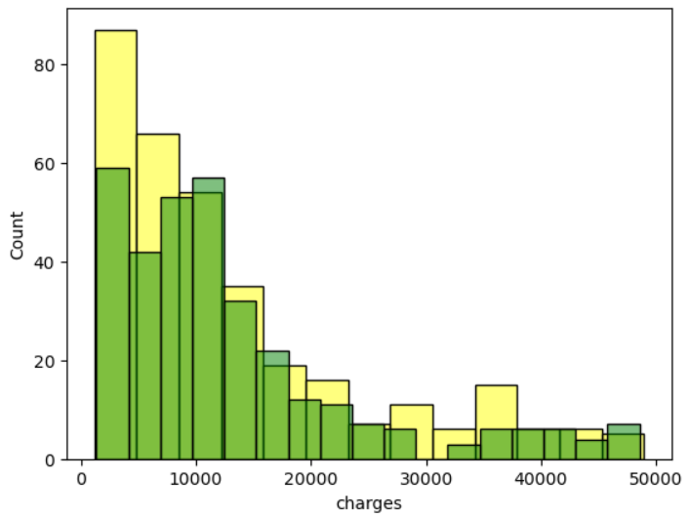




Models Performances
Task is Regression we use the Regression algorithm’s for building for the Medical cost prediction problem.
Linear Regression
K-Nearest Neighbors Regressor
Decision Tree
Regressor
Random Forest Regressor

Slide 11
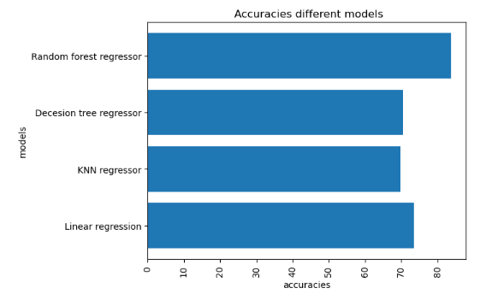
Performance of different models
As we Observed that all models are
performing well.
The Random forest regressor gives
best predictions of 83% compare with
other models.
The decision tree and KNN both are
similar and gives predictions of 70%.

Slide 12

THANK YOU

