Slide 1
Austin Metro Bike Trips
STA380 Introduction to Machine Learning – Project
<Insert Names and EIDs in Alphabetical Order>

Slide 2
Random Forests

Slide 3
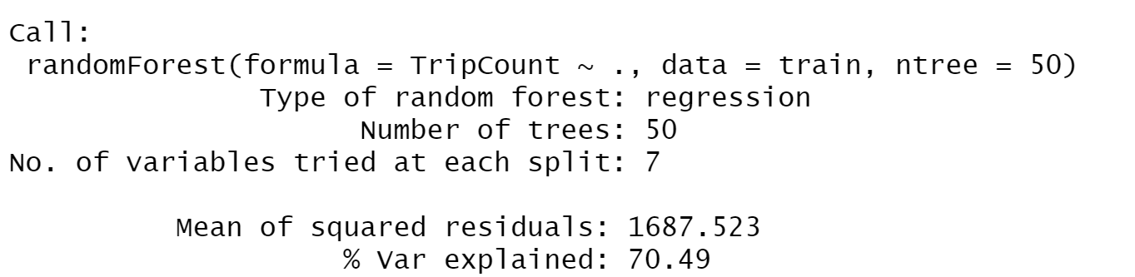
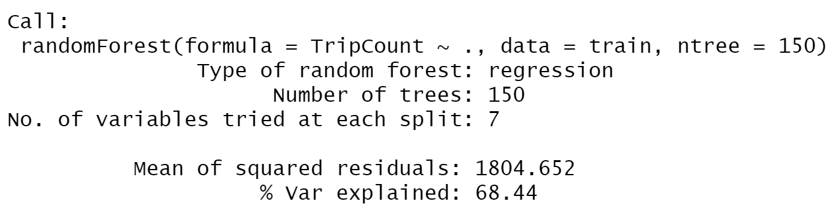
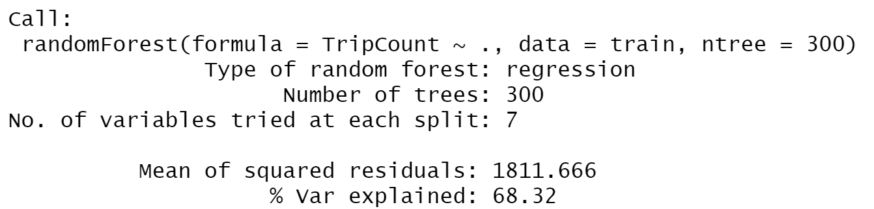
Random Forests at (B = 50, B = 150, B = 300) and (M=7) yield different results

Slide 4
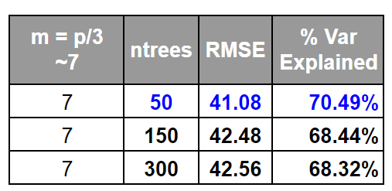
Random Forests at (B = 50, B = 150, B = 300) and (M=7) yield different results
This is unexpected behavior!
May require a larger M due to random sampling of variables having a strong effect.
Bagging

Slide 5
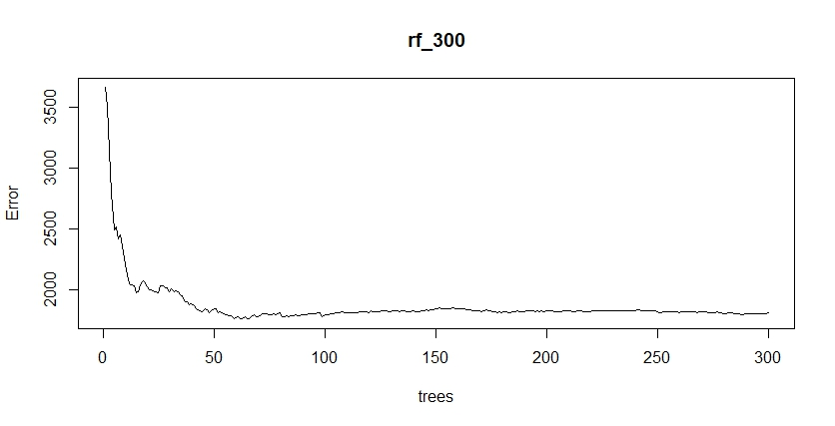
Random Forests begin to diminish returns a little over 100 trees
50 trees is not special! The randomness of the forest can create ….RANDOMNESS!

Slide 6
Bagging

Slide 7
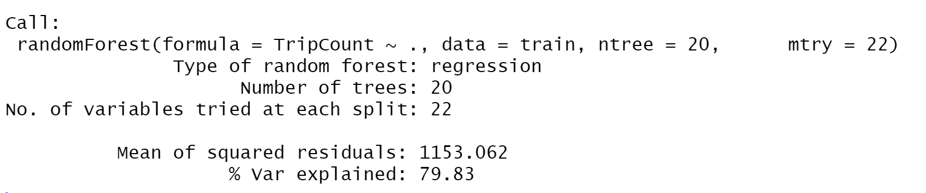
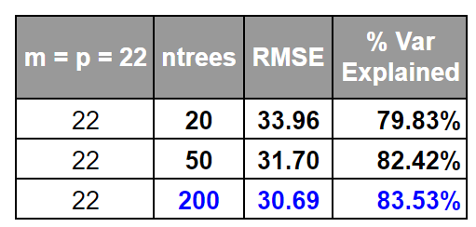
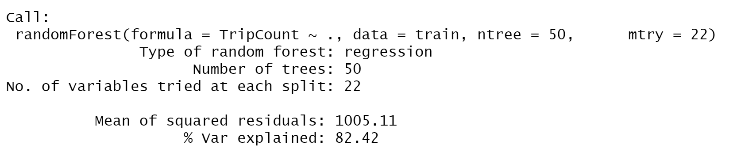
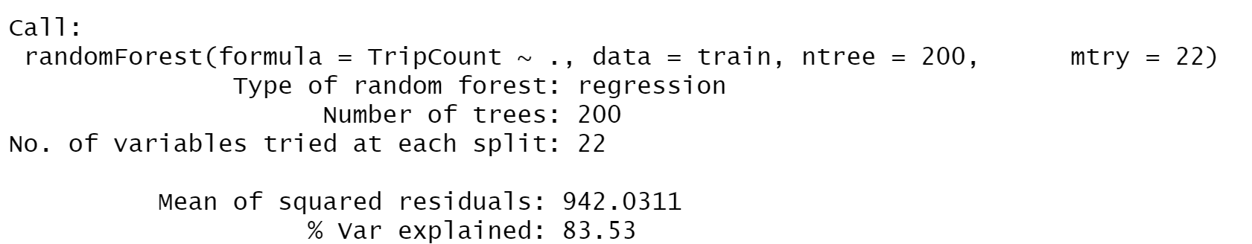
Bagging at (B = 20, B = 50, B = 200) yields different results

Slide 8
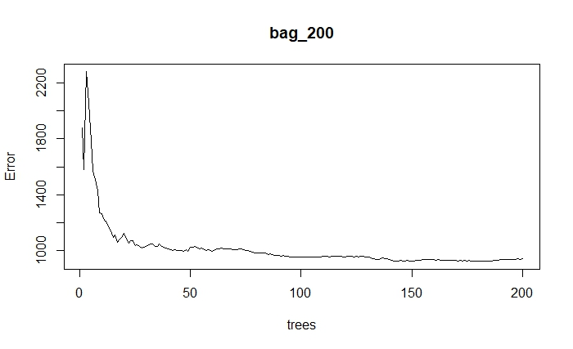
Bagging begins to diminish returns close to (B = 150)

Slide 9
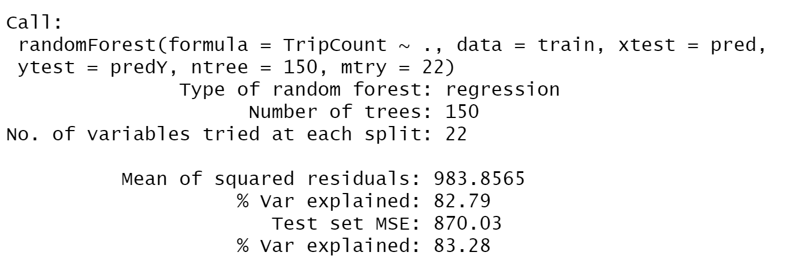
Cross-validating Bagging (B = 150) is strong!
Validation RMSE = 29.50!
Low RMSE with bagging signals that a large part of the variables should be important if not all.

