Slide 1
BANK-CUSTOMER-CHURN
PYTHON FOR BANKING

Slide 2
Dataset:
From mavenanalytics.io
10,000 customers across France, Germany, and Spain.
Credit Score, Geography, Age, Tenure, Balance, and Product Count.
Language: Python 3.x
Data Manipulation: Pandas, NumPy
Visualization: Matplotlib, Seaborn, Plotly (Interactive).
The Objective:
Identify high-risk segments and provide mitigation strategies.
Data-driven insights to reduce attrition.

Slide 3
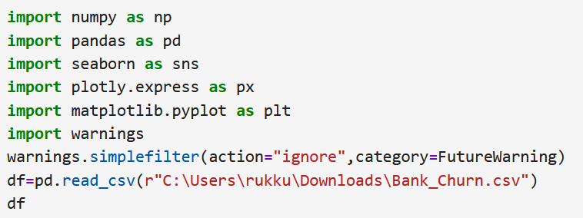
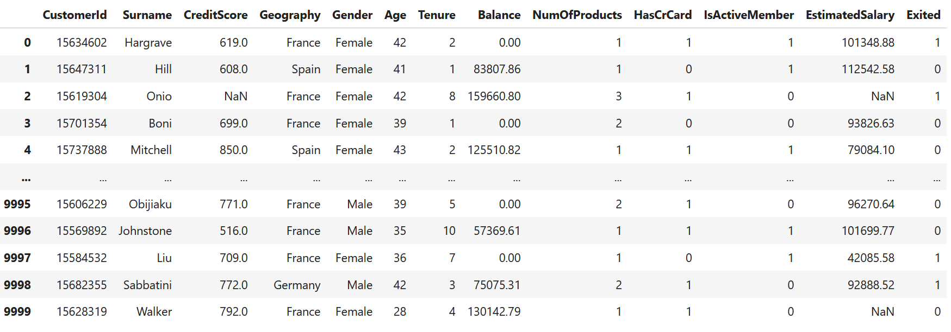
DATA LOADING
Initial Overview of Data set:
Columns
Head()
Tail()
Shape
Info
Describe()
Dtypes

Slide 4
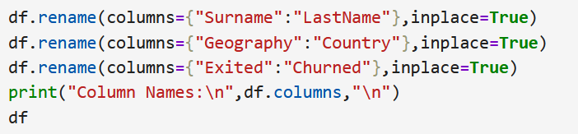
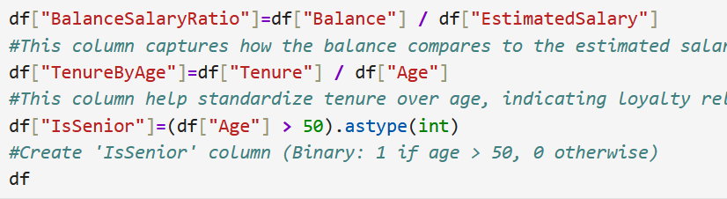
DATA PREPROCESSING
NULL data handling
Duplicate data handling
Column Renaming
Derived columns

Slide 5
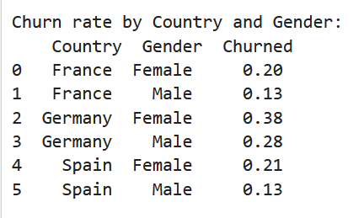
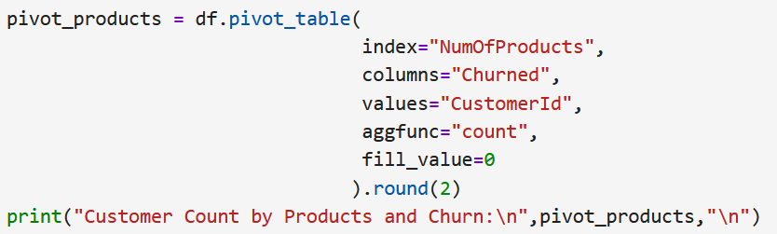
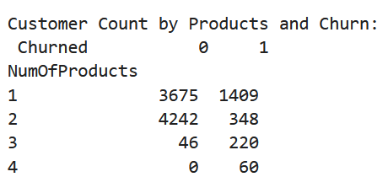
EXPLORATORY ANALYSIS
Group By
Pivot Table

Slide 6
STATISTICAL ANALYSIS
Numerical Column Summary:
Average Age: Typically 38–40 years.
Churn Rate: Approximately 20% of customers have left.
Account Balance: High frequency of 0, suggesting inactive or secondary accounts.

Slide 7
STATISTICAL ANALYSIS
Categorical Column Summary:
Geography: Data dominated by France.
Gender: Mostly balanced, with higher female churn in specific clusters.

Slide 8
STATISTICAL ANALYSIS
Grouped Statistics by Churn:
High-Value Loss: Churned customers hold higher average balances, indicating a loss of premium clients.
Age Factor: Customers 40+ are more likely to leave.

Slide 9
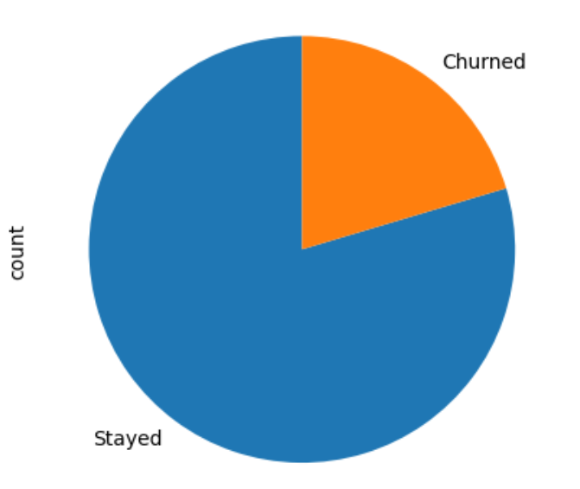
VISUALIZATION
Clear class imbalance.
20% of customers exited (1 in 5).
1. Overall Churn Proportion (Pie Chart)

Slide 10
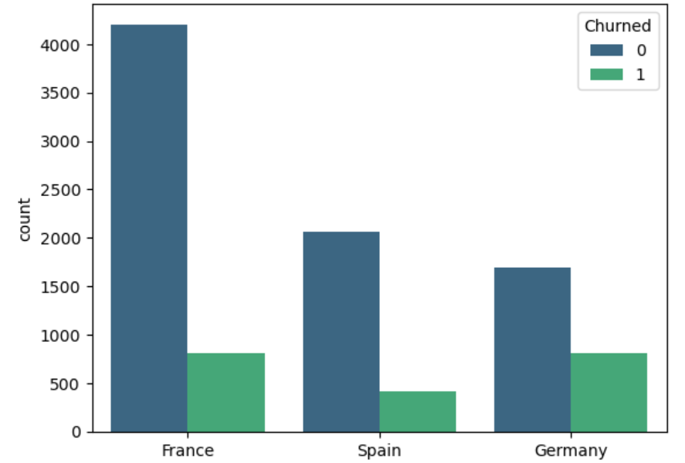
VISUALIZATION
France has the most customers.
Germany has the highest churn proportion
2. Churn Frequency by Country
(Count Plot)

Slide 11
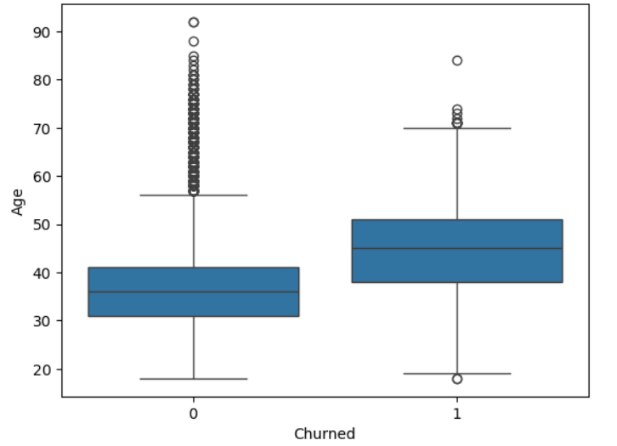
VISUALIZATION
Churned customers are older (Mid-40s vs. Mid-30s).
Higher age = Higher risk
3.Age Distribution by Churn (Box Plot)

Slide 12
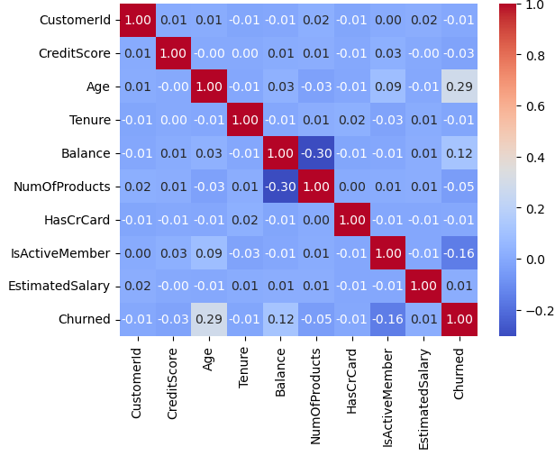
VISUALIZATION
Age is the top driver of churn (positive).
Active members are least likely to churn (negative).
4.Feature Correlation Matrix
(Heatmap)

Slide 13
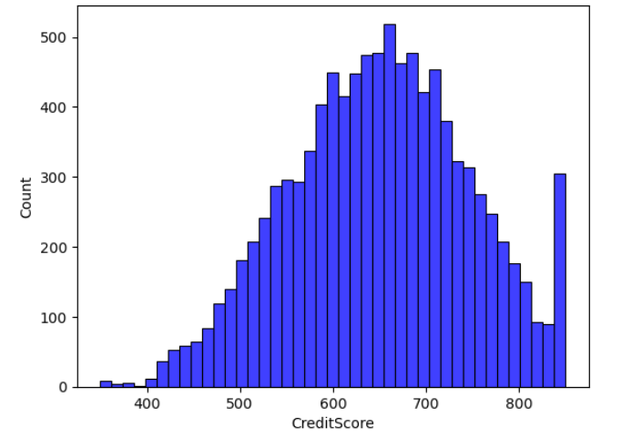
VISUALIZATION
Most customers fall in the 600–700 range.
Small spike of churned customers with low credit scores (below 400).
5. Credit Score Density (Histogram)

Slide 14
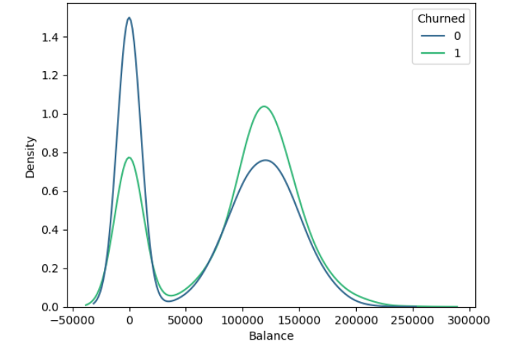
VISUALIZATION
A large group of retained customers has a zero balance.
100k–150k balance = Risk of churn.
6. Balance Distribution by Churn
(Overlapping Histogram)

Slide 15
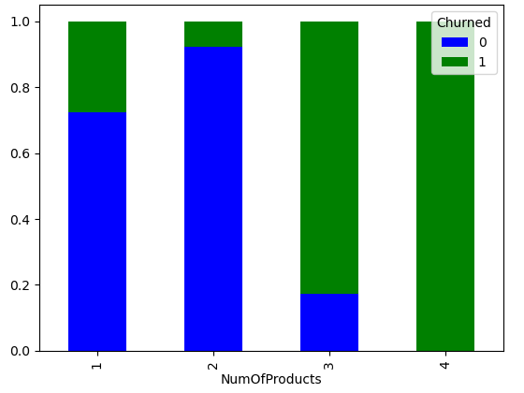
VISUALIZATION
3-4 Products: Near 100% churn rate (High risk).
2 Products: Highest customer loyalty
7. Product Count Impact (Stacked Bar Chart)

Slide 16
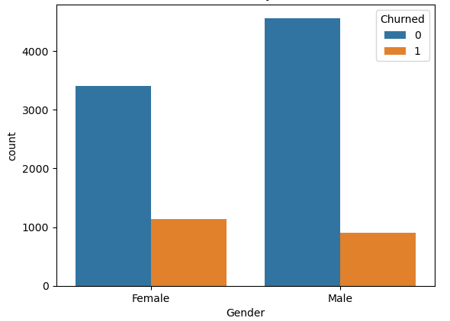
VISUALIZATION
Females show higher churn rates than males.
Develop gender-specific retention strategies.
8. Gender-wise Churn Analysis
(Count Plot)

Slide 17
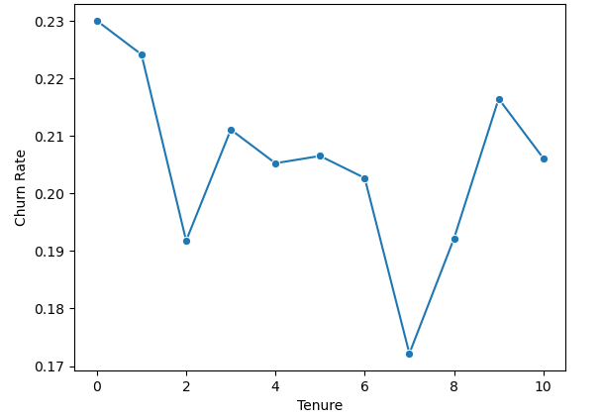
VISUALIZATION
Significant dip at Tenure 7 (~0.17).
Churn rate spikes sharply from year 7 to 9.
9. Churn Rate by Tenure (Line Chart)

Slide 18
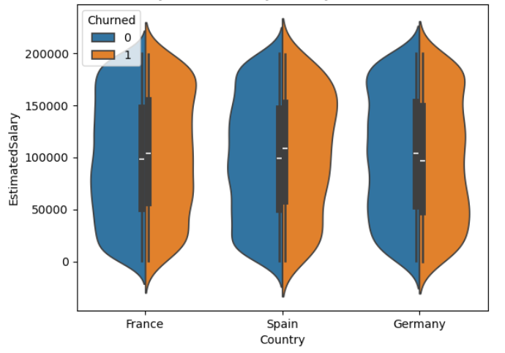
VISUALIZATION
Similar salary levels across all three countries.
Suggesting income is not the main driver of regional churn.
10. Salary Distribution by Geography
(Violin Plot)

Slide 19
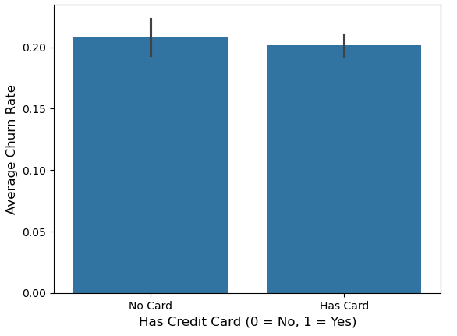
VISUALIZATION
Churn rates are identical with or without credit cards.
Card ownership does not impact loyalty.
11. Churn Rate by Credit Card Ownership
(Bar Plot)

Slide 20
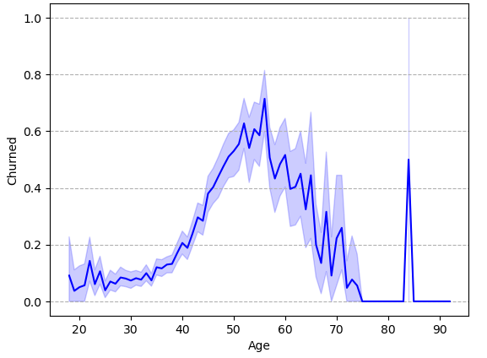
VISUALIZATION
Churn risk rises from age 35, peaks at age 50–55.
Minor risk for under 35s and seniors.
12. Churn Trend by Age
(Line Plot)

Slide 21
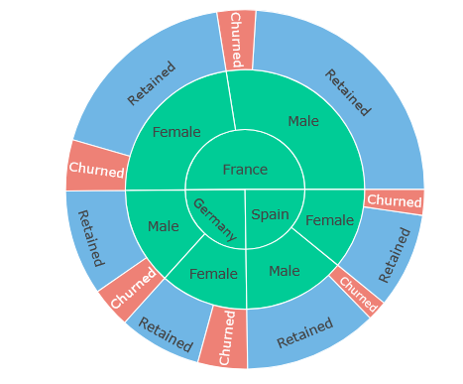
VISUALIZATION
France occupies the largest portion of the customers.
Females in Germany have a higher churn rate.
13.Hierarchical Churn Breakdown
(Sunburst Chart)

Slide 22
RECOMMENDATIONS
Regional: Launch a competitive audit and loyalty program in Germany.
Retention: Create "Wealth Management" perks for the 40–55 age group.
Product: Focus on moving 1-product customers to 2-products.
Engagement: Launch re-activation campaigns for inactive members.

Slide 23
CONCLUSION
Summary: By targeting the German market and the 40+ age demographic, the bank can reduce churn by an estimated 5–10%.
Next Step: Implement a Machine Learning Early-Warning System to flag high-risk customers in real-time.

Slide 24
THANK YOU

