Slide 1
Student Innovation in Fitness
Music to Fitness: A Smart Hardware Prototype
CSE7101- Capstone Project
Review-4
Batch Number: Com_11
Roll Number | Student Name
20221COM0137 | Abhishek Gowda
20221COM0162 | Rithin U Reddy
20221COM0187 | Rukmini Surve M
Under the Supervision of,
Prof. Mr Mohamed Shakir
Assistant Professor
School of Computer Science and Engineering
Presidency University
Name of the Program: COM
Name of the HoD: Dr Pallavi V
Name of the Program Project Coordinator: Mr. Muthuraj V
Name of the School Project Coordinators: Dr. Sampath A K , Dr. Geetha A

Slide 2
Contents
Basic Idea
Proposed System
Objectives
System Architecture
Source code details
80 % Implementation of system
Draft Report Status
Research Paper Status
Gantt Chart
References

Slide 3
Basic Idea:
• Aim: To develop a hardware prototype that adapts music based on real-time heart-rate readings.
• Goal: Enhance motivation during workouts and improve focus during study by automatically adjusting music type according to the user’s BPM.
• Hardware used: ESP32 development board, MAX30102 heart-rate sensor, 0.96″ OLED display, DFPlayer Mini MP3 module, microSD card, 8Ω 1W speaker, breadboards, jumper wires, resistors, capacitors, push buttons (optional).
• Expected outcome: Real-time personalised music response to physiological data (heart rate).

Slide 4
Objectives
Measure accurate heart-rate data using the MAX30102 sensor.
Process BPM values on ESP32 and classify them into calm, normal, and high-intensity zones.
Store pre-selected music tracks on a microSD card using DFPlayer Mini.
Automatically play the appropriate music type based on the user’s heart-rate zone.
Display live BPM and system status on a 0.96″ OLED screen.
Build a portable, low-cost fitness-assistive hardware prototype.

Slide 5
Proposed System:
The system continuously reads the user’s heart rate through MAX30102.
The ESP32 processes the BPM value and categorises it into three zones: calm, normal, or high-intensity.
Based on the detected zone, the ESP32 sends commands to the DFPlayer Mini to play the corresponding song stored on the microSD card.
The OLED display shows the real-time BPM and the music category being played.

Slide 6
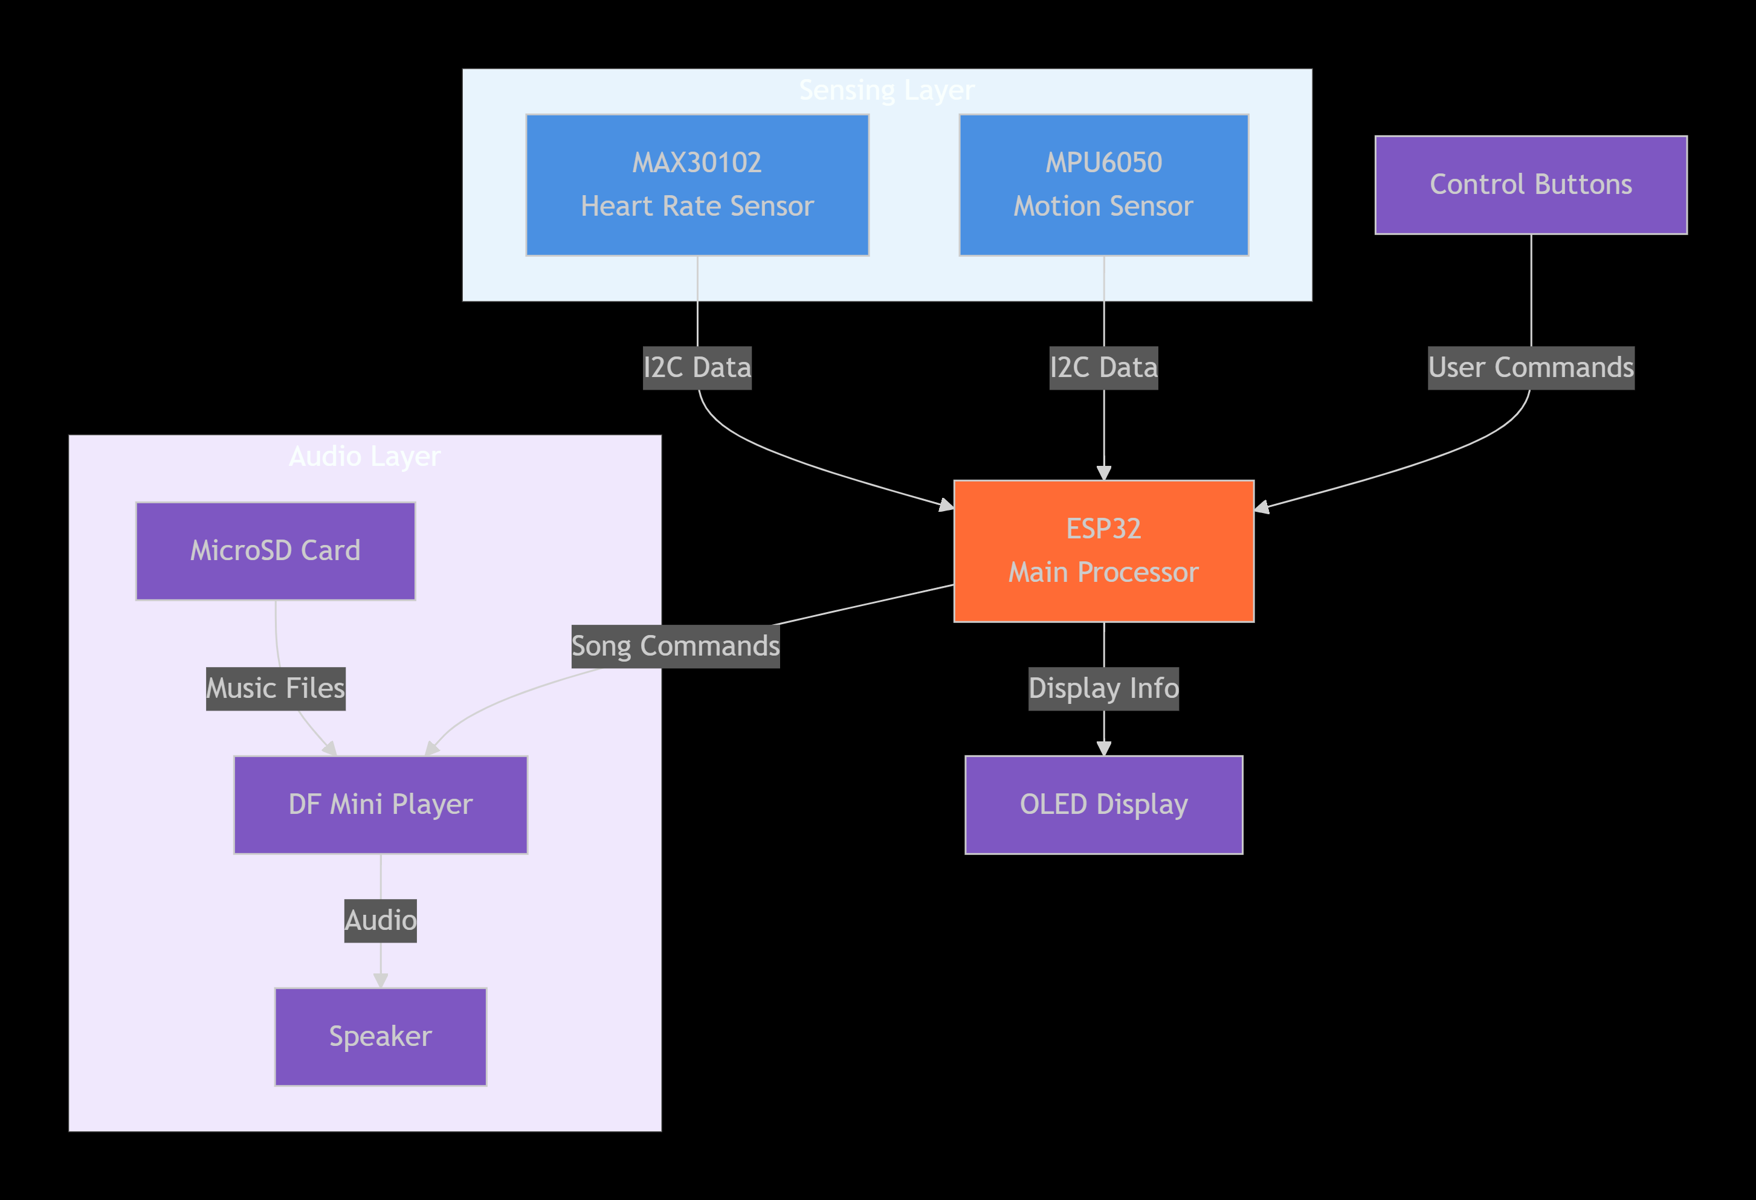
System Architecture:

Slide 7
Source Code Details:
Description: Complete implementation with structured and documented code.
Current Status:
• All modules coded: MAX30102 heart-rate reading, OLED display output, DFPlayer Mini music control.
• Heart-rate zones successfully mapped to 3 music tracks (calm/normal/high).
• Code cleaned, structured, and commented.

Slide 8
80% implementation of the System
Description: Demonstrated 80% functionality of the working prototype.
Current Status:
• Hardware fully assembled on dual breadboards (ESP32 + MAX30102 + OLED + DFPlayer + speaker).
• Real-time BPM detection tested and stable.
• Music plays automatically according to heart-rate zones.
• Display is showing BPM + status.

Slide 9
80% completed Report
Description: Completed report in softcopy, formatted as per University guidelines.
Current Status:
• Chapters drafted: Problem Statement, Objectives, Literature Review, System Architecture, Hardware Components, Methodology, Flowcharts, Block Diagrams.
• Formatting applied as per requirements (Times New Roman, alignment, page numbering, etc.).
• Remaining: Results, Conclusion, and References (will be added after final testing).

Slide 10
100% Completed Research Paper
Completed research paper as per IEEE template.

Slide 11
Live Demo:
Demonstration of heart-rate measurement and display.
Place finger on MAX30102 sensor → OLED shows current BPM and zone
Plays music that is suitable for heart rate.

Slide 12
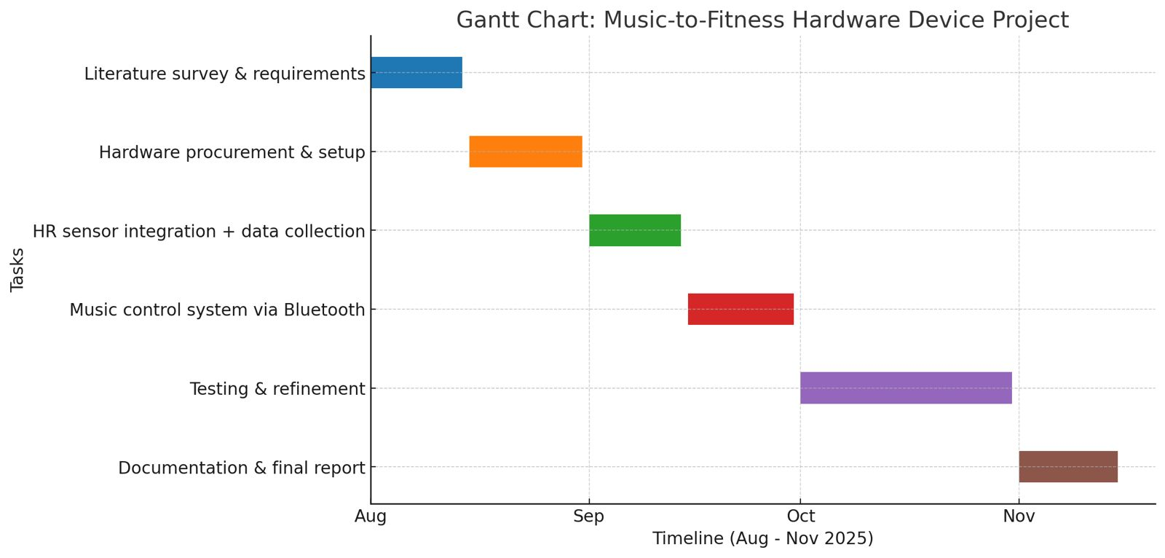
Timeline of the Project (Gantt Chart)

Slide 13
References (IEEE Paper format)
• H. Liu, J. Hu, and M. Rauterberg, “Music Playlist Recommendation Based on User Heartbeat and Music Preference,” IEEE Transactions, 2009.
• ISO/IEEE 11073, “Personal Health Device Communication Standards.”

Slide 14
References:
• Espressif Systems, “ESP32 Technical Reference Manual,” 2024.
• Maxim Integrated, “MAX30100 Pulse Oximeter and Heart-Rate Sensor Datasheet,” 2024.
• A. F. Barbosa et al., “Heart Rate Based Real-Time Music Adaptation,” IEEE Access, May 2022 (online repository, no volume/page).
• IEEE Standard 11073 for Health Informatics, 2023 (repository document, no volume/page).
• Additional IEEE/Scopus papers from the project literature survey.

Slide 15


