Slide 1
Flutter CRUD App with Back4App (BaaS)
Task Manager App – A Flutter-Based CRUD Application Using Back4App (BaaS)
Student Name: NABANKUR CHAKRABORTY
BITS ID: 2022MT70192
Subject Name: Cross Platform Application Development
Subject Code: SEMTZG585

Slide 2
Description
Project Title:
Task Manager App – A Flutter-Based CRUD Application Using Back4App (BaaS)
Project Overview:
This project is a Flutter-based Task Manager Application that utilizes Back4App as a Backend-as-a-Service (BaaS). Students will develop an app that enables user authentication and task management using a cloud backend without needing to build a custom server.
Key Features:
User Authentication – Register and login using a student email ID.
CRUD Operations on Tasks – Users can Create, Read, Update, and Delete tasks.
Backend as a Service (BaaS) – No need to write backend code, as Back4App handles data storage.
Real-Time Database Syncing – Task updates are reflected dynamically.
Secure Logout – Users can safely log out.
Technology Stack:
Frontend: Flutter (Dart)
Backend: Back4App (Parse Server)
Database: Back4App Cloud Database
Version Control: GitHub
Hosting: Local device for development

Slide 3
Resource
Youtube Link: https://youtu.be/35xHciwS21Y?si=2qwtr9YCL4H6K0Xw
GitHub Link: https://github.com/ruknaban/Task-Manager-App.git

Slide 4
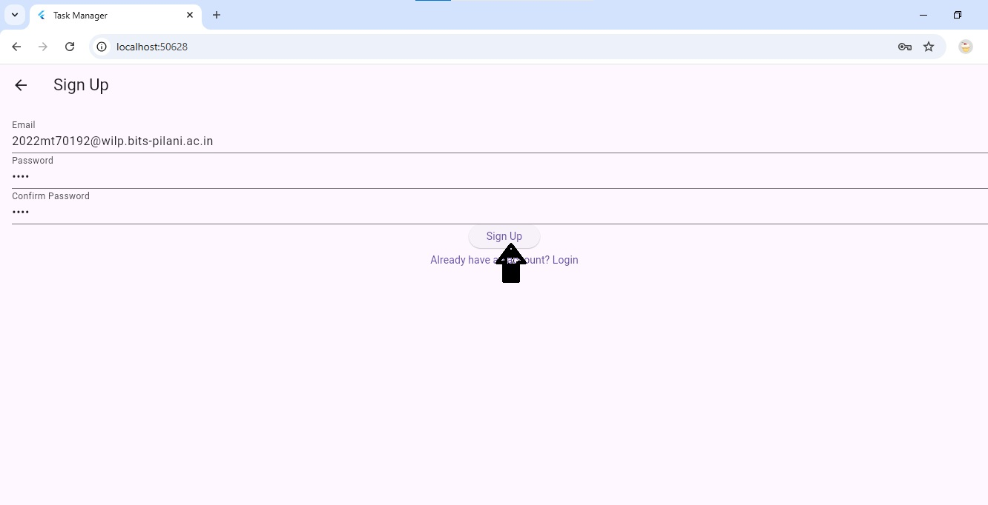
Sign Up Page

Slide 5
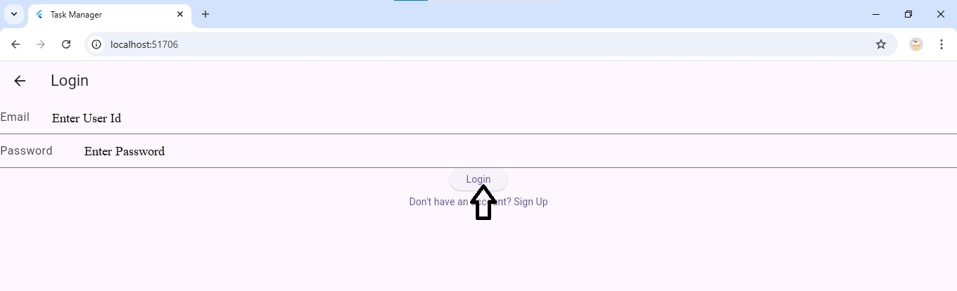
Login Page

Slide 6
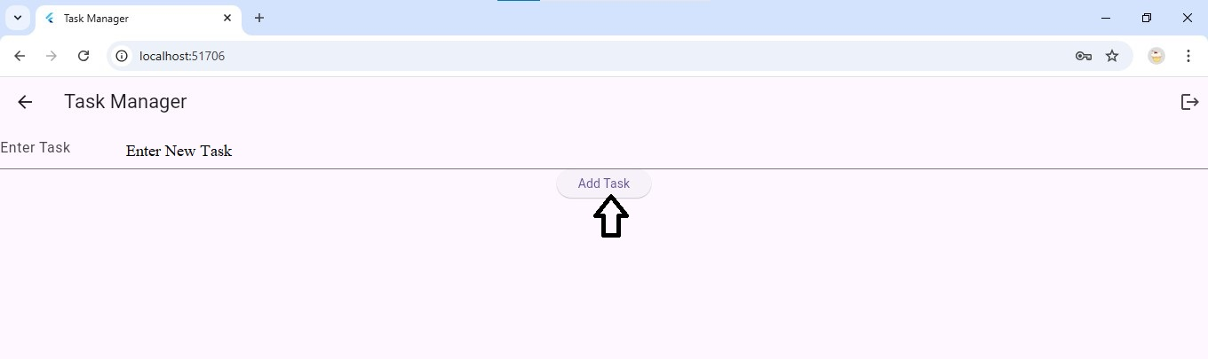
Task Creation Page

Slide 7
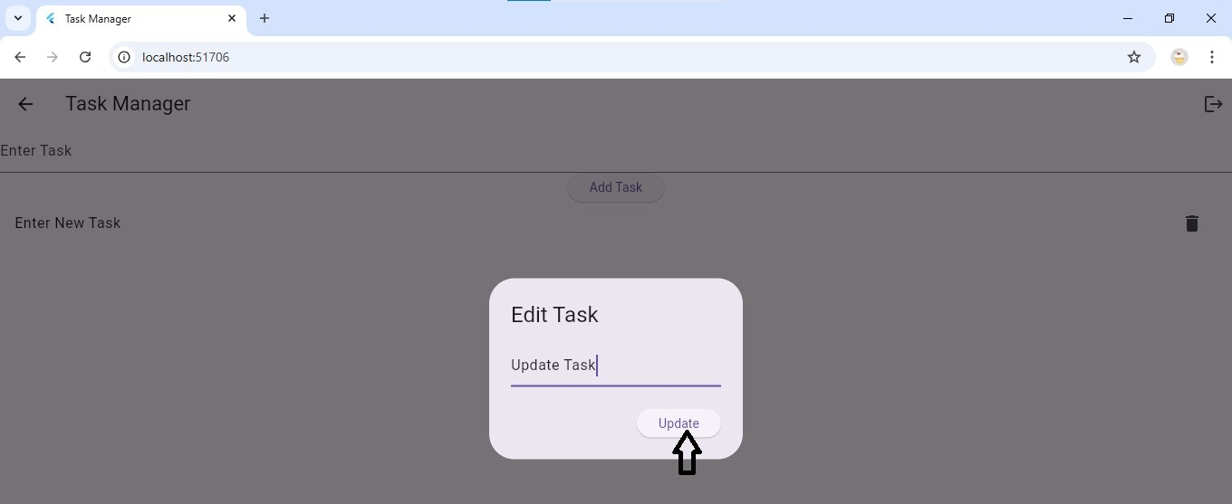
Update Task

Slide 8
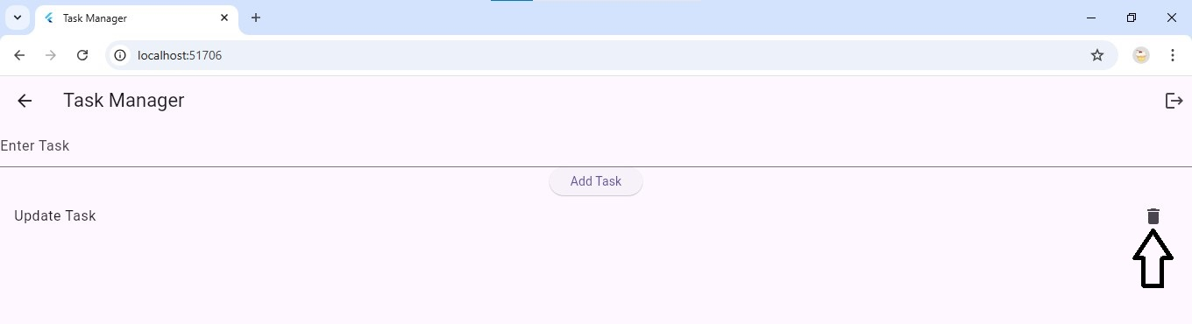
Delete Task

Slide 9
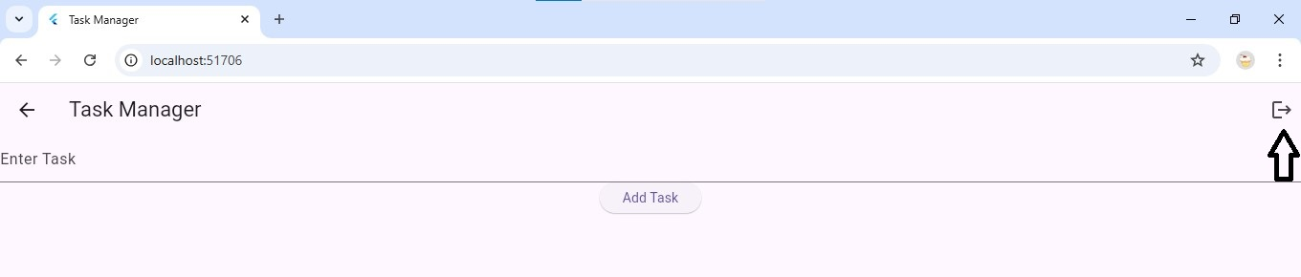
Logout Page

Slide 10
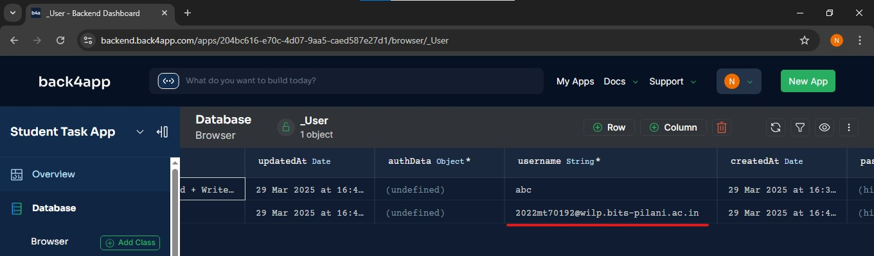
User Successfully Created in Back4App Application

Slide 11
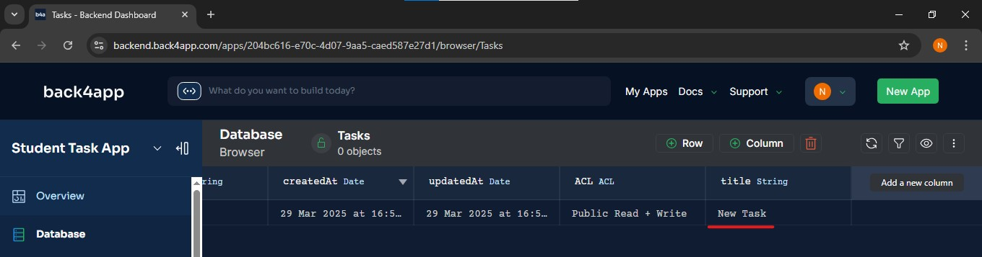
Task Created Successfully

Slide 12
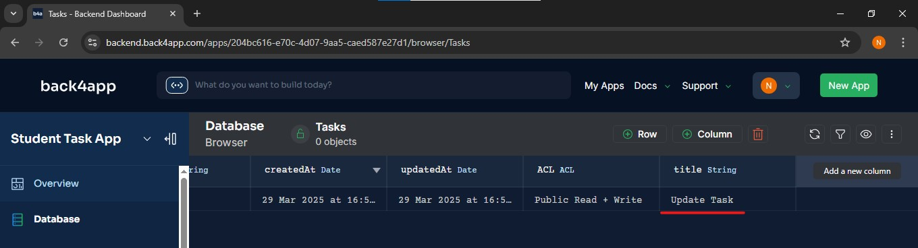
Task Updated Successfully

Slide 13
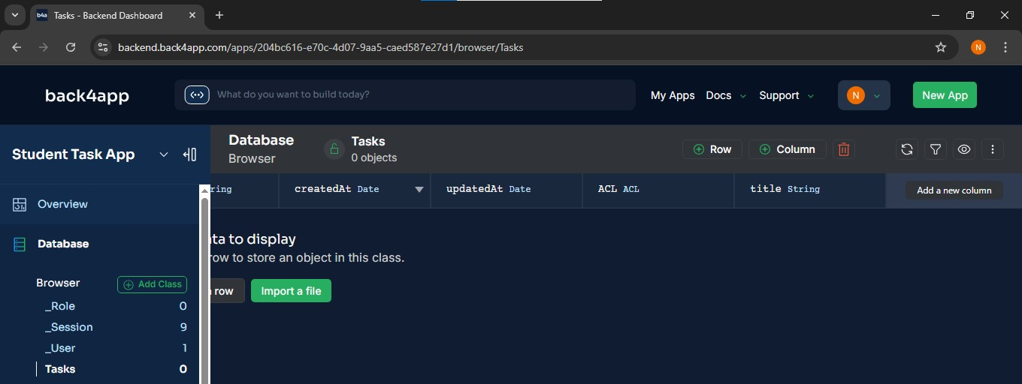
Task Deleted Successfully

Slide 14
THANK YOU

