Slide 1


Path Finding & Nevigation System
Smart solution of finding path
1

Slide 2
Present by:
Rukonuzzaman Topu
Student ID- 232002280
Department of CSE
Green University of Bangladesh
2

Slide 3
CONTENTS OF THIS Project
Project Goals
User Control & Customization
Future Improvements
Features
Real World Application
3

Slide 4
Project Goals
Develop a pathfinding algorithm that can efficiently navigate through crowded and dynamic environments.
Minimize delivery time while ensuring safety and avoiding obstacles.
Reduce dependence on human intervention for route planning.
4

Slide 5
Features
Dynamic rendering of the grid with different cell types (start, finish, wall, empty, path).
Real-time visualization of the pathfinding process highlighting explored nodes and the final path.
User control over speed of pathfinding animation.
5

Slide 6
User Control and Customization
Choice between 4 pathfinding algorithms: Dijkstra's , A*,BFS and DFS.
Adjustable grid size and obstacle density.
Interactive placement of start and finish points and drawing of obstacles.
Control panel with sliders and buttons for easy manipulation.
6

Slide 7
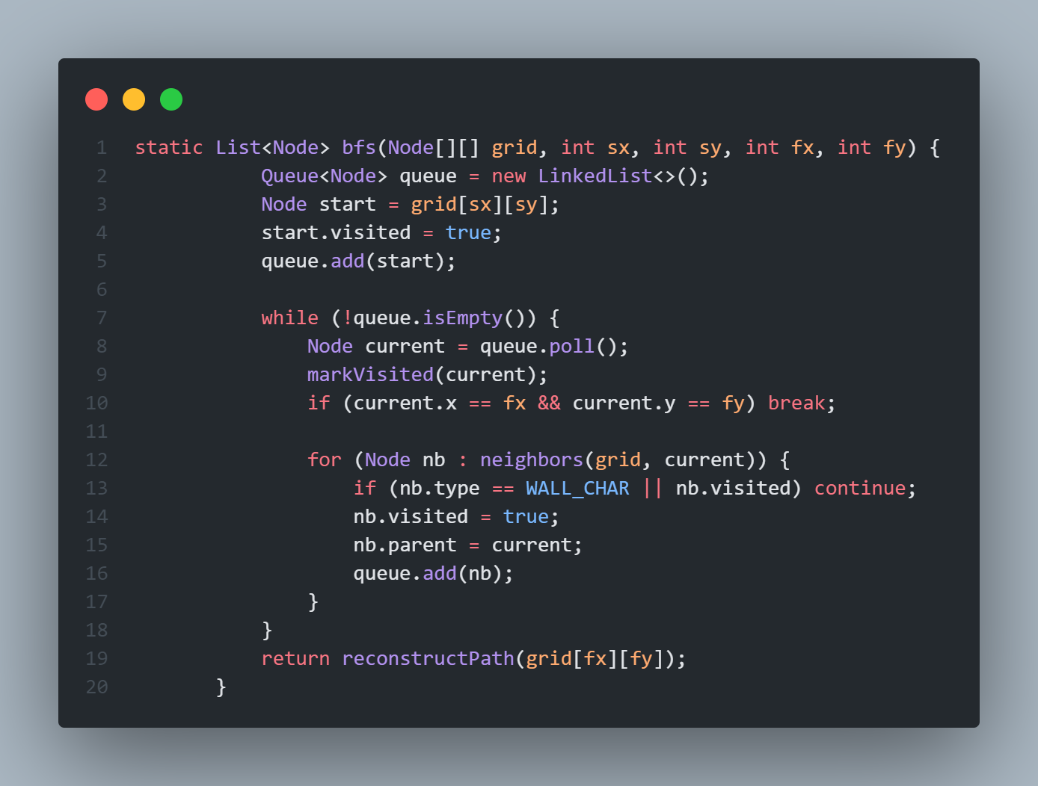
BFS:

Slide 8
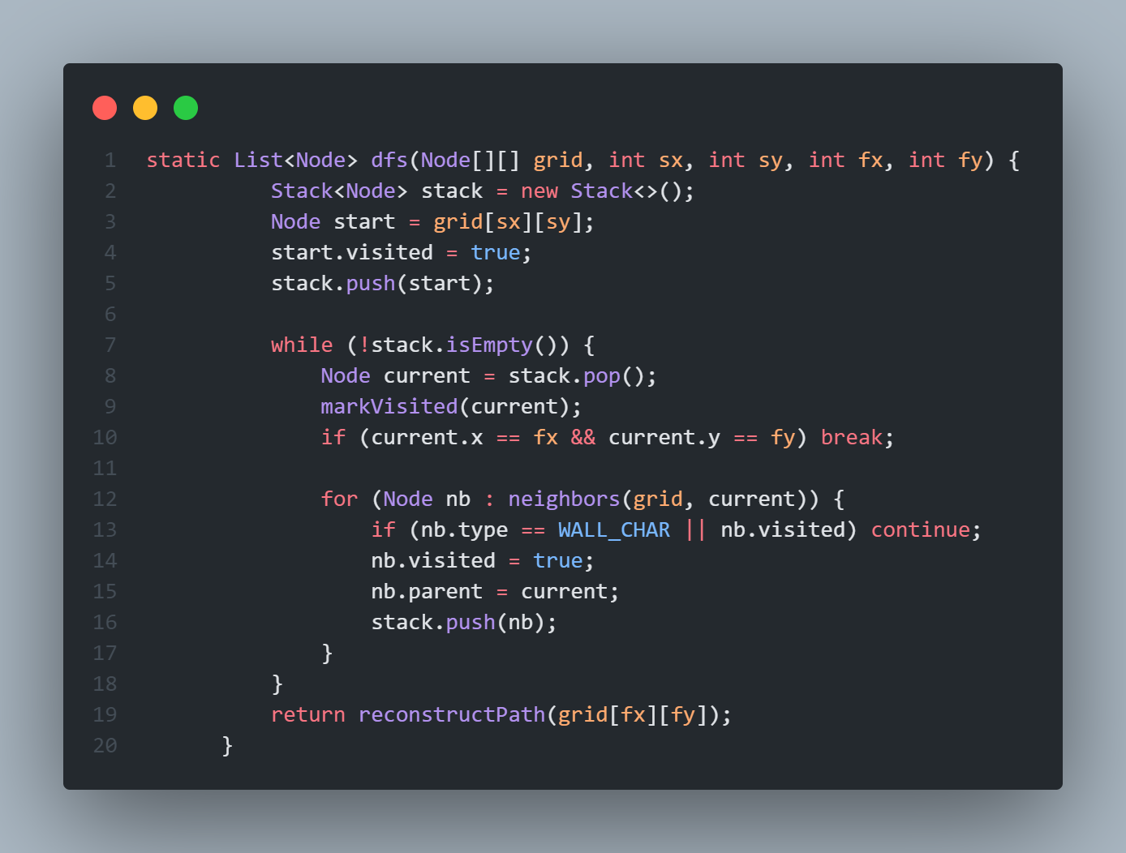
DFS:

Slide 9
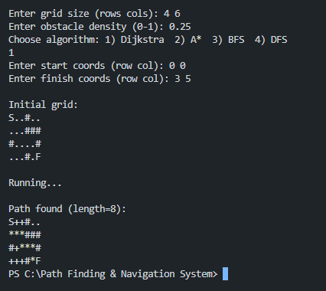
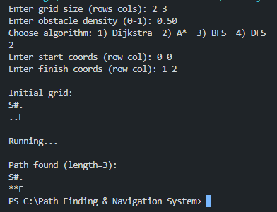
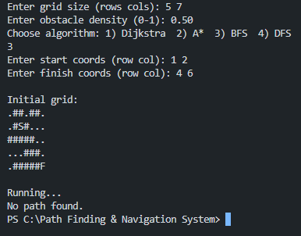
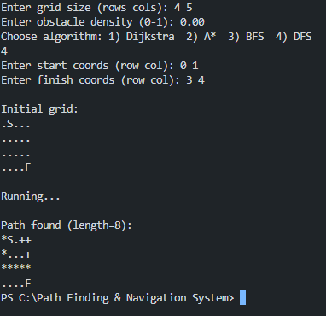
OUTPUT:

Slide 10
Real World Application
Emergency response vehicles
Strategic gameplay
Route optimization for delivery vehicles
Autonomous robots in factories
Traffic management systems
Warehouse automation
7

Slide 11
Future Improvements
Potential enhancements for the project
Exploration of additional pathfinding algorithms
Integration with real-world applications or games
8

Slide 12
Thank you
9

