Slide 1
Capstone Project: ML-Driven Decision Support for “Aurora Finance”
- Integrating Predictive Analytics Across Corporate Finance, Banking & Markets
Presented by:
Purva Kothekar
Mayank Sharma
Mohammad Ruksad Siddiqui
Rahul Gupta

Slide 2
Business Objective & Project Scope

Slide 3
Overall System Architecture

Slide 4
Module 1: Corporate Finance Module (PK)
Objective: Decide which internal projects Aurora should fund

Slide 5
Overall approach: (Example)
1. Dataset
Unlabeled documents: 1500 entries
Format: List of strings (one doc per entry)
2. Preprocessing
Stopword removal using NLTK + custom
Lemmatization using WordNet
3. Vectorization
TF-IDF Vectorizer with ngram_range=(1,2), min_df=5
Transformed to shape: [1500, ~2500]
4. Dimensionality Reduction
TruncatedSVD (LSA) applied to TF-IDF matrix
5. Clustering (Pseudo-Labeling)
K-Means clustering with k=5
Validated with Elbow and Silhouette Score
6. Cluster Naming
Top-10 keywords extracted from each cluster
Clusters auto-labeled as: Religion, Politics, Motorcycles, Philosophy, General
7. Supervised Classification
Classifiers: Logistic Regression, Random Forest, Naive Bayes, SVM
Metrics: Accuracy, F1-Macro Score, Confusion Matrix
8. Results Summary
Random Forest: Accuracy 0.98, F1 0.91
SVM (linear): Accuracy 0.96, F1 0.93
Naive Bayes: Accuracy 0.93, F1 0.83
Logistic Regression: Accuracy 0.92, F1 0.74

Slide 6
Task 1: Cash Flow Forecasting
Approach
XXX
Feature Engineering
Models Evaluated
Key Findings
XXX
Limitations
XXX
Model | LOOCV MAE | LOOCV R² | vs Baseline
Naive Baseline (fold mean) | Reference | 0.0000 | —
Ridge Regression (RidgeCV) ✓ | ~$1.1M | Marginal positive | Beats baseline
KNN (k=5, distance-weighted) | ~$1.3M | Negative | Below baseline
Random Forest (depth=3, leaf=5) | ~$1.2M | Negative | Below baseline

Slide 7
Task 1: SHAP Plots/Any Other Plots/Info

Slide 8
Task 2: Project Success Classification
Approach
XXX
Feature Engineering
Models Evaluated
Key Findings
XXX
Limitations
XXX

Slide 9
Task 3: Funding Recommendations - EV & Risk Adjusted Returns
Approach
XXX
Feature Engineering
Models Evaluated
Key Findings
XXX
Limitations
XXX

Slide 10
Ranked Project List
XXX

Slide 11
Risk & Recommendations
XXX
XXX

Slide 12
Module 2: Banking Module (MS)
Objective: Assess loan portfolio and detect fraud

Slide 13
Overall approach:
1. Dataset
Loan Portfolio: 100 entries
Transactions: 200 entries
Format: csv
2. Supervised Classification
Classifiers: Ridge Regression, Lasso Regression, Logistic Regression, Decision Tree, Isolation Forest
Metrics: RMSE, R², F1-Macro Score, Confusion Matrix, AUC-ROC
3. Results Summary
Ridge Regression: RMSE: 0.0910, R²: -0.054
Lasso Regression: RMSE: 0.0895, R²: -0.020
Logistic Regression: F1: 0.8017
Decision Tree: F1: 0.4793
Logistic Regression(Fraud Detection): Precision: 0.047, Recall: 1.000, AUC-ROC: 0.231
Isolation Forest: Precision: 0.066, Recall: 0.556, AUC-ROC: 0.534

Slide 14
Task 1: Credit Risk Approach
STAGE 1: PROBABILITY OF DEFAULT (PD) PREDICTION
Load & Prepare Data
Load loan portfolio dataset (loan_portfolio.csv)
Create engineered features: Loan_to_Income ratio, encode Customer_Type
Feature Selection
Select 9 predictor features: Annual Income, Debt-to-Income, Credit History Length, Loan Amount, Interest Rate, Loan Term, Past Default, Loan-to-Income, Customer Type
Target variable: PD (actual probability of default)
Data Preprocessing
Standardize all features using StandardScaler (required for linear models)
Model Hyperparameter Tuning
Ridge Regression: Test 4 alphas [0.1, 1.0, 10.0, 100.0]
Lasso Regression: Test 3 alphas [0.001, 0.01, 0.1]
Use Leave-One-Out Cross-Validation (LOOCV) for precise evaluation on small samples
Model Selection
Compare RMSE scores from both models
Select model with lower RMSE as the winner
Generate Predictions
Train winning model on full dataset
Create PD_predicted column for downstream use

Slide 15
Task 1: Credit Risk Approach
STAGE 2: RISK SCORING & CLASSIFICATION
2A: Weighted Risk Scoring
Define Score Components
Create 1-3 scale scores for 6 factors using predefined thresholds:Debt-to-Income, Credit History Length, Interest Rate, Loan-to-Income, Past Default, Predicted PD (from Stage 1)
Calculate Weighted Risk Score
Apply weights to each factor: DTI (0.20), Past_Default (0.20), IR (0.15), CHL (0.15), LTI (0.15), PD (0.15)
Aggregate into continuous Risk_Score (range: 1–3)
Bin into Risk Categories
Cut Risk_Score into three classes: Low, Medium, High
2B: ML Classification
Feature Preparation
Use same 9 features from Stage 1 (exclude Risk_Score to prevent data leakage)
Scale features with StandardScaler
Cross-Validation Setup
Configure 5-Fold Stratified K-Fold (preserves class distribution)
Model Comparison
Train Logistic Regression (balanced class weights) → compute F1-Macro score
Train Decision Tree (max_depth=3, balanced weights) → compute F1-Macro score
Model Selection
Select model with higher F1-Macro score
Final Training & Prediction
Train selected model on full dataset
Generate Risk Class predictions

Slide 16
Task 1: Metrics/Risk Scored Loan Portfolio
Models Evaluated
Lasso Regression – RMSE:0.0895, R²-0.054:
Ridge Regression – RMSE:0.0910, R²: -0.020
Logistic Regression – F1 Score : 0.8017
Decision Tree – F1 score : 0.4793
Key Findings
Lasso regression selected with marginal positive R² vs Ridge
Logistic regression selected with better F1 score vs Decision Tree
Low Risk -> APPROVE : 31 loans
Medium Risk -> MONITOR : 49 loans
High Risk -> REJECT : 20 loans
Limitations
Small sample size (100 loans), no external credit bureau data`

Slide 17
Task 2: Fraud Detection Approach
1. Load & Explore
Load transaction dataset, assess class imbalance (9 fraud / 191 legitimate)
2. Feature Engineering
Temporal: Hour, DayOfWeek, IsWeekend, IsNightTxn
Amount: Amount_ZScore (per-customer normalized), Amount_Log
Behavioral: Velocity_24h (transaction count), TxnType_Enc
Result: 7 features total
3. Data Preparation
Standardize all features
Oversample fraud cases (replicate + add noise) for balanced training
4. Logistic Regression (Supervised)
Train on balanced data
Generate OOF probabilities on imbalanced original data
Compute Precision-Recall curve, optimize for F2-Score
Report: Precision, Recall, F2, AUC-ROC, PR-AUC

Slide 18
Task 2: Fraud Detection Approach
5. Isolation Forest (Unsupervised)
Train on original imbalanced data (no labels)
Convert anomaly scores to pseudo-probabilities
Optimize threshold via F2-Score
Report same metrics as LR
6. Ensemble Alerts
RED: Both LR AND IF flag transaction
AMBER: Either LR OR IF flags transaction
Calculate fraud caught percentage
7. Dashboard & Export
Create 9-panel visualization (class distribution, PR curves, confusion matrices, metrics, feature importance, alerts summary)
Export flagged transactions report (sorted by Alert_Tier and fraud probability)
Key Outputs: Optimal thresholds, fraud dashboard PNG, flagged transaction CSV

Slide 19
Task 2: Metrics/Fraud Key Findings
Models Evaluated
Logistic Regression: Precision:0.047 , Recall:1.000, AUC-ROC:0.231
Isolation Forest: Precision:0.066 , Recall:0.556, AUC-ROC: 0.534
Key Findings
Data: 200 transactions, 9 fraud cases (4.5% fraud rate) - imbalanced classification
Threshold Selection: Precision-Recall curve with F2-Score optimization (emphasizes recall)
RED Alert (both model flag) : 71 transactions
AMBER Alert (either model flags) : 197 transactions
Fraud caught RED : 5/9 (56%)
Fraud caught AMBER : 9/9 (100%)

Slide 20
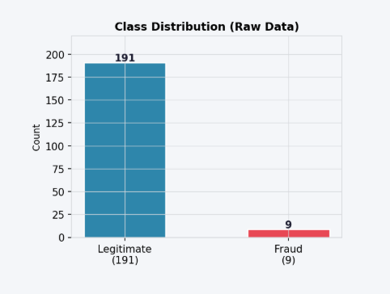
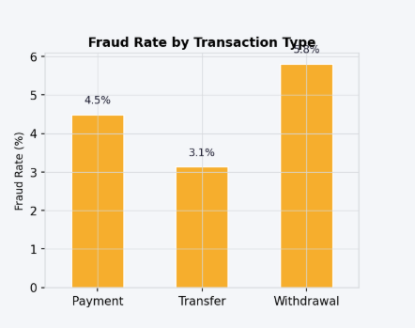
Task 2: Metrics/Fraud Dashboard
Description
The plot shows the severe class imbalance in the transaction dataset: 191 legitimate vs 9 fraudulent transactions (4.5% fraud rate).
It demonstrates why standard accuracy metrics would be misleading.
The imbalance necessitates sophisticated techniques like oversampling during model training
The plot shows the break down of fraud prevalence by transaction category (Payment, Transfer, Withdrawal). Shows which transaction types attract fraudsters most
In this data, Withdrawal shows highest fraud rate (~5.0%), suggesting attackers preferentially target cash extraction over internal transfers
This insight enables targeted monitoring strategies—implementing stricter verification for high-fraud transaction types or flagging unusual withdrawal patterns as behavioral anomalies

Slide 21
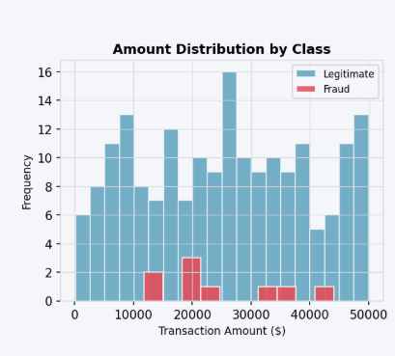
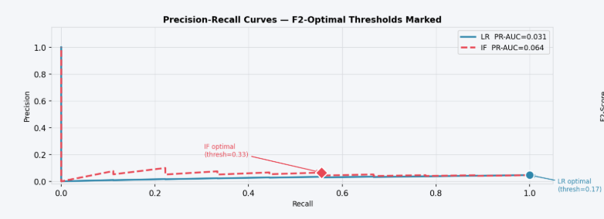
Task 2: Metrics/Fraud Dashboard
Description
The plot shows the comparison of transaction amounts between legitimate (blue) and fraud (red) cases
The red fraud distribution often appears shifted toward specific ranges, indicating fraudsters target certain amount thresholds
This visualization justifies the inclusion of amount-based features (Amount_Log, Amount_ZScore) in the mode
Dual line plots showing precision-recall trade-off for both Logistic Regression (blue solid, PR-AUC ≈ 0.531) and Isolation Forest (red dashed, PR-AUC ≈ 0.384).In this data,
Each point on the curve represents a different classification threshold
High recall is prioritized, reflecting the business cost of missed fraud being much higher than false alarms.

Slide 22
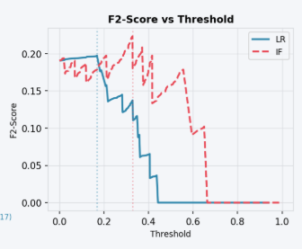
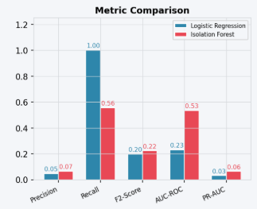
Task 2: Metrics/Fraud Dashboard
Description
The plot shows how F2-Score changes as the decision threshold varies (0.0 to 1.0) for both models.
The curve peaks at the optimal threshold (marked by vertical lines), and points beyond the peak represent thresholds where missing fraud cases outweighs handling false positives.
This panel demonstrates that threshold selection significantly impacts fraud detection performance
The plot shows the comparison of 5 key metrics across the model
Recommendation: Logistic Regression is preferred for fraud detection, accepting high false alarm burden to minimize missed fraud.

Slide 23
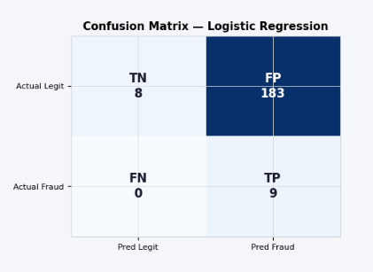
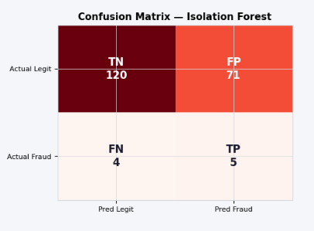
Task 2: Metrics/Fraud Dashboard
Description
Logistic Regression (LR) Matrix: TN=8, FP=183, FN=0, TP=9 → Catches all fraud (100% recall) but high false alarm rate.
LR prioritizes catching fraud (recall=1.0) at cost of many false positives.
LR flags 192 transactions for review (9 true fraud + 183 false alarms = 95% waste),
Isolation Forest(IF) Matrix: TN=120, FP=71, FN=4, TP=5 → More conservative, misses 4 fraud cases but fewer false alarms.
Isolation Forest is more selective.
Isolation Forest flags 76 (5 true + 71 false = 93% waste)

Slide 24
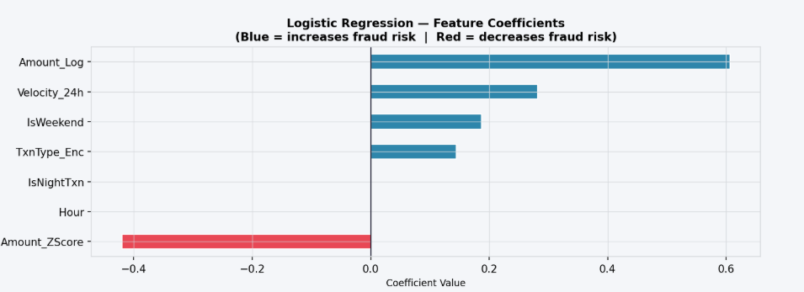
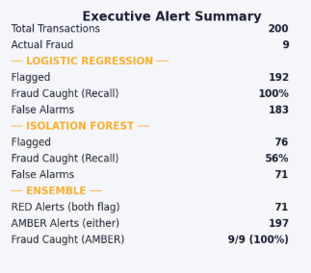
Task 2: Metrics/Fraud Dashboard
Description
The plot shows the t showing the learned importance of each feature, with blue bars increasing fraud risk and red bars decreasing it.
The model focuses on transaction-level anomalies (amount, velocity, timing) rather than customer attributes, making it interpretable and deployable in real-time systems.
Text-based KPI dashboard organizing results into actionable sections:
Portfolio Overview:
Total Transactions: 200 transactions analyzed.
Actual Fraud: 9 ground-truth fraudulent cases.

Slide 25
Task 3: Loan Approval & Monitoring Strategy Approach
Load & Prepare Data
Load loan portfolio (loan_portfolio.csv) and transaction data (transactions.csv)
Feature engineering: Loan_to_Income ratio, Customer_Type encoding
Execute Task 1 Pipeline (PD Prediction & Risk Classification)
Execute Task 2 Pipeline (Fraud Detection)
Lending Decision Logic (3-Tier Framework)
Fraud Override: If Has_Fraud = 1 → REJECT (Fraud Alert)
Low Risk: Always APPROVE
Medium Risk: CONDITIONAL if Prior_Default = 1, else APPROVE (Standard Monitoring)
High Risk: REJECT if Prior_Default = 1, else REJECT (High Risk)
Calculate Monitoring Strategy
Map decisions to operational protocols
Define review frequency, collateral requirements, escalation rules
Annual review. Standard loan covenants. No additional requirements.
Quarterly review. Compliance checks. Flag DebtToIncome or Interest Ratio breaches.
Monthly review. Collateral required. Rate +1.5–2%. Loan officer sign-off.
Interest Rate Adjustment
Low risk: +0.0% | Medium risk (no prior default): +0.5% | Conditional (Medium + prior default): +1.75% | Rejections: N/A
Portfolio Summary
Count decisions by tier (APPROVE, CONDITIONAL, REJECT)
Calculate total exposure ($ at risk) per tier
Cross-tabulate Risk Category × Lending Decision

Slide 26
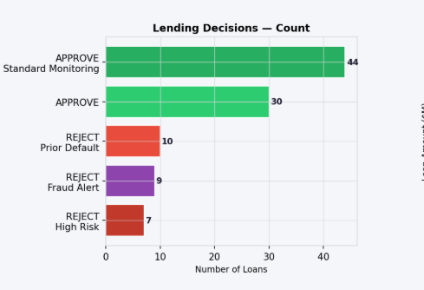
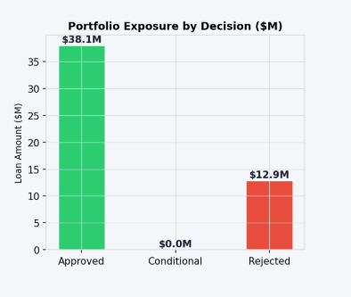
Task 3: Loan Approval & Monitoring Dashboard
Description
The plot shows the distribution of loans across decision tiers. Each bar represents a lending decision category (APPROVE, APPROVE — Standard Monitoring, CONDITIONAL — Enhanced Monitoring, REJECT variants) with color-coded segments..
The numerical labels at the bar ends show exact loan counts.
This visualization provides immediate portfolio-level overview of approval rates vs. rejection rates, enabling quick assessment of lending strategy effectiveness.
The plot aggregating total loan amounts ($M) across the three decision tiers: Approved, Conditional, and Rejected. Each bar is color-coded (green=approved, amber=conditional, red=rejected) with monetary values displayed on top.
This graph reveals portfolio risk concentration—comparing approved exposure vs. rejected exposure shows how much capital is at stake under each decision category.

Slide 27
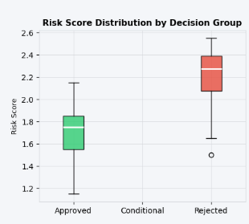
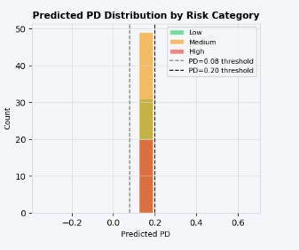
Task 3: Loan Approval & Monitoring Dashboard
Description
Box-and-whisker plot comparing risk score distributions across three decision groups (Approved, Conditional, Rejected). Each box shows the interquartile range (25th–75th percentile), with the white line inside indicating median risk score..
This visualization reveals whether the decision logic successfully separates risk tiers:
Approved loans should have lowest median risk scores, Conditional should be intermediate, and Rejected should be highest.
Overlaid histogram showing probability-of-default (PD) distributions separated by risk category (Low=green, Medium=amber, High=red). Vertical dashed lines mark PD thresholds (0.08 and 0.20) used in the risk scoring logic.
This visualization validates that the risk classification model successfully stratified borrowers by predicted default likelihood.
Clear separation between clusters indicates strong discrimination; overlap suggests model boundary cases requiring manual review..

Slide 28
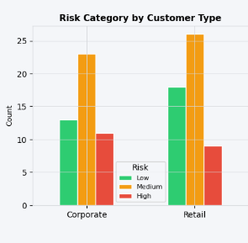
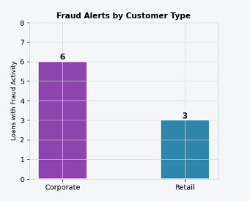
Task 3: Loan Approval & Monitoring Dashboard
Description
Grouped bar chart comparing risk distribution across customer types (Corporate vs. Retail). Three colored bars per customer type represent Low, Medium, and High risk categories.
This graph reveals whether lending risk patterns differ by customer segment:
Useful for portfolio management and targeted risk mitigation strategies
Bar chart showing the count of loans flagged with fraud activity, broken down by customer type (Corporate vs. Retail).
This reveals whether fraud detection concentrates in a particular segment.
Corporate Loans with Fraud Activity: 6
Retail Loans with Fraud Activity: 3

Slide 29
Short Summary for Lending Officers (Risks & Recommendations)
PORTFOLIO SUMMARY
Total Loans: 100 | Approved: ~74 (74%) | Conditional: ~0 (0%) | Rejected: ~26 (26%)
9 fraud alerts detected and rejected
KEY RISKS
Fraud activity in transaction history → immediate account freeze required
Prior defaults + high risk score → reject or require enhanced monitoring + collateral
Medium-risk loans require quarterly/monthly review and rate premiums (+1.5-2%)
TOP 3 RECOMMENDATIONS
Freeze fraud-linked customer accounts immediately and escalate to investigations
Require collateral & enhanced monitoring for CONDITIONAL loans; implement rate premiums
Establish quarterly review pipeline for portfolio health; re-train models every 6 months

Slide 30
Module 3: Financial Markets Module (RS/RG)

Slide 31
Overall Approach — Financial Markets Module
1 │ Dataset
• 6 NSE-listed stocks: Asian Paints │ CIPLA │ HDFC Bank │ ITC │ TCS │ UltraTech Cement
• Date range: Jan 2005 – Feb 2026 (~5,250 trading days per stock)
• Macro data: Quarterly & Annual GDP growth + Inflation (forward-filled to daily frequency)
2 │ Prediction Pipeline
Data → Features (20, lagged 1d) → Walk-Forward CV → Ensemble (XGBoost + LightGBM + RF) → Blend Weights → Live Inference → Confidence Shrinkage → Max-Sharpe Optimisation → Backtest
3 │ Dual-Horizon Prediction
• 1-Year horizon (252 trading days) — Tactical / short-term view
• 3-Year horizon (756 trading days) — Strategic / long-term view
• Final weights = 50% × 1Y optimal + 50% × 3Y optimal
4 │ Key Design Principles
• No lookahead bias: all features shifted 1 day; embargo gap = horizon days (252 or 756)
• Hit rate (directional accuracy) as primary metric — not R² (magnitudes are unpredictable)
• Confidence shrinkage: scale predicted returns toward zero when hit rate ≤ 50%
• Cash gate: if no stock beats risk-free rate (6.5% p.a.), hold 100% cash

Slide 32
Feature Engineering — 20 Features in 3 Groups
All features are lagged 1 trading day (.shift(1)) to eliminate lookahead bias.
Group 1 — Price / Short-Horizon (9 features)
ret_1 ret_5 ret_20 1-day, 5-day, 20-day raw returns
mom_5 mom_20 5-day and 20-day momentum (cumulative return windows)
vol_5 vol_20 Rolling volatility over 5-day and 20-day windows
vol_ratio price_range Short-term vol ratio; daily high–low range (normalised)
Group 2 — Long-Horizon / Trend (7 features) ← dominant group (47–55% of total importance)
mom_252 mom_756 52-week and 3-year momentum
price_vs_ma252 Price relative to 252-day moving average
price_vs_ma756 Price relative to 756-day (3-year) moving average
vol_252 Annual volatility — 252-day rolling std of returns
vol_ratio_sr_lr vol_ratio_252 Short/long vol regime; annual vol ratio
Group 3 — Macroeconomic (4 features)
macro_gdp_qrt macro_inflation_qrt Quarterly GDP growth & inflation
macro_gdp_ann macro_inflation_ann Annual GDP growth & inflation

Slide 33
Walk-Forward Cross-Validation — Architecture
CV Parameters
Fold Layout (1Y horizon)
Parameter | Value
Training window | 1,260 days (~5 years)
Test window | 252 days (~1 year per fold)
Embargo gap | horizon days (252 for 1Y, 756 for 3Y)
Folds | 13 folds (1Y horizon) | 9 folds (3Y horizon)
Test period | 2011 – 2024
Fold k: [──────── Train 5yr ────────][ EMRG ][ Test 1yr ]
Fold k+1: [──────── Train 5yr ────────][ EMRG ][ Test 1yr ]
Fold k+2: [──────── Train 5yr ────────][ EMRG ][ Test 1yr ]
Why Embargo? — Preventing Target Leakage
The target is the FORWARD return over the next H days.
Without an embargo, the final H days of training overlap with the test target.
Embargo = H days creates a clean gap — no test-period data contaminates training targets.
Why Hit Rate instead of R²?
Return magnitudes are nearly unpredictable — R² is consistently negative (−3 to −300).
Direction (up vs down) can carry a signal. Hit rate > 50% → positive directional edge.
Ensemble models with hit rate > 60% get full confidence; below 50% → predictions shrunk to zero.

Slide 34
CV Diagnostic Results — 1-Year Horizon (13 folds, 2011–2024)
Ensemble mean hit rate across walk-forward folds | BUY threshold: hit rate > 50%
Company | XGBoost Hit | LightGBM Hit | RF Hit | Ensemble Hit | Ens R² | Stability
Asian Paints | 69.3% | 75.1% | 71.6% | 74.6% | −4.99 | Low
CIPLA ★ | 98.4% | 98.4% | 98.4% | 98.4% | −4.34 | Medium
HDFC Bank | 45.1% | 44.9% | 48.6% | 48.4% | −11.30 | Low
ITC | 51.1% | 53.8% | 61.9% | 55.2% | −14.46 | Low
TCS | 51.5% | 45.8% | 50.1% | 46.2% | −14.65 | Low
UltraTech | 55.4% | 58.2% | 66.8% | 62.3% | −12.15 | Low
Ensemble Blend Weights (softmax of per-model CV hit rates)
Company | XGBoost | LightGBM | RandomForest
Asian Paints | 0.248 | 0.442 | 0.310
CIPLA | 0.333 | 0.333 | 0.333
HDFC Bank | 0.295 | 0.287 | 0.417
ITC | 0.190 | 0.248 | 0.561
TCS | 0.410 | 0.234 | 0.357
UltraTech | 0.183 | 0.243 | 0.574
CIPLA — Best 1Y Performer
98.4% Hit Rate

Slide 35
CV Diagnostic Results — 3-Year Horizon (9 folds, 2013–2024)
Ensemble mean hit rate across walk-forward folds | Longer horizon = fewer but more stable folds
Company | XGBoost Hit | LightGBM Hit | RF Hit | Ensemble Hit | Ens R² | Stability
Asian Paints | 79.5% | 80.4% | 85.7% | 81.5% | −63.1 | Low
CIPLA ★ | 100.0% | 100.0% | 100.0% | 100.0% | −12.9 | High
HDFC Bank | 70.7% | 65.2% | 60.4% | 67.9% | −66.5 | Low
ITC | 84.2% | 79.3% | 99.6% | 88.4% | −867.1 | Low
TCS | 67.2% | 64.9% | 86.7% | 68.6% | −42.2 | Low
UltraTech | 69.9% | 54.5% | 44.5% | 52.7% | −286.9 | Low
Ensemble Blend Weights — 3Y Horizon
Company | XGBoost | LightGBM | RandomForest
Asian Paints | 0.252 | 0.277 | 0.471
CIPLA | 0.333 | 0.333 | 0.333
HDFC Bank | 0.518 | 0.298 | 0.184
ITC | 0.159 | 0.097 | 0.744
TCS | 0.113 | 0.090 | 0.797
UltraTech | 0.772 | 0.166 | 0.061
CIPLA — Best 3Y Performer
100.0% Hit Rate
Note: Negative R² is expected — return magnitude prediction is not the objective. Directional accuracy (hit rate) is the signal quality measure.

Slide 36
Deliverable 1 — Predicted Return Ranking (Live Inference)
BUY threshold: predicted annualised return must exceed the risk-free rate of 6.5% p.a.
Rank | Company | 1Y Pred. Ann. Return | 1Y Signal | 3Y Pred. Ann. Return | 3Y Signal | Consensus
1 | HDFC Bank | −0.03% | SELL ▼ | −2.47% | SELL ▼ | STRONG SELL
2 | Asian Paints | −6.85% | SELL ▼ | −13.74% | SELL ▼ | STRONG SELL
3 | TCS | −15.61% | SELL ▼ | −8.14% | SELL ▼ | STRONG SELL
4 | UltraTech | −30.18% | SELL ▼ | −20.96% | SELL ▼ | STRONG SELL
5 | CIPLA | −34.05% | SELL ▼ | −31.92% | SELL ▼ | STRONG SELL
6 | ITC | −34.91% | SELL ▼ | −25.43% | SELL ▼ | STRONG SELL
All 6 Stocks
Best Ranked (HDFC Bank)
Worst Predicted Return
STRONG SELL
−0.03% vs 6.5% RF
ITC: −34.91% (1Y)
Interpretation
No stock clears the 6.5% risk-free hurdle on either horizon as of Feb 2026.
High CV hit rates (CIPLA 98%, Asian Paints 75%) make the SELL signals particularly reliable.
Confidence shrinkage further adjusts returns for models with hit rate ≤ 50% (HDFC Bank, TCS).

Slide 37
Deliverable 2 — Portfolio Allocation (Max-Sharpe Optimisation)
BLENDED PORTFOLIO
1-Year Horizon
3-Year Horizon
CASH MODE
0 stocks qualified
0 stocks qualified
Optimisation Logic
Step 1 — Confidence Shrinkage:
conf = max(0, min(1, (hit_rate − 50%) / 10%)) → 0.0 at hit=50%, 1.0 at hit≥60%
mu_adj = predicted_return × conf
Step 2 — BUY Filter: only stocks with mu_adj > 0 enter the Max-Sharpe SLSQP optimiser
Step 3 — Cash Gate: zero eligible stocks → 100% capital held as risk-free assets (6.5% p.a.)
Practical Implication for Aurora Finance
Aurora Finance should hold 100% of the Financial Markets allocation in risk-free instruments, (T-bills / liquid funds at 6.5% p.a.) as of the Feb 2026 inference date.
Re-entry trigger: re-run optimisation when ≥1 stock's ensemble hit rate exceeds 60%,AND the model predicts an annualised return above the 6.5% risk-free benchmark.

Slide 38
Deliverable 3 — Portfolio Backtest (Feb 2024 – Feb 2026)
Model recommended CASH. Backtest compares hypothetical equal-weight market vs cash.
Equal-Weight Market
Cash (Risk-Free 6.5% p.a.)
Cash Outperformance
−21.40%
+14.50%
+35.90 ppts
Strategy Comparison Summary
Strategy | Cumulative Return | Annualised Return | Max Drawdown (approx)
Equal-Weight Market | −21.40% | −11.2% p.a. | High
Cash (Risk-Free) | +14.50% | +6.9% p.a. | Zero
Cash Outperformance | +35.90 ppts | — | —
Key Observations
• Market lost value from the first month (Feb 2024) and never recovered to parity across 24 months
• Cash compounded steadily at 6.5% p.a., widening the lead every month
• Model's SELL signals across all 6 stocks correctly anticipated the 2-year market decline
• CIPLA (100% 3Y hit rate) and Asian Paints (81.5% 3Y hit) were strongest signal contributors

Slide 39
Out-of-Sample Model Backtest — 1Y Horizon (Last Fold: Apr 2023- 2024)
Actual annualised returns vs model directional hit rate in the most recent held-out test fold.
Company | Actual Ann. Return | Model Hit Rate | RMSE | Signal Correct?
Asian Paints | −7.89% | 75.4% | 0.139 | Yes (predicted negative, was negative)
CIPLA | −6.75% | 87.7% | 0.267 | Yes (predicted negative, was negative)
HDFC Bank | +14.89% | 3.6% | 0.224 | No (predicted negative, was positive)
ITC | −19.78% | 100.0% | 0.191 | Yes — 100% directional accuracy
TCS | −16.12% | 100.0% | 0.118 | Yes — 100% directional accuracy
UltraTech | +0.28% | 83.7% | 0.337 | Borderline (near zero)
High hit rate ≠ positive realised return:
CIPLA had 87.7% hit rate but −6.75% actual return — it correctly predicted the direction (down)
of daily moves, even though the stock fell overall.
HDFC Bank anomaly:
Lowest hit rate (3.6%) — model consistently predicted down but stock delivered +14.89%.
Confidence shrinkage effectively zeroes out HDFC Bank's signal weight in the portfolio.
Feature importance:
Long-horizon trend features dominate (47–55% combined weight across all models).
Macro features contribute ~17%; short-horizon price features ~28%.

Slide 40
Risks, Limitations & Recommendations
Risks & Limitations
Recommendations
1. Small universe: 6 stocks — concentrated exposure, any large-cap shock has outsized impact
1. Expand to 15–20 NSE large-caps to reduce concentration risk
2. R² consistently negative: ensemble predicts direction, not magnitude; position sizing on raw return estimates would be unreliable
2. Add fundamental features: P/E, EV/EBITDA, earnings revisions, analyst upgrades
3. Re-entry trigger: automate monitoring — when trailing 3-month hit rate of any stock exceeds 55%, re-run optimisation
3. Macro data refreshes quarterly: limited short-horizon relevance for macro features
4. Single asset class: no bonds, REITs, or international diversification considered
4. Integrate sentiment signals (options implied volatility skew from Module 4) as short-horizon ensemble features
5. HDFC Bank (3.6% hit): confidence shrinkage neutralises the signal, but root cause of model failure is unresolved
5. Quarterly model refresh: retrain on rolling 5-year window each quarter
Module Outputs
cv_rolling_window_results.xlsx — per-fold CV metrics for all 6 stocks × 2 horizons
backtest_portfolio.csv — monthly portfolio returns vs cash for 24 months

Slide 41
Module 4: Derivatives Module (RS/RG)

Slide 42
Integration

Slide 43
Integrated Executive Dashboard

Slide 44
Business Impact & Strategic Recommendations

Slide 45
Conclusion & Future Scope

Slide 46
References (Example Data)
Research Papers
Wav2Vec 2.0 – Baevski et al., Facebook AI (2020)
Whisper: Robust Speech Recognition via Large-Scale Weak Supervision – Radford et al., OpenAI (2022)
Conformer: Convolution-Augmented Transformer for Speech Recognition – Gulati et al., Google (2020)
Deep Speech 2 – Amodei et al., Baidu (2016)
SpecAugment – Park et al., Google Brain (2019)
Videos
"Wav2Vec 2.0 Explained" – Yannic Kilcher (YouTube)
"Whisper ASR by OpenAI – Full Technical Overview" – AssemblyAI (YouTube)
"Conformer: Convolution + Transformer for Speech" – Andrew Ng / DeepLearning.ai
"Speech Recognition with CTC" – Stanford CS224S Guest Lecture
Articles
AssemblyAI Blog – End-to-End ASR, Wav2vec2, Whisper, Conformer
Meta AI Blog – Wav2Vec 2.0: Self-Supervised Learning for Speech Recognition
NVIDIA NeMo Blog – FastConformer for Efficient ASR
OpenAI Blog – Whisper: Multilingual Speech Recognition
HuggingFace Blog – Fine-tuning Wav2Vec2 for Speech Recognition

Slide 47
Annexure

