Slide 1




CONNECTTEL Predictive Customer Churn System
Using Machine Learning to Identify At-Risk Customers Before They Leave
MACHINE LEARNING
CUSTOMER CHURN PREDICTION
EXPLAINABLE AI

Slide 2


The Business Problem
Revenue Leakage at Scale
What the Retention Team Needs
ConnectTel loses recurring revenue every time a customer cancels and switches to a competitor. The economics are asymmetric: acquiring a new customer costs significantly more than retaining an existing one — making churn a direct threat to profitability, not just a customer-satisfaction metric.
1
Predict at-risk customers
Identify who is likely to churn before cancellation occurs.
Goal: Actionable churn prediction, not just high accuracy.
2
Flag high-risk profiles early
Surface warning signals with enough lead time to act.
3
Enable proactive intervention
Empower retention agents to reach customers before they leave.

Slide 3






Project Objective
Predict which customers are most likely to churn early enough for the retention team to intervene — with predictions that are interpretable, reliable, and actionable.
Understand Patterns
Engineer Features
Analyze customer data and surface meaningful churn signals through rigorous EDA.
Transform raw fields into predictive inputs that capture spending behavior and service engagement.
Train & Compare Models
Evaluate Rigorously
Benchmark multiple ML families to identify the strongest performer on this dataset.
Use business-relevant metrics — not just accuracy — to assess real-world utility.
Explain with SHAP
Enable Retention Strategy
Decompose model predictions into interpretable feature contributions for stakeholder trust.
Deliver a prioritized customer list and risk rationale to the retention team.

Slide 4

Dataset Overview
Telco Customer Churn dataset — a structured record of customer demographics, service subscriptions, and account activity used to model cancellation behavior.
Feature Categories
Target Variable
Churn — binary indicator of whether a customer cancelled their service.
Values: Yes / No
Demographics
Gender, Senior Citizen status, Partner, Dependents — baseline customer profile attributes.
Dataset Role
Services Subscribed
Each row represents one customer at a point in time. The model learns from historical patterns to score current customers by churn likelihood.
Phone Service, Internet Service type, Online Security, Backup, Device Protection, Tech Support, Streaming TV & Movies — breadth of engagement.
Account Information
Tenure, Contract type, Payment Method, Monthly Charges, Total Charges — financial and commitment signals.

Slide 5

Initial Data Audit
A systematic quality check performed before any modeling — identifying data integrity issues, leakage risks, and preprocessing requirements.
TotalCharges Cleaning
customerID Exclusion
Target Distribution
Leakage Audit
Column contains non-numeric values and requires explicit type conversion before use. Not ready for modeling in raw form.
Unique identifier with no predictive signal. Excluded from all feature sets to avoid noise.
Churn class balance assessed to inform evaluation strategy and sampling decisions during training.
No major prediction-time leakage risks detected. All features reflect information available before a churn event occurs.
Procedural Leakage Risk: Preprocessing (scaling, encoding, imputation) must be fitted exclusively on training data. Solution: All transformations are encapsulated inside an ML pipeline to enforce this boundary at every experiment.

Slide 6
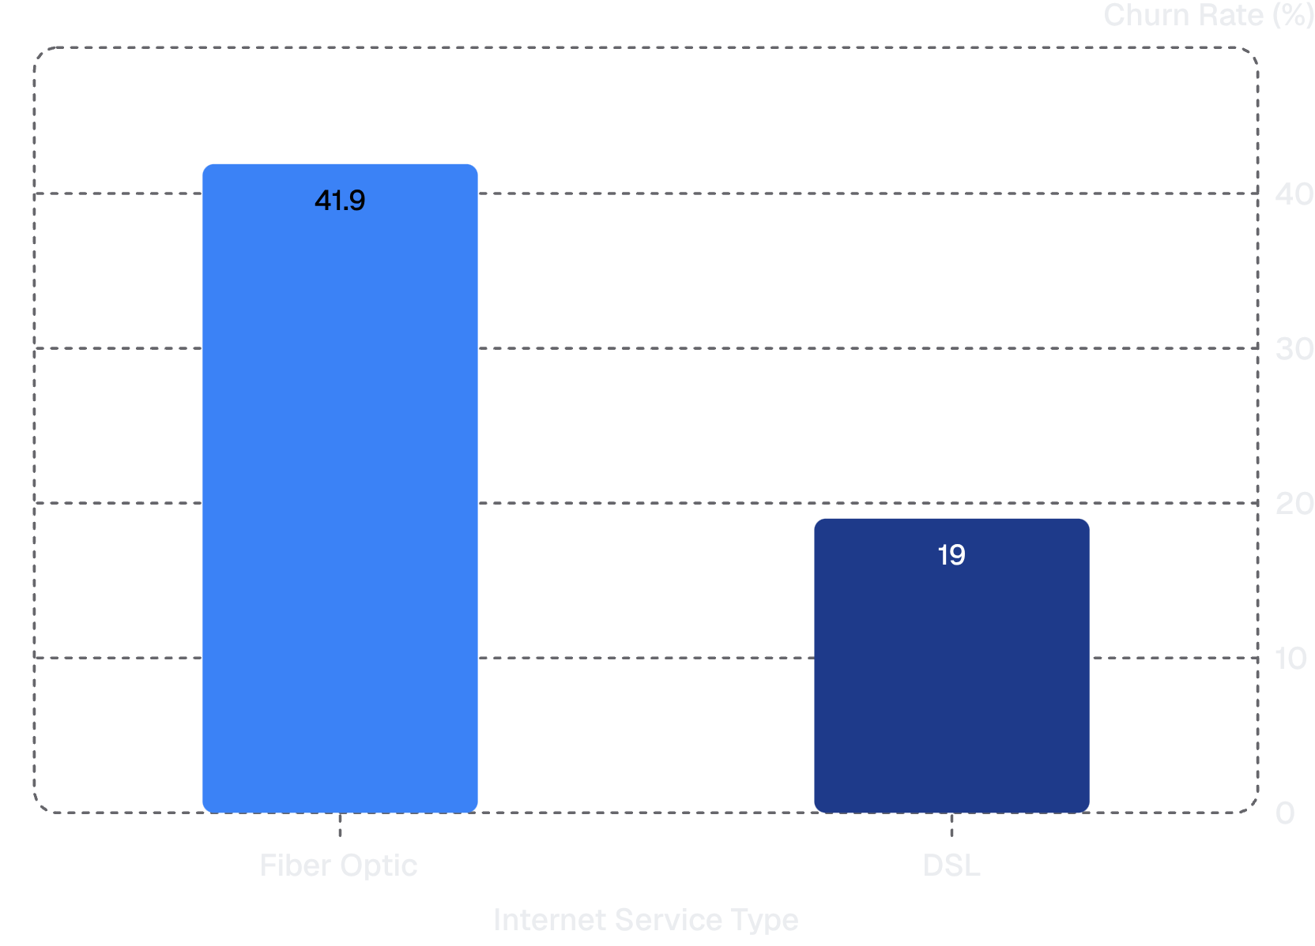
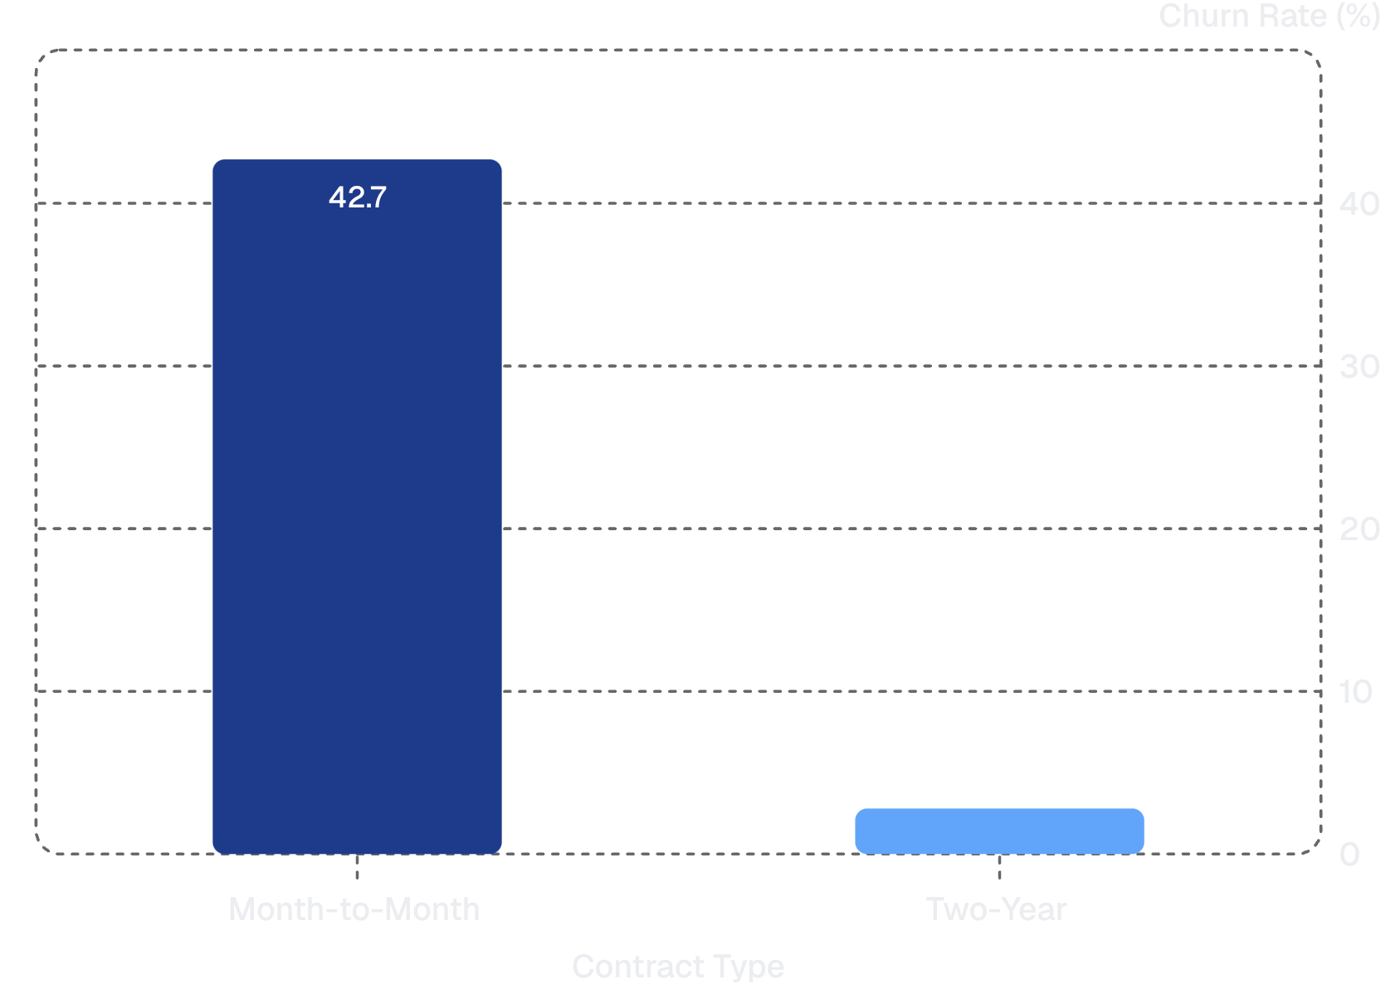

EDA: Key Churn Signals
Exploratory analysis surfaces two variables with especially strong differentiation in observed churn rates — providing the clearest early evidence of predictive signal in this dataset.
Fiber Optic customers churn at 41.9% — more than twice the rate of DSL customers at 19.0%. This gap likely reflects higher expectations, greater price sensitivity, or competitive pressure in the fiber segment.
Month-to-Month customers churn at 42.7% compared to just 2.8% for Two-Year contract holders. Contract structure is the single strongest observed differentiator — reflecting both customer commitment and switching cost.
These patterns suggest strong predictive signals. They do not yet quantify feature importance — that will be determined by the model and confirmed with SHAP analysis.

Slide 7



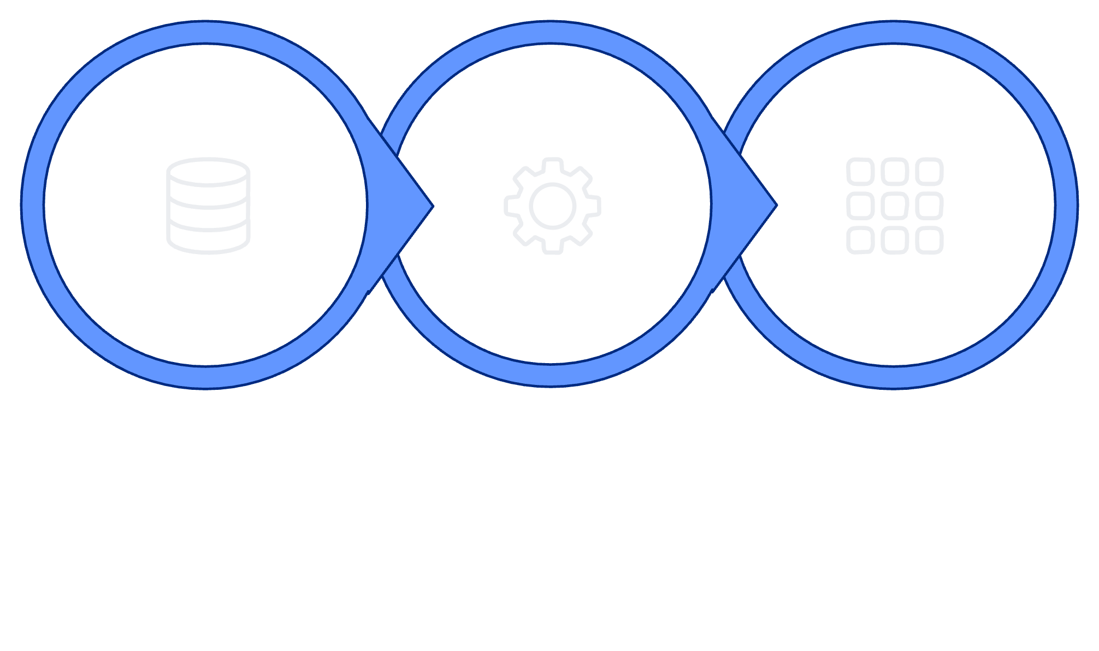
Feature Engineering
Raw fields are transformed into engineered features that better represent customer behavior — using only information available at prediction time to avoid leakage.
TotalChargesPerTenure
ServiceCount
Additional Engineered Features
Formula: Total Charges ÷ Tenure
Captures a customer's average monthly spending intensity across their entire relationship with ConnectTel. A customer who spends more per month relative to tenure may signal higher service dependency — or alternatively, billing shock that drives churn.
Formula: Count of active service subscriptions
Measures the breadth of service adoption across phone, internet, streaming, security, and support products. Customers with deeper service integration tend to have higher switching costs and lower churn propensity.
Design goal: Capture nonlinear relationships and service interaction effects not expressed by any single raw variable.
Additional features will be finalized during implementation based on correlation analysis and model-driven feature selection.
Raw Customer Data
Feature Engineering
Model-Ready Matrix

Slide 8



Machine Learning Approach
Three model families are benchmarked to capture different types of patterns in customer behavior — from interpretable linear relationships to complex nonlinear interactions.
Logistic Regression
Random Forest
XGBoost
Role: Interpretable baseline
Establishes a performance floor and provides coefficient-level transparency. Any more complex model must meaningfully outperform this baseline to justify its added complexity.
Role: Nonlinear ensemble
Captures nonlinear feature relationships and complex interactions through bagged decision trees. Robust to outliers and naturally handles mixed feature types without extensive preprocessing.
Role: Gradient boosting champion
Sequentially corrects residual errors on tabular data. Strong out-of-the-box performance on structured datasets with efficient hyperparameter tuning via GridSearchCV.
Model selection is not predetermined. Final choice will be driven by evaluation metrics on the held-out test set — not prior assumptions about which algorithm performs best.

Slide 9
Training & Evaluation Pipeline
A rigorous end-to-end workflow designed to prevent data leakage, ensure generalization, and produce evaluation results that reflect true out-of-sample performance.
1
Stratified Train/Test Split
Why This Matters
Split preserves the churn class ratio in both partitions — ensuring neither set is accidentally over- or under-represented by churners.
Leakage is the most common reason ML models fail to replicate lab performance in production. Every guardrail in this pipeline exists to ensure reported metrics reflect what the model will actually achieve on unseen customers.
2
Preprocessing Pipeline (Train Only)
Numerical: Imputation → Scaling. Categorical: Encoding. All transformers fitted exclusively on training data — test set is transformed, never fitted.
Pipeline Enforcement
All preprocessing steps are wrapped inside sklearn.Pipeline objects. This makes leakage-free execution automatic — not a manual discipline.
3
K-Fold Cross-Validation
Assesses model stability across multiple training folds. Flags overfitting before final evaluation.
4
Hyperparameter Tuning
GridSearchCV applied within training set only. No test data is touched during tuning.
5
Final Evaluation on Held-Out Test Set
All reported metrics computed once on the test set after all decisions are finalized.

Slide 10


Evaluation Strategy
Accuracy alone is insufficient for churn prediction. Business context — the cost of missed churners vs. wasted retention spend — drives metric selection and threshold decisions.
Primary Metric
Threshold Analysis
The default 0.5 probability threshold is rarely optimal in business contexts. By adjusting the classification threshold, the retention team can choose their operating point:
ROC-AUC
Threshold-independent measure of the model's ability to discriminate churners from non-churners across all possible operating points. The single most informative summary of classification performance for imbalanced business problems.
Lower Threshold → Higher Recall
Higher Threshold → Higher Precision
Supporting Metrics
Cast a wider net — catch more churners, accept more false positives. Best when retention outreach is low-cost.
Focus only on highest-risk customers — minimize wasted effort. Best when retention offers are expensive or limited.
Metric | Business Question
Precision | Of predicted churners, how many actually leave? Limits wasted retention resources.
Recall | Of actual churners, how many do we catch? Minimizes missed intervention opportunities.
F1 Score | Harmonic balance between precision and recall.
Confusion Matrix | Full breakdown of TP, FP, TN, FN for operational review.
Threshold selection is a business decision, not a purely technical one. The final operating point will be determined in consultation with the retention team's capacity and budget constraints.

