Slide 1
Beijing Multi-Site
Air Quality Analysis
📊
12
Monitoring Stations
Statistical Insights from UCI Dataset
(2013 – 2017)
420K
Hourly Records
4 yrs
2013 – 2017
Week 2 – Activity 2 · 2511-YCCIA-MSE
1 / 12

Slide 2
Dataset Overview
2 / 12
12
420K
18
4 yrs
Monitoring
Stations
Hourly
Records
Columns
Mar 2013 –
Feb 2017
Columns
Data Types
year · month · day · hour · PM2.5 · PM10 · SO2 · NO2 · CO · O3 · TEMP · PRES · DEWP · RAIN · wd · WSPM · station
float64 — pollutant & weather readings
int64 — year, month, day, hour
object — wind direction (wd), station name
Task 1 Complete
Dataset successfully loaded from 12 CSV files. First 5 rows displayed, all column names and dtypes confirmed, combined shape verified: 420,768 rows × 18 columns.
Source: UCI ML Repository – Beijing Multi-Site Air Quality Data | Zhang et al., 2017

Slide 3
Task 2: Data Cleaning
3 / 12
Missing Values by Column
Cleaning Strategy
CO
4.92%
01
Assess
O3
3.16%
74,027 missing cells out of 7.57M total (< 1%)
NO2
2.88%
02
Fill Numeric
SO2
2.14%
PM2.5, PM10, SO2, NO2, CO, O3, TEMP, PRES, DEWP, RAIN, WSPM → per-station median
PM2.5
2.08%
03
Fill Categorical
PM10
1.53%
Wind direction (wd) → per-station mode (most common direction)
wd
0.43%
WSPM
0.08%
04
Verify
0 missing values remaining — all 420,768 rows retained
✓ All 420,768 rows retained — zero rows dropped!
Per-station fill strategy preserves local pollution patterns | No rows dropped

Slide 4
Task 3: Basic Statistical Analysis
4 / 12
Variable | Mean | Median | Min | Max | Std Dev
PM2.5 (µg/m³) | 79.27 | 55.00 | 2.00 | 999.00 | 80.06
PM10 (µg/m³) | 104.24 | 82.00 | 2.00 | 999.00 | 91.12
SO2 (µg/m³) | 15.64 | 7.00 | 0.29 | 500.00 | 21.46
NO2 (µg/m³) | 50.38 | 43.00 | 1.03 | 290.00 | 34.71
CO (µg/m³) | 1212.91 | 900.00 | 100.00 | 10,000 | 1134.27
O3 (µg/m³) | 56.93 | 44.00 | 0.21 | 1071.00 | 55.83
TEMP (°C) | 13.54 | 14.50 | -19.90 | 41.60 | 11.43
⚠ Mean PM2.5 (79.27 µg/m³) = 15.9× the WHO annual limit of 5 µg/m³
CO shows the highest variability (std 1,134) — extreme pollution events drive the spread

Slide 5
Task 3: PM2.5 by Station – Mean Concentration
5 / 12
Dongsi
WHO
5 µg/m³
85.66
Urban
Wanshouxigong
84.53
Nongzhanguan
84.38
Gucheng
83.41
Wanliu
83.11
Guanyuan
82.51
Aotizhongxin
82.12
Tiantan
81.72
Shunyi
78.85
Changping
70.55
Huairou
69.01
Dingling
65.43
Rural
Urban core stations 20–30% more polluted than suburban/rural stations

Slide 6
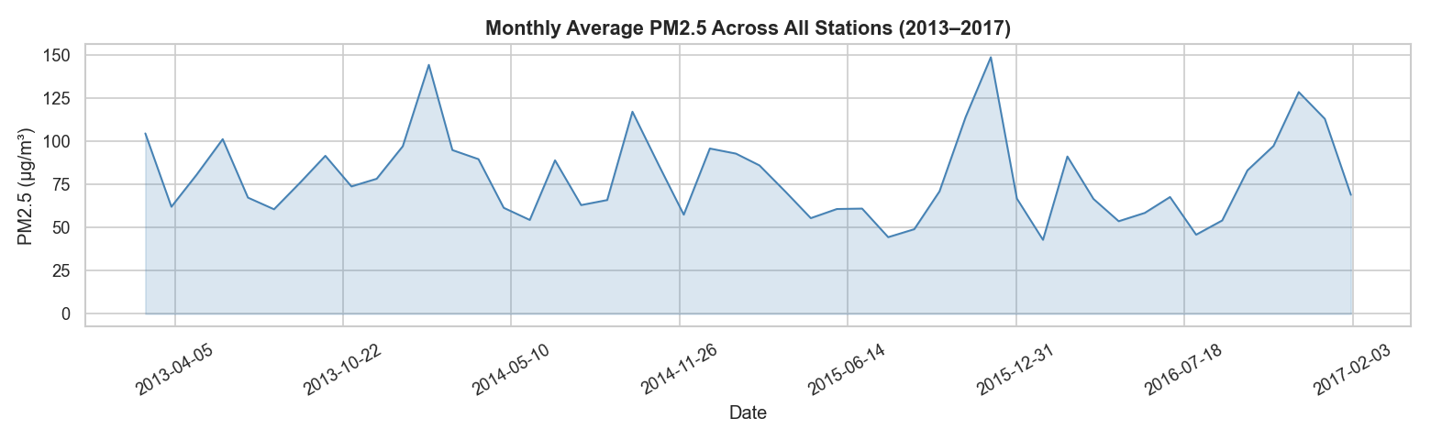
Task 4: PM2.5 Monthly Trend (2013 – 2017)
6 / 12
Seasonal cycles are clear — peaks in winter, troughs in summer. No sustained downward trend across the 4-year period, indicating pollution was not improving.
Task 4 – Data Visualisation | Seasonal winter peaks dominant across all years

Slide 7
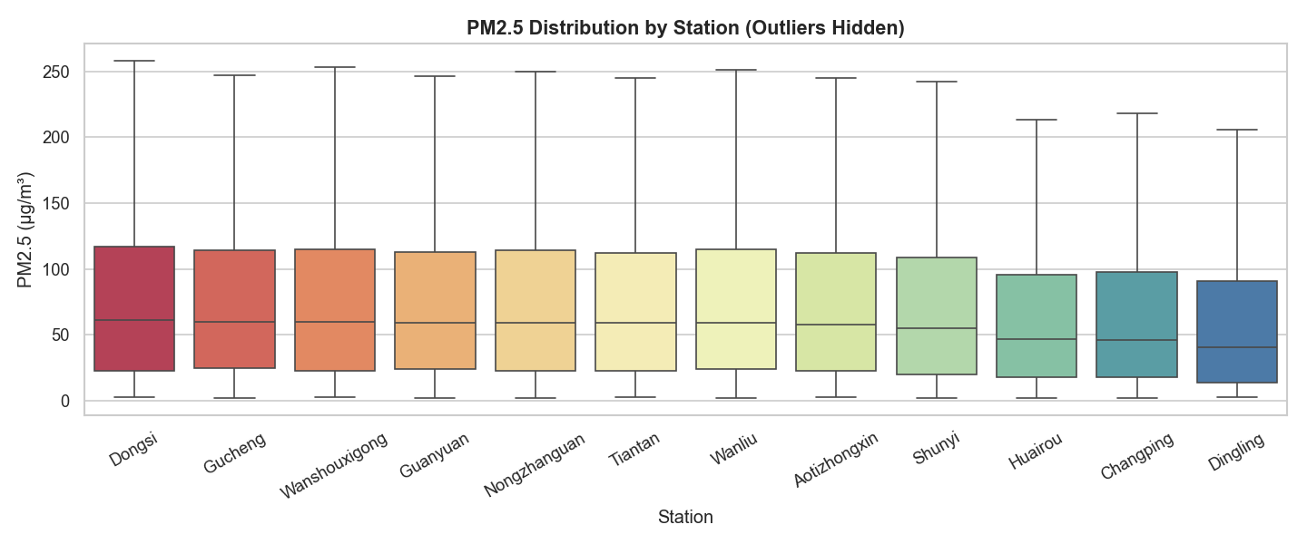
Task 4: PM2.5 Distribution by Station (Box Plot)
7 / 12
All stations show wide interquartile ranges — high day-to-day variability is driven by weather events (wind, rain) and traffic/industrial cycles.
Task 4 – Data Visualisation | Outliers hidden for clarity

Slide 8
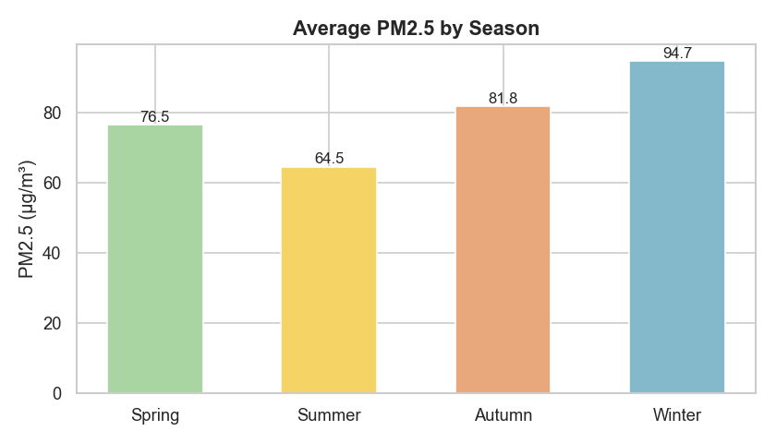
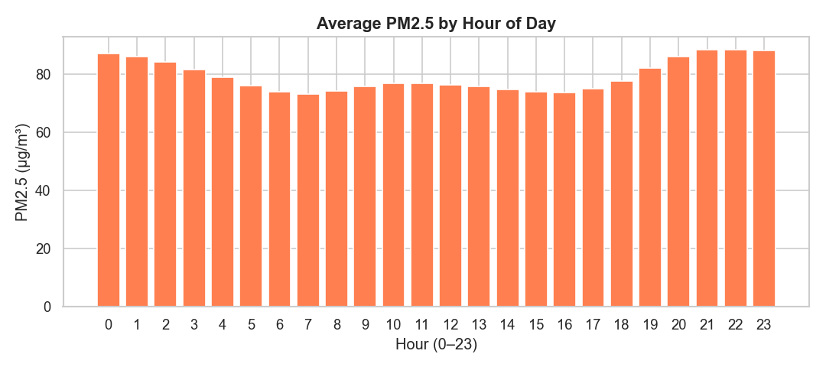
Task 4: Seasonal and Hourly Patterns
8 / 12
Winter PM2.5 (94.7 µg/m³) is 1.5× higher than Summer (64.5 µg/m³) — heating coal combustion and cold air temperature inversions trap pollutants.
PM2.5 peaks during morning (8–10am) and evening (9–11pm) rush hours, reflecting traffic emissions and reduced atmospheric mixing at night.
Task 4 – Data Visualisation | Winter heating + rush-hour traffic are primary drivers

Slide 9
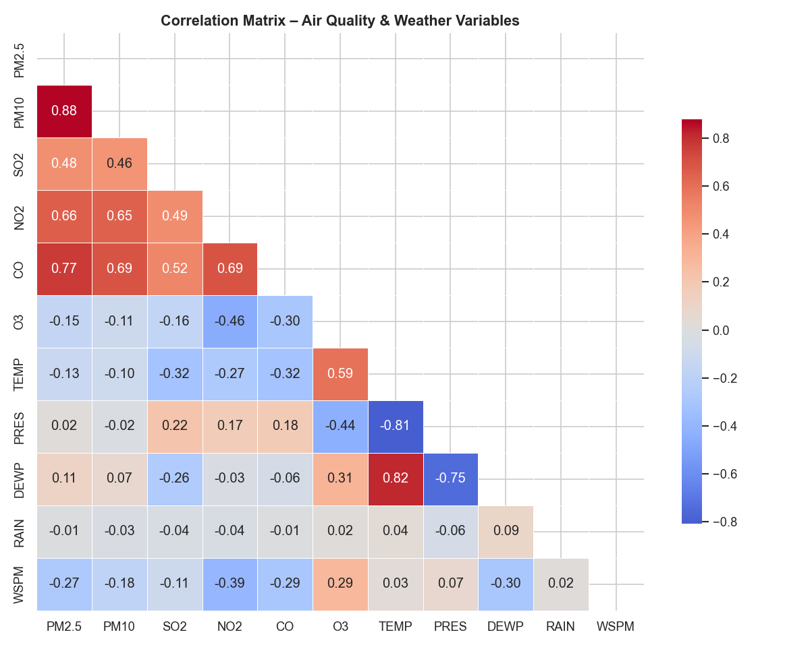
Task 5: Correlation Heatmap
9 / 12
0.88
PM2.5 ↔ PM10
0.77
PM2.5 ↔ CO
−0.27
PM2.5 ↔ WSPM
PM2.5 co-moves strongly with PM10 (r=0.88) and CO (r=0.77), suggesting shared combustion sources. Wind speed (r=−0.27) is the strongest natural dispersal factor.
Task 5 – Correlation Analysis | Lower triangle shown; r values rounded to 2 d.p.

Slide 10
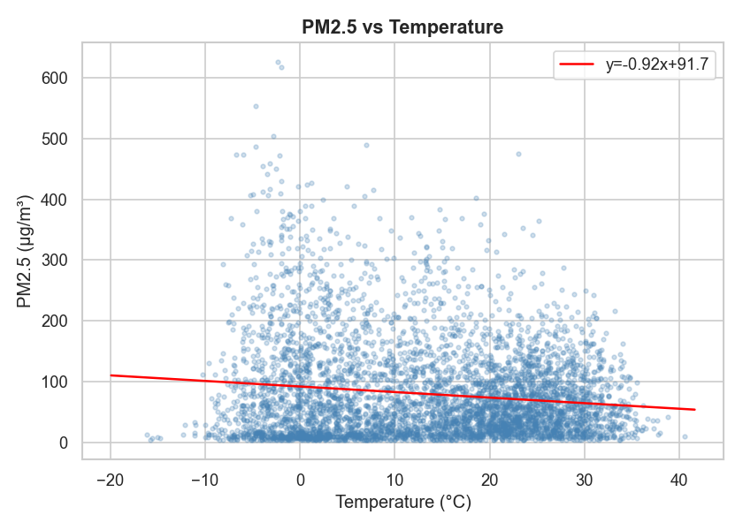
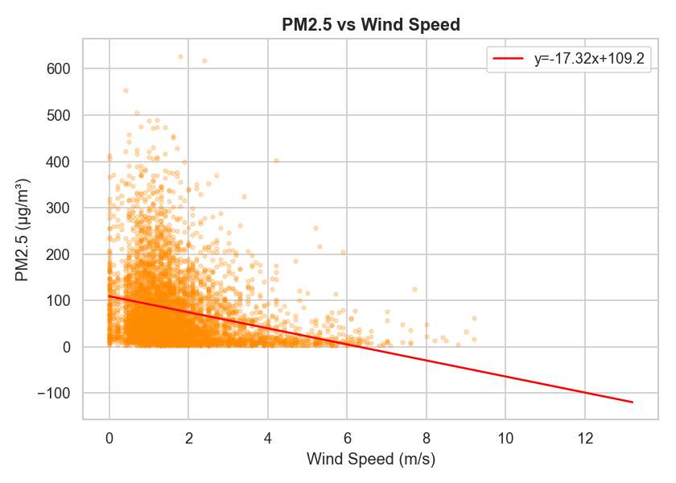
Task 5: Key Correlations with PM2.5
10 / 12
PM2.5 vs Temperature (r=−0.13): Cold air suppresses vertical mixing, trapping pollutants near the ground — hence higher PM2.5 in winter.
PM2.5 vs Wind Speed (r=−0.27): Stronger winds disperse particulate matter more effectively — the primary natural cleansing mechanism.
Task 5 – Correlation Analysis | Sample of 5,000 points shown; trend line fitted to full dataset

Slide 11
Task 6: Key Insights & Conclusions
11 / 12
All 12 stations exceed WHO annual PM2.5 limit (5 µg/m³) by 13–17×
Dongsi (urban core) most polluted: 85.66 µg/m³ mean
Dingling (suburban/rural) least polluted: 65.43 µg/m³ mean
Winter PM2.5 (94.7 µg/m³) is 1.5× Summer (64.5 µg/m³)
Morning & evening rush hours show clear PM2.5 spikes
CO strongest non-weather predictor of PM2.5 (r=0.77) — combustion
Wind speed is the key natural dispersal mechanism (r=−0.27)
No significant improvement 2013–2017 — sustained policy action needed
Week 2 – Activity 2 · 2511-YCCIA-MSE

Slide 12
References & Tools
12 / 12
Dataset
UCI ML Repository – Beijing Multi-Site Air Quality Data
Zhang, S. et al. (2017) · https://archive.ics.uci.edu/dataset/501/beijing+multi+site+air+quality+data
WHO Guideline
WHO Global Air Quality Guidelines: PM2.5 annual mean limit = 5 µg/m³ (WHO, 2021)
Python Tools
Python 3 · pandas · numpy · matplotlib · seaborn
Analysis Period
March 2013 – February 2017 · Hourly observations from 12 monitoring stations across Beijing
Week 2 – Activity 2 · 2511-YCCIA-MSE

