Slide 1
Salary Prediction Python EDA Project
Oreste RUKUNDO
September,2024

Slide 2
Introduction
Salary prediction is a crucial application of machine learning and statistical modeling that seeks to estimate the salary of an individual based on various factors
Accurate salary predictions are valuable for job seekers, employers, and policy makers
The objective of this project is to analyze factors affecting salary predictions

Slide 3
Research Questions
Which features are strongly associated with salary prediction?
How do different features interact to affect salary?

Slide 4
Dataset overview
This dataset contains:
Information about the salaries of employees at a company.
Each row represents a different employee, and the columns include information such as age, gender, education level, job title, years of experience, and salary.
1file
6 columns: Three Strings, Two integers, One decimal
Source: This dataset is created solely for educational use, and any commercial use is strictly prohibited, and this dataset was generated by large language models and not collected from actual data sources.
https://www.kaggle.com/datasets/rkiattisak/salaly-prediction-for-beginer

Slide 5
Exploratory Data Analysis
Columns:
Age: This column represents the age of each employee in years. The values in this column are numerical.
Gender: This column contains the gender of each employee, which can be either male or female. The values in this column are categorical.
Education Level: This column contains the educational level of each employee, which can be high school, bachelor's degree, master's degree, or PhD. The values in this column are categorical.

Slide 6
Job Title: This column contains the job title of each employee. The job titles can vary depending on the company and may include positions such as manager, analyst, engineer, or administrator. The values in this column are categorical.
Years of Experience: This column represents the number of years of work experience of each employee. The values in this column are numerical.
Salary: This column represents the annual salary of each employee in US dollars. The values in this column are numerical and can vary depending on factors such as job title, years of experience, and education level.

Slide 7
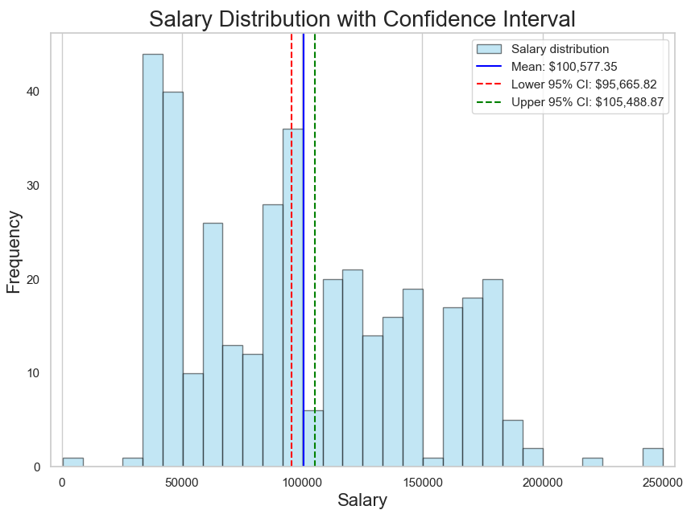
True Mean salary is $100,577.35

Slide 8
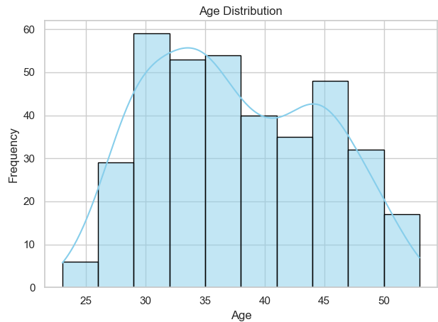
High proportion of employees are between 30 and 45 years old
Age distributions affect the workforce, productivity, and economic growth

Slide 9
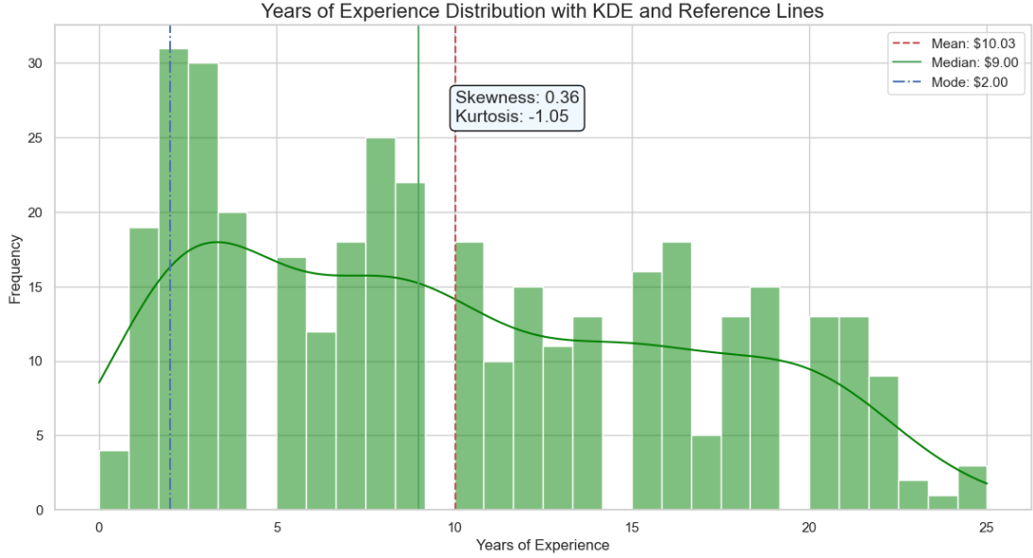
Positive Skewness (0.36) indicates that while most people have fewer years of experience, there are some with significantly more years of experience.
The combination of positive skewness and negative kurtosis means that while most salaries are clustered towards the lower end of the experience spectrum, the distribution does not have extreme outliers as frequently as a normal distribution might.

Slide 10
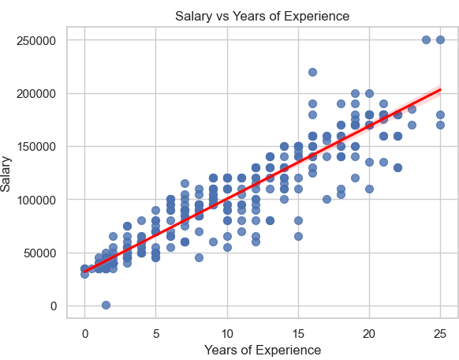
A high correlation between salary and years of experience implies a strong, positive relationship, suggesting that as employees gain more experience, their salaries tend to rise. This insight can be valuable for career planning, salary negotiations, and organizational compensation strategies.

Slide 11
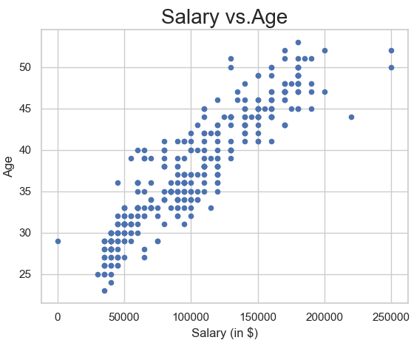
Salary may increase with age due to accumulated experience, seniority, and career advancement. This would show a positive correlation where older individuals tend to have higher salaries

Slide 12
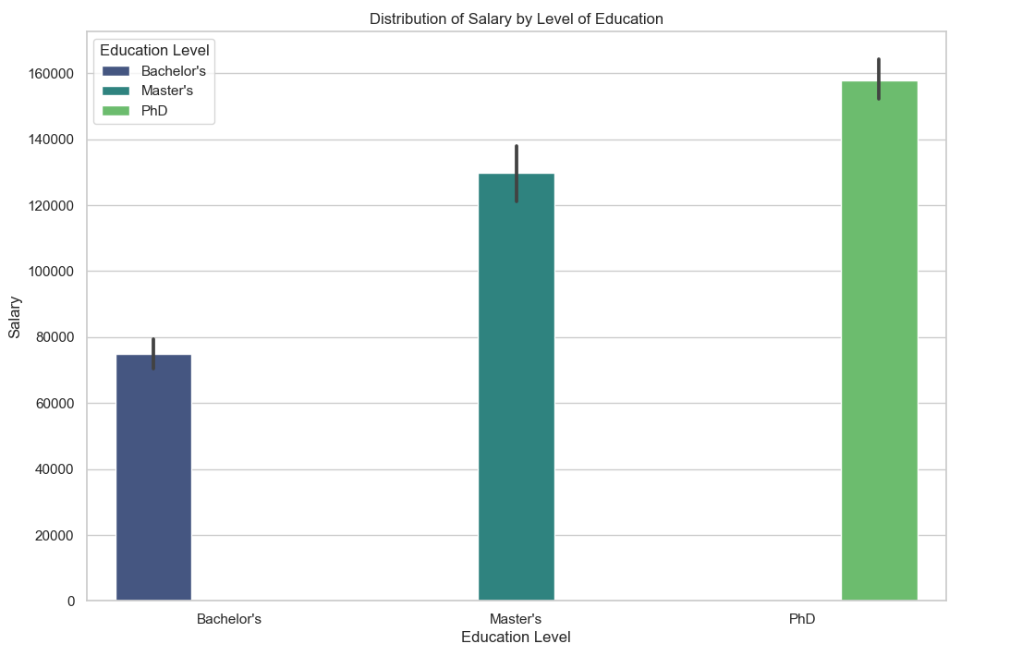
Higher education levels lead to higher salaries,
Important insights about the value of education in the job market

Slide 13
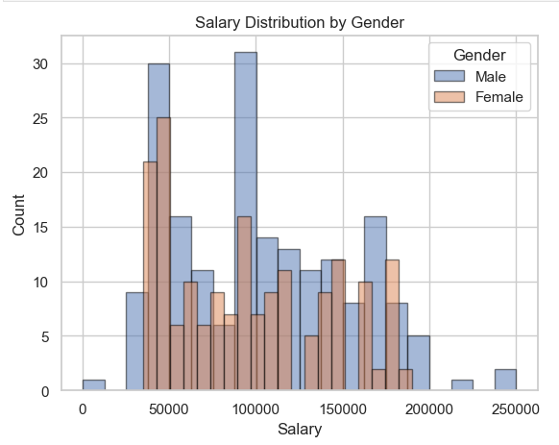
Salaries are not similarly distributed among both genders.
Differences in median salaries, spread, and potential outliers between genders.

Slide 14
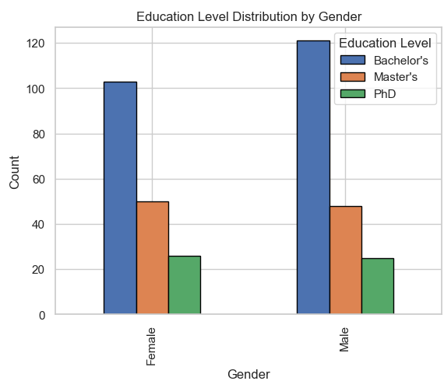
Differences in educational qualifications contribute to salary differences

Slide 15
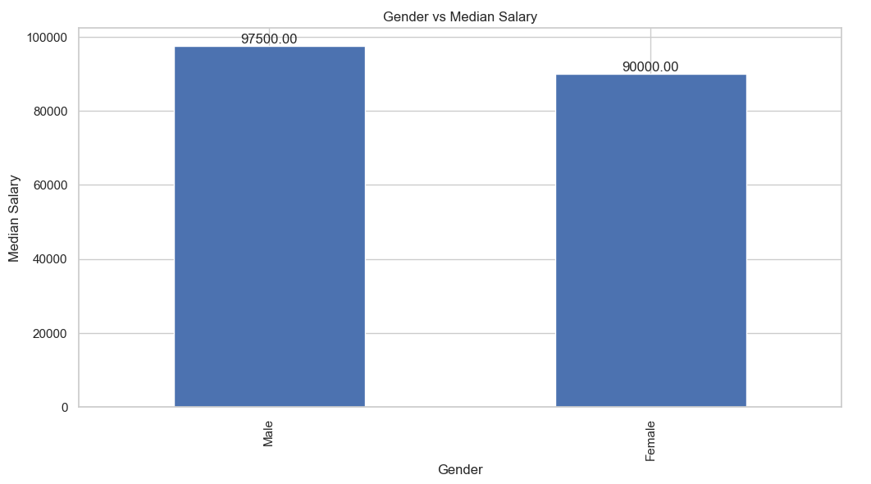
This graph shows that Male have $7500 (median salary) more than Female

Slide 16
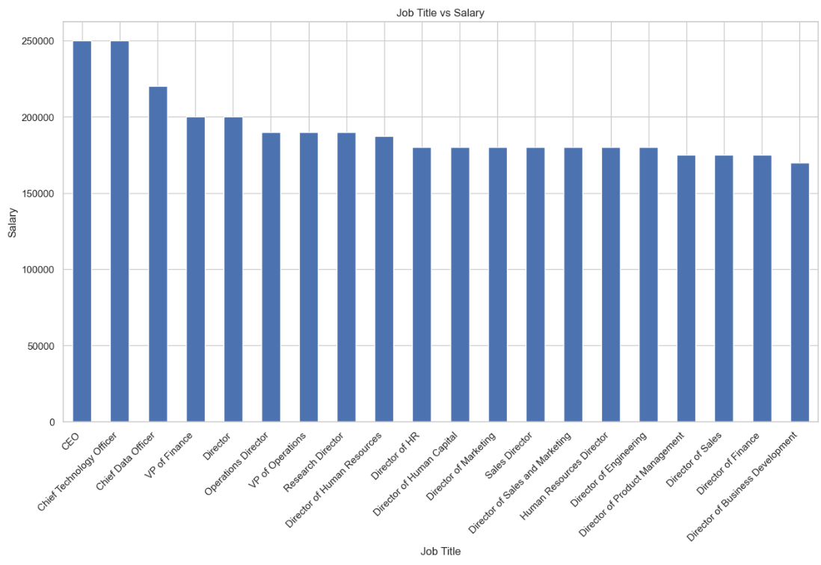
Job titles come with varying responsibilities and skill requirements, which can significantly influence salary.
Higher-level roles (e.g. CEO, Chef technology officer,…) typically command higher salaries.

Slide 17
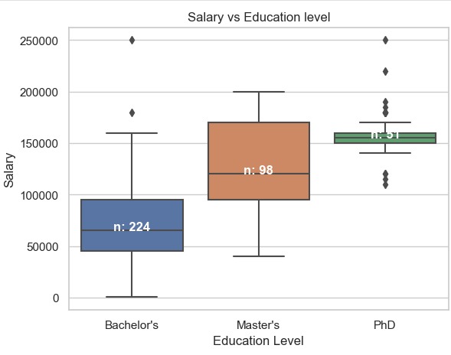
This graph shows the median salary for each education level
Bachelors have some outliers which are the higher salaries for the employees with experience
PhD also have some outliers which are the higher salaries for the employees with experience and lower salaries for those with no experience or lower job title

Slide 18
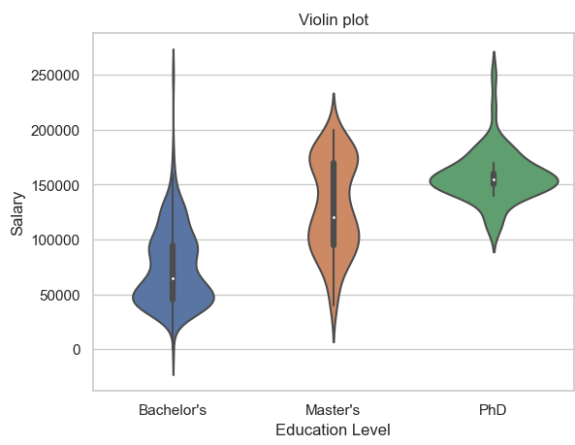
The density of salaries at different Education levels show that more employees are clustered around that salary range

Slide 19
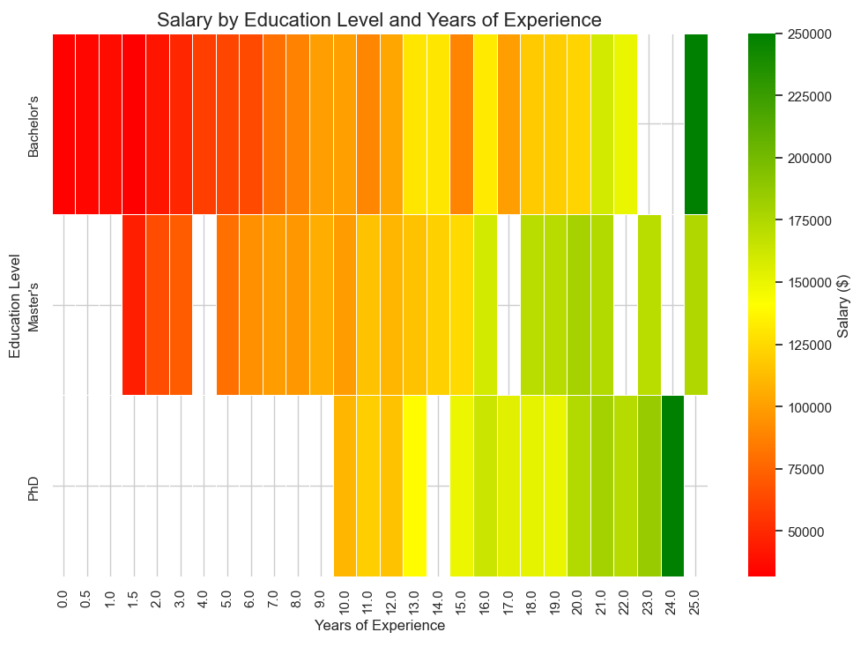
The green color represent higher salaries, while red colors represent lower salaries.
It shows how salaries vary with different combinations of education levels and years of experience

Slide 20
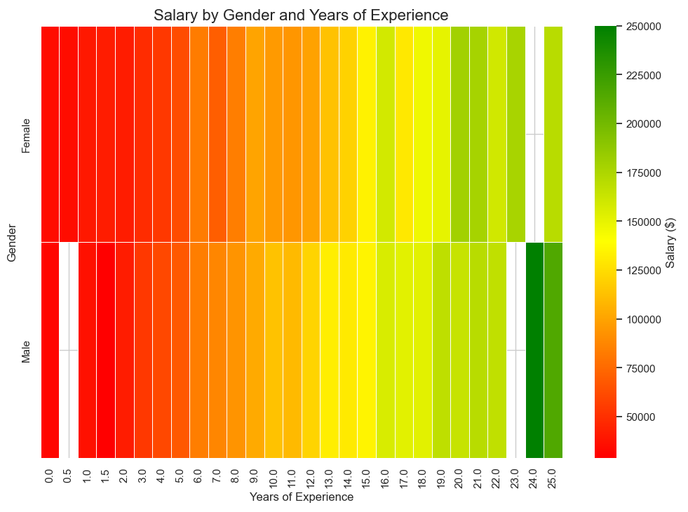
For the average salaries between males and females for the same years of experience, there are noticeable gender-based salary differences.

Slide 21
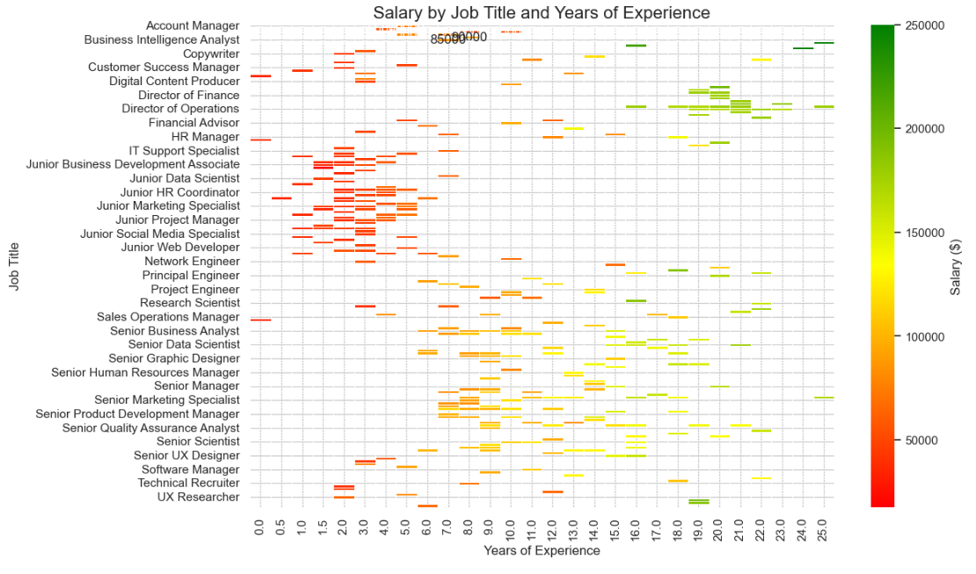
Salaries change with years of experience within each job title
Different average salaries for different job titles at the same years of experience

Slide 22
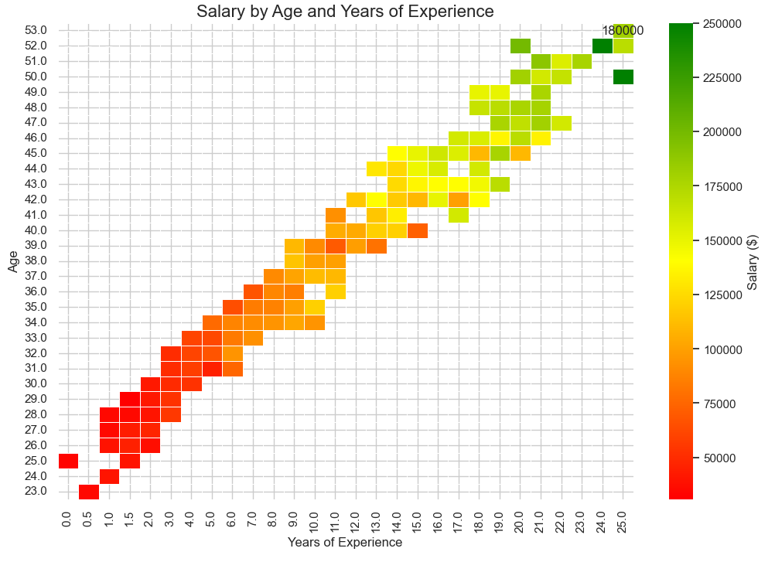
Older employees in specific roles tend to earn more compared to younger employees in similar positions.

Slide 23
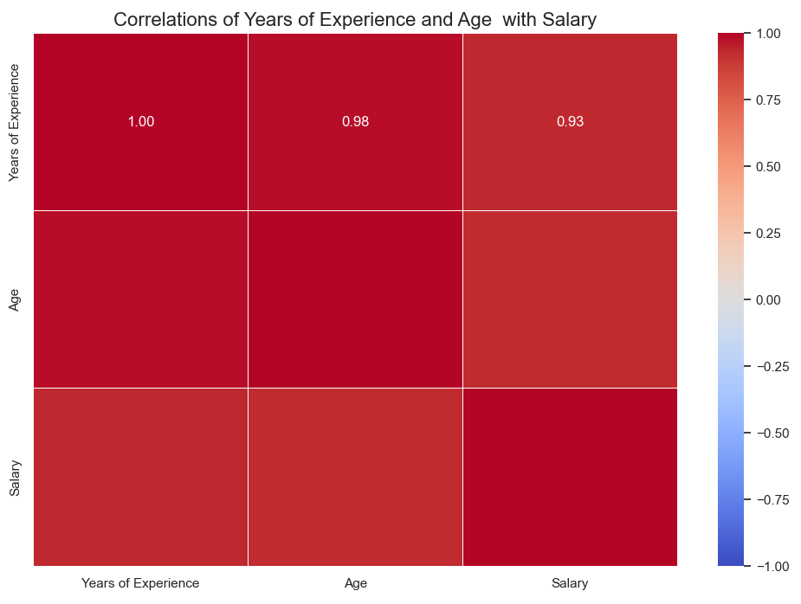
There is a strong positive correlation, suggesting that older individuals tend to have more years of experience
A strong positive correlation, showing that as years of experience increase, salaries tend to be higher
A strong positive correlation, indicating that older employees generally earn higher salaries, likely due to their accumulated experience.

Slide 24
Conclusion
Based on my analysis Age, Years of Experience, Education Level, and job title are strongly associated with salary prediction?
More Years of experience ,high education level and high job title imply high salary income. This means that all features are positively correlated not only between each other but also with salary.

Slide 25
Strategic Recommendations
Employees
Employers
Focus on gaining experience, acquiring relevant skills, and considering role changes to increase earning potential Use predictive models and data insights to support salary negotiations, demonstrating how your experience and skills align with higher salary ranges.
Ensure that salary structures reflect experience, job responsibilities, and market trends. Regularly review and adjust compensation to remain competitive. Create clear career paths &development opportunities that align with salary increases, helping employees understand how they can progress in their careers.

Slide 26
Thank you !
Q&A

