Slide 1
1.The Magic of React Routing (The "Why")
"Old World" (Traditional Web), every time you clicked a link, the browser sent a request to a server, waited for a whole new HTML file, and then white-screened while it reloaded. This is slow and resets all your variables (State).
In the "New World" (React/SPA), we use a Router. The Router intercepts the click. Instead of asking the server for a new page, it simply tells React: "Don't refresh! Just hide the 'Home' component and show the 'About' component." This makes the app feel like a mobile app—fast and smooth.

Slide 2
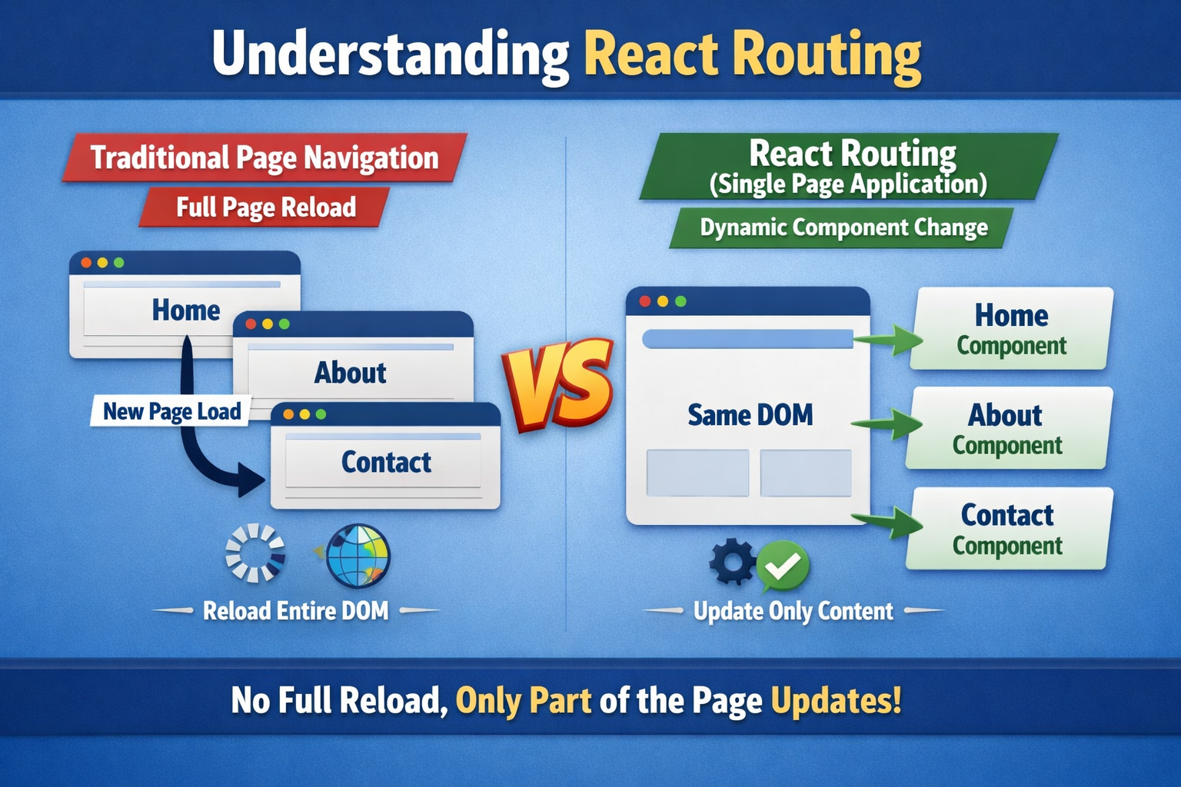

Slide 3
The Core Components (The "Engine")
BrowserRouter: This is the "Parent." It connects your app to the browser's URL bar. Without this, React doesn't know what the URL is.
Routes: Think of this as a Switch Statement. It looks at the current URL and scans all the children to see which one matches. It ensures only one page is shown at a time.
Route: This is the specific "Case." It has two parts: the Path (the address) and the Element (the component).
{use_this:npm install react-router-dom}
Example: path="/contact" means "If the user types /contact," and element={<Contact />} means "draw this on the screen."

Slide 4
Navigation vs. Links (The "Trap")
This is the most common mistake for beginners. In HTML, we use <a> tags. But in React, an <a> tag is like a "Reset Button"—it kills the app's memory (State).
Explain that the <Link> component is a special React tool that changes the URL without triggering a refresh. When a student uses <Link to="/profile">, the URL changes instantly, the back button still works, but the React State stays alive.

Slide 5
Real-World Example: The "Cinema App"
In a Movie App, the Header (Logo/Search) should stay at the top while the movie list changes below it.
The Static Part: Elements outside the <Routes> (like your Navbar) never re-render. This saves performance.
The Dynamic Part: Elements inside the <Routes> swap based on the link.
Explain that /movies/123 is a "Single Movie Page." You don't build 100 pages for 100 movies; you build one page that changes its content based on the ID.

Slide 6
Dynamic Routing (useParams)
Instead of creating Rama.jsx, John.jsx, and Sara.jsx, we use a Colon (:) in the path.
The Path: /student/:name
The Hook: useParams() is like a vacuum—it sucks the "name" out of the URL and gives it to you as a variable.
If the URL is /student/rama, the variable name becomes "rama". This allows one single component to be reused for thousands of different data points.

Slide 7
Programmatic Navigation (useNavigate)
Explain that sometimes, a user doesn't click a link to move. Sometimes the Code decides to move the user.
Example: A user clicks "Pay Now." After the payment is successful, you want to automatically send them to the "Success" page.
The Hook: useNavigate() gives you a "Function" (usually named Maps).
The Action: Calling Maps('/success') tells the browser to change the URL immediately.
This is essential for redirects after forms, login screens, or protected pages.

