Slide 1
Applications of microprocessor

Slide 2
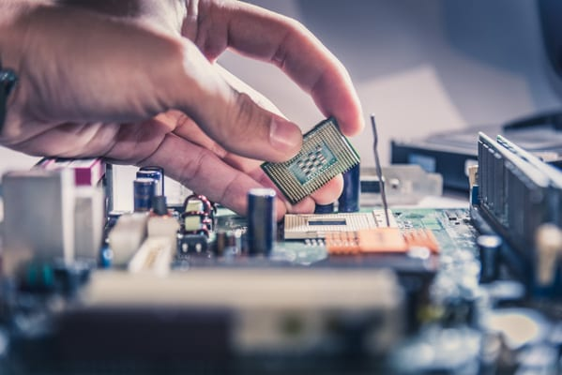
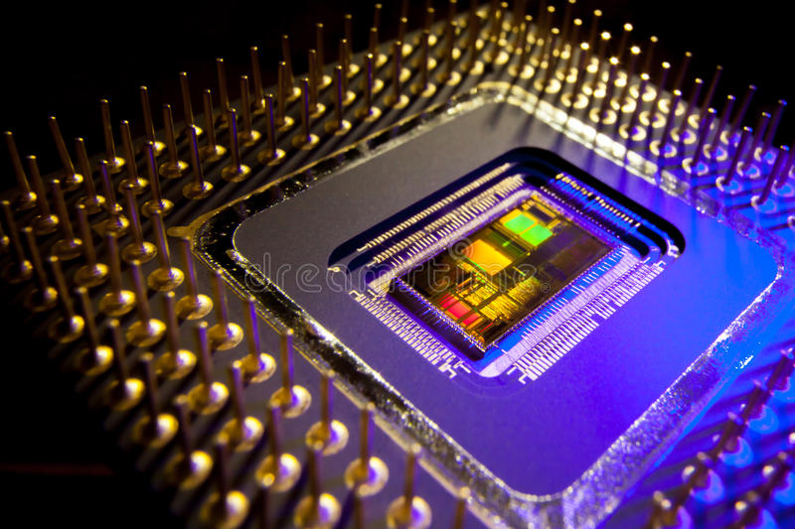
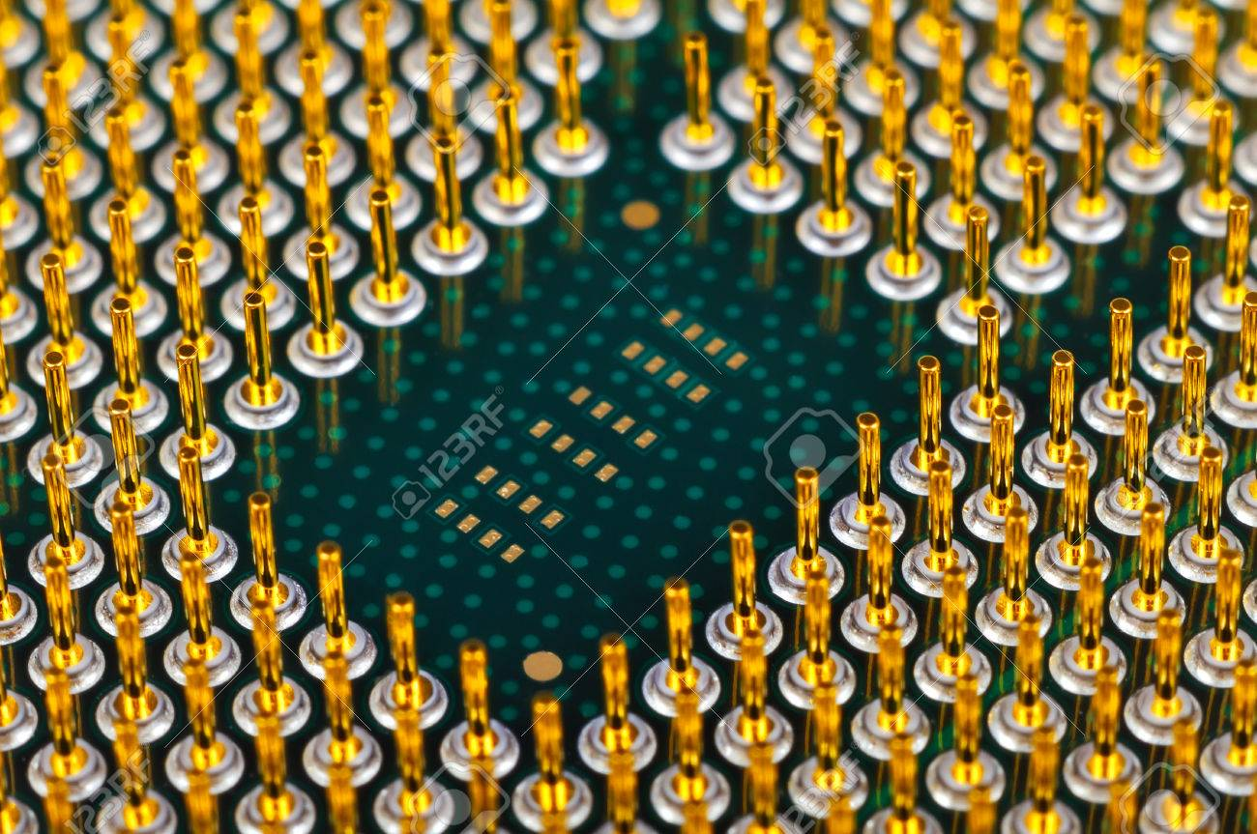
What is microprocessor?

Slide 3
Uses of microprocessor
In Home Appliansces
In mobile electronics
In metering
In Automotive Electronics
In building automation

Slide 4
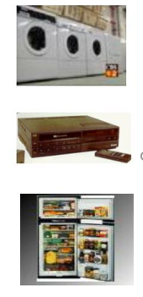
Home appliances
Refrigeration
cooking
washing
audio /video
mobile accessories
remote control
Home lighting system
video game system
alarm clock

Slide 5
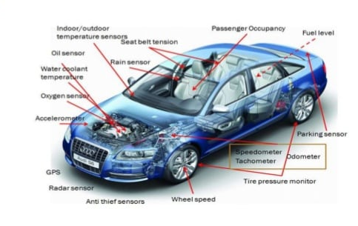
In Automotive Electronics

Slide 6
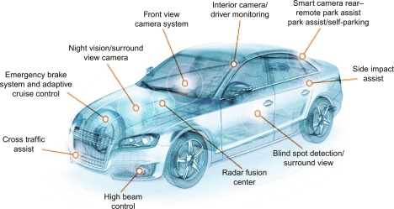
Where do we find electronics in car

Slide 7
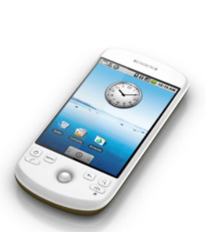
In mobile electronics
Microprocessor can be found in practically every electronic consumer product computer mobile phone automobile microwave or television has at least one microprocessor inside

Slide 8
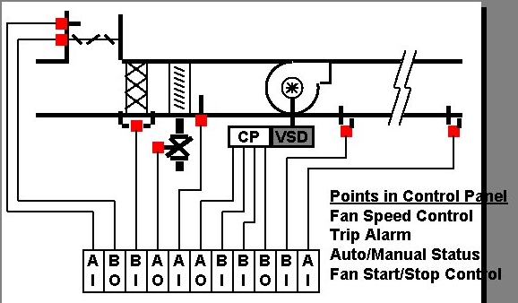
In building automation

Slide 9
In metering
Smart meter
Two advanced
metering insfructure
demand response
distribution electronic
AMI
Electronic meter
on way
Automatic meter reading
remote meter reading
AMR/RMR
Electromechanical meter

Slide 10
Thank you
submitted by : Rukya Islam
Id : 192-15-13319
section : e

