Slide 1
Horrorscopes
Does astrology influence crime?

Slide 2
Topic Selection
Astrology is interesting
Crime is fascinating
Every criminal has a birthdate
Data on crime is widely available

Slide 3
Source Data
Wiki Scrape from List of Famous Serial Killers
Has killer name
Has killer date of birth
Provides number of confirmed and potential victims
KCPD Crime Data for 2009
Has time and date of crime
Has area where crime was committed
Notes type of crime and if a firearm was used

Slide 4
Questions We Hope to Answer
Does crime happen more often during certain astrological seasons?
Is there a particular astrological sign that is more likely to be a murderer?
Are Pisces men the worst?

Slide 5
Data Exploration - Wikipedia Data
Once originally scraped, we found erroneous entries for Wikipedia articles such as “The Dating Game” and “September 11th attacks” as well as duplicate entries for several killers
When that error was fixed, we then encountered a handful of entries that only noted the year the killer was apprehended – these entries were removed.
Code was then written to assign an astrological sign to each killer by their date of birth
Data was then exported to a CSV

Slide 6
Data Exploration – KCPD Crime Data for 2009
We removed unnecessary columns, leaving only the report number of each crime, the “from date”, the “from time”, description of the crime, whether a firearm was used and the classification of the crime.
Data ranges from 01/01/2009 to 12/31/2009 and has over 100,000 rows.
Once cleaned, data was loaded to our database.

Slide 7
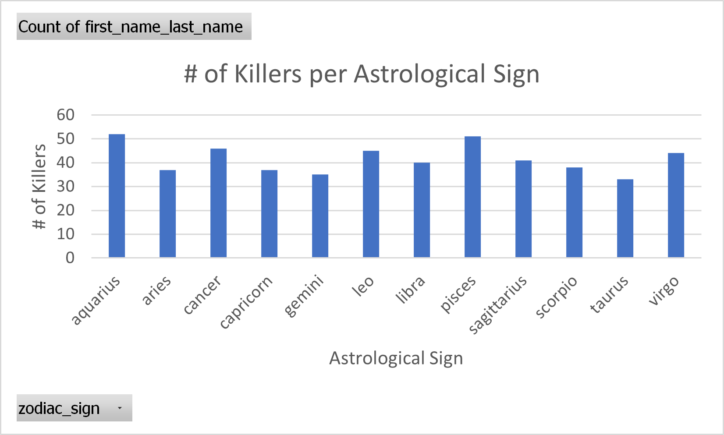
Analysis Phase – Wikipedia Data
In Excel, we compared the number of killers per astrological sign and found that two signs are more commonly serial killers than the others: Aquarius and Pisces.

Slide 8
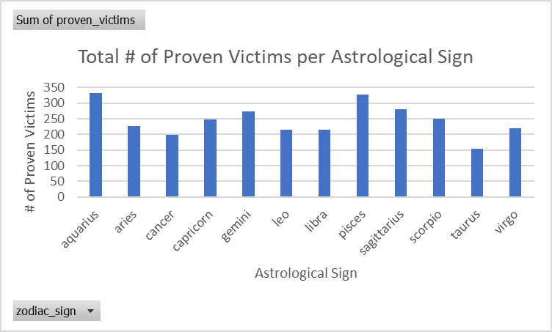
Analysis Phase – Wikipedia Data (cont.)
In addition, we examined confirmed victim counts for each astrological sign and were able to determine that two signs are statistically more violent: Aquarius and Pisces.

Slide 9
Analysis Phase – KCPD Crime Data for 2009
In Tableau, we created a relationship between the Full Moon Data for 2009 and the KCPD Crime Data in order to create charts that compared spikes in crime to which astrological sign the moon was in.
We found that number of reports are highest when the moon is in Virgo.
When examining what classification of crime is most likely during certain seasons, we found that misconduct is most likely to occur during a Taurus Full Moon, theft is more likely to occur during an Aries Full Moon and Violent Crime is more likely to occur in a Gemini Full Moon.
Firearms were far more likely to be used when the Full Moon is in Pisces.

Slide 10
Dashboard
We are building a website to function as our Project Dashboard. The blueprint for the website is shown on the next slide.
Users will be able to interact with the website by inputting their date of birth, which will return a list of the top 10 serial killers with that staar sign.

Slide 11
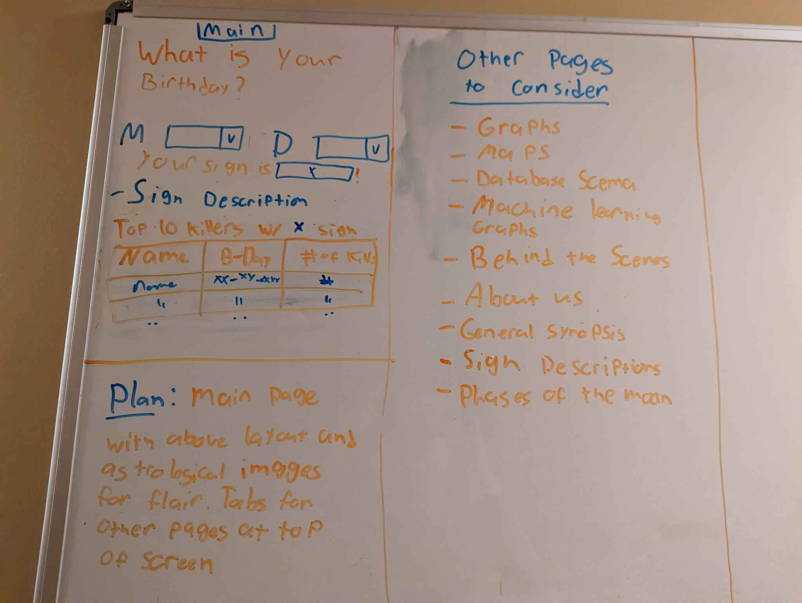
Dashboard - Blueprint

Slide 12
Technologies Used
Google Colab
Tableau
Excel
Mito
Adobe Illustrator
Python
SQL
Postgres
Pandas
Javascript
Bootstrap
AWS
Jupyter Notebook
Microsoft Word

