Slide 1
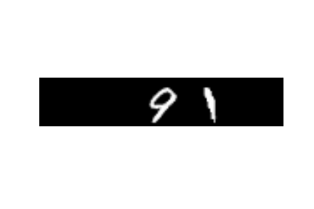
9
1
Output Labels
Input Image
Convolution
Layer 1
Max Pooling
Layer 1
Convolution
Layer 2
Max Pooling
Layer 2
10
Independent Fully connected
Layers
Fully connected
Layers

