Slide 1
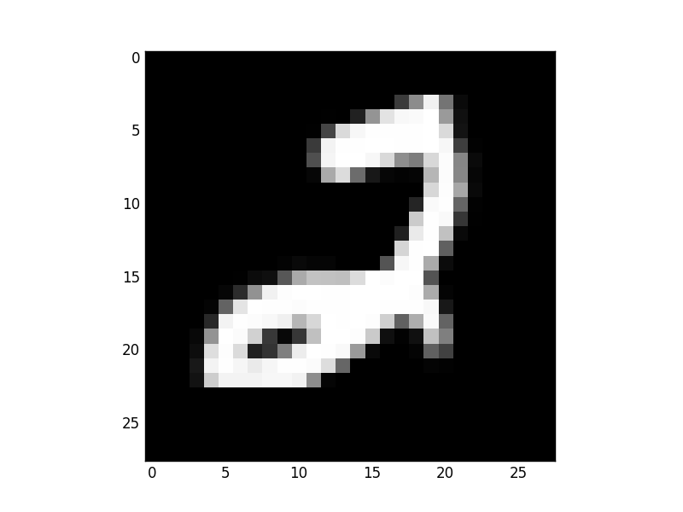
Output Label
2
Input Image
Convolution
Layer 1
Max Pooling
Layer 1
Convolution
Layer 2
Max Pooling
Layer 2
Fully connected
Layer 1
Fully connected
Layer 2

