Slide 1


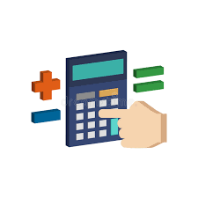
TECH LASKIN

Slide 2

ABOUT:
NAME OF THE PROJECT: TECH LASKIN
This project based on Calculator. The term Laskin is a Finnish word and it means Calculator
CREATED BY:
S.NURIL HIJAS (IIIyr IT RIT)
H.RUMA JAISWAL(IIIyr IT RIT)
J.VIDHYA SRI(IIIyr IT REC)
R.VIVTHA(IIIyr ECE REC)

Slide 3
OVERVIEW:
THESE ARE THE OVERVIEW OF THE PROJECTS:
ABSTRACT
INTRODUCTION
PROPOSED SYSTEM
IMPLEMENTATION AND OUTPUT
FUTURE ENHANCEMENT
CONCLUSION

Slide 4
ABSTRACT:
This project describes The Calculator Project. This project was developed by the TECH DREAMZ team. The central aim of the project to perform all the basic operation . The user touch the screen to enter the input and the operation is performed behind the screen and the output is displayed on the console window. Then the screen is cleared to load the another data.
BASIC OPERATIONs like : ADDITION, SUBTRACTION, MUTIPLICATION & DIVISION

Slide 5
INTRODUCTION:
CALCULATOR:
A calculator is a device that perform arithmetic operations. The simplest calculator can do only addition , subtraction, multiplication, and division. More sophisticated calculators can handle exponential operations, roots, algorithms, trigonometric functions, and hyperbolic functions. Internally , some calculators actually perform all of these functions by repeated processes of addition. Before 1970, a more primitive form of calculator, the slide rule, was commonly used. One of the most primitive calculator is ABACUS.

Slide 6
PROPOSED SYSTEM:
The central aim of the project is to perform all the basic operation using ULK .
TECHNOLOGY TO BE USED:
ULK kit
PC(PERSONAL COMPUTER)
With connectivity cables
PROPERTIES OF TECHNOLOGY:
The ULK kit need to connect with PC using Ethernet cable and ULK kit to change the Mode in LAB mode and to connect with PC. In PC to run the program in the command prompt and to locate the file and mount to another file and to display the result.

Slide 7
IMPLEMENTATION:
The project will display the result of the basic operations. First the PC will connect with the ULK kit and to write the C programing code to execute the operations. In the ULK kit in LED screen , We need to include an image with the screen solution 320 x 240. In image to locate the some X and Y location to point the values and in the code section the operation according to X and Y locations and the output will displayed in the PC terminal.

Slide 8
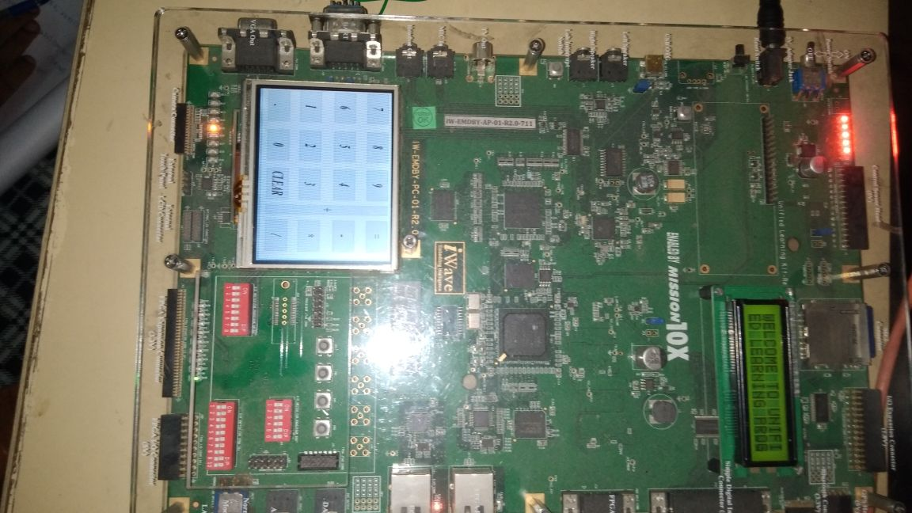
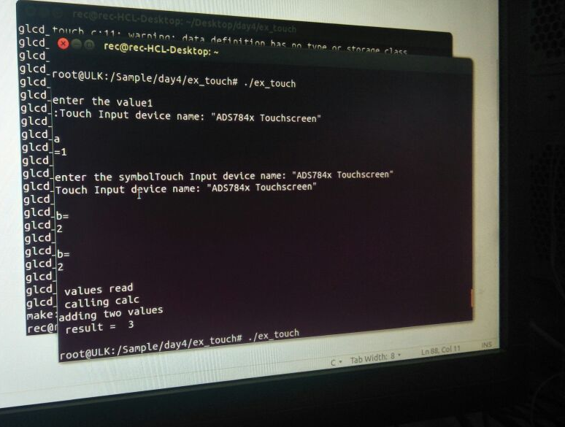
OUTPUT:

Slide 9
FUTURE ENHANCEMENT:
the future we can reconstruct our project and we can develop the project mainly for business operationsIn. In future is not in a way of button, switches, etc and almost we are all use only the touch to display the process, so we are develop for the future problems.

Slide 10
CONCLUSION:
Thus the calculator which performs simple calculations such as addition subtraction, multiplication, and division is developed using ULK kit. The problems encountered was converting the .jpg image to .bmp file and getting the input from the input from users which has been solved and executed

Slide 11
THANK YOU FOR YOUR SUPPORT
BY
TECH DREAMZ TEAM

