Slide 1
Spoken Digit Recognition using Artificial Neural Network
A Project on Voice based digit recognition
Mohammed Rumaan 4MT20AI018 13/12/2023

Slide 2
Problem Statement
As we propel towards a more interactive and hands-free era of technology, voice recognition has emerged as a pivotal interface. However, the accurate recognition and classification of spoken digits, ranging from 0 to 9, present a unique challenge. The ability to seamlessly interpret and process spoken numerals is crucial for the development of intuitive voice-controlled systems.
The primary problem we aim to address is the need for a robust Spoken Digit Recognition System that can operate across diverse scenarios. This includes accommodating various speakers, accounting for different accents, and handling diverse recording conditions. Achieving high accuracy in identifying spoken digits is not only a technological feat but also a fundamental step towards enhancing user experiences and accessibility in a voice-driven world.
Our project focuses on leveraging Artificial Neural Networks (ANN) in combination with Mel-frequency cepstral coefficients (MFCC) to create a system that not only accurately recognizes spoken digits but also demonstrates real-world applicability.

Slide 3
Objective
Our primary goal is to develop an effective Spoken Digit Recognition System utilizing the power of Artificial Neural Networks (ANN) and Mel-frequency cepstral coefficients (MFCC). Through this project, we aim to achieve the following objectives:
Accurate Digit Identification: Create a system capable of accurately identifying spoken digits ranging from 0 to 9, ensuring precision across diverse speakers, accents, and recording conditions.
Integration of MFCC: Leverage Mel-frequency cepstral coefficients (MFCC) as a feature extraction technique, capturing essential spectral characteristics of the audio signal. This will enhance the model's ability to discern subtle nuances in spoken digits.
ANN for Complex Feature Learning: Design and implement an Artificial Neural Network with hidden layers for intricate feature learning. The neural network will be trained to recognize and classify spoken digits based on the extracted MFCC features.
Real-world Applicability: Develop a system that goes beyond theoretical accuracy, demonstrating its practical usability in real-world scenarios and voice-driven interfaces.

Slide 4
Expected Outcome
With the successful completion of our project, we expect the following outcomes and achievements:
Fully Functional Spoken Digit Recognition System: A robust and fully operational system capable of accurately recognizing and classifying spoken digits (0-9) across a diverse range of scenarios.
High Accuracy in Digit Detection:Achievement of high accuracy rates in digit detection, ensuring reliability and precision in the classification process.
Effective Use of MFCC: Demonstration of the effectiveness of Mel-frequency cepstral coefficients (MFCC) in capturing and representing the spectral characteristics of spoken digits, contributing to the model's accuracy.
Real-world Applicability: Emphasis on the practical applicability of our system in real-world settings, showcasing its potential integration into voice-activated devices, software, and AI assistants.
Improved User Experiences: A contribution to the enhancement of user experiences in voice-driven interactions, reducing errors and providing a seamless spoken digit recognition experience.
Versatility Across Different Speakers and Accents: Validation of the system's versatility by accurately processing spoken digits from various speakers, accommodating different accents, and adapting to diverse recording conditions.

Slide 5
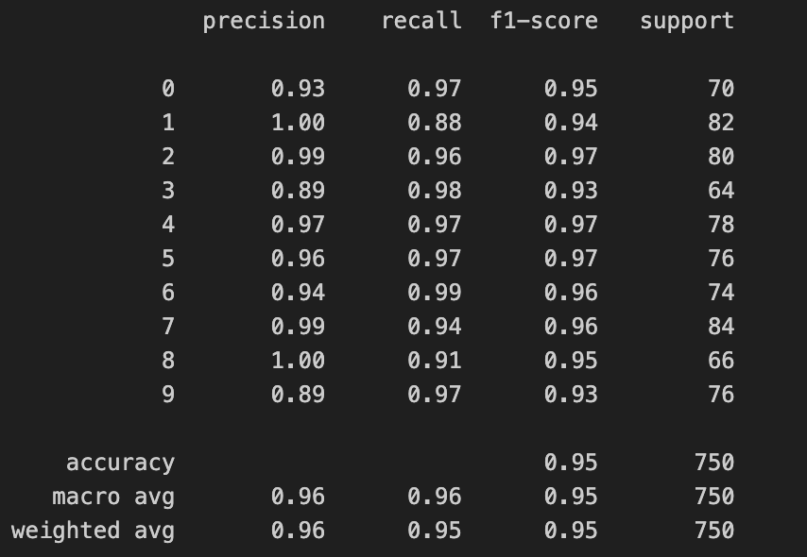
Results
Let's delve into the performance metrics and accuracy achieved during the training and testing phases of our Spoken Digit Recognition System. The following classification report provides a comprehensive overview:

Slide 6
Key Metrics:
Precision: Reflects the accuracy of positive predictions.
Recall: Measures the model's ability to capture all positive instances.
F1-Score: Harmonic mean of precision and recall, providing a balance between the two.
Support: Number of actual occurrences of the class in the specified dataset.
Accuracy:
Overall accuracy of our Spoken Digit Recognition System: 95%.
The high precision, recall, and F1-score values highlight the effectiveness of our model in accurately classifying spoken digits across different classes.

Slide 7
Further Development
As we conclude this presentation, it's essential to explore the potential future endeavors and extended applications stemming from our Spoken Digit Recognition project:
Multilingual Support: Extend the system to recognize spoken digits in multiple languages, broadening its applicability to a global context.
Continuous Digit Recognition: Enhance the system for continuous digit recognition, allowing seamless interpretation of spoken numbers within longer sequences.
Voice-Controlled Devices: Integration with voice-controlled devices such as smart home systems, ensuring a hands-free and intuitive user experience.
Accessibility Features: Incorporate the system into accessibility features for visually impaired individuals, aiding in tasks that involve numerical information.
Real-time Processing: Explore real-time processing capabilities, enabling instantaneous recognition of spoken digits in various live scenarios.
Noise Robustness: Further improve the model's robustness to handle noisy environments, ensuring consistent performance in diverse acoustic conditions.
Adaptation to New Domains: Adapt the Spoken Digit Recognition System for other domains, such as financial transactions or numerical data input in various applications.

Slide 8
Conclusion
In closing, our journey to develop a Spoken Digit Recognition System using Mel-frequency cepstral coefficients (MFCC) and Artificial Neural Networks (ANN) has been both enlightening and promising. Through the amalgamation of cutting-edge technology and sound theoretical foundations, we've achieved:
Accurate Digit Recognition: A system that excels in accurately recognizing and classifying spoken digits (0-9) across diverse speakers and recording conditions.
MFCC's Role in Spectral Representation: Successful integration of Mel-frequency cepstral coefficients (MFCC) as a powerful tool for capturing and representing spectral characteristics in audio signals.
Real-world Applicability: Demonstration of the system's real-world applicability, paving the way for improved user experiences in voice-controlled interfaces.
High Performance Metrics: A model that exhibits high precision, recall, and F1-score, resulting in an impressive overall accuracy of 95%.

Slide 9
Thank You

