Slide 1





AllerHybrid: A hybrid system to predict the allergen using k-mer and physicochemical properties
Paper ID: 111
Authors: Md Ruman Islam [presenting] Md Kashem Ahmed Limon Mian
Department of Computer Science & Engineering
Shahjalal University of Science and Technology
18-20 November
MIST, Dhaka, Bangladesh
iceeict2021mist.org
Conference ID: 53905
Notes:
This is Md Ruman Islam,
From Department of CSE, SUST.
Today I'm going to present a paper titled "AllerHybrid: A hybrid system to predict the allergen using k-mer and physicochemical properties"

Slide 2
Outline
What is Allergen?
Hazards of Allergy
Allergen Detection Methods
Bioinformatics Methods
Accuracy of Existing Tools
Data Collection and Processing
Methodology
Result and Analysis
Conclusion
Notes:
Here is the outline.
First I'll talk on Allergy and Allergen
Then I'll discuss about the burden of Allergy.
Later, I'll share the current methodology of detecing the allergen and the performance of existing tools.
Next, I'll explain the process of data collection and filtering. Most importantly I'll clarify the Methodology of our model.
Finally I'll analysis the result and shall share the github link of our implementaiotn and data.

Slide 3
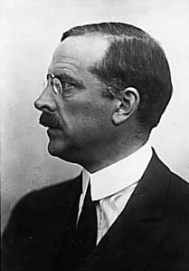
What is Allergen?
Clemens von Pirquet (1874–1929)
Creator of the idea of allergy
“Allergy” came from the Greek words allos (different) and ergia (energy or action).
Immune system's reaction to substance.
Notes:
Ther term Allergy was first introduced by Mr. Clemens von Pirquet.
The root of Allergy word is Greek Language. Which means different action or energy. Actually it is the different action or energy of immune system to a substance

Slide 4
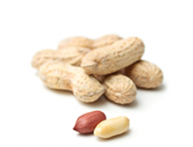
What is Allergy?
Foods

Slide 5
What is Allergen?
Allergen
Responsible for allergy
Antigen
Harmless invader substances
Protein
Notes:
The substances which are responsible for Allergy is called Allergen.
An allergen is a substance that can cause an allergic reaction. In some people, the immune system recognizes allergens as foreign or dangerous. As a result, the immune system reacts by making a type of antibody called IgE to defend against the allergen. This reaction leads to allergy symptoms.
Allergen symptoms may vary from person to person, gender to gender, age to age, geolocation to geolocation.

Slide 6
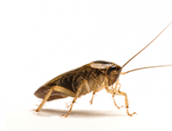
What is Allergy?
Foods
Cockroach

Slide 7
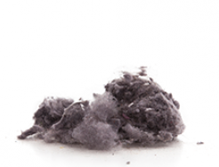
What is Allergy?
Foods
Cockroach
Dust

Slide 8

What is Allergy?
Foods
Cockroach
Dust
Drugs

Slide 9
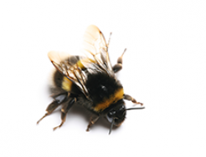
What is Allergy?
Foods
Cockroach
Dust
Drugs
Insect

Slide 10
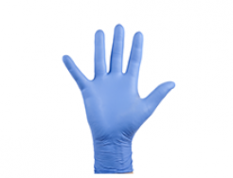
What is Allergy?
Foods
Cockroach
Dust
Drugs
Insect
Latex

Slide 11
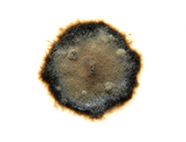
What is Allergy?
Foods
Cockroach
Dust
Drugs
Insect
Latex
Mold

Slide 12

What is Allergy?
Foods
Cockroach
Dust
Drugs
Insect
Latex
Mold
Pet

Slide 13

What is Allergy?
Foods
Cockroach
Dust
Drugs
Insect
Latex
Mold
Pet
Pollen
Notes:
Here are some common source of allergen which are responsible for allergic diseases.
Peanuts, bee, dog, cat and other substances like dust, drugs, latex are the most common.

Slide 14
Hazards of Allergy
25% Bangladeshi are affected by allergy.
According to WAO: White Book on Allergy: Update 2013
400 million suffer from allergic rhinitis.
300 million suffer from asthma.
240-550 million suffer from food allergy.
400 million will be affected by asthma by 2025.
Notes:
According to a study 25% Bangladeshi are affected by allergy.
World Allergy Organization shared in 2013 in White Book that ................

Slide 15
Hazards of Allergy
Allergen affected children findings from a 2009 to 2010 study of 38,480 children

Slide 16
Hazards of Allergy
Country | Year Costs Calculated | Population (2010) | Direct Costs* | Indirect Costs** | Total Costs Estimated
Australia | 2007 | 23 million | A$ 1.1 billion | A$ 8.3 billion | A$9.4 billion
Finland | 2005 | 5.3 million | €468 million | €51.7 million | €519.7 million
South Korea | 2005 | 50 million | - | - | US$ 2.046 billion
Israel | 2007 | 7.5 million | - | - | US$250 million
Mexico | 2007 | 103 million | - | - | US$35 million
USA | 2005 | 310.2 million | US$ 25.9 billion | US$ 14.7 billion | US$40.6 billion
Source: Member Society Reports in: Pawankar R, Canonica GW, Holgate ST, and Lockey RF
Notes:
Allergy is not only a burden to our health but also an economical burden.
For example in 2005, US spent $40 million on allergy related issues.
So, it is better to take prevension in order to escape those unwanted complexities.

Slide 17
Allergen Detection Methods
Experimental Methods:
Time consuming process
Expensive
Difficult for choosing candidate
Bioinformatics Methods
Require less time to detect
Cheaper
Easier for choosing candidate
Notes:
There are two types of Allergen detection methods.
One is experimental and other one is Bioinformatics.
Relatively Bioninformatics methods require less time, less money and easier for choosing candidate.

Slide 18
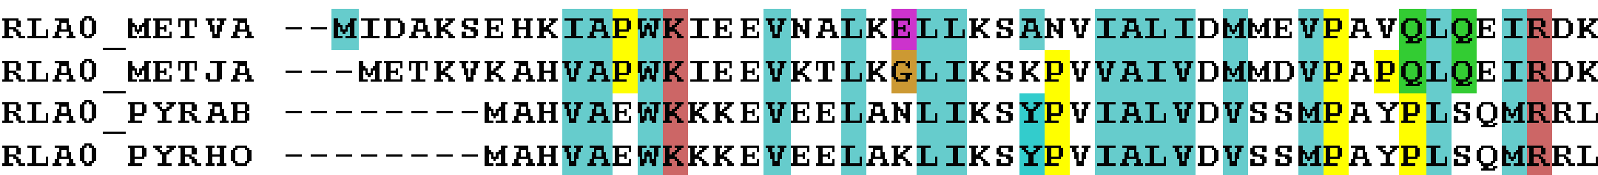
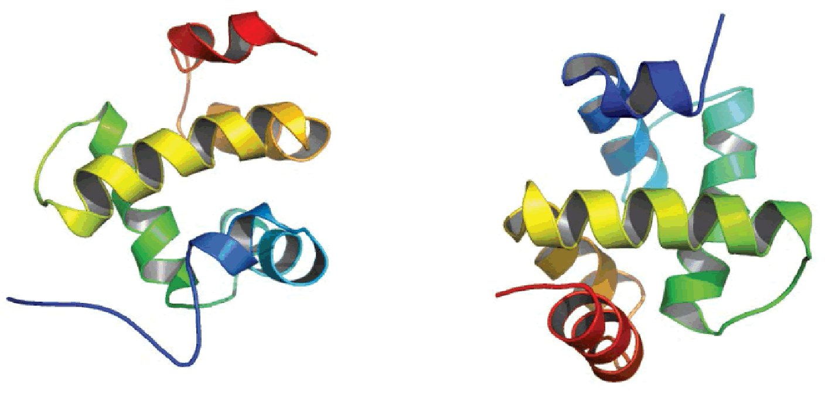
Bioinformatics Methods
Expe
Alignment-based allergen detection
Structure-based allergen detection
Notes:
If two proteins are sequentially and structurally similar to one another then they may act as allergen or non-allergen.
Hence, there are two processes in Bioinformatics for detecting allergen.
One is Alignment based and other one is structure based.

Slide 19
Bioinformatics Methods
Sequence Based tools
AllerDictor
Sortaller
Allerhunter
Weballergen
Structure Based tools
Cross-react
AllerTop v.2
AllerFp
AllerTop
APANN
Notes:
Here is the list of existing tools for detecing the allergen.

Slide 20
Accuracy of Existing Tools
Tool | Accuracy
AlgPred 2.0 | 94.25%
AllerTop v.2 | 90%
AllerFp | 85%
AllerDictor | 85%
AllerCatPro | 84%
Notes:
We can see that AlgPred 2 is the most accurate tool among the currently avilable tools.
For improvig the accuracy we have created AllerHybrid model.

Slide 21
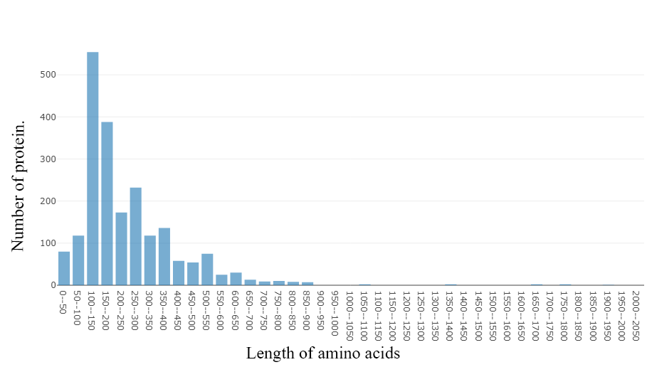
Data Collection and Processing
Frequency distribution of 2582 unique Allergen protein sequences
Notes:
For detecting the Allergen we need the both Allergen and Non-allergen protein sequences.
First, we have collected 2,582 unique allergens.
Graph is showing the number of protein sequences against their length.

Slide 22
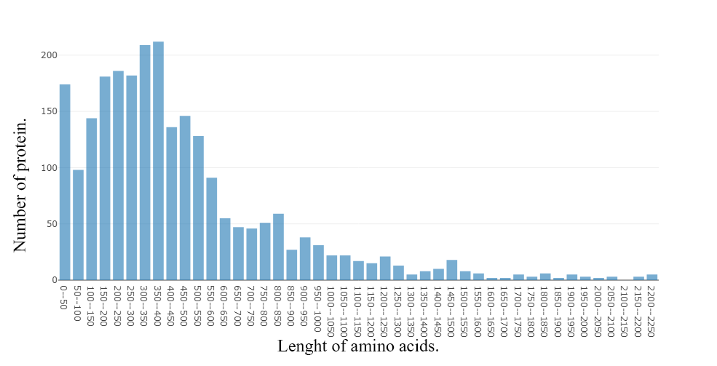
Data Collection and Processing
Frequency distribution of 2428 unique Non-Allergen protein sequences
Notes:
Later, we have collected 2,428 unique non-allergens.
Graph is showing the number of protein sequences against their lengh.

Slide 23
Data Collection and Processing
Filter Protein sequences
Unique Allergen 2,582 and Non-Allergen 2,428
Remove sequence if length is <10 or >2,000
Unique Allergen 2,002 and Non-Allergen 2,427
Notes:
After collecting the protein sequences we have filtered out the short and long length sequencs.
We have got 2,002 allergens and 2,427 Non-Allergens after removing the sequences which are less than 10 or greater than 2,000

Slide 24
Data Collection and Processing
Label protein sequences
If sequence is Allergen label with 1
Otherwise label with -1
Notes:
Labed the allergen with 1.
Which is the positive dataset.
And non-allergen with -1.
Which is the negative dataset.

Slide 25
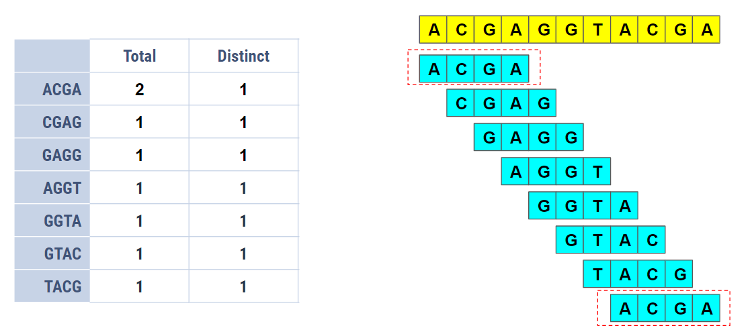
Data Collection and Processing
Total K-mers for a sequence is N-k+1, where N = number of Amino Acids, k = k-mers length.
For example in sequence ACGAGGTACGA, N = 11, let k = 4. So, total k-mers is 11 - 4 +1 = 8 and total unique k-mers is 7(ACGA duplicate).
Notes:
If the lengh of a sequence is N and if we wan to calcualte the k-mer. Then the total k-mers will be Lengh of sequence - k-mers length + 1. In the example, the lengh of the sequence is 11 and let k = 4, so there will be 8 k-mers.
As there are two ACGA k-mers in the sequence, so there are 7 unique k-mers.

Slide 26
Data Collection and Processing
Frequency count of k-mers(k=6) for sequences using CountVectorizer
unique k-mers(k=6) | AVTPMS1 | FKSSWN2 | .... | IGHDGS12,45,150
Sequence
S1 | 5 | 2 | .... | 10
S2 | 1 | 4 | .... | 1
... | 8 | 6 | .... | 2
S4049 | 7 | 7 | .... | 15
Notes:
For our dataSet we have got 12,45, 150 unique 6 mers using CountVectorizer.

Slide 27
Data Collection and Processing
Extract top max 2,00,000 features from 12,45,150 features
unique k-mers(k=6) | ATVPMS1 | FSKSWN2 | .... | IHGDGS2,00,000
Sequence
S1 | 4 | 2 | .... | 10
S2 | 7 | 7 | .... | 8
... | 8 | 6 | .... | 2
S4049 | 7 | 5 | .... | 45
Notes:
We have choosed 2,00,000 features from the 12,45,150 features using TF-IDF method.

Slide 28
Data Collection and Processing
Normalize the frequency counts
For normalizing the frequency counts, each data has been divided by N - k + 1. Where, N is the length of corresponding protein sequence and k = 6.
Notes:
Then we normalize each frequency count by dividing by the N - k + 1.
Where, N is the length of corresponding protein sequence and k = 6

Slide 29
Data Collection and Processing
8-Physiochemical values of Amino Acid
Notes:
List of 8-Physicochemical values of Amino Acid.
Which we have collected from other sources.

Slide 30
Data Collection and Processing
5 E-descriptors value of amino acids. E2(size), E3(helix-forming propensity), E4(relative abundance), E5(β-strand formingpropensity)
Notes:
List of 5 E-descriptors values of Amino Acid.
Which we have collected from other sources.

Slide 31
Data Collection and Processing
Express protein sequeces by Physicochemical properties
For expressing the protein sequence by 5 E-descriptor and 8-physicochemical properties, we have sumup the descriptors values and proprieties values for all of the amino acids
Notes:
For expressing the protein sequence by 5 E-descriptor and 8-physicochemical properties, we have sumup the descriptors values and proprieties values for all of the amino acids

Slide 32
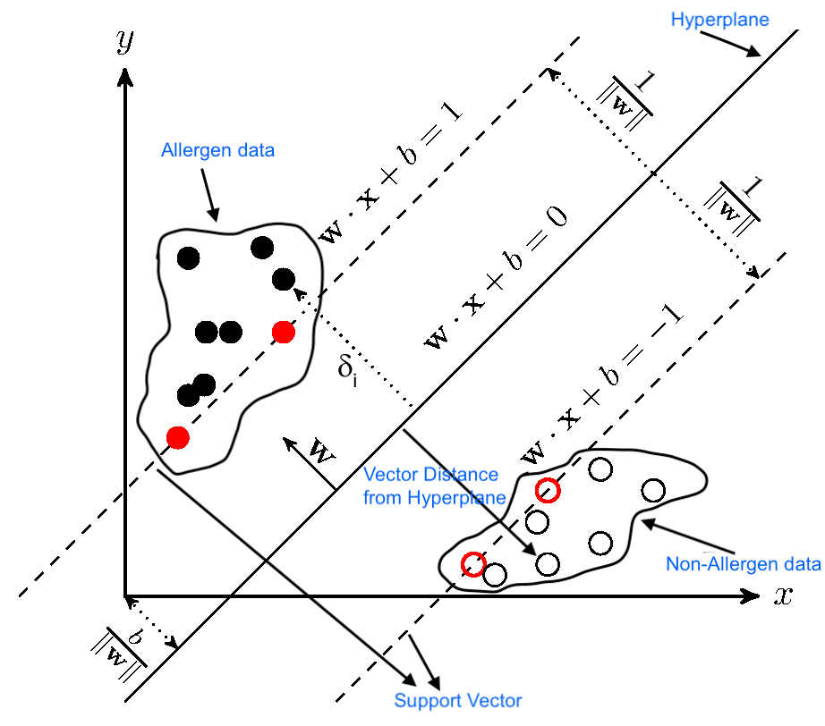
Methodology
Calculate vector distance from SVM Hyperplane to each sequence's frequency vector
Training data size 90%
Testing data size 10%
Vector distance from Hyperplane is called svmScore
Notes:
We have Calculated vector distance from SVM Hyperplane to each sequence's frequency vector to use in our Hybrid Model.
We named the vector distance as svmScore.
We have alrady disucss about frequency count in data processing step.
In our SVM model we choosed 90% data for training.
Because we got the best performance after taking 90%.

Slide 33
Methodology
SVM with MLP
Allergen
MLP
hidden_layer_sizes = (4,7,2)
activation='relu'
solver='adam'
max_iter=1000
Trained System
Result (Acc 94.28%)
Calculate svmScore
Non-Allergen
Training Data (67%)
Physicochemical properties
Data set
Testing Data
(33%)
Notes:
Here is the sequence diagram for our model.
First we have calculated the svmScore. We have shared the details in previous slide.
Also we have expressed the sequences by Physicochemcial properites in data processing step.
Now, we have the svmScore and Physicochemical data set to run the ANN.
We have used 67% data for training and 33% data for testing.
Then created the MLP model with 3 hidden layers
We have got the best accuracy 94.28% on our model.

Slide 34
Result and Analysis
Precision Table
Method | Dataset | Accuracy
ANN | EigenVector Data | 70%
ANN | 8-physiochemical Data | 79%
SVM | 8-physiochemical Data | 70%
SVM | EigenVector Data | 72%
SVM | k-mer | 75%
SVM with MLP | K-mer and EigenVector | 94.28%
Notes:
We have also experimented on our dataset using different model.
Here is the chart of our method, dataset and their accuracy.

Slide 35
Result and Analysis
Comparison with existing tools
Tool | Accuracy
AllerHybrid | 94.28%
AlgPred 2.0 | 94.25%
AllerTop v.2 | 90%
AllerFp | 85%
AllerDictor | 85%
AllerCatPro | 84%
Notes:
We have also compared our tool with other existing tools.
Clearly we can see that our tool is the most accurate tool. Which can predict allergen and non-allergen 94.28% accurately.

Slide 36
Conclusion
Our implemented method is better than all of the existing tools. Because we have used the hybrid model.
It can be used for predicting Allergen and Non-Allergen
Dataset and the implementation have been shared to the following link for future improvement. https://github.com/ruman23/AllerHybrid
Notes:
We have shared the dataset and model in github.

Slide 37
Any Questions?

Slide 38
Thank You

