Slide 1
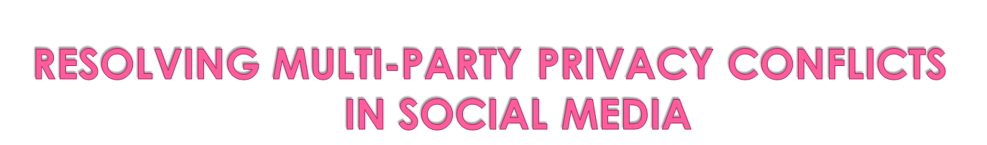
Presented by
S.SUSHMA DEEPTHI 14568T0953
M.DEEKSHITHA 14568T0910
D.HARSHINI 14568T0912
RUMANATHASKEEN 14568T0937
UNDER THE GUIDENCE OF
T.SWAPNA

Slide 2

Abstract.
Existing System.
Proposed System.
Requirements.
Modules.
Conclusion

Slide 3
Items shared through Social Media may affect more than one user’s privacy — e.g., photos that depict multiple users, comments that mention multiple users, events in which multiple users are invited, etc. The lack of multi-party privacy management support in current main stream Social Media infrastructures makes users unable to appropriately control to whom these items are actually shared or not. Computational mechanisms that are able to merge the privacy preferences of multiple users into a single policy for an item can help solve this problem. However, merging multiple users’ privacy preferences is not an easy task, because privacy preferences may conflict, so methods to resolve conflicts are needed. Moreover, these methods need to consider how users’ would actually reach an agreement about a solution to the conflict in order to propose solutions that can be acceptable by all of the users affected by the item to be shared. Current approaches are either too demanding or only consider fixed ways of aggregating privacy preferences. In this paper, we propose the first computational mechanism to resolve conflicts for multi-party privacy management in Social Media that is able to adapt to different situations by modelling the concessions that users make to reach a solution to the conflicts. We also present results of a user study in which our proposed mechanism outperformed other existing approaches in terms of how many times each approach matched users’ behaviour.

Slide 4

Very recent related literature proposed mechanisms to resolve multi-party privacy conflicts in social media.
Some of them need too much human intervention during the conflict resolution process, by requiring users to solve the conflicts manually or close to manually; e.g., participating in difficult-to comprehend auctions for each and every co-owned item.
Other approaches to resolve multi-party privacy conflicts are more automated, but they only consider one fixed way of aggregating user’s privacy preferences(e.g., veto voting) without considering how users would actually achieve compromise and the concessions they might be willing to make to achieve it depending on the specific situation.
Only considers more than one way of aggregating users’ privacy preferences, but the user that uploads the item chooses the aggregation method to be applied, which becomes a unilateral decision without considering the preferences of the others.

Slide 5
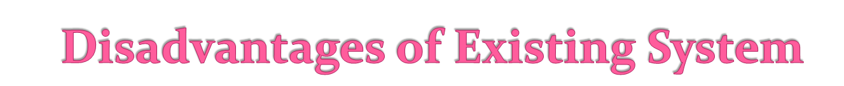
Computational mechanisms that can automate the negotiation process have been identified as one of the biggest gaps in privacy management in social media.
The main challenge is to propose solutions that can be accepted most of the time by all the users involved in an item (e.g., all users depicted in a photo),so that users are forced to negotiate manually as little as possible, thus minimizing the burden on the user to resolve multi-party privacy conflicts.

Slide 6

In this paper, we present the first computational mechanism for social media that, given the individual privacy preferences of each user involved in an item, is able to find and resolve conflicts by applying a different conflict resolution method based on the concessions users’ maybe willing to make in different situations.
The mediator inspects the individual privacy policies of all users for the item and flags all the conflicts found. Basically, it looks at whether individual privacy policies suggest contradictory access control decisions for the same target user. If conflicts are found the item is not shared preventively.
The mediator proposes a solution for each conflict found. To this aim, the mediator estimate show willing each negotiating user may be to concede by considering: her individual privacy preferences, how sensitive the particular item is for her, and the relative importance of the conflicting target users for her.

Slide 7
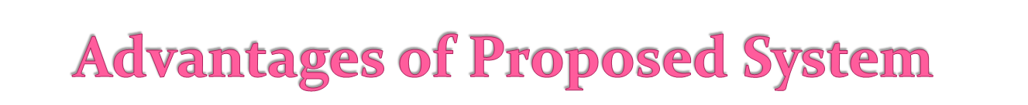
The use of a mediator that detects conflicts and suggests a possible solution to them.
Works as an interface to the privacy controls of the underlying Social Media infrastructure
We also present a user study comparing our computational mechanism of conflict resolution and other previous approaches to what users would do themselves manually in a number of situations.
The results obtained suggest our proposed mechanism significantly outperformed other previously proposed approaches in terms of the number of times it matched participants’ behaviour in the study.

Slide 8
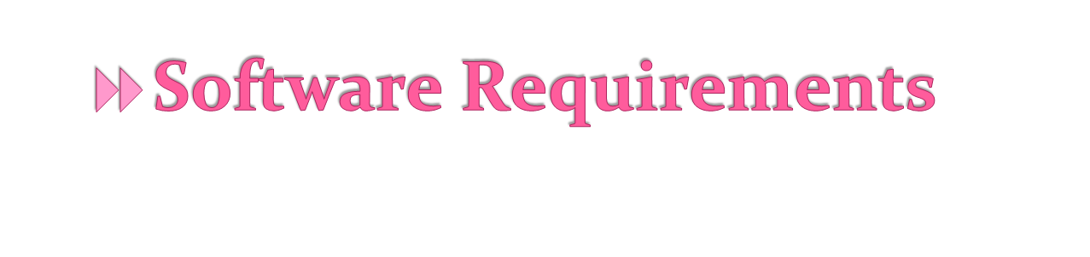
Operating System: Windows XP or later
Database: MY SQL
Tools: JDK

Slide 9
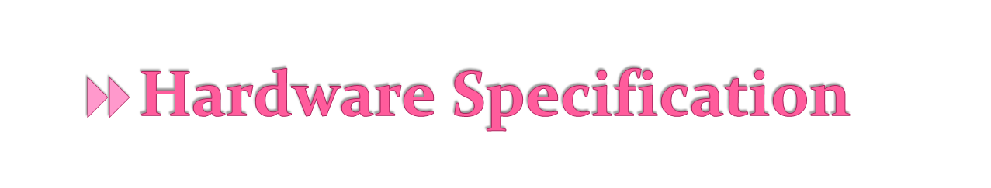
Processor:P4 OR Higher
Ram :2 GB
Hard Disk: PC with 320GB

Slide 10

Conflict Detection
Conflict Resolution

Slide 11

We need a way to compare the individual privacy preferences of each negotiating user in order to detect conflicts among them. However, each user is likely to have defined different groups of users, so privacy policies from different users may not be directly comparable. To compare privacy policies from different negotiating users for the same item, we consider the effects that each particular privacy policy has on the set of target users T. Privacy policies dictate a particular action to be performed when a user in T tries to access the item. In particular, we assume that the available actions are either 0 (denying access) or 1 (granting access).

Slide 12

When conflicts are detected, the mediator suggests a solution according to the following principles:
_ Principle 1: An item should not be shared if it is detrimental to one of the users involved — i.e., users refrain from sharing particular items because of potential privacy breaches and other users allow that as they do not want to cause any deliberate harm to others.
_ Principle 2: If an item is not detrimental to any of the users involved and there is any user for whom sharing is important, the item should be shared — i.e., users are known to accommodate others’ preferences
_ Principle 3: For the rest of cases, the solution should be consistent with the majority of all users’ individual preferences — i.e., when users do not mind much about the final output

Slide 13

In this paper, we present the first mechanism for detecting and resolving privacy conflicts in Social Media that is based on current empirical evidence about privacy negotiations and disclosure driving factors in Social Media and is able to adapt the conflict resolution strategy based on the particular situation. In a nutshell, the mediator firstly inspects the individual privacy policies of all users involved looking for possible conflicts. If conflicts are found, the mediator proposes a solution for each conflict according to a set of concession rules that model how users would actually negotiate in this domain.

Slide 14

THANK YOU

