Slide 1

CS5200 - Database Theory and Application
Title : Smart Soccer Club Operations Platform
Project Plan Report

Slide 2
Team Members
Lnu Rumana Thaskeen 700742859 - Team Leader
Aishwarya pasumarthy 700759282
Vivek reddy nakkala 700762302
Vamshi Kalyan Thummala 700766446
sai giridhar jittaboini 700761988
Nekkalapu Manesh 700756918

Slide 3
Main Idea of the Project?
The platform aims to streamline and manage the day-to-day operations of soccer clubs. Using Flask as the web framework, the application serves as the backend that connects to MongoDB, a NoSQL database, to handle data operations.
Key Features:
Team Management: Streamlined handling of teams, including creating, reading, updating, and deleting team records, with essential details such as names, coaches, and establishment years organized within a MongoDB collection.
Player Management: Comprehensive system for registering players, viewing and updating their profiles, and managing associations with teams, leveraging MongoDB's flexible document structure for storing player data.
Match Coordination: Robust scheduling system for organizing matches, updating details, and accessing past and upcoming match information, all maintained in a dedicated MongoDB collection for easy access and reference.

Slide 4
Tech Stack Used for Project
Backend Development: Flask and Python
Flask is utilized for its agility in crafting the soccer platform's backend, with Python libraries managing database interactions, user sessions, and API services. PyMongo bridges Flask with MongoDB, Flask-JWT-Extended secures endpoints, and Flask-RESTful aids in efficient REST API construction.
Python version 3.8 or higher would be used

Slide 5
Cont…
Frontend Development: React Framework
Leveraging HTML, CSS, and JavaScript, the frontend of the Smart Soccer Club Operations Platform is crafted to be both aesthetically pleasing and responsive, with React facilitating fast and interactive user experiences. React component-based approach streamlines UI development, promoting reusability and consistency with components such as team lists, player profiles, and match schedules.
Database: MongoDB
MongoDB's flexible, document-oriented NoSQL structure is ideal for managing the dynamic data of a soccer operations platform, accommodating varied team and player attributes efficiently. Its ability to scale horizontally suits the evolving nature of sports data management, supporting complex queries and analytics integral to the platform's operations.

Slide 6
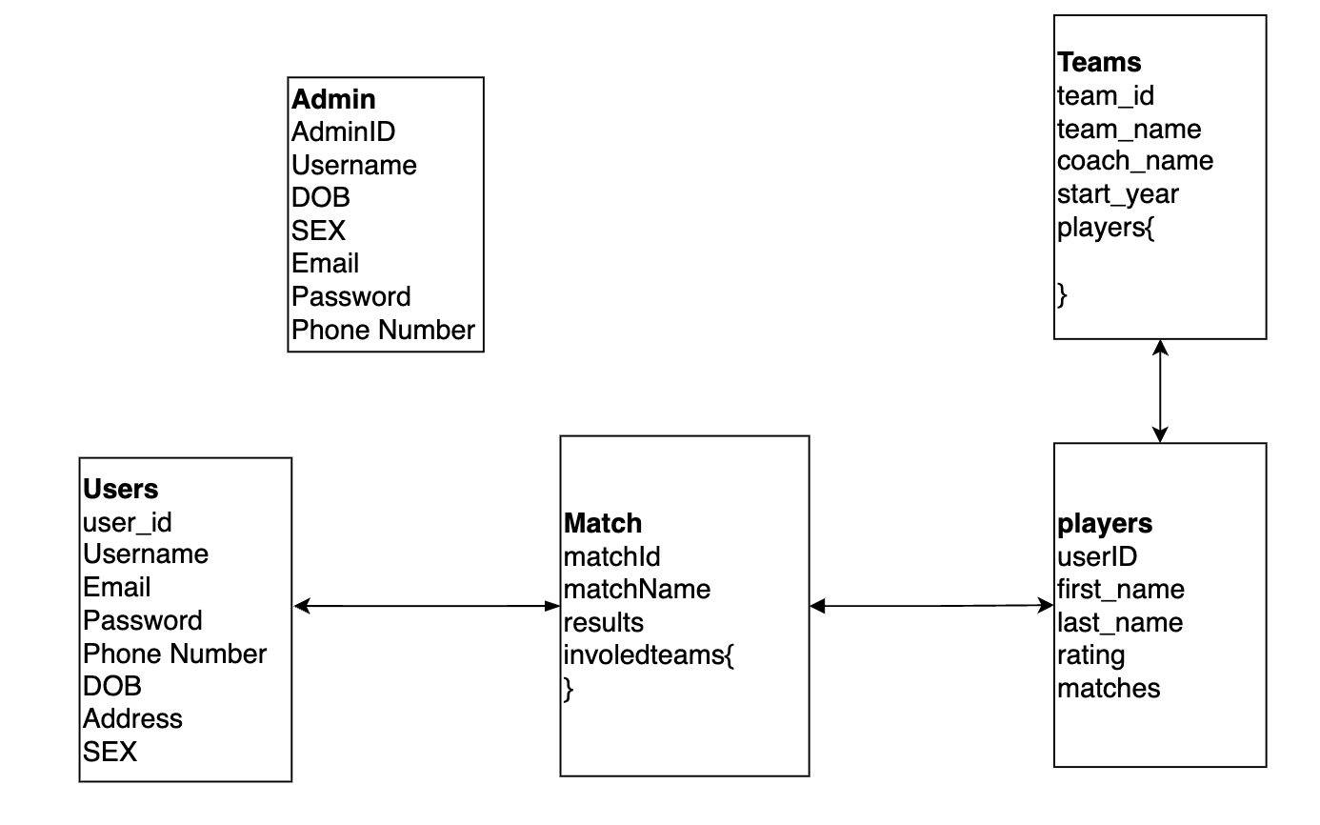
ER Diagram of the Database?

Slide 7
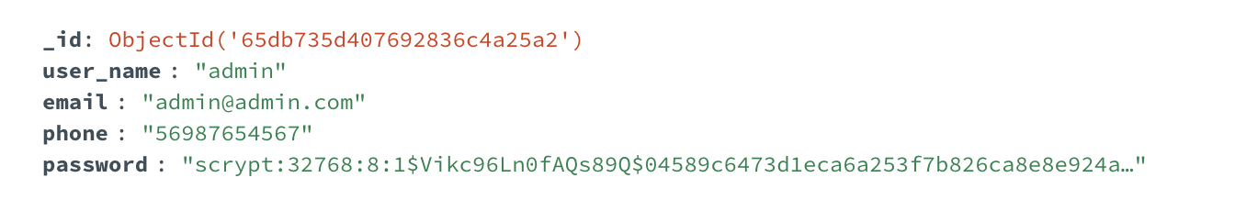
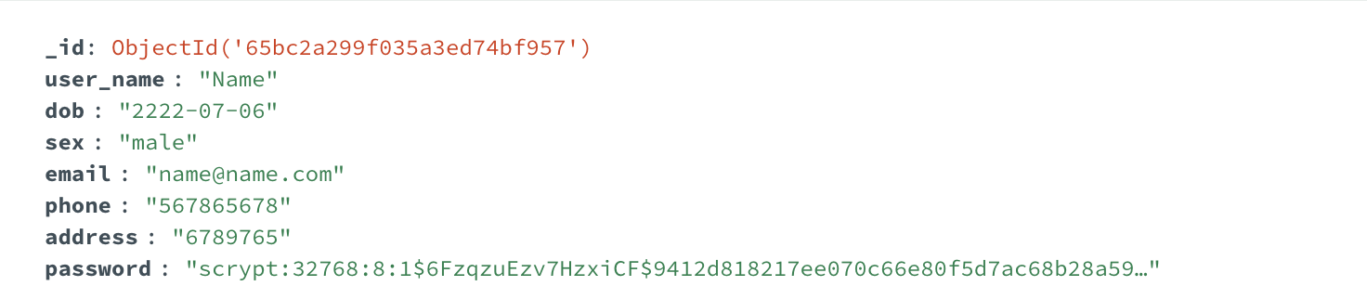
Sample Schema of the Database?

Slide 8
User and their Needs
User Demographics:
Primary Audience: The platform targets soccer club managers, coaches, players, and fans who are looking for an efficient way to manage teams, view player statistics, schedule matches, and follow soccer club activities online.
User Expectations and Demands:
Easy Registration: Users expect a simple sign-up process to access team and match information, including basic information gathering for account creation.
Secure Authentication: A robust sign-in mechanism is crucial for protecting user accounts and maintaining the integrity of the platform's data.
Comprehensive Team and Player Info: A detailed and accessible catalog of team and player information is critical for users to track performance and manage rosters.

Slide 9
Cont …
Team and Player Profiles: Our platform meticulously catalogs comprehensive data on teams and players, including team names, player biographies, statistical data, performance ratings, photographs, positions, nationality, and historical achievements, to offer a rich and engaging user experience.
User Registration and Security: We implement a secure registration and login framework, collecting vital user information such as names, email addresses, encrypted passwords, and profile images to personalize and secure the user experience.
Match Scheduling and Results: The platform maintains up-to-date records of matches, including fixture dates, venues, participating teams, scores, and individual performance metrics, facilitating seamless organization and tracking of soccer events.
Promotions and Engagements: Through an advanced feature for managing promotions, we handle details regarding special event codes, discount values, validity, and relevance to specific matches or merchandise, aiming to boost user participation and loyalty.

Slide 10
Input Data
Team and Player Management: Offers comprehensive insights into teams and players with details like names, roles, stats, and history, enhancing engagement and administration.
User Registration and Security: Features a secure sign-up and login process, collecting essential user information for a personalized and safe user experience.
Match and Event Tracking: Streamlines match scheduling and tracking with details on dates, locations, scores, and achievements, improving club operations.

Slide 11
Stored Information
Team and Player Information: Our database meticulously catalogs detailed profiles for teams and players, including names, roles, performance stats, images, and historical data, enriching engagement and facilitating comprehensive management.
User Registration and Security: We securely store critical user information, such as names, email addresses, encrypted passwords, and profile avatars, ensuring a personalized and secure platform experience.
Match and Event Data: Detailed records of matches and events are kept, encompassing dates, venues, participating teams, scores, and player achievements, streamlining the organization and tracking to optimize soccer club operations.

Slide 12
Relevance for Stored Information
Team and Player Profiles: Vital for enriching the platform with comprehensive data on teams and players, facilitating informed management decisions, and enhancing user engagement.
User Registration and Security: Essential for safeguarding user accounts and personalizing the platform experience, ensuring both security and user satisfaction.
Match Scheduling and Results: Crucial for efficient organization of matches and transparency in results, enabling effective planning and user engagement.
Promotional Activities: Key to driving user engagement through targeted offers and discounts, enhancing the sense of community and loyalty among users.

Slide 13
Team Roles
Frontend Developers (Aishwarya and Vivek): They ensure our website's aesthetic appeal and user-friendliness. Their focus is on intuitive navigation and a visually engaging experience for our visitors.
Backend Developers (Vamshi and Giridhar): Responsible for the core functionalities of our platform, they manage the technical aspects that keep the website running smoothly, especially under heavy user load.
Database Administrators (Manesh and Rumana): Tasked with data management and security, they organize and safeguard our data, ensuring fast access to information and maintaining data integrity.
Team Leader ( Rumana): Guides the project towards its goals, coordinating efforts across teams, and ensuring that every aspect of the project aligns with our objectives and timelines.

Slide 14

Thank you !!!

