Slide 1
Morphius
Self-configuring modular robot that navigates through cracks and debris for inspection

Slide 2
Problem Statement
Use of modular robots for rescue operations involve constraints on parameters such as speed, size, shape of robot, locomotion mechanisms, etc. This requires development and design of a MRS that optimizes the above parameters. The use of heterogeneous modules capable of self-reconfiguration improves speed of locomotion and resourcefulness at the cost of simplicity.

Slide 3
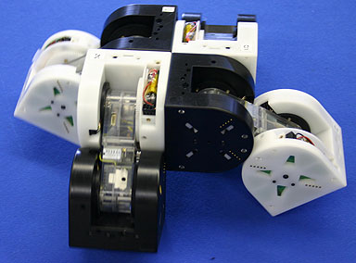
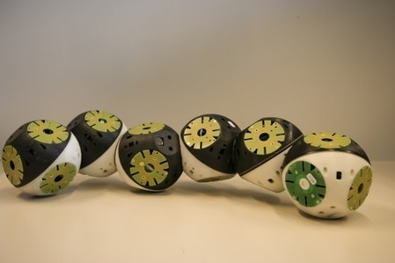
Existing Technology
M-Tran - III
RoomBots

Slide 4
Comparison
Existing Technology | Our technology
Relatively homogenous modules lacking in functionality | Heterogenous modules - tailored for use in disaster struck areas
Not practically deployable | Practically deployable
Designed for generalized applications - performance degrades | Problem oriented approach - provides better results
Expensive | Cost effective

Slide 5
Limitations
Not suited for rescue operations in disasters - earthquake, hurricane
Difficult to deploy in disaster struck areas
Less cost effective technology
Not adaptable to different types of terrain or obstacles
Lack decision making capability

Slide 6
Proposed Solution
Heterogenous modules - different functions tailored for our application
Autonomous & self- reconfigurable
Robust design for rough environment
Providing map of the disaster struck area
Adapts to the different terrain using different morphology

Slide 7
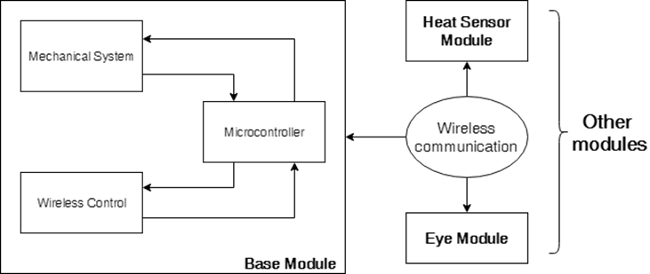
Robotic System Structure

Slide 8
Base Module Architecture

Slide 9
Secondary Module Architecture

Slide 10
Hardware & Software Assembly
Hardware:
Atmega2560, Arduino Nano
Wi-Fi
Motor -
geared, 10kg stall torque, 100rpm
geared, quadrature encoder, 150rpm
Servo - 7kg at 1.5A, 6V
Micro DC motor - geared, 5kg torque
Motor driver - L298n, L293d
Bevel gears - 3D printed
Wheels: 6.5cm, 10.9cm
Pi Camera - 5MP
Software:
Autodesk Fusion 360
AutoCAD
Opencv - python library
Aruco - python library
ArUco markers - 3cm x 3cm, 5x5 matrix size

Slide 11
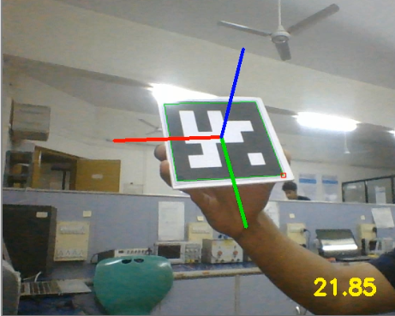
Aruco Detection

Slide 12
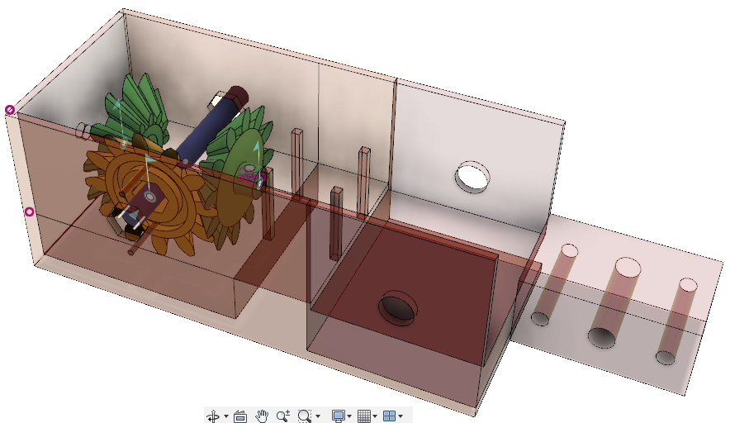
Linking Mechanism
3 bevel gears - 3D printed
1 geared DC motor, 1 Servo motor
Genderless connector - bolt

Slide 13
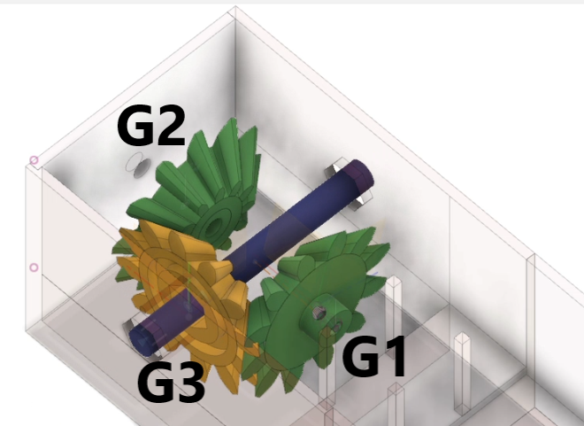
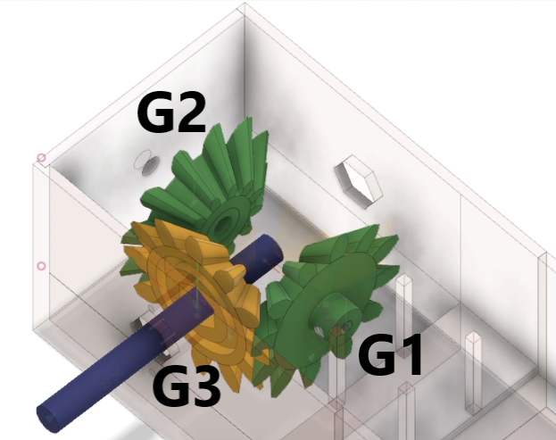
Linking Mechanism
Closed Screw Mechanism
Open Screw Mechanism

Slide 14
Result Analysis
Tradeoff between size and speed for motors and wheels
Alignment of wheels for stability and speed enhancement
Sturdier actuation mechanism with minimum constraint
Detection and alignment of modules for connection
Chances of misalignment while engaging
Size of the markers has to be minimized according to the smallest module

Slide 15
Conclusion
Speedy-modular-robots have potential to be used in rescue operations
Speed control possible using PWM
Decision making capability has been added to the modules
ArUco Markers have improved the accuracy of alignment of two modules.
Machine Learning can be used to improve performance over the period
Sturdy modular design for rough terrains ensure protection of sensors

Slide 16
Future Scope
Using machine learning for configuration
Improving the linking mechanism design and making it compact
Using cloud for data collection and remote monitoring
Development of different modules with different sensors

Slide 17
Morphius Accessibility
Entire project is open source and is accessible to everyone.
All the instructions and required files are regularly updated on github and can be easily accessed using the following link:
https://github.com/rumankazi/project_morphius
YouTube Channel:
https://www.youtube.com/channel/UCsKmAn2daWavVmRRQK_fTjw

Slide 18
References
M. Yim, D. G. Duff, and K. Roufas, “Modular reconfigurable robots, an approach to urban search and rescue,” in Proceedings of the 1st International Workshop on Human-friendly Welfare Robotics Systems, Taejon, Korea, 2000.
H. Ahmadzadeh, E. Masehian, and M. Asadpour, “Modular robotic systems: characteristics and applications,” Journal of Intelligent & Robotic Systems, vol. 81, no. 3-4, pp. 317–357, 2016.
H. Kurokawa, K. Tomita, A. Kamimura, S. Kokaji, T. Hasuo, and S. Murata, “Distributed self-reconfiguration of m-tran iii modular robotic system,” The International Journal of Robotics Research, vol. 27, no. 3-4, pp. 373–386, 2008.
J. Davey, N. Kwok, and M. Yim, “Emulating self-reconfigurable robots design of the smores system,” in 2012 IEEE/RSJ International Conference on Intelligent Robots and Systems (IROS). IEEE, 2012, pp. 4464–4469.
C. S. S. Reddy, A. Agrawal, K. Anupama et al., “Sq-bot-a modular robot prototype for self-reconfiguring structures,” in International Conference on Robotics: Current Trends and Future Challenges (RCTFC),. IEEE, 2016, pp. 1–6.

Slide 19
J. Zhao, X. Cui, Y. Zhu, and S. Tang, “A new self-reconfigurable modular robotic system ubot: Multi-mode locomotion and self-reconfiguration,” in 2011 IEEE International Conference on Robotics and automation (ICRA). IEEE, 2011, pp. 1020–1025.
A. Spr¨owitz, R. Moeckel, M. Vespignani, S. Bonardi, and A. J. Ijspeert, “Roombots: A hardware perspective on 3d self-reconfiguration and locomotion with a homogeneous modular robot,” Robotics and Autonomous Systems, vol. 62, no. 7, pp. 1016–1033, 2014.
S. Chitta and J. Ostrowski, “Motion planning for heterogeneous modular mobile systems,” in ICRA’02. IEEE International Conference on Robotics and Automation, 2002. Proceedings., vol. 4. IEEE, 2002, pp. 4077–4082.
G. Hu, S. Huang, L. Zhao, A. Alempijevic, and G. Dissanayake, “A robust rgb-d slam algorithm,” in 2012 IEEE/RSJ International Conference on Intelligent Robots and Systems. IEEE, 2012, pp. 1714–1719.
“Raspberry Pi 3 Model B - Raspberry Pi.” [Online]. Available: https://www.raspberrypi.org/products/raspberry-pi-3-model-b/

