Slide 1

Sardar Patel Institute of Technology
Electronics and Telecommunication Department
B.E Project (ETP701)
Stage 2
Morphius : Self-reconfiguring modular robot that navigates through cracks and debris for inspection
A project under the guidance of
Dr. Preetida V-Jani
Group Number 4
Ruman Kazi
Ameya Nambisan
Simran Tiwari

Slide 2
Problem Statement
Use of modular robots for rescue operations involve constraints on parameters such as speed, size, shape of robot, locomotion mechanisms, etc. This requires development and design of a MRS that optimizes the above parameters. The use of heterogeneous modules capable of self-reconfiguration improves speed of locomotion and resourcefulness at the cost of simplicity.

Slide 3
Objectives
●Study of existing MRS (Phase 1)
●Development & Designing the structure of MRS (Phase 1-2-3)
●Inter-module mechanical connection Mechanism (Phase 3)
●Wireless Communication amongst the modules (Phase 2-3)
●Determining the best possible path and configuration (Phase 4)
●Improving the speed of MRS (Phase 4)

Slide 4
Comparison
Existing Technology | Our technology
Relatively homogenous modules lacking in functionality | Heterogenous modules - tailored for use in disaster struck areas
Not practically deployable | Practically deployable
Designed for generalized applications - performance degrades | Problem oriented approach - provides better results
Expensive | Cost effective

Slide 5
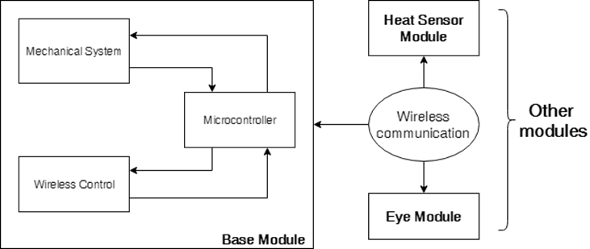
Robotic System Structure

Slide 6
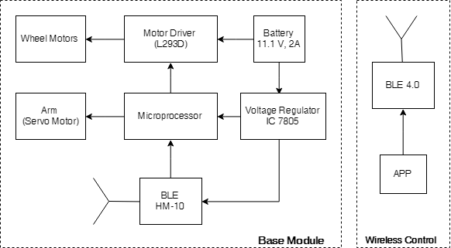
Base Module Architecture

Slide 7
Limitations
Not suited for rescue operations in disasters - earthquake, hurricane
Difficult to deploy in disaster struck areas
Less cost effective technology
Not adaptable to different types of terrain or obstacles
Lack decision making capability

Slide 8
Proposed Solution
Heterogenous modules - different functions tailored for our application
Autonomous & self- reconfigurable
Robust design for rough environment
Providing map of the disaster struck area
Adapts to the different terrain using different morphology

Slide 9
Previous Work
Backbone design of robot
Working Prototype of base module
Established wireless communication
Power budgeting of single module
Analysis of various connection mechanisms

Slide 10
Previous Remarks
Minimize the parameters to be controlled
Weight Calculation
Different wireless communication protocols testing
Voltage v/s current rating for motors

Slide 11
Progress Achieved - Phase 3
Optimization of the design of the base module
Selection of motors of locomotion with high stall torque (10kg)
Prototype of connection mechanism
Image processing for identification and alignment
Study path planning and mapping algorithms

Slide 12
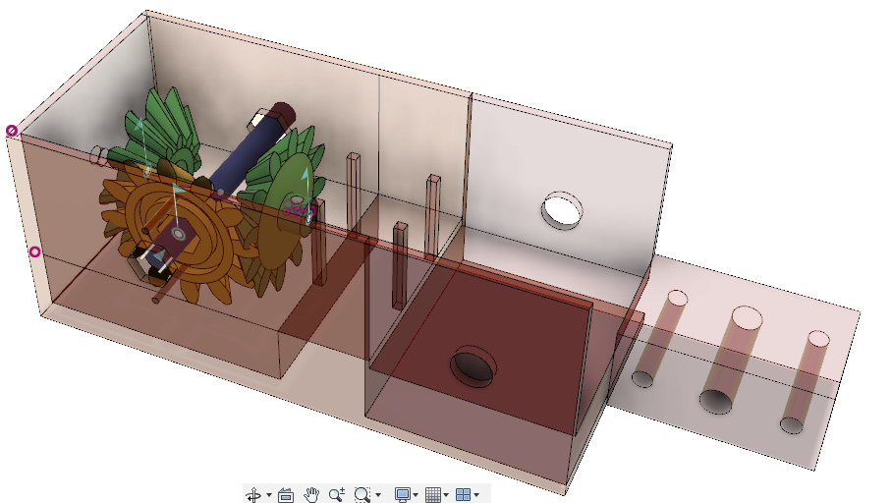
Actuation Mechanism
3 bevel gears - 3D printed
1 geared DC motor, 1 Servo motor
Genderless connector - bolt

Slide 13
Testing
Hardware:
Atmega2560, Arduino Nano
Bluetooth - HM10 , Xbee
Motor -
geared, 10kg stall torque, 100rpm
geared, quadrature encoder, 150rpm
Servo - 7kg at 1.5A, 6V
Micro DC motor - geared, 5kg torque
Motor driver - L298n, L293d
Bevel gears - 3D printed
Wheels -
(diameter)6.5cm, 10.9cm
Castor
Software:
Autodesk Fusion 360
AutoCAD
Opencv - python library
Aruco - python library
ArUco markers - 14x14, 5x5 matrix size

Slide 14
Result Analysis
Tradeoff between size and speed for motors and wheels
Alignment of wheels for stability and speed enhancement
Sturdier actuation mechanism with minimum constraint
Detection and alignment of modules for connection
Chances of misalignment while engaging
Size of the markers has to be minimized according to the smallest module

Slide 15
Further Planning
Phase 4 (First week of April):
Development of other connectable heterogeneous modules
Algorithm for deciding optimal path and configuration
Development of reconfiguration algorithm

Slide 16
Morphius Accessibility
Entire project is open source and is accessible to everyone.
All the instructions and required files are regularly updated on github and can be easily accessed using the following link:
https://github.com/rumankazi/project_morphius
YouTube Channel:
https://www.youtube.com/channel/UCsKmAn2daWavVmRRQK_fTjw

Slide 17
References
H. Ahmadzadeh, E. Masehian and M. Asadpour, "Modular Robotic Systems: Characteristics and Applications", Springer, Dordrecht, 2015.
Stoy, Kasper & Brandt, David & Christensen, David. (2010). Self-Reconfigurable Robots: An Introduction.
Haruhisa Kurokawa,Kohji Tomita, Akiya Kamimura, Shigeru Kokaji, Takashi Hasuo,Satoshi Murata , "Distributed Self-Reconfiguration of M-TRAN III Modular Robotic System ," in International Journal of Robotics March 2008
Jay Davey, Ngai Kwok and Mark Yim, "Emulating Self-reconfigurable Robots - Design of the SMORES System " in 2012 IEEE/RSJ International Conference on Intelligent Robots and Systems
Jie Zhao, Xindan Cui, Yanhe Zhu, et al. “A new self-reconfigurable modular robotic system UBot: Multi-mode locomotion and self-reconfiguration,” IEEE International Conference on Robotics and Automation. Piscataway, NJ, USA , pp. 1020-1025, 2011.
H. Ercan and P. Boyraz, "Design of a Modular Mobile Multi Robot System: ULGEN (Universal-Generative Robot)", IEEE Xplore, 2016.

Slide 18
C. S. S. Reddy, S. patlolla, A. Agrawal and K. R. Anupama, "SQ-BOT - a modular robot prototype for self-reconfiguring structures," 2016 International Conference on Robotics: Current Trends and Future Challenges (RCTFC), Thanjavur, 2016, pp. 1-6.
S. Chitta and J. R. Ostrowski, "Motion planning for heterogeneous modular mobile systems," Proceedings 2002 IEEE International Conference on Robotics and Automation (Cat. No.02CH37292), Washington, DC, USA, 2002, pp. 4077-4082 vol.4
Andres Castano Wei-Min Shen Peter Will, "CONRO: Towards Deployable Robots with Inter-Robots Metamorphic Capabilities, " in Autonomous Robots June 2000, Volume 8, Issue 3, pp 309–324
R. Fitch, Z. Butler, D. Rus, "Reconfiguration planning for heterogeneous self-reconfiguring robots, " in 2003 IEEE/RSJ International Conference on Intelligent Robots and Systems (IROS 2003)
Shimizu, T. Kato, M. Lungarella and A. Ishiguro, "Adaptive Reconfiguration of a Modular Robot through Heterogeneous Inter-Module Connections", IEEE Xplore, 2008.

