Slide 1

Sardar Patel Institute of Technology
Electronics and Telecommunication Department
Final Year Project Phase 2
A project under the guidance of
Dr. Preetida V. Jani
Group Number 4
Ruman Kazi
Ameya Nambisan
Simran Tiwari

Slide 2
Morphius
Self-reconfiguring modular robot that navigates through cracks and debris for inspection

Slide 3
Problem Statement
Use of modular robots for rescue operations involve constraints on parameters such as speed, size, shape of robot, locomotion mechanisms, etc. This requires development and design of a MRS that optimizes the above parameters. The use of heterogeneous modules capable of self-reconfiguration improves speed of locomotion and resourcefulness at the cost of simplicity.

Slide 4
Objectives
Development and designing of Modular Robotic System (MRS)
Inter-module connection Mechanism
Wireless Communication
Determining the best possible path and configuration
Improving the speed of MRS
Decision making capability

Slide 5
Problems in current technology
Not suited for rescue operations in disasters - earthquake, hurricane
Difficult to deploy in practical environment
Expensive technology
Not adaptable to different types of terrain or obstacles
Lack decision making capability

Slide 6
Solution we are providing
Heterogenous modules - different functions tailored for our application
Autonomous & self- reconfigurable
Robust design for rough environment
Providing map of the disaster struck area
Adapts to the certain terrain using different morphology

Slide 7
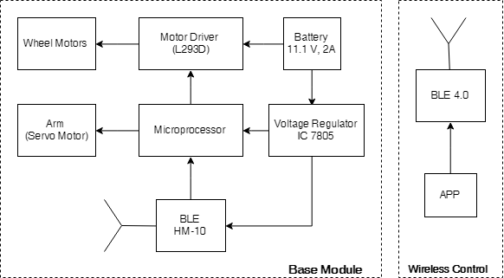
System Design

Slide 8
Progress Achieved
Backbone design of robot
Working Prototype of base module
Established wireless communication
Power budgeting of single module
Analysis of various connection mechanisms

Slide 9
Problems faced
Balancing Center of Mass by aligning the connection mechanism accordingly thereby preventing module from toppling
Size and placement of wheels for stability and speed enhancement
Establishing communication and speed control
Alignment of DC motor and wheels for balanced motion

Slide 10
Comparison
Existing Technology | Our technology
Relatively homogenous modules lacking in functionality | Heterogenous modules - tailored for use in disaster struck areas
Not practically deployable | Practically deployable
Designed for generalized applications - performance degrades | Problem oriented approach - provides better results
Expensive | Cost effective

Slide 11
Further Planning
Phase 2 (First week of November, 2018):
Optimization of base module
Prototype of connection mechanism
Phase 3 (Third week of February, 2019):
Development of other connectable heterogeneous modules
Wireless communication amongst modules
Development of reconfiguration algorithm
Phase 4 (First week of April):
Image processing through Eye Module and analysis of terrain
Algorithm for deciding optimal path and configuration

Slide 12
Morphius Accessibility
Entire project is open source and is accessible to everyone.
All the instructions and required files are uploaded and regularly uploaded on github and can be easily accessed using the following link:
https://github.com/rumankazi/project_morphius

Slide 13
References
H. Ahmadzadeh, E. Masehian and M. Asadpour, "Modular Robotic Systems: Characteristics and Applications", Springer, Dordrecht, 2015.
Stoy, Kasper & Brandt, David & Christensen, David. (2010). Self-Reconfigurable Robots: An Introduction.
Haruhisa Kurokawa,Kohji Tomita, Akiya Kamimura, Shigeru Kokaji, Takashi Hasuo,Satoshi Murata , "Distributed Self-Reconfiguration of M-TRAN III Modular Robotic System ," in International Journal of Robotics March 2008
Jay Davey, Ngai Kwok and Mark Yim, "Emulating Self-reconfigurable Robots - Design of the SMORES System " in 2012 IEEE/RSJ International Conference on Intelligent Robots and Systems
Jie Zhao, Xindan Cui, Yanhe Zhu, et al. “A new self-reconfigurable modular robotic system UBot: Multi-mode locomotion and self-reconfiguration,” IEEE International Conference on Robotics and Automation. Piscataway, NJ, USA , pp. 1020-1025, 2011.
H. Ercan and P. Boyraz, "Design of a Modular Mobile Multi Robot System: ULGEN (Universal-Generative Robot)", IEEE Xplore, 2016.

Slide 14
C. S. S. Reddy, S. patlolla, A. Agrawal and K. R. Anupama, "SQ-BOT - a modular robot prototype for self-reconfiguring structures," 2016 International Conference on Robotics: Current Trends and Future Challenges (RCTFC), Thanjavur, 2016, pp. 1-6.
S. Chitta and J. R. Ostrowski, "Motion planning for heterogeneous modular mobile systems," Proceedings 2002 IEEE International Conference on Robotics and Automation (Cat. No.02CH37292), Washington, DC, USA, 2002, pp. 4077-4082 vol.4
Andres Castano Wei-Min Shen Peter Will, "CONRO: Towards Deployable Robots with Inter-Robots Metamorphic Capabilities, " in Autonomous Robots June 2000, Volume 8, Issue 3, pp 309–324
R. Fitch, Z. Butler, D. Rus, "Reconfiguration planning for heterogeneous self-reconfiguring robots, " in 2003 IEEE/RSJ International Conference on Intelligent Robots and Systems (IROS 2003)
Shimizu, T. Kato, M. Lungarella and A. Ishiguro, "Adaptive Reconfiguration of a Modular Robot through Heterogeneous Inter-Module Connections", IEEE Xplore, 2008.

