Slide 1


Notes:
Selskaper som investerer i IT og utnytter mulighetene digitalisering gir vil stå igjen som vinnere i morgendagens marked.
Intility representerer en IT-plattform laget spesielt for selskaper som ønsker å bruke IT til å bli bedre, ved å gjøre de ansatte mer produktive og dermed øke selskapets konkurransekraft.

Slide 2
vCenter REST API and Performance Monitoring
VMUG Norway
December 2018
Rudi Martinsen, Intility AS
@RudiMartinsen | https://rudimartinsen.com | rudi@intility.no

Slide 3
About me..
Rudi Martinsen
Senior Cloud Engineer, Intility
Cloud Infrastructure
Infrastructure and performance monitoring
Automation and integration
vExpert
Twitter: @RudiMartinsen
Blog: rudimartinsen.com

Slide 4
Agenda
Intility | VMware
vSphere performance monitoring – a short recap
REST APIs – a (very) short introduction
Exploring vCenter REST APIs
Adding vCenter metrics to the Performance monitoring solution

Slide 5








About Intility
A fully managed digital business platform
35 000+ USERS
4 000+ APPS
1 600 LOCATIONS
600+
COMPANIES
40
COUNTRIES
6
CONTINENTS
600 companies, 1600 locations
A European network and security platform
67 quarters of continuous organic growth
300+ employees
Strategic partners
Notes:
Intility er en administrert skyplattform som benyttes av over 500 selskaper med over 15 000 brukere.
I sum handler det om å ta ansvar for IT-miljøet til kundene i det daglige.
Ved å la 250 spesialiserte teknikere ha fokus på denne ene tjenesten sikres en høy kvalitet som gir seg utslag i en stabil kundemasse --klikk---

Slide 6
Intility – VMware environment

Slide 7
Intility – VMware environment
5
vCenters

Slide 8
Intility – VMware environment
5
vCenters
80
Clusters

Slide 9
Intility – VMware environment
5
vCenters
80
Clusters
350
Hosts

Slide 10
Intility – VMware environment
5
vCenters
80
Clusters
5000
VMs
350
Hosts

Slide 11
Intility – VMware environment
5
vCenters
80
Clusters
20
Storage Arrays
5000
VMs
350
Hosts

Slide 12
vSphere Performance monitoring – Short recap

Slide 13
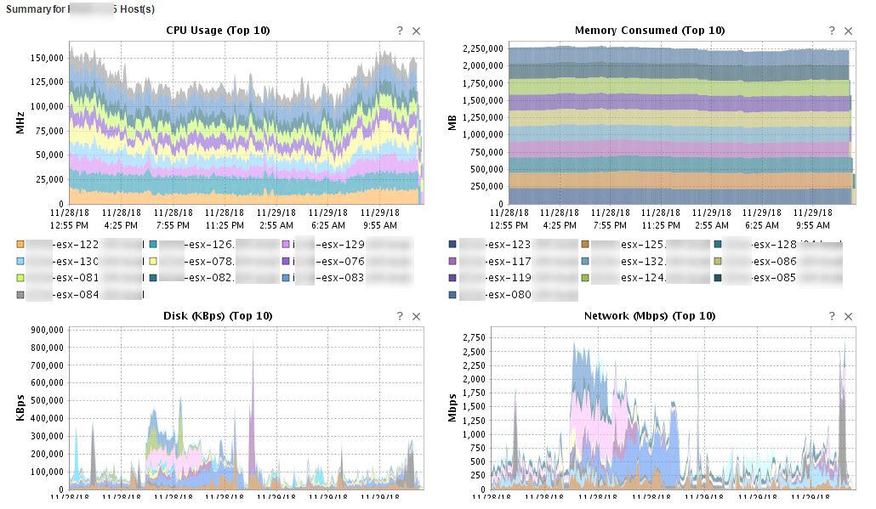
vSphere Performance monitoring – Short recap

Slide 14
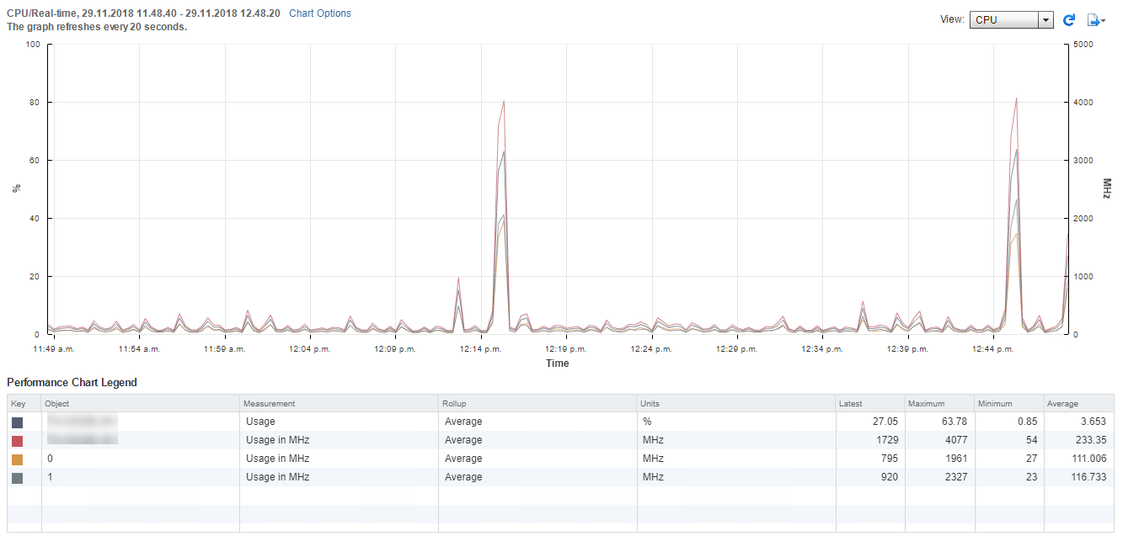
vSphere Performance monitoring – Short recap

Slide 15
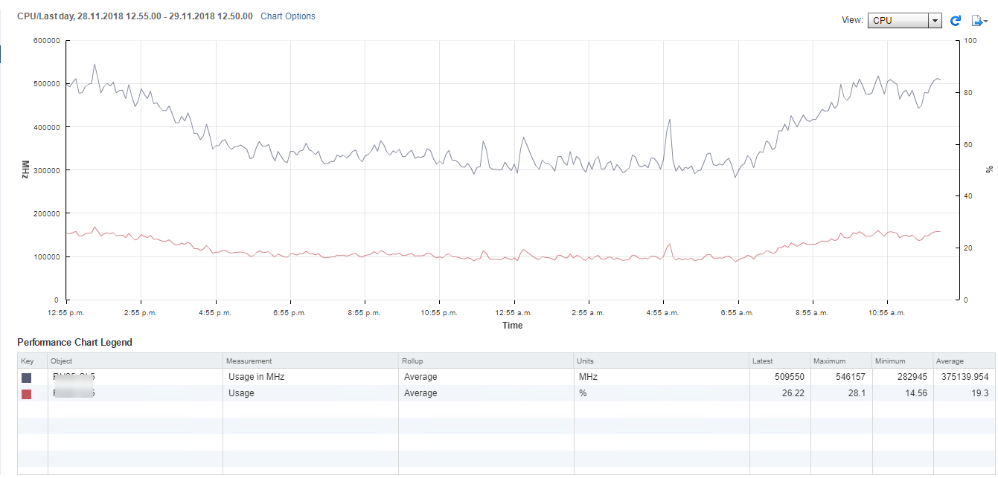
vSphere Performance monitoring – Short recap

Slide 16
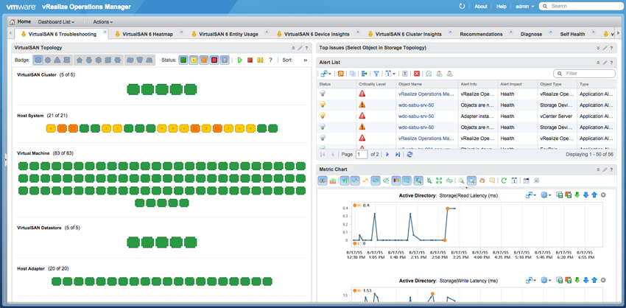
vSphere Performance monitoring – Short recap

Slide 17
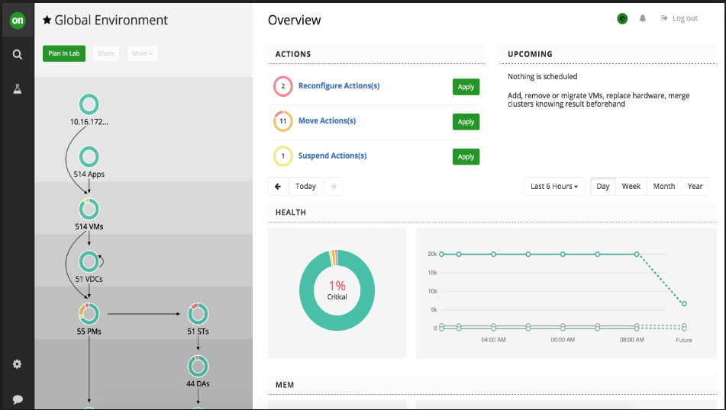

vSphere Performance monitoring – Short recap

Slide 18
vSphere Performance monitoring – Short recap

Slide 19
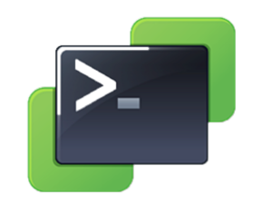
vSphere Performance monitoring – Short recap
Pull
vCenter

Slide 20


vSphere Performance monitoring – Short recap
Pull
vCenter
Store

Slide 21
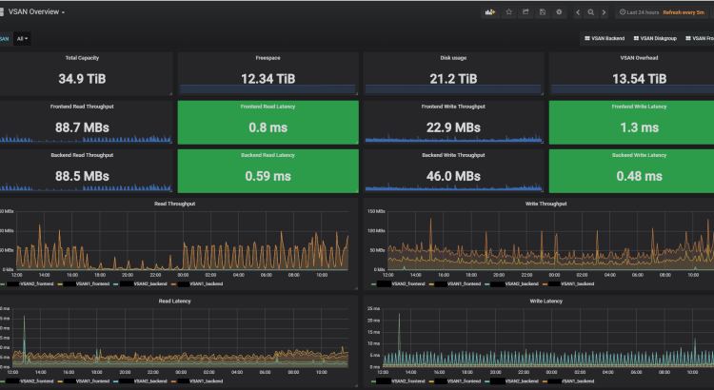

vSphere Performance monitoring – Short recap
Pull
vCenter
Visualize
Store

Slide 22
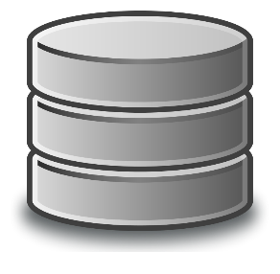
vSphere Performance monitoring – Short recap
Pull
SAN
vCenter
Visualize
Store

Slide 23
Demo

Slide 24
APIs and REST
Application Programmable Interface
A way to interact with an application
What is REST?
REpresentational State Transfer
Uses common HTTP methods
Consume APIs

Slide 25
APIs and REST
Application Programmable Interface
A way to interact with something
What is REST?
REpresentational State Transfer
Consume APIs
Uses common HTTP methods
A server-side web API is a programmatic interface consisting of one or more publicly exposed endpoints to a defined request–response message system, typically expressed in JSON or XML, which is exposed via the web—most commonly by means of an HTTP-based web server.
- Google

Slide 26
vSphere APIs
Until recently most vSphere APIs where SOAP based
Most of the SDK’s (PowerCLI, RbVmomi, PyVmomi, etc) uses these APIs
With vSphere 6.5 vCenter shipped with a shiny new REST API
Further extended in 6.7 and 6.7 U1
SOAP and REST will co-exist for a while
Some of the new stuff will only be available through REST

Slide 27
Exploring the APIs
https://code.vmware.com/
https://<your-vcsa>/apiexplorer
Postman collections
Powershell, Python, curl etc

Slide 28
Demo

Slide 29
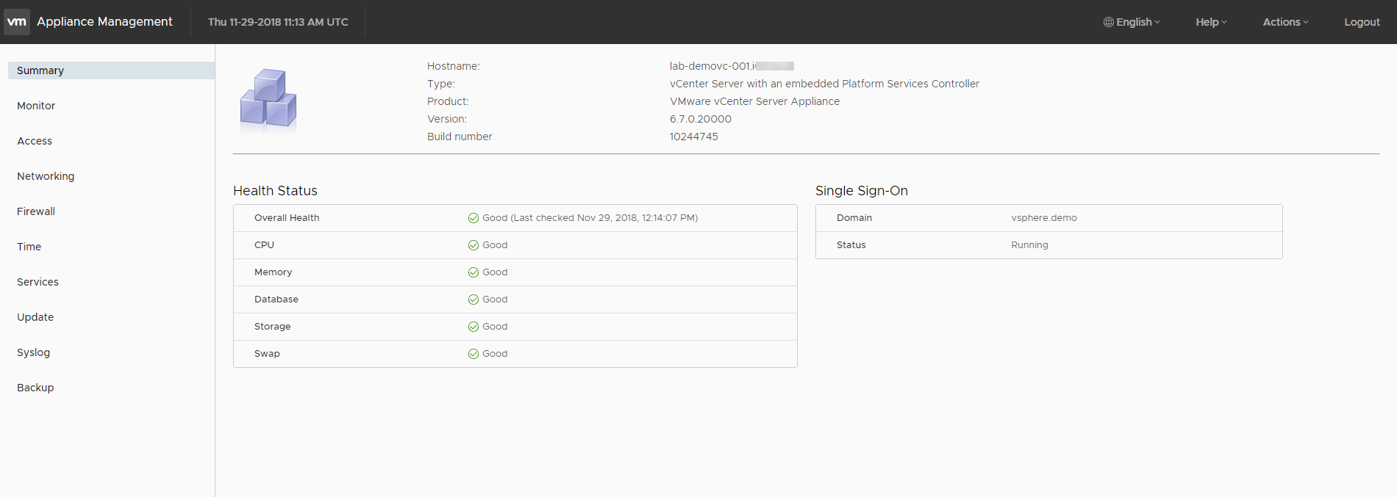
VCSA Management - VAMI

Slide 30
Extending the performance monitoring solution

Slide 31
Extending the performance monitoring solution
Pull
SAN
vCenter
Visualize
Store

Slide 32

Extending the performance monitoring solution
Pull
SAN
VCSA
vCenter
Visualize
Store

Slide 33
Demo

Slide 34
Resources
https://www.rudimartinsen.com/vsphere-performance/
https://www.influxdata.com/time-series-platform/influxdb/
https://grafana.com/
https://code.vmware.com/apis
https://github.com/vmware/vsphere-automation-sdk-rest/tree/master/samples/postman
https://www.rudimartinsen.com/2018/12/03/vsphere-performance-vcenter-server-appliance-vcsa-monitoring/

Slide 35
Thank you
@RudiMartinsen | https://rudimartinsen.com | rudi@intility.no

Slide 36
REST - Request methods
GET
Retrieve data
POST
Submit data
PUT
Update / replace existing data
DELETE
Guess?
Other methods (rarely used)
PATCH
HEAD
CONNECT
OPTIONS
TRACE
https://developer.mozilla.org/en-US/docs/Web/HTTP/Methods

Slide 37
REST - Authentication methods
HTTP Basic
Encodes your username and password to a base64 string
Encoded but not encrypted
API Key
Typically created through a web portal/back end
«Cannot» handle authorization
Very easy to use
Oauth 2.0
Application Key and Secret
Common when granting access between apps. Ie: Wordpress to Twitter
Authorization is granted by the user (you)

