Slide 1



Slide 2
vSphere REST APIs for the VMware Admin
VMUG Norway
June 2019
Rudi Martinsen, Intility AS
@RudiMartinsen | https://rudimartinsen.com | rudi@intility.no

Slide 3
About me..
Rudi Martinsen
Senior Cloud Engineer, Intility
Cloud Infrastructure
Automation and integration
Infrastructure and performance monitoring
vExpert 2018-2019
VMUG Norway Leader
Twitter: @RudiMartinsen
Blog: rudimartinsen.com

Slide 4
Agenda
REST APIs – a short introduction
Exploring vCenter REST APIs
Why REST APIs vs other SDKs?
vSphere performance monitoring – a short recap
Extending the Performance monitoring solution

Slide 5
APIs and REST
Application Programmable Interface
A way to interact with an application
What is REST?
REpresentational State Transfer
Consume APIs
Uses common HTTP methods
A server-side web API is a programmatic interface consisting of one or more publicly exposed endpoints to a defined request–response message system, typically expressed in JSON or XML, which is exposed via the web—most commonly by means of an HTTP-based web server.
- Google

Slide 6
REST principals
Not a standard
«Architectural style»
A few principals
Client - server
Stateless
Cacheable
Layered
Uniform interface
Resource identification
HATEOAS, discoverability
Idempotency
Run the same api call multiple times results in same state
https://en.wikipedia.org/wiki/Representational_state_transfer

Slide 7
REST - Request methods
GET
Read / Retrieve data
POST
Create / Submit data
PUT
Update / replace existing data
DELETE
Guess?
CRUD – Create Read Update Delete
Other methods (rarely used)
PATCH
HEAD
CONNECT
OPTIONS
TRACE
https://developer.mozilla.org/en-US/docs/Web/HTTP/Methods

Slide 8
REST – Response codes
Standard HTTP response codes
20x
Success
Created
40x
Bad request
Not found
Authorization
50x
«Internal server error»
https://developer.mozilla.org/en-US/docs/Web/HTTP/Status

Slide 9
Anatomy of REST
URI
Uniform Resource Indicator
Often referred to as URL (Uniform Resource Locator)
<protocol>://<base uri>/<resource>(/<id>?queryparams)
https://server/api/computers/1234567
Method
GET https://server/api/computers/1234567
Body
When sending stuff to the server
Media-type (content-type)
Often JSON or XML
Header
Passing content-type, version, authentication etc
Response code
20x, 40x, 50x

Slide 10
Demo
Notes:
https://swapi.co

Slide 11
REST - Authentication methods
HTTP Basic
Encodes your username and password to a base64 string
Encoded but not encrypted
API Key
Typically created through a web portal/backend (i.e. Github)
«Cannot» handle authorization
Very easy to use
Oauth 2.0
Application Key and Secret
Common when granting access between apps. ie: Wordpress to Twitter

Slide 12
vSphere APIs
Until recently most vSphere APIs where SOAP based
Most of the SDK’s (PowerCLI, RbVmomi, PyVmomi, etc) uses these APIs
With vSphere 6.5 vCenter shipped with a shiny new REST API
Further extended in 6.7, 6.7 U1 and 6.7 U2
SOAP and REST will co-exist for a (long) while
Some of the new stuff will only be available through REST

Slide 13
Exploring the APIs
https://code.vmware.com/
https://<your-vcsa>/apiexplorer, in 6.7 U2 inside vCenter!
Postman collections
Powershell, curl etc

Slide 14
Demo

Slide 15
Why REST APIs vs the other SDKs?
Integration
Modern
Ease of use?
Language dependencies
Cloud portals today have lots of APIs
No installation and updating packages
Functionality

Slide 16
Extending the performance monitoring solution

Slide 17
vSphere Performance monitoring – Short recap

Slide 18
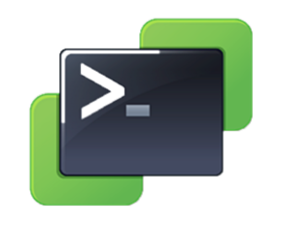
vSphere Performance monitoring – Short recap
Pull
vCenter

Slide 19


vSphere Performance monitoring – Short recap
Pull
vCenter
Store

Slide 20
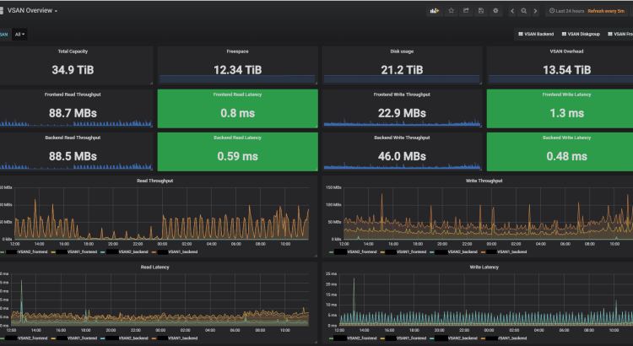

vSphere Performance monitoring – Short recap
Pull
vCenter
Visualize
Store

Slide 21
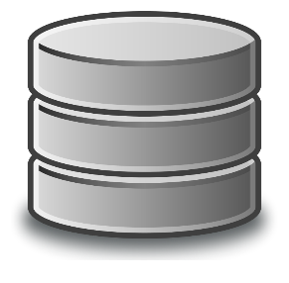
vSphere Performance monitoring – Short recap
Pull
SAN
vCenter
Visualize
Store

Slide 22
Extending the performance monitoring solution
Pull
SAN
vCenter
Visualize
Store

Slide 23

Extending the performance monitoring solution
Pull
SAN
VCSA
vCenter
Visualize
Store

Slide 24
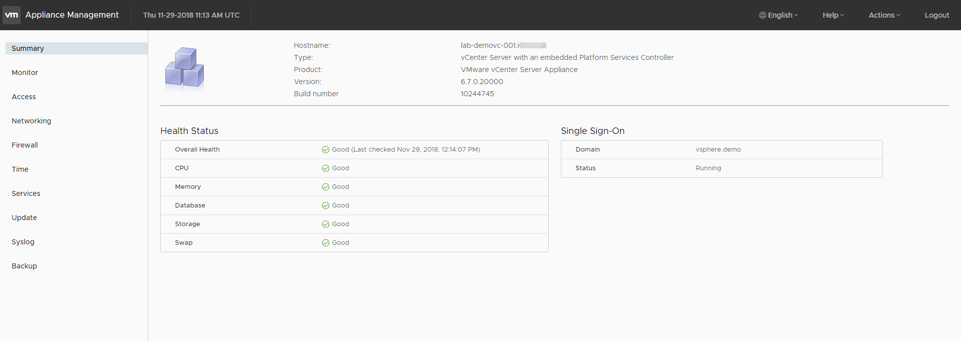
VCSA Management - VAMI

Slide 25
Demo

Slide 26
Resources
https://www.rudimartinsen.com/vsphere-performance/
https://www.influxdata.com/time-series-platform/influxdb/
https://grafana.com/
https://code.vmware.com/apis
https://github.com/vmware/vsphere-automation-sdk-rest/tree/master/samples/postman
https://www.rudimartinsen.com/2018/12/03/vsphere-performance-vcenter-server-appliance-vcsa-monitoring/

Slide 27
Thank you
@RudiMartinsen | https://rudimartinsen.com | rudi@intility.no

