Slide 1


Slide 2
vSphere Performance Monitoring – For FREE!
VMUG Norway – May 2018
Rudi Martinsen, Intility AS
@RudiMartinsen | https://rudimartinsen.com | rudi@intility.no

Slide 3
About me..
Rudi Martinsen
  Senior Cloud Engineer, Intility
  Cloud Infrastructure
  Infrastructure and performance monitoring
  Automation and integration
  Twitter: @RudiMartinsen
  Blog: rudimartinsen.com

Slide 4
Agenda
vSphere performance monitoring
Building your own solution – The components
  Pull stats
  Store stats
  Visualize stats
More data sources
What’s next

Slide 5
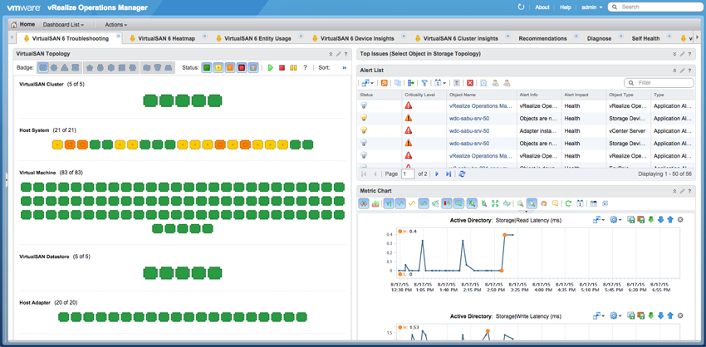
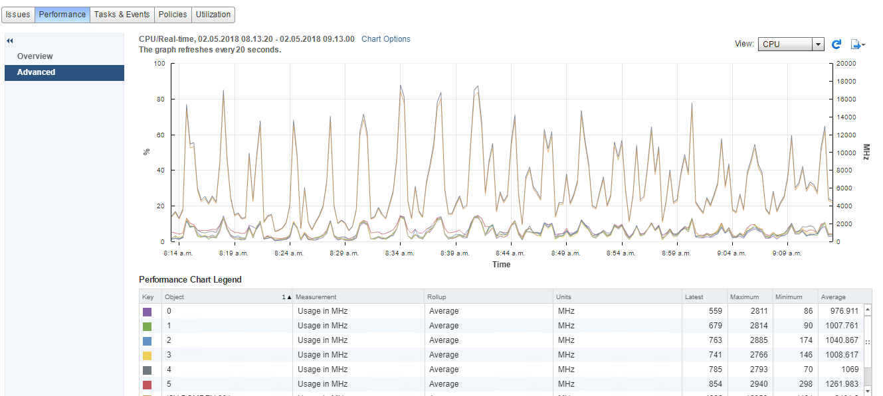
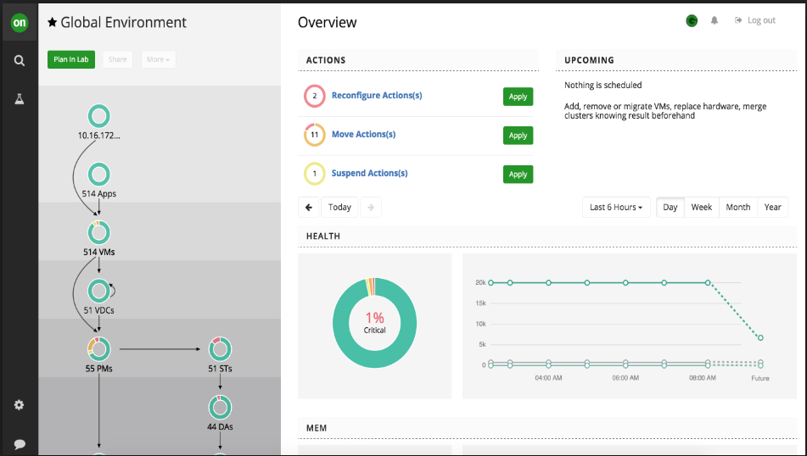

Performance monitoring
Why performance monitoring?
Lots of different solutions out there
  Perf charts in vCenter
  vRealize
  Turbonomic
  SCOM
  ++
Why do it yourself?
  «Single pane of glass»
  Customizations – more metrics
  Granularity
  Retention
  Complexity (implement and maintain)
  Cost

Slide 6
DIY – The concepts
Pull
Store
Visualize

Slide 7

Pulling stats
vSphere APIs and SDKs
PowerCLI is our friend
Lots of resources available
  http://www.lucd.info/2009/12/30/powercli-vsphere-statistics-part-1-the-basics/
  https://www.rudimartinsen.com/2017/07/12/vsphere-performance-data-part-3-get-stat/

Slide 8
Demo – Pull stats

Slide 9




Store data
What database solution to choose?
Why time-series (TSDB)?
  https://www.influxdata.com/time-series-database/
Some TSDBs out there:
  Graphite
  Prometheus
  OpenTSDB
  InfluxDB
InfluxDB
  https://www.influxdata.com/time-series-platform/influxdb/

Slide 10
InfluxDB
Open source (commercial product available)
Easy setup
Fast
Stores millions of events
4000 VMs & 200 Hosts, 12 metrics, 20 sec interval, 4 months
1 timestamp (20s interval) = 50400 rows (4200 * 12)
3 timestamps = 1 minute = 151 200 rows per minute
4 months = 172 800 minutes = 26 127 360 000 rows
<80 GB
800 GB
  https://www.rudimartinsen.com/2017/07/13/vsphere-performance-data-part-4-influxdb/

Slide 11
InfluxDB – concepts
Compared to SQL:
  Database
  Measurements ≈ tables
  Points ≈ rows
  Schemaless
Point protocol
  «measurement»,«tag set» «field set» «timestamp»
  cpu,host=server01,region=west value=21 1525343801000000000
  Precision (seconds -> nanoseconds)
Retention policy ≈ aging and deletion of (old) data
Continuous queries – can be used for aggregating data
Tradeoffs
  No update concept
  No/limited joins
  Limited functions and sorting
Administration done via CLI, API or Chronograf

Slide 12
Demo – Store data

Slide 13


Visualizing
How do you visualize all the data you’ve collected?
Some alternatives:
  Graphite
  Prometheus
  Kibana
  Chronograf
  Grafana
Grafana
  https://grafana.com/

Slide 14
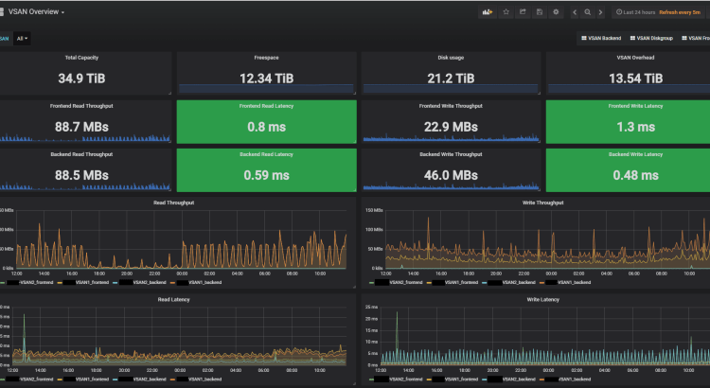
Grafana
Open source
Easy setup
Fast
Many available datasources and panels OOB
Lots of plugins available for extending the product
V5 recently released with new great features
http://www.rudimartinsen.com/2017/07/21/vsphere-performance-data-part-6-the-dashboards/

Slide 15
Demo – Visualize data

Slide 16
DIY – The concepts
Pull
Store
Visualize

Slide 17
Demo – Pulling things together

Slide 18


Summary
Pull
vCenter
Visualize
Store

Slide 19
Demo - Ok.. Let’s bring in some more data.
I need more data!

Slide 20
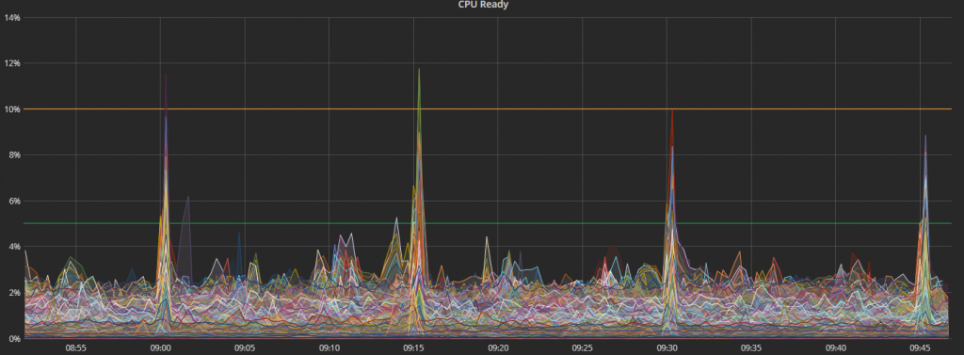
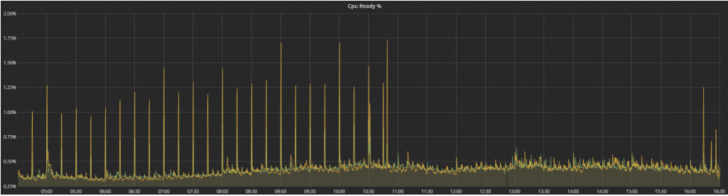
Real-world example
We saw regular spikes in CPU Ready for VMs across the platform (4k VMs) every 15 minutes
After troubleshooting we found that a process run by SCOM was the cause of the spike
Together with Microsoft Premium support we found that this process did an event collection which we didn’t use and need. We turned it off, and saw immediate results
https://adatum.no/operationsmanager/scom-virtualization-host-cpu-spikes

Slide 21
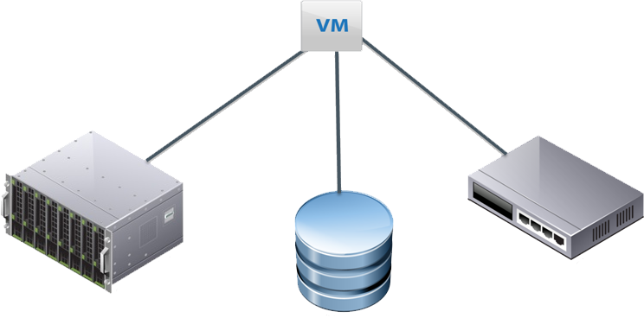
Add sources – Build your «single pane of glass»
Several components build up your infrastructure
Most of today’s (modern) infrastructure «stuff» and products ships with API’s
Not all offers perf stats, hopefully yours does
Building your own solution gives plenty of possibilites on how to include these components in your dashboards

Slide 22
Demo – Adding Storage stats

Slide 23
What’s next
More data sources
Redo the polling part
Increase usage in organisation
API
Analytics

Slide 24
Resources
https://www.rudimartinsen.com/vsphere-performance/
http://www.lucd.info/2009/12/30/powercli-vsphere-statistics-part-1-the-basics/
https://www.influxdata.com/time-series-platform/influxdb/
https://grafana.com/
https://www.virtuallyghetto.com/2017/05/correlating-vsan-perf-metrics-from-vsphere-web-client-to-both-powercli-vsan-mgmt-api.html
https://www.youtube.com/watch?v=vrz0X07Rero (Grafana used in vSAN monitoring)

Slide 25
Thank you
@RudiMartinsen | https://rudimartinsen.com | rudi@intility.no

