Slide 1


Slide 2
vSphere Performance Monitoring – For FREE!
#VMTN5524E
VMworld Europe
November 2018
Rudi Martinsen, Intility AS
@RudiMartinsen | https://rudimartinsen.com | rudi@intility.no

Slide 3
About me..
Rudi Martinsen
Senior Cloud Engineer, Intility
Cloud Infrastructure
Infrastructure and performance monitoring
Automation and integration
vExpert
Twitter: @RudiMartinsen
Blog: rudimartinsen.com

Slide 4
Agenda
vSphere performance monitoring
Building your own solution – The components
Pull stats
Store stats
Visualize stats
More data sources
What’s next

Slide 5
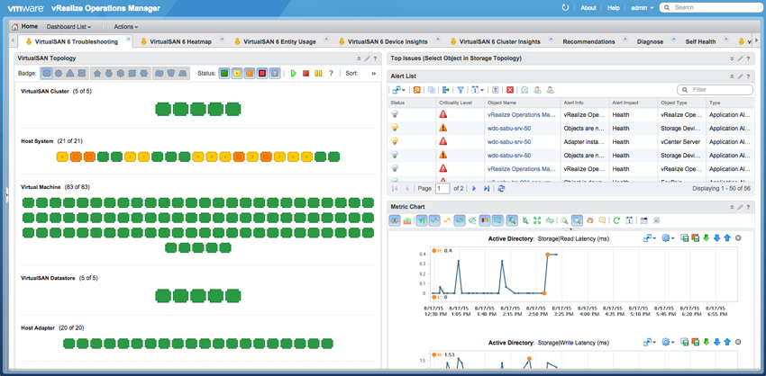
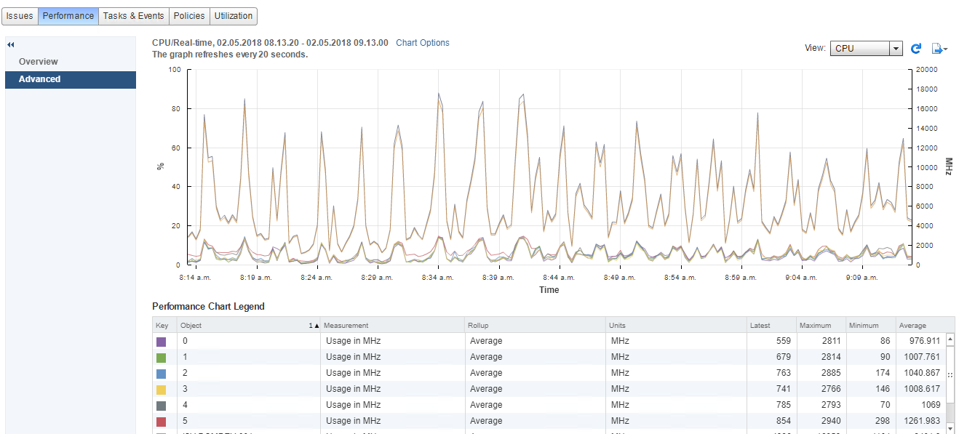
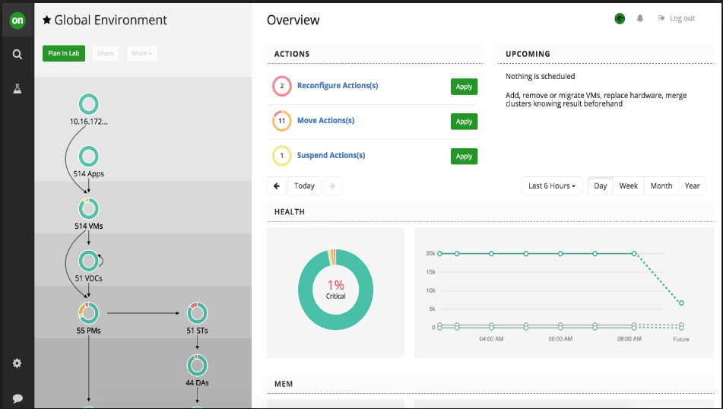

Performance monitoring
Why performance monitoring?
Lots of different solutions out there
Perf charts in vCenter
vRealize
Turbonomic
SCOM
++
Why do it yourself?
«Single pane of glass»
Customizations – more metrics
Granularity
Retention
Complexity (implement and maintain)
Cost

Slide 6
DIY – The concepts
Pull
Store
Visualize

Slide 7

Pulling stats
vSphere APIs and SDKs
PowerCLI is our friend
Lots of resources available
http://www.lucd.info/2009/12/30/powercli-vsphere-statistics-part-1-the-basics/
https://www.rudimartinsen.com/2017/07/12/vsphere-performance-data-part-3-get-stat/

Slide 8




Store data
What database solution to choose?
Why time-series (TSDB)?
https://www.influxdata.com/time-series-database/
Some TSDBs out there:
Graphite
Prometheus
OpenTSDB
InfluxDB
InfluxDB
https://www.influxdata.com/time-series-platform/influxdb/

Slide 9
InfluxDB
Open source (commercial product available)
Easy setup
Fast
Stores millions of events
4000 VMs & 200 Hosts, 12 metrics, 20 sec interval, 4 months
1 timestamp (20s interval) = 50400 rows (4200 * 12)
3 timestamps = 1 minute = 151 200 rows per minute
4 months = 172 800 minutes = 26 127 360 000 rows
<80 GB
800 GB
https://www.rudimartinsen.com/2017/07/13/vsphere-performance-data-part-4-influxdb/

Slide 10
InfluxDB – concepts
Compared to SQL:
Database
Measurements ≈ tables
Points ≈ rows
Schemaless
Point protocol
«measurement»,«tag set» «field set» «timestamp»
cpu,host=server01,region=west value=21 1525343801000000000
Precision (seconds -> nanoseconds)
Retention policy ≈ aging and deletion of (old) data
Continuous queries – can be used for aggregating data
Tradeoffs
No update concept
No/limited joins
Limited functions and sorting
Administration done via CLI, API or Chronograf

Slide 11


Visualizing
How do you visualize all the data you’ve collected?
Some alternatives:
Graphite
Prometheus
Kibana
Chronograf
Grafana
Grafana
https://grafana.com/

Slide 12
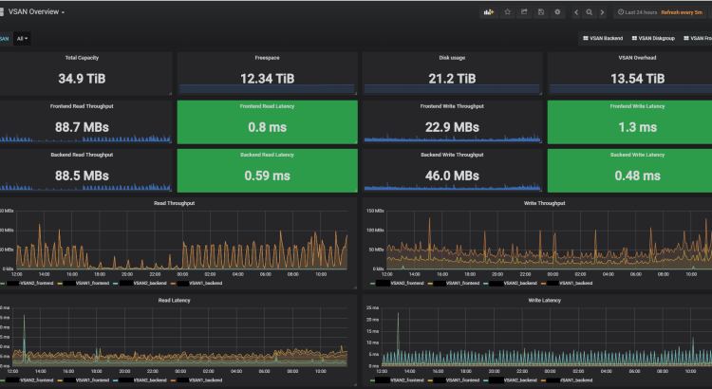
Grafana
Open source
Easy setup
Fast
Many available datasources and panels OOB
Lots of plugins available for extending the product
http://www.rudimartinsen.com/2017/07/21/vsphere-performance-data-part-6-the-dashboards/

Slide 13
Demo – Pulling things together

Slide 14


Summary
Pull
vCenter
Visualize
Store

Slide 15
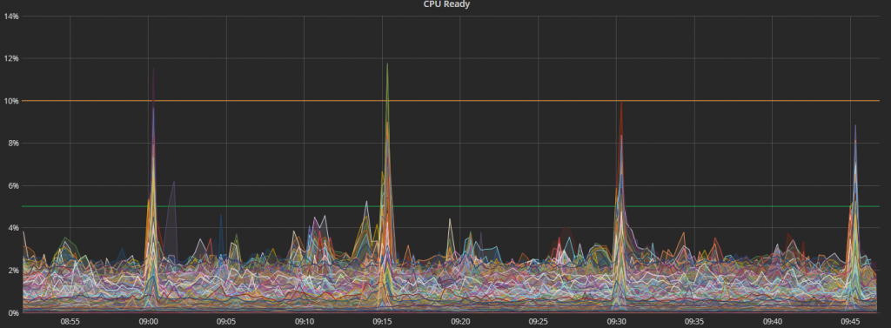
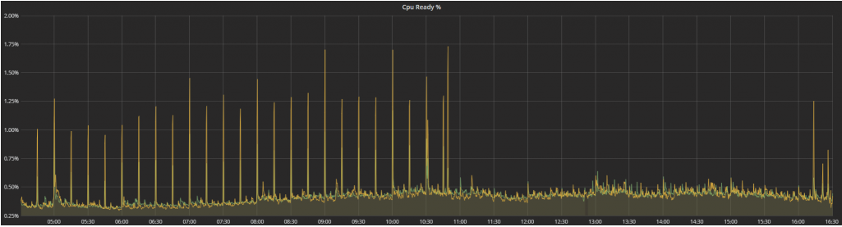
Real-world example
We saw regular spikes in CPU Ready for VMs across the platform (4k VMs) every 15 minutes
After troubleshooting we found that a process run by SCOM was the cause of the spike
Together with Microsoft Premium support we found that this process did an event collection which we didn’t use and need. We turned it off, and saw immediate results
https://adatum.no/operationsmanager/scom-virtualization-host-cpu-spikes

Slide 16
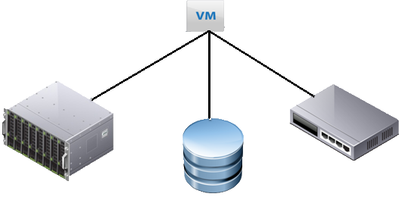
Add sources – Build your «single pane of glass»
Several components build up your infrastructure
Most of today’s (modern) infrastructure «stuff» and products ships with API’s
Not all offers perf stats, hopefully yours does
Building your own solution gives plenty of possibilites on how to include these components in your dashboards

Slide 17
Demo - Let’s bring in some more data.

Slide 18
What’s next
More data sources
Redo the polling part
NEW!! Telegraf (by Influx) native vSphere plugin
Increase usage in organisation
API
Analytics

Slide 19
Resources
https://www.rudimartinsen.com/vsphere-performance/
http://www.lucd.info/2009/12/30/powercli-vsphere-statistics-part-1-the-basics/
https://www.influxdata.com/time-series-platform/influxdb/
https://grafana.com/
https://www.virtuallyghetto.com/2017/05/correlating-vsan-perf-metrics-from-vsphere-web-client-to-both-powercli-vsan-mgmt-api.html
https://www.youtube.com/watch?v=vrz0X07Rero (Grafana used in vSAN monitoring)
https://github.com/influxdata/telegraf/blob/release-1.8/plugins/inputs/vsphere/README.md (new input plugin in Telegraf)
https://www.rudimartinsen.com/2018/10/01/vsphere-performance-data-new-vsphere-plugin-for-telegraf/ (new input plugin in Telegraf)

Slide 20
Thank you
@RudiMartinsen | https://rudimartinsen.com | rudi@intility.no

