Slide 1
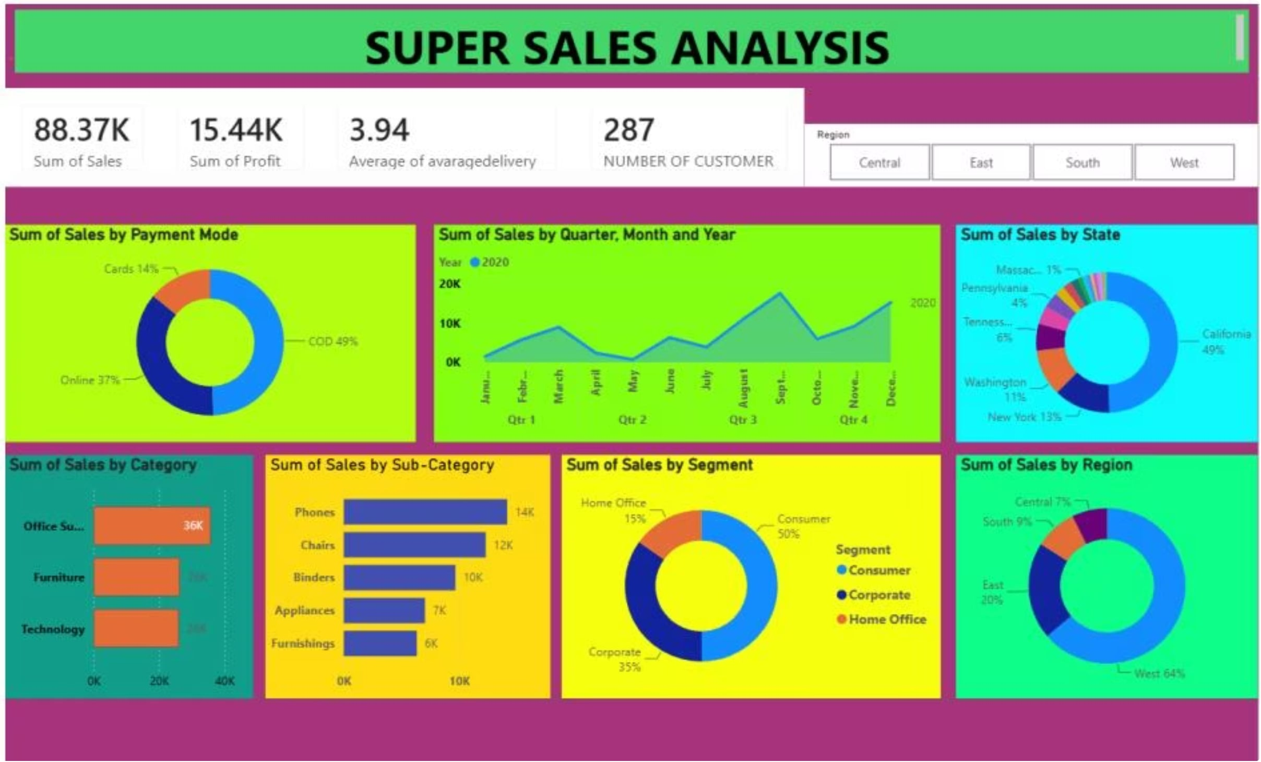
Super Sales Analysis
A comprehensive Power BI dashboard evaluating overall sales performance across regions, categories, and customer segments.
BUSINESS INTELLIGENCE REPORT

Slide 2
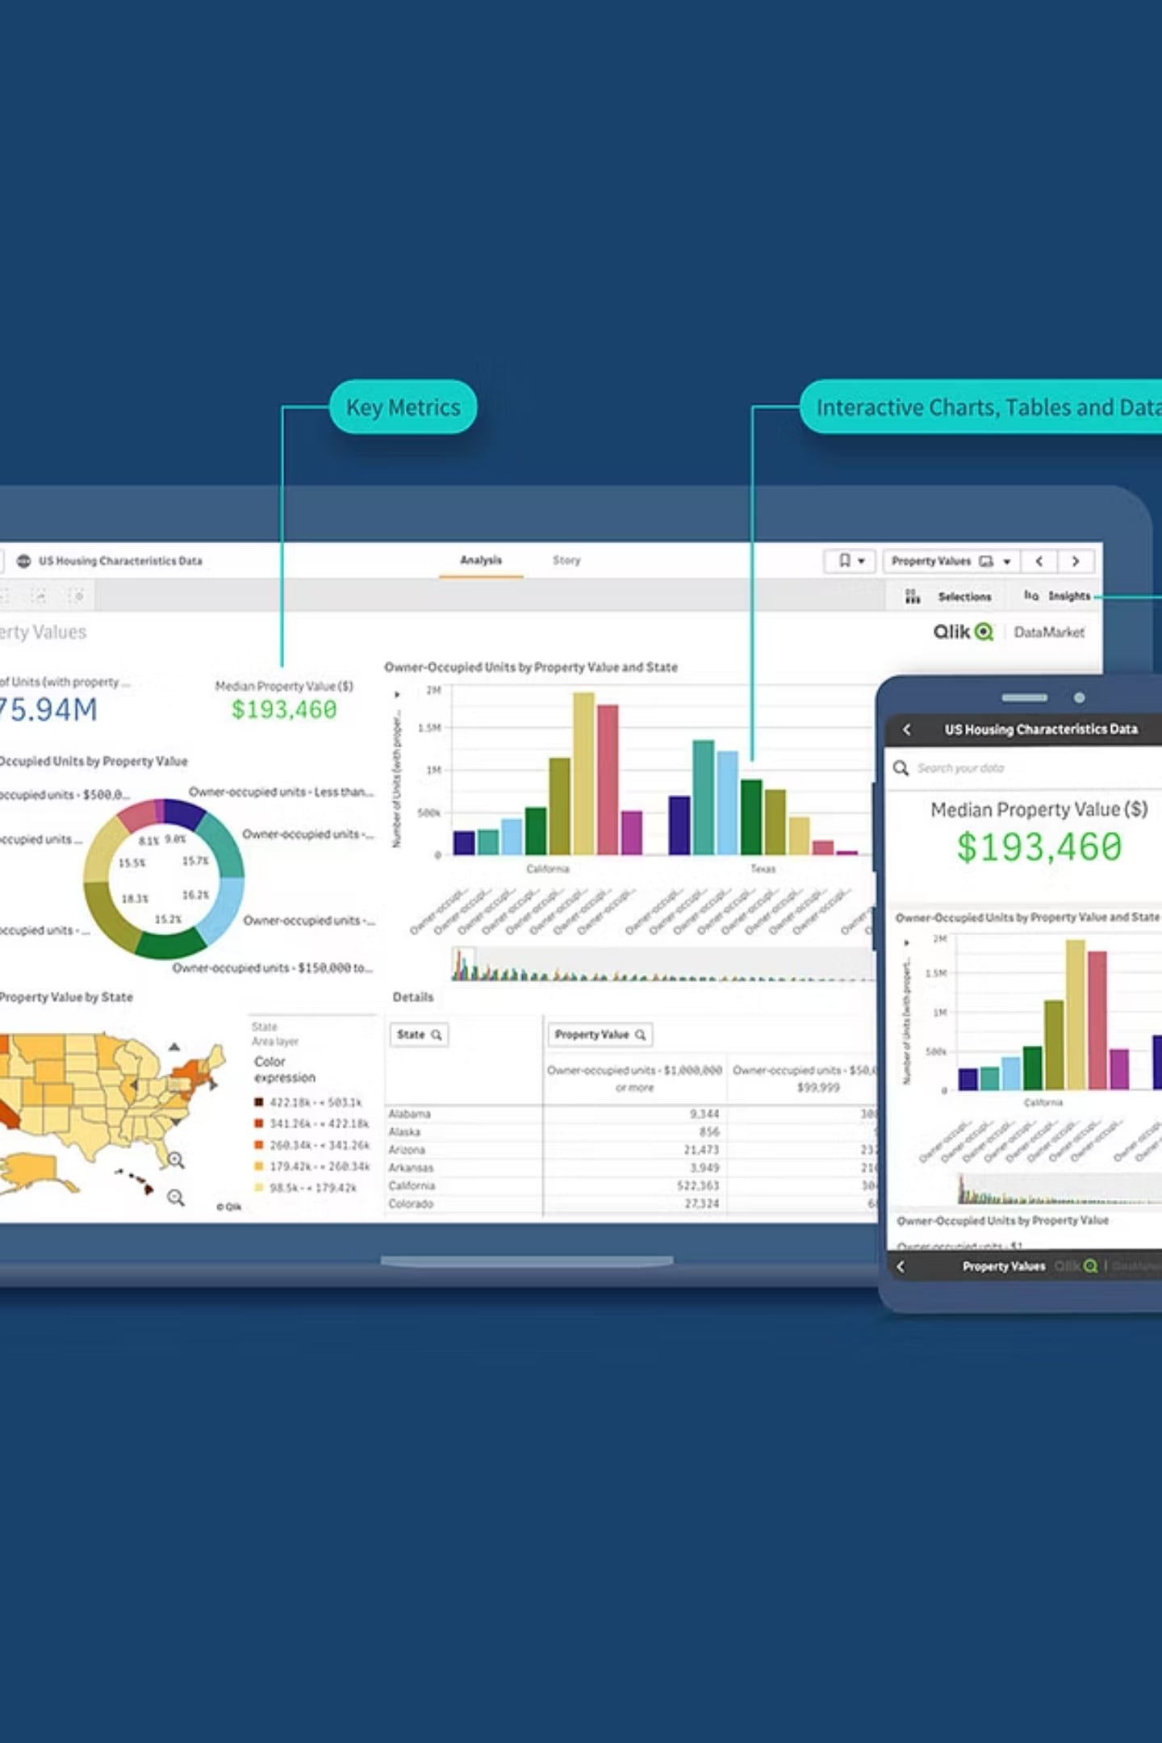
Executive Summary
This report presents an interactive Power BI dashboard developed to evaluate overall sales performance. The dashboard enables management to monitor sales, profit, delivery performance, customer distribution, payment preferences, regional performance, and product trends — providing a centralized, data-driven view of business operations.

Slide 3

Business Problem & Project Objectives
The Challenge
Project Objectives
Management requires a centralized dashboard to monitor business performance, identify profitable products and regions, understand customer behavior, and support data-driven decisions.
Analyze sales performance
Monitor KPIs
Compare regions, states, categories & segments
Identify business opportunities

Slide 4
Dashboard KPIs
88.37K
15.44K
Total Sales
Total Profit
3.94
287
Avg. Delivery (Days)
Customers
These four key performance indicators provide management with an at-a-glance view of business health, covering revenue, profitability, delivery efficiency, and customer base size.

Slide 5
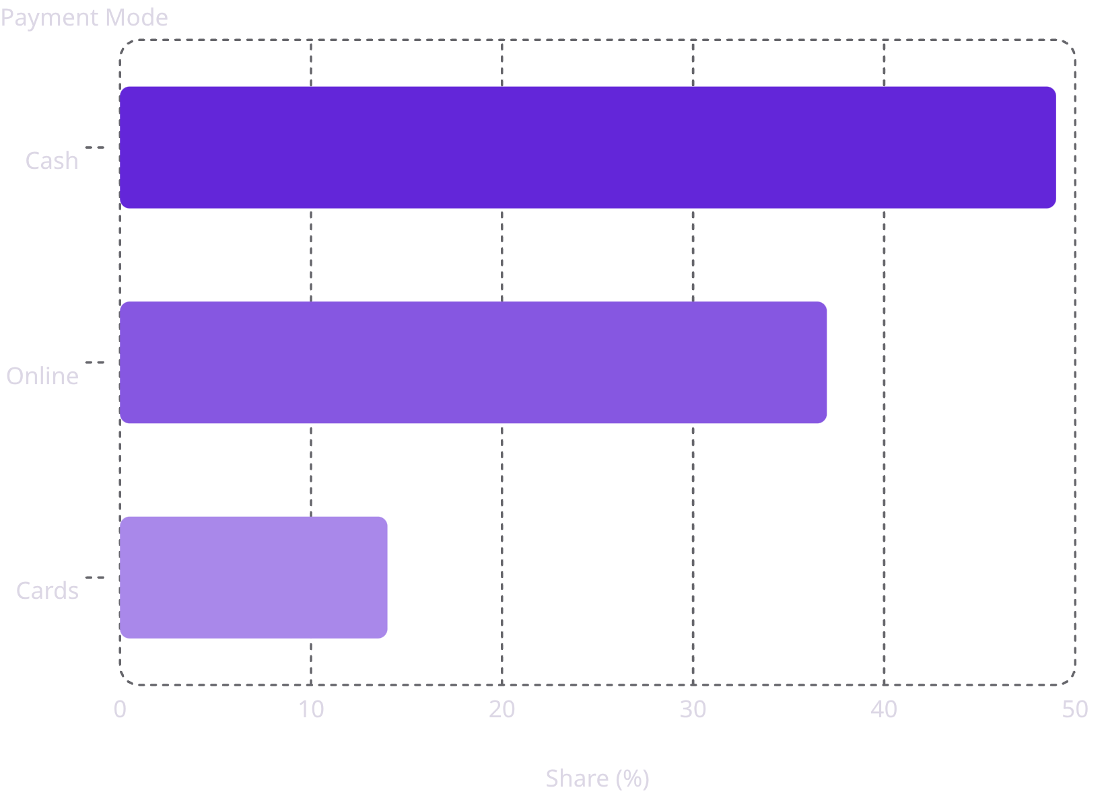
Sales by Payment Mode
Cash Dominates
Cash on Delivery (COD) contributes the largest share of sales at 49%, followed by Online payments at 37% and Cards at 14%. Promoting digital payment adoption represents a clear opportunity to reduce cash dependency and streamline transaction processing.

Slide 6
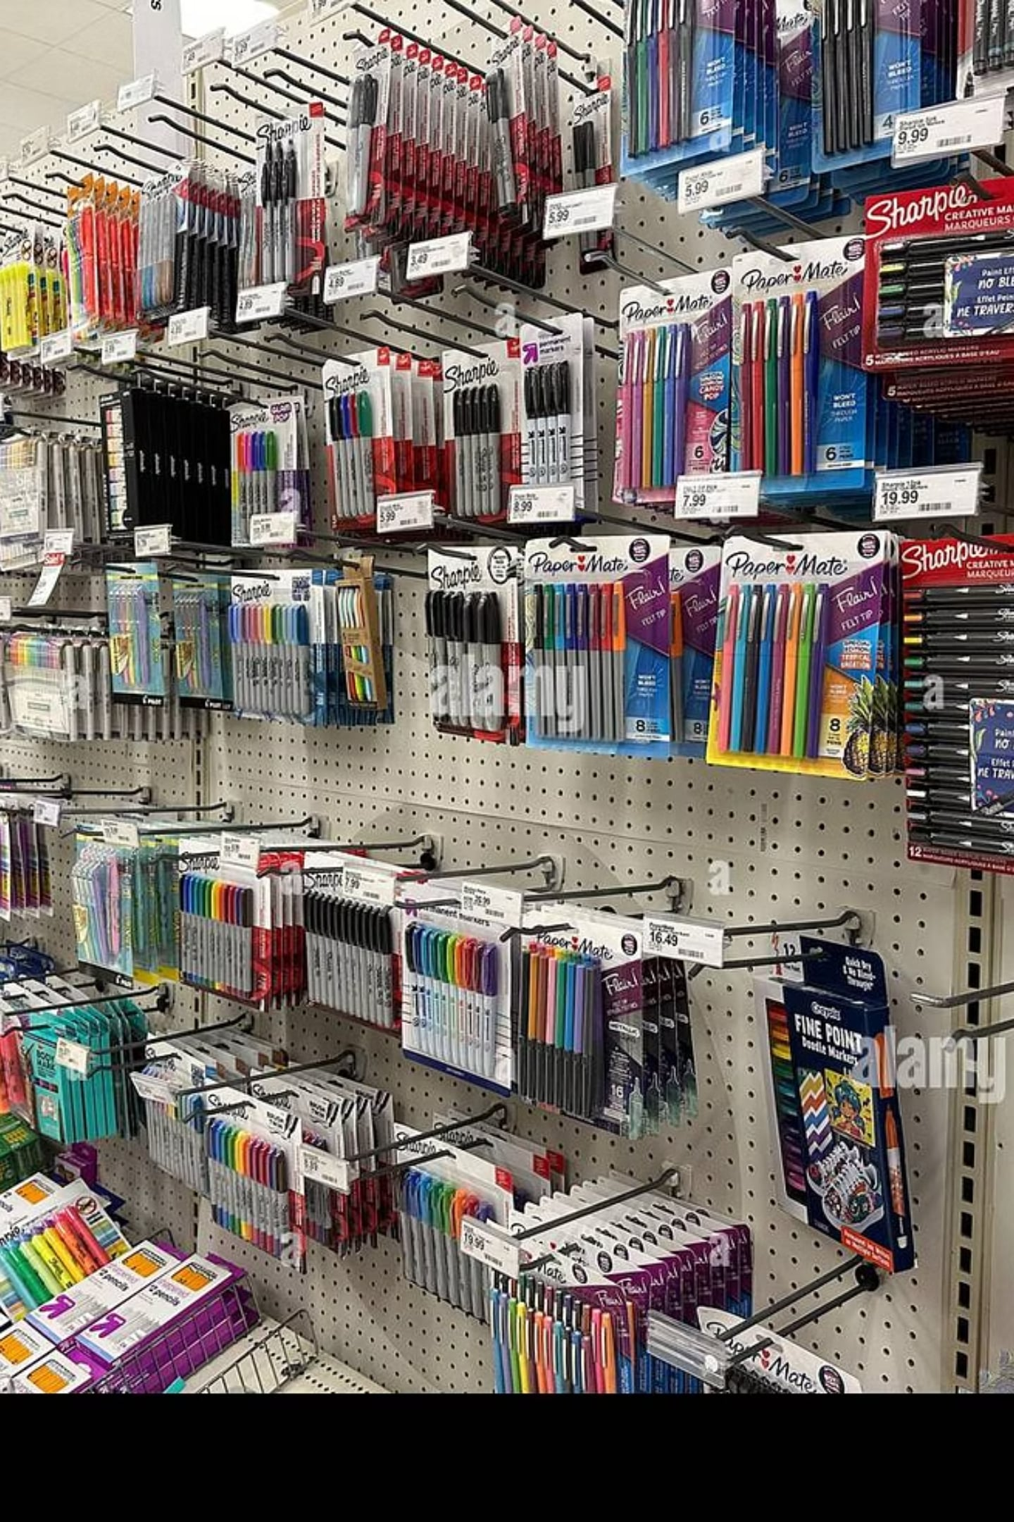
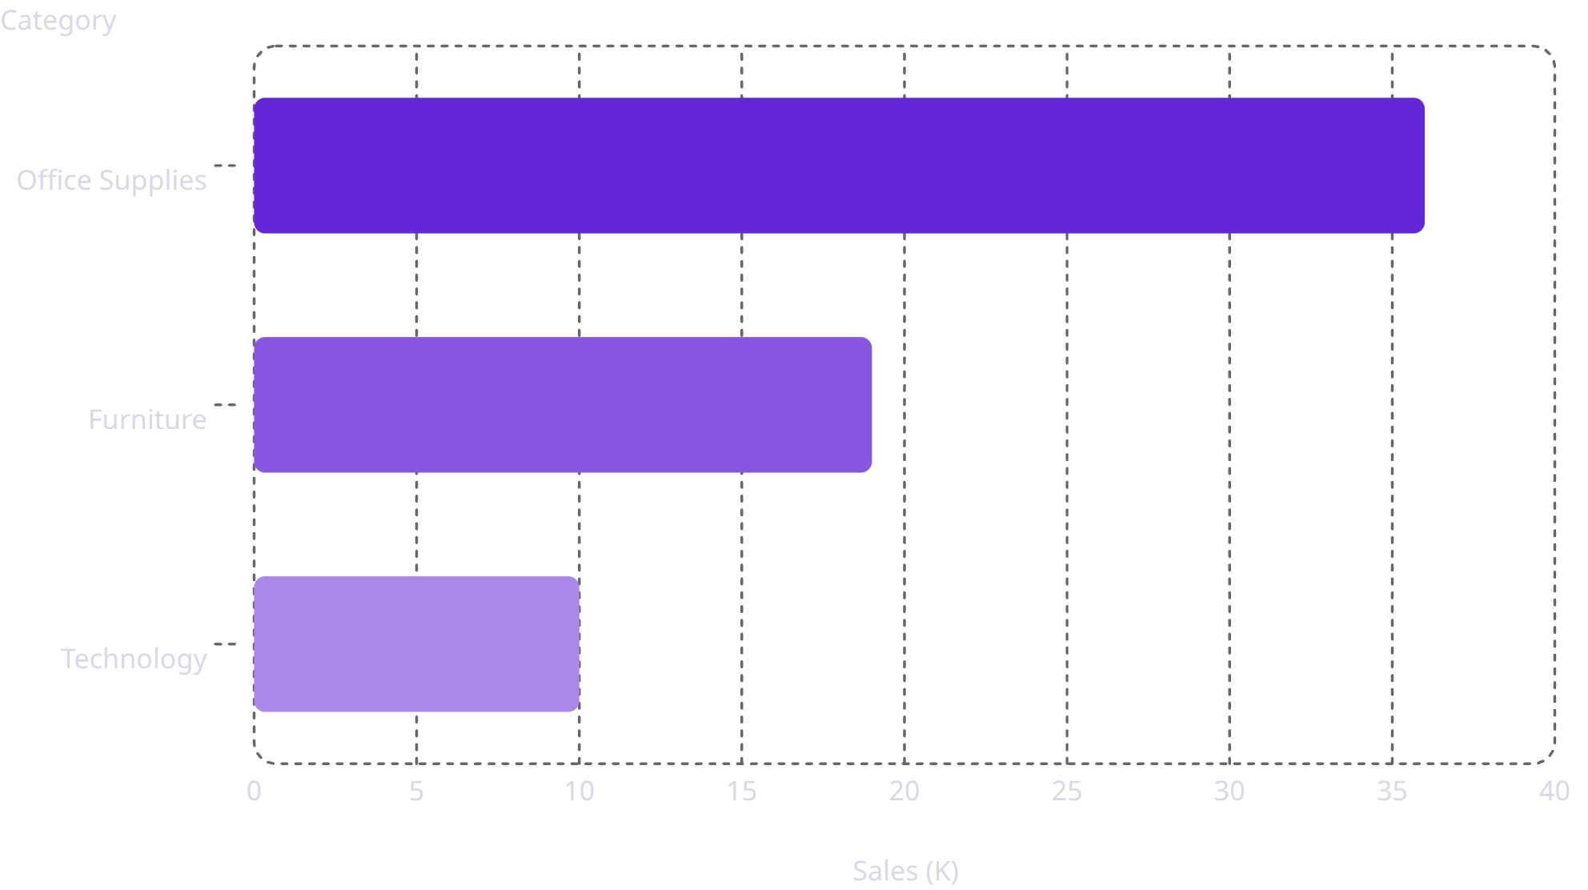
Sales by Category & Sub-Category
Office Supplies lead overall sales at 36K, followed by Furniture at 19K and Technology at 10K. Within sub-categories, Phones generate the highest sales at 14K, with Chairs (12K) and Binders (10K) also contributing significantly.
Category Breakdown

Slide 7
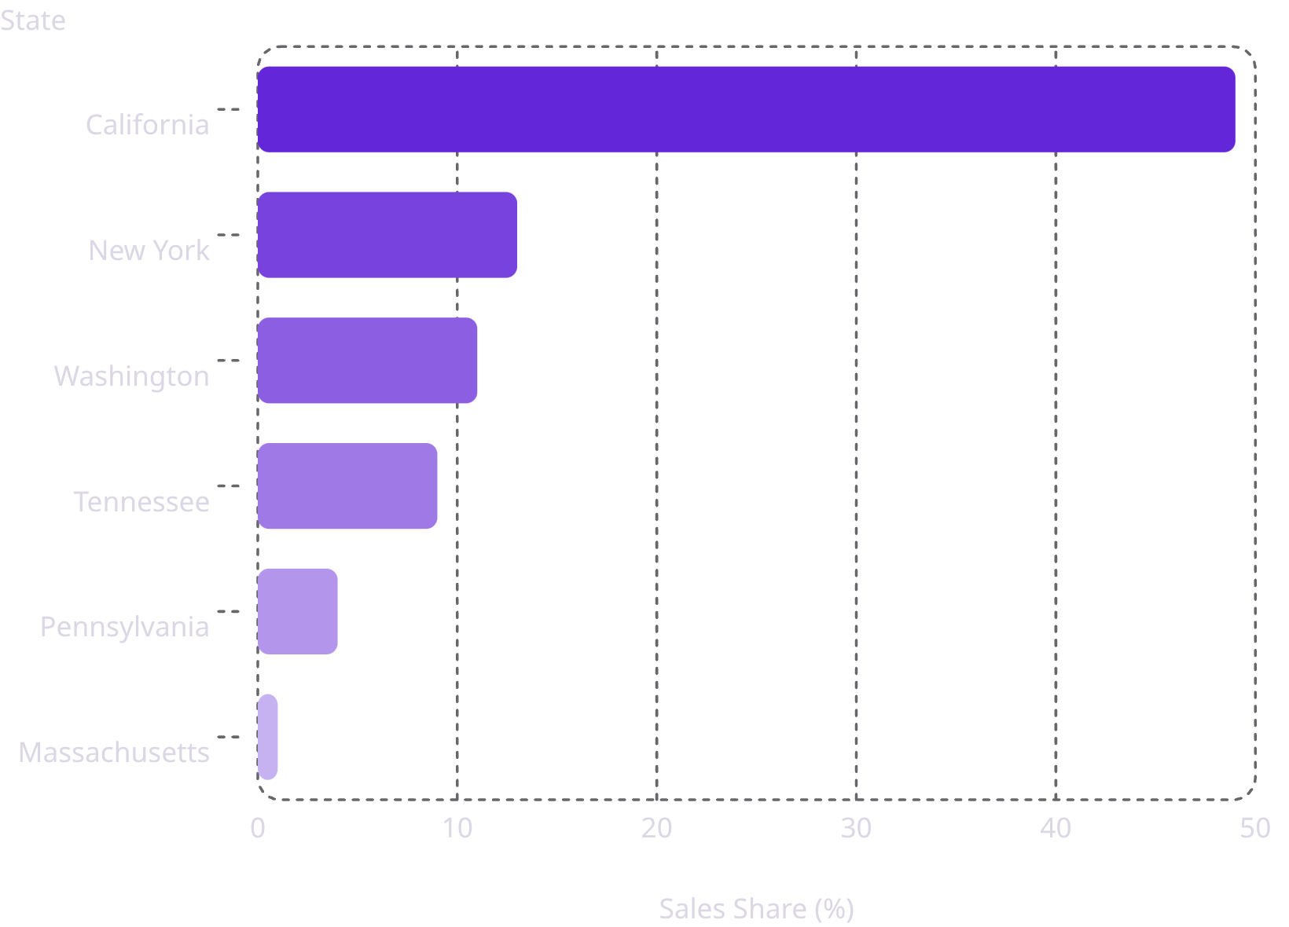
State & Regional Performance
West Region Dominates
The West region accounts for 64% of total sales, with California alone contributing 49%. The East follows at 20%, while South (9%) and Central (7%) represent lower-performing regions. Increasing marketing efforts in these lower-performing regions could unlock significant growth potential.

Slide 8
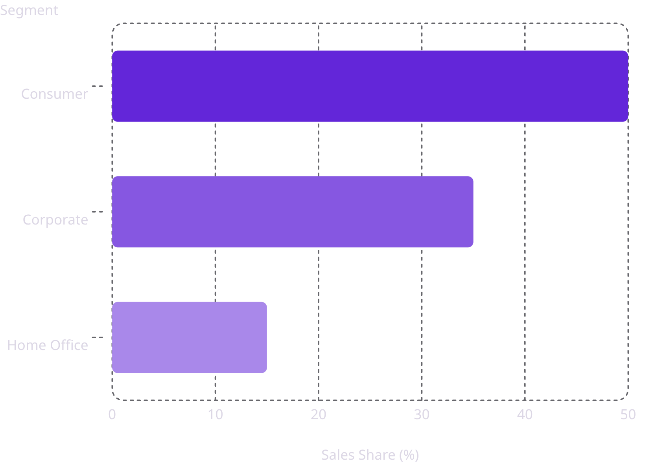
Customer Segments & Sales Trend
Consumer Segment Leads
The Consumer segment contributes the highest share of sales at 50%, followed by Corporate (35%) and Home Office (15%). Sales peak during the final quarter (Q4), indicating strong seasonal demand. Building targeted customer loyalty programs for the Consumer segment could further strengthen this revenue stream.

Slide 9






Business Insights & Recommendations
Inventory Focus
Regional Marketing
Focus inventory on high-demand products like Phones and Office Supplies.
Increase marketing in low-performing regions (Central, South).
Digital Payments
Logistics
Promote digital payment adoption to reduce cash dependency.
Improve logistics to reduce the 3.94-day average delivery time.
Customer Loyalty
Resource Allocation
Build loyalty programs to retain and grow the 287-customer base.
Allocate resources based on regional demand patterns.

Slide 10
Power BI Features & Business Value
Power BI Features Used
Business Value
This Power BI dashboard transforms raw sales data into meaningful business intelligence through interactive visualizations and business-focused insights. It provides a single source of truth for business performance, helping stakeholders monitor KPIs, identify trends, and make faster, data-driven strategic decisions.
Power Query & Data Modeling
DAX Measures & KPI Cards
Donut, Bar & Area Charts
Slicers & Interactive Filtering
Dashboard Formatting

